Slide 1
SRv6 for Mobile User-Plane
draft-ietf-dmm-srv6-mobile-uplane-04
IETF104
S.Matsushima, C.Filsfils, M.Kohno, D.Voyer, C.Perkins, P.Camarillo

Slide 2
Summary of Updates from v03 to v04
Lightweight updates
Pseudo-code correction.
Some clarification text for predefined SRv6 functions, Traditional mode, IPv6 user-traffic and Args.Mob.Session.
Simplified the text regarding Network Slicing.
Naming complaint
Args.Mob.Session : No any ideas received after IETF103.
T.M.Tmap : “T.M.GTP4.D” was proposed instead.
Another major feedback from review comments
Whether to support ‘Drop-in’ scenario. (i.e; IPv4 SA and UDP src port transparency for GTP-U)

Slide 3
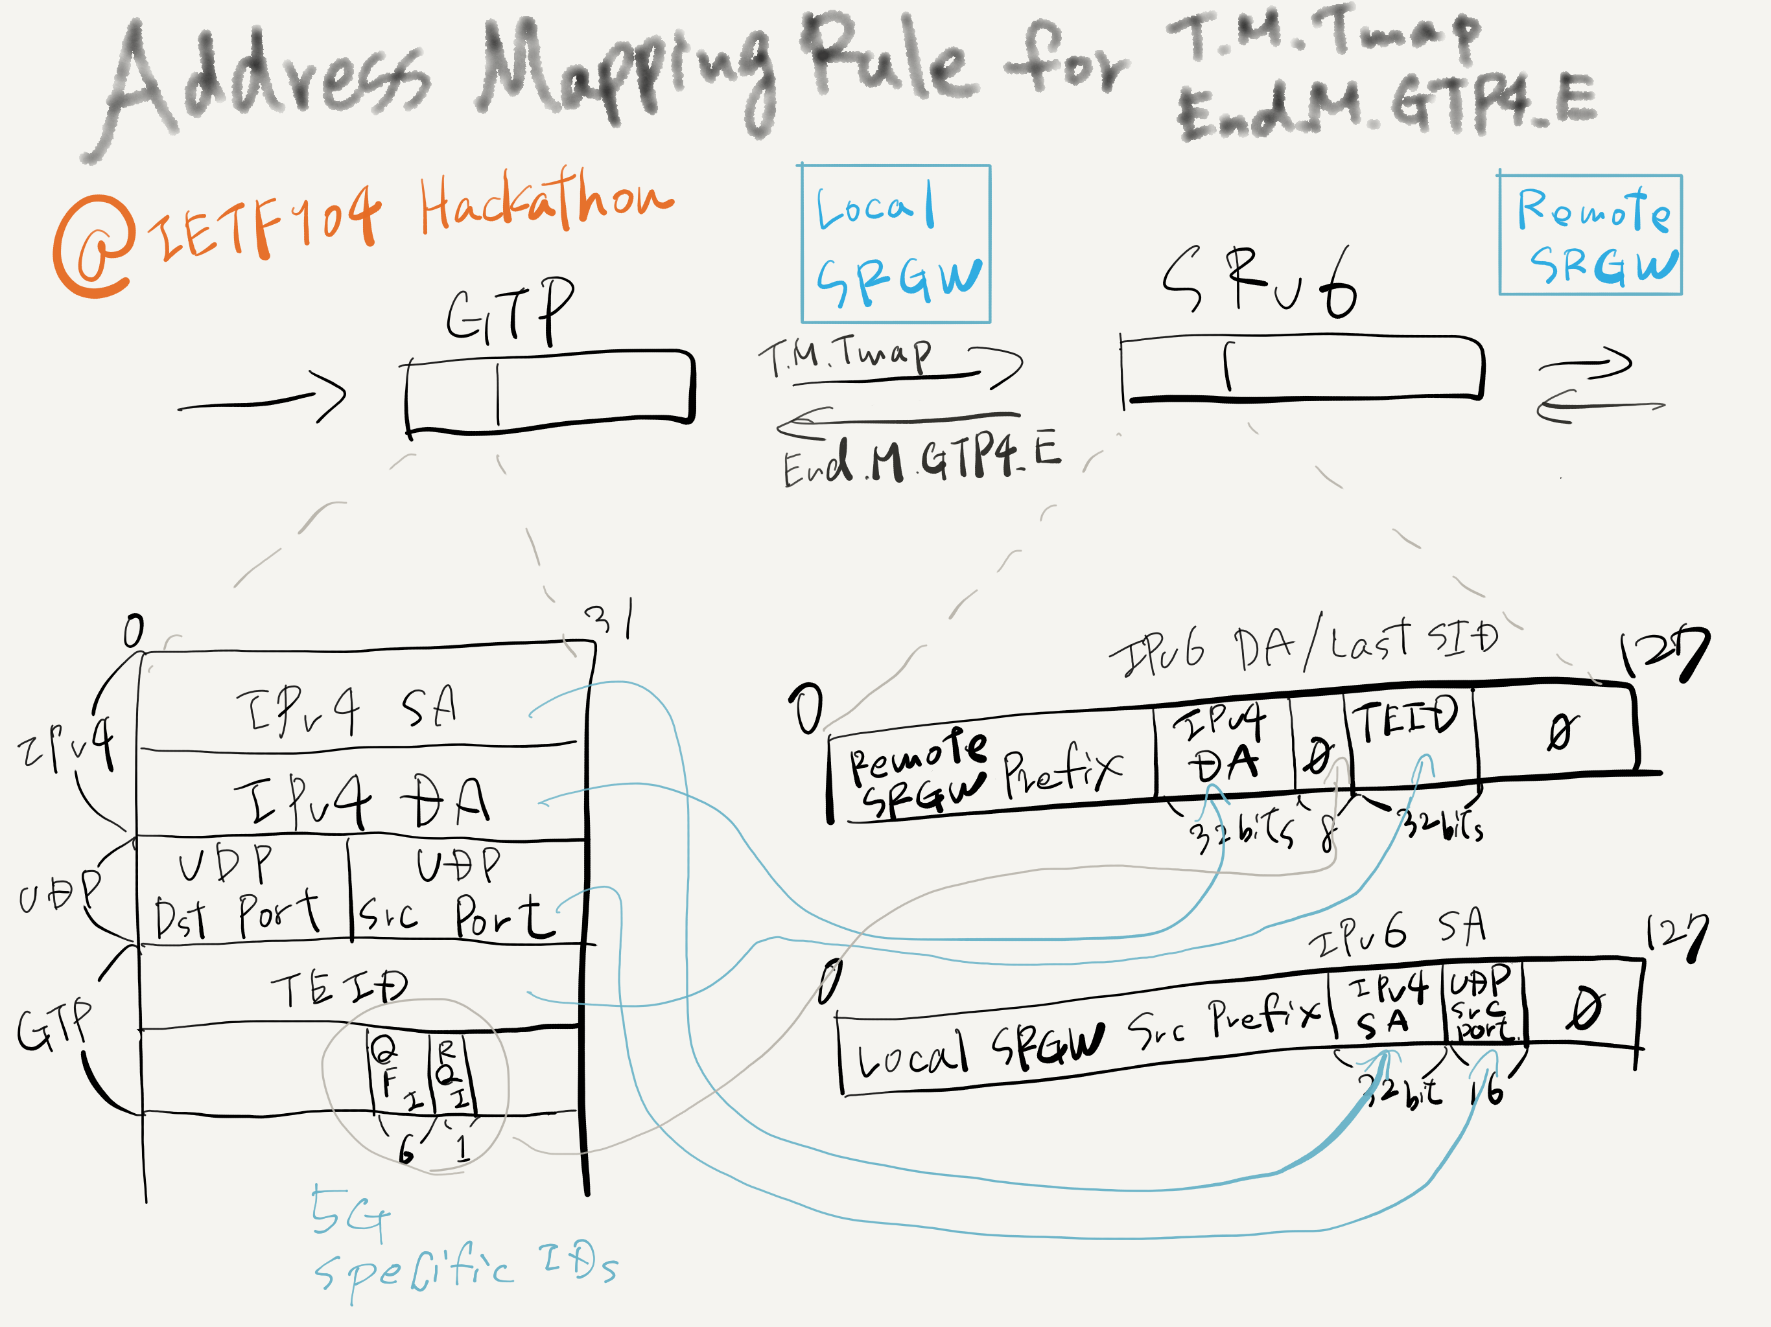
Feedback from Hackathon
Two target functions has been implemented for VPP and P4 Switch.
New mapping rule of GTP-U<->SRv6 has been studied
It is possible to support both ‘Args.Mob.Session’ and ‘Drop-in’ scenario.
The codes are now open-sourced:
VPP and P4

Slide 4
Next Steps
Reflect the review result
More correction for pseudo-code.
Improving clarity and readability to deal with the rest of feedback comments.
Any other feedbacks from WG are really welcome.
Update mapping rules between GTP-U and SRv6
Reflect the hackathon takeaways to the spec.
Implementation
If you are interested in hackathon to implement SRv6 mobile user plane, you’re welcome to join.

Slide 5
Thank you
Questions and comments?

