Slide 1
Deploying Hybrid Access Networks with MPTCP IETF104, March 2019
O. Bonaventure (Tessares)

Slide 2
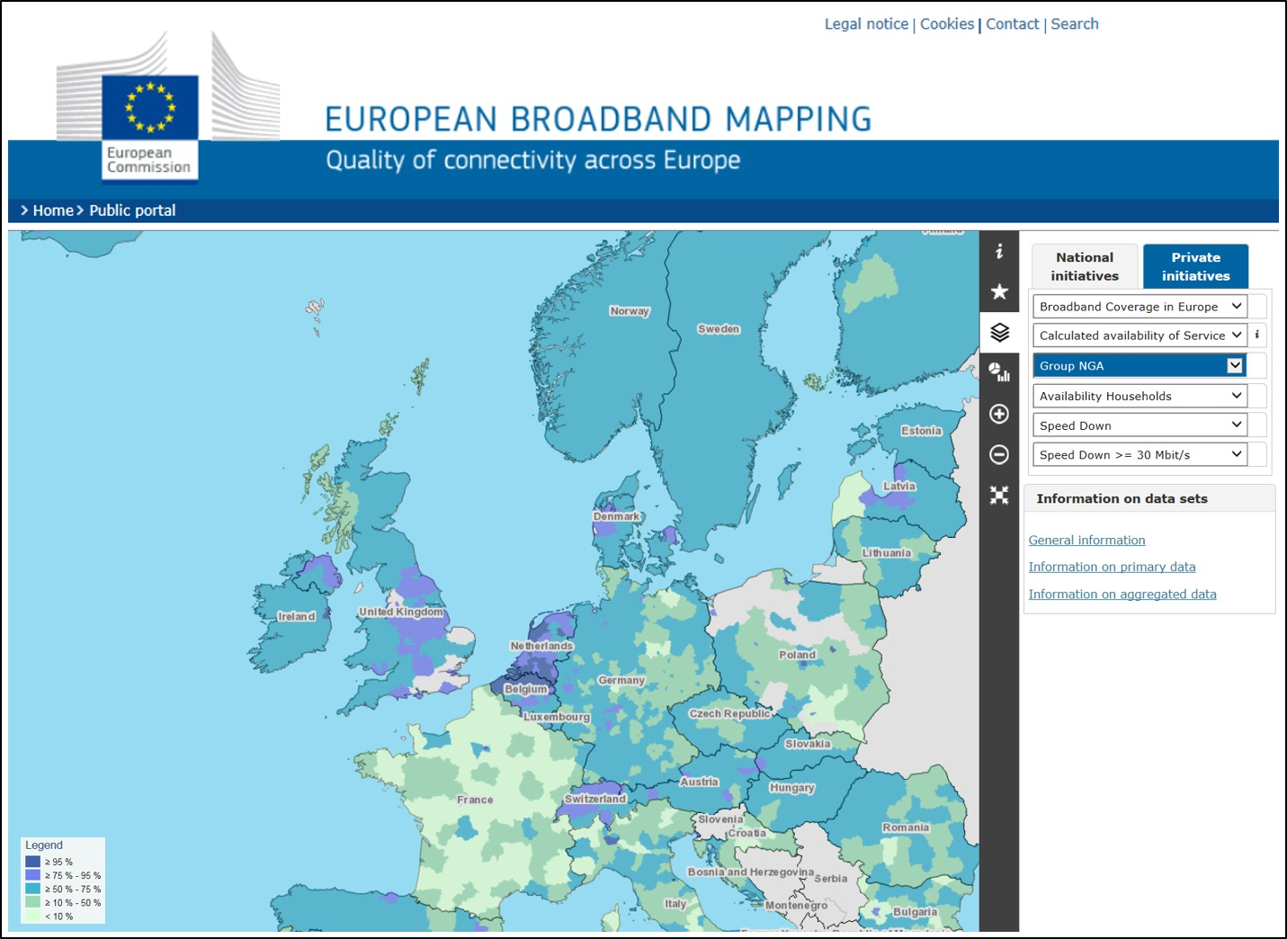
Motivation

Slide 3

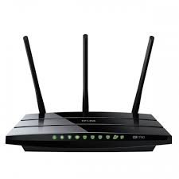



Using Multipath TCP to build Hybrid Access Networks
DSL
TCP
Multipath TCP
Regular TCP
TCP
Hybrid Access
Gateway
4G/LTE
See BBF's WT-378 and draft-ietf-tcpm-converters discussed within the tcpm working group

Slide 4
Deploying Hybrid CPEs
Includes a transparent TCP<->MPTCP proxy
Three main types of deployments
Proxy added to an existing xDSL CPE that is attached to an LTE CPE
Allows to reuse existing CPEs, but performance issues
Proxy in hybrid CPE that combines xDSL and LTE
Requires replacing existing CPEs
xDSL CPE modified to redirect IP packets to LTE CPE that includes Proxy
Reuses existing CPEs and leverages performance of LTE CPE

Slide 5



Running the proxy on an hybrid CPE
SYN+MP-JOIN
LTE
@H
SYN+ACK
SYN+ACK
SYN
DSL
Hybrid CPE
HAG
SYN
ADD_ADDR(@H)
SYN+ACK+MP-CAPABLE
SYN+MP-CAPABLE
TCP
MPTCP
TCP

Slide 6
Running the proxy on an LTE CPE
LTE CPE
SYN+MP-CAPABLE
SYN
LTE
@H
SYN+ACK
SYN
DSL
DSL CPE
HAG
SYN
SYN+MP-CAPABLE

Slide 7
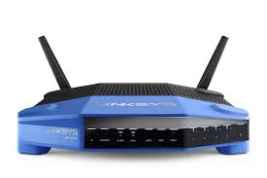
Performance of Hybrid CPEs
Mainly depends on their CPU
Example with Linksys WRT1200 AC using an Armada 385 @1.33 Ghz
DSL : X Mbps, 20 msec
LTE : X Mbps, 20, 50 or 80 msec

Slide 8
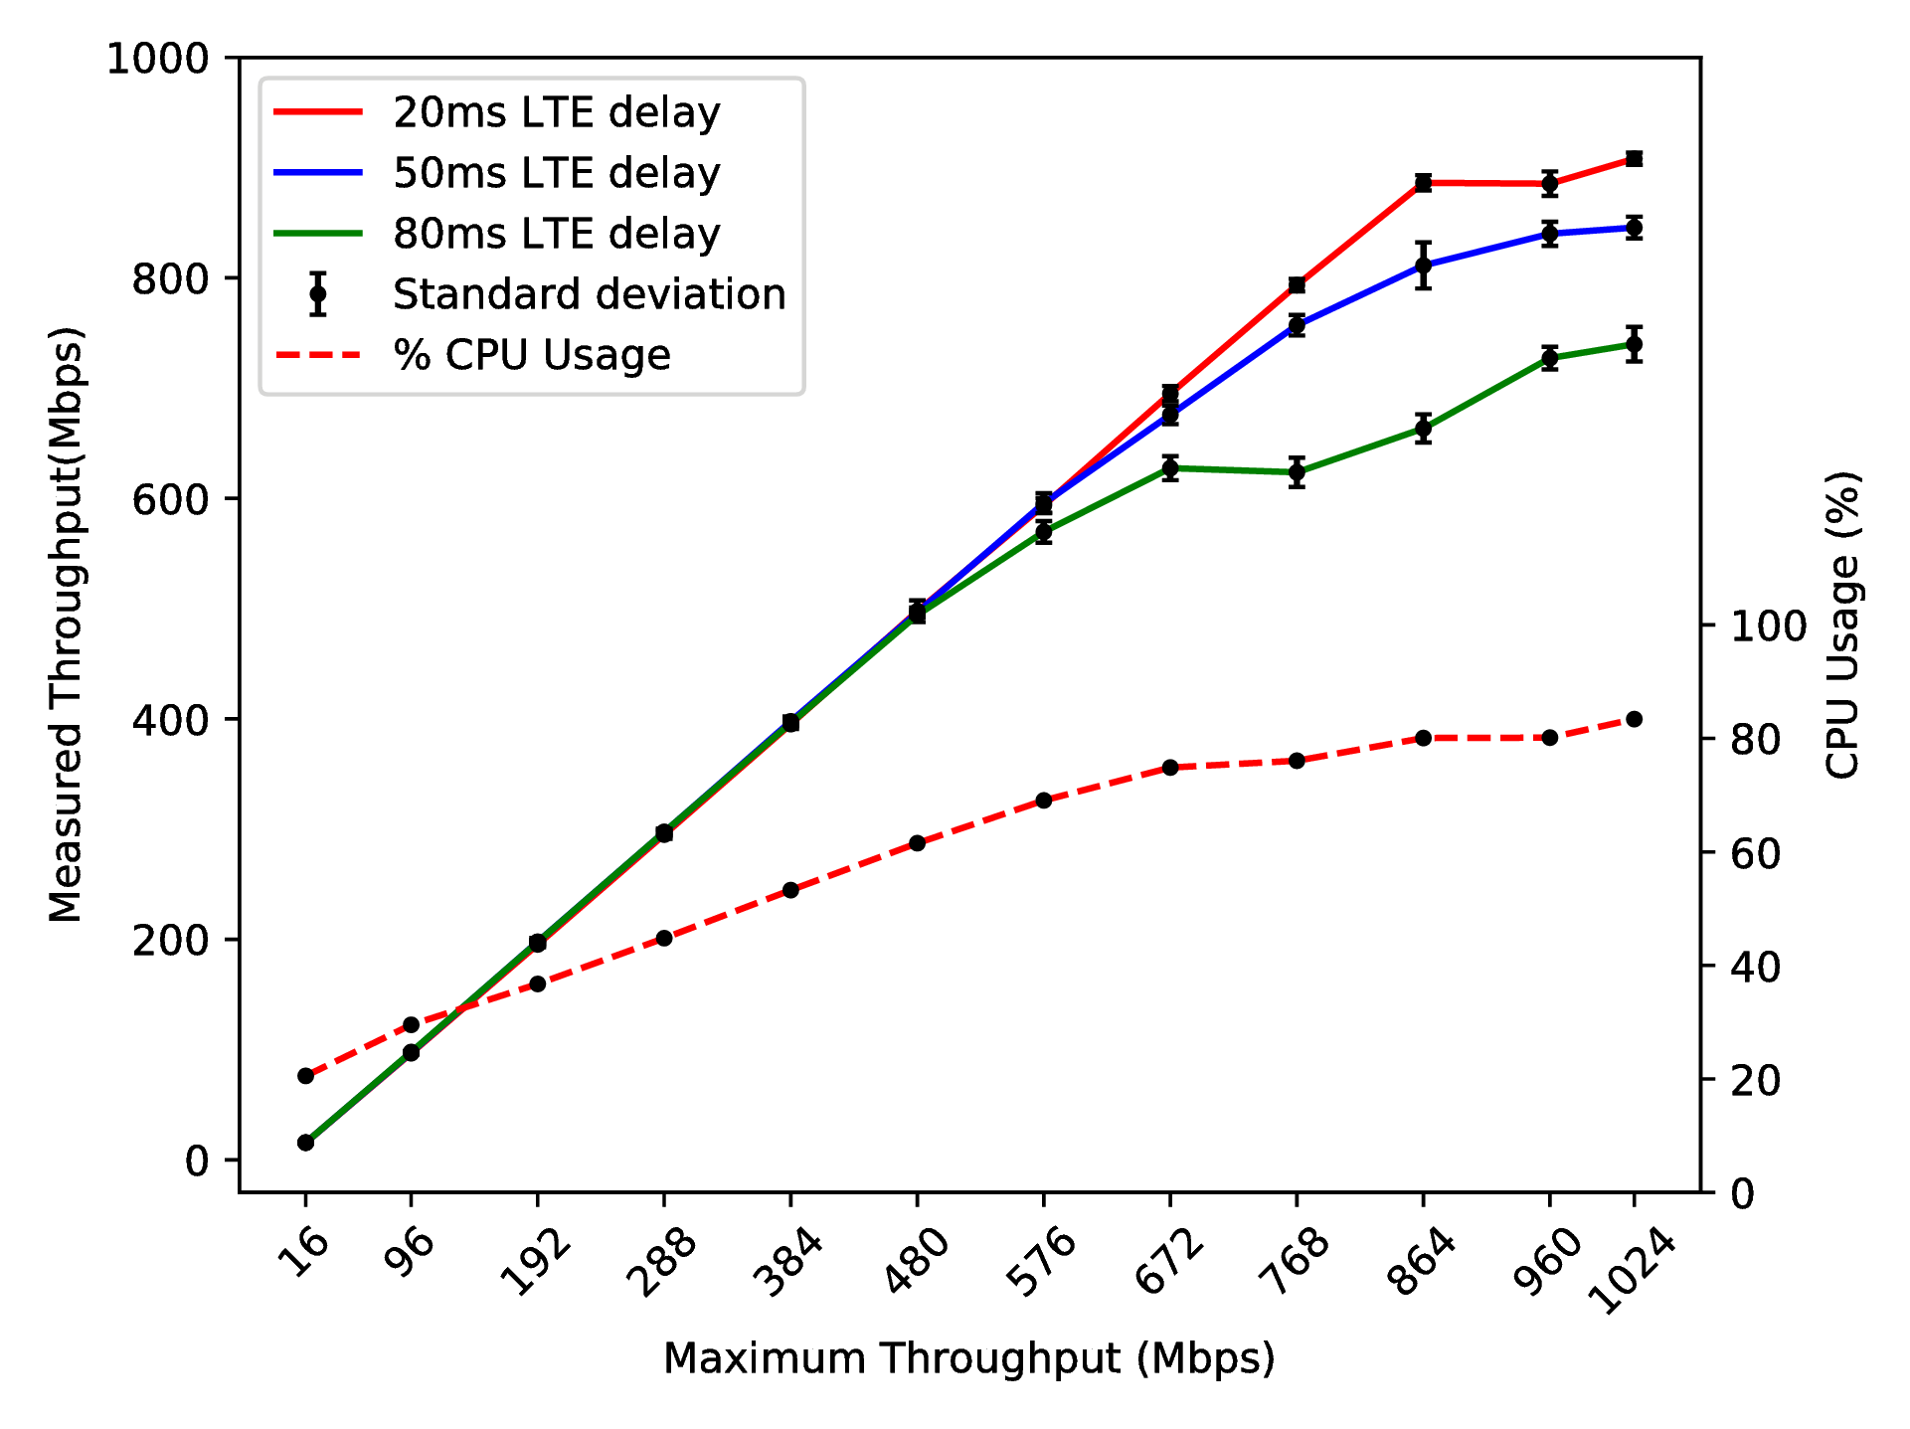

Slide 9
The Hybrid Access Gateway
Deployment models depend on how the xDSL and LTE networks are organised
Centralised HAG if they only converge in backbone
Distributed HAGs located where both networks interconnect
HAG can run on physical servers or inside virtual machines

Slide 10
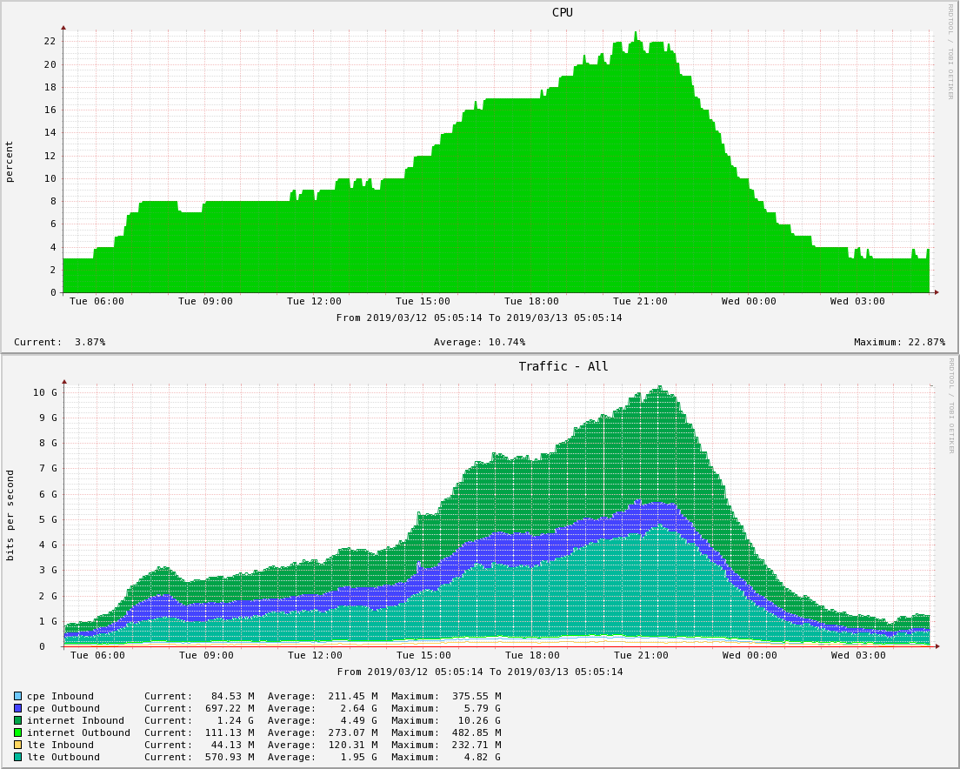

Slide 11
Conclusion
Multipath TCP enables Hybrid Access Networks that boost Internet access
Several deployment models for CPEs
Hybrid CPE and two boxes solutions
Several deployment models for HAGs
Centralised HAG and Distributed HAG
3GPP has recently selected Multipath TCP with the 0-rtt convert protocol for Access Traffic Steering Switch and Splitting (ATSSS) in 5G
See discussion on draft-ietf-tcpm-converters in tcpm

