Slide 1
draft-ietf-lpwan-schc-yang-data-model-07
Ana Minaburo
Laurent Toutain

Slide 2
Model
Draft: -07
Yang Model: ietf-schc@2022-02-15.yang
Covers RFC8724 and RFC8824
Rule definition (Compression/Fragmentation/No Compression)
Identifiers (FID, MO, CDA, Frag parameters,…}
Compound-ack and OAM augment the model

Slide 3
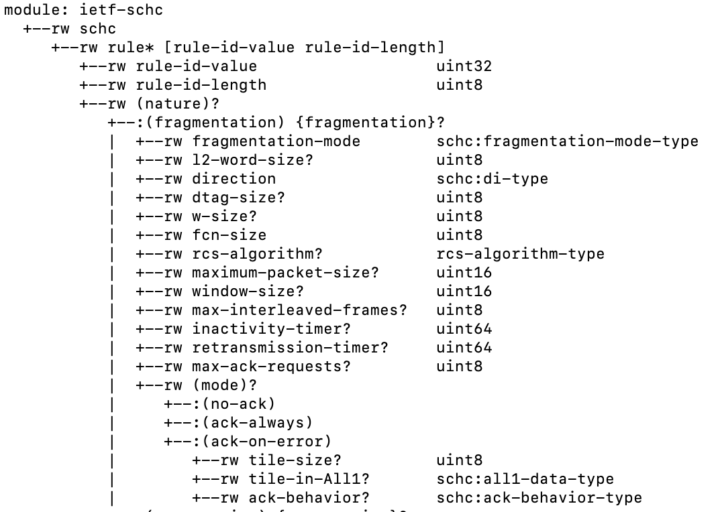
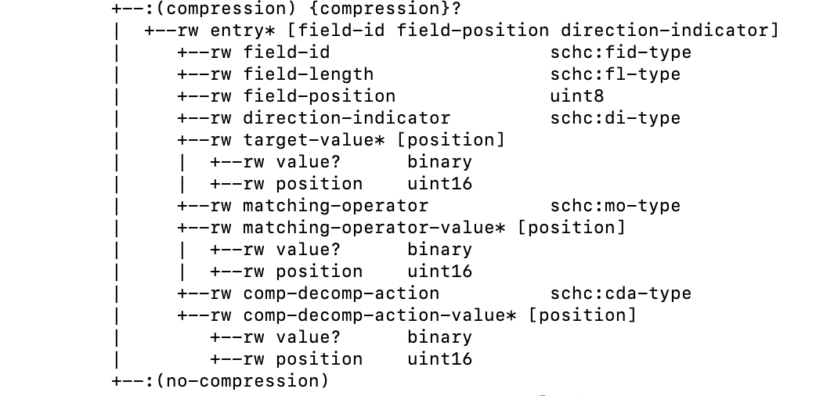
Model

Slide 4
Changes
Dominique review :
Change some names to be closer to RFC8724
Max simultaneous frag: max-interleaved-frames
Add some conditions for fragmentation parameter regarding the mode.

Slide 5
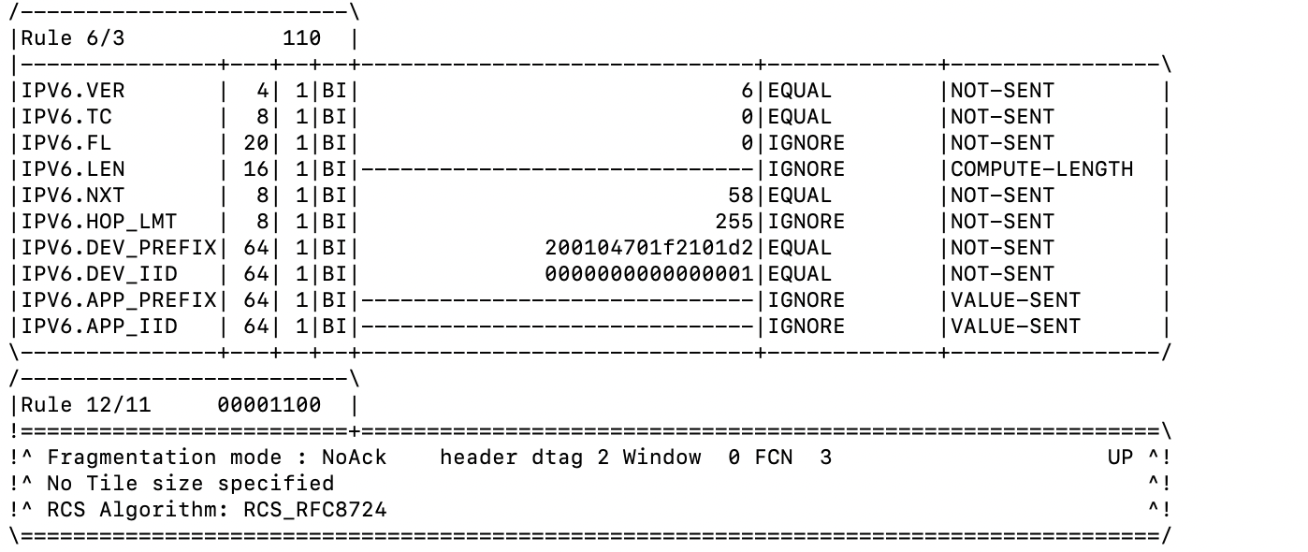
Hackathon results
Implement JSON model:
Checked with yangson

Slide 6
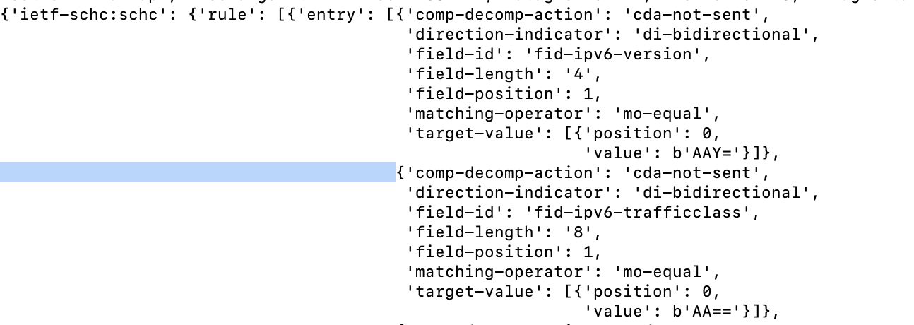
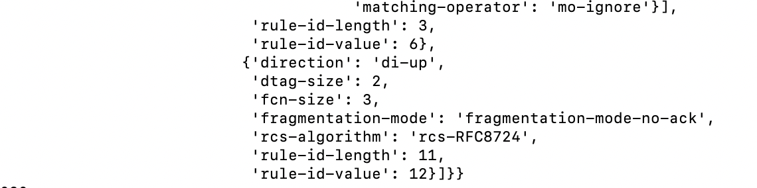
JSON representation
~ 2500 Bytes
…

Slide 7
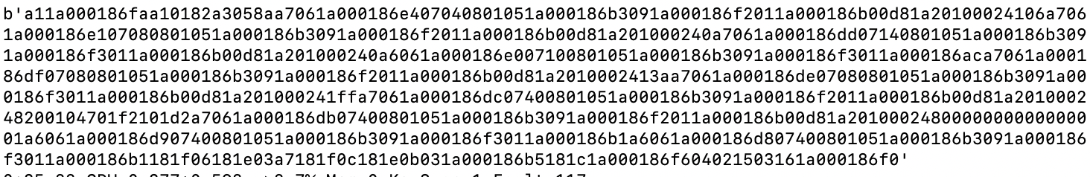
CBOR representation
~ 400 Bytes

Slide 8
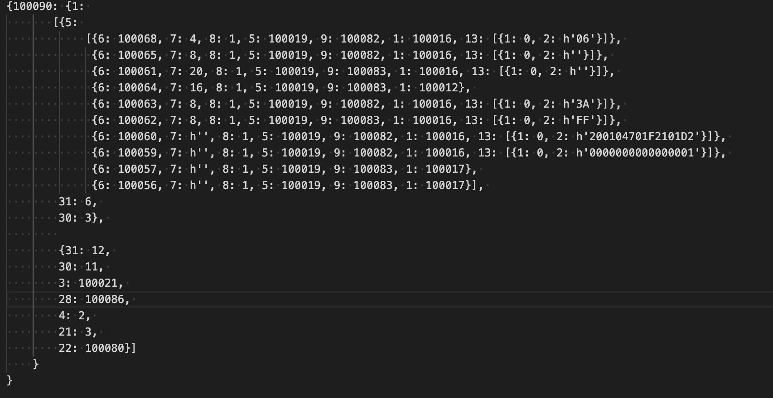
CBOR representation (diagnostic)
Impact of SID size mainly on identifiersI

Slide 9
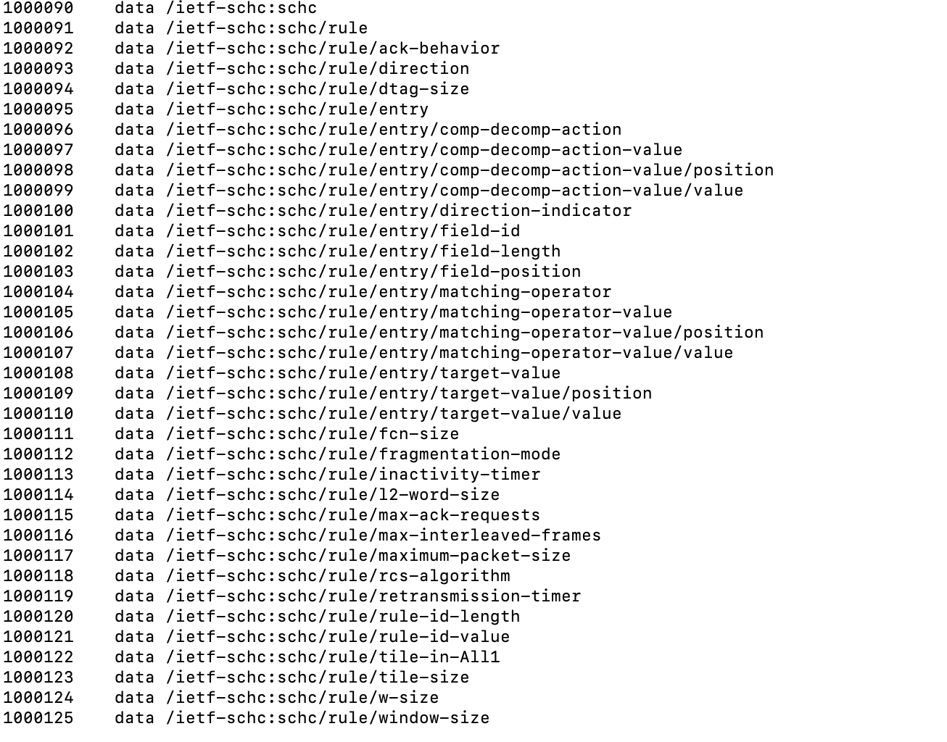
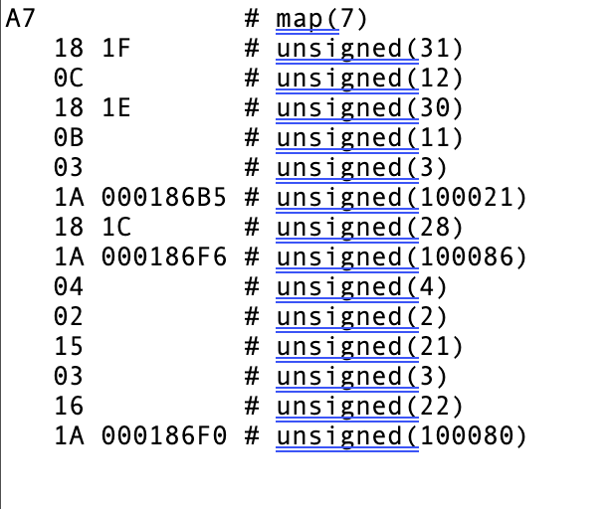
SID
+30

