Slide 1
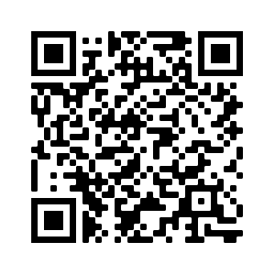
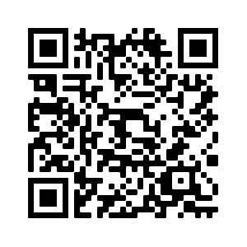
SD-JWT
Selective Disclosure for JWTs
draft-fett-selective-disclosure-jwt
oauthstuff/draft-selective-disclosure-jwt

Slide 2
Decoupling Issuance & Presentation
Decoupled Model
Identity Federation
RP chooses which claims are required to be released to receive service.
Identity Provider
Issuer
Reusable, contains all claims known to the Issuer
full credential
Only claims relevant to given request: Already selectively disclosed!
End-User
(Holder)
End-User
Set of Claims
Subset from the Issuer-signed credential relevant to given request.
subset of claims
Relying Party
Verifier

Slide 3
Selective Disclosure
Issuer issued a whole set of claims:
{
"iss": "https://server.example.com",
"sub": "some-user-identifier",
"aud": "s6BhdRkqt3",
"given_name": "John",
"family_name": "Doe",
"email": "johndoe@example.com",
"phone_number": "+1-202-555-0101",
"address": {
"street_address": "123 Main St",
"locality": "Anytown",
"region": "Anystate",
"country": "US"
},
"birthdate": "1940-01-01"
}
But Verifier needs only a subset in a given request:
{
"iss": "https://server.example.com",
"sub": "some-user-identifier",
"aud": "s6BhdRkqt3",
"given_name": "John",
"family_name": "Doe",
"email": "johndoe@example.com",
"phone_number": "+1-202-555-0101",
"address": {
"street_address": "123 Main St",
"locality": "Anytown",
"region": "Anystate",
"country": "US"
},
"birthdate": "1940-01-01"
}
Notes:
Remember: One credential, many uses
SD: Releasing only a selected subset of the claims in the credential
Privacy feature
Required by many use cases, regulations, projects
Challenge: Signature must still be checkable

Slide 4
SD-JWT
Selective Disclosure for JWTs

Slide 5
“Simple” is a feature.

Slide 6
Why another Spec?
 | Existing SD schemes | SD-JWT
Complexity | (Very) Complex | As simple as possible
Algorithms | Advanced cryptography | Standard cryptography with salted hashes
Format | Binary formats | JSON & JWT
Security | Hard to audit | Easy to understand & verify
Availability | Lack of implementations | Widely-available JWT libraries can be leveraged; Already 4 independent implementations
Use Cases | often limited to the identity use cases | Universal (beyond identity use cases)

Slide 7
Salted Hash Approach
Idea:
Issuer hashes each claim value together with a random salt
  "John" → hash(salt, "John") → "PvU7cWjuHUq6w-i9XFpQZhjT-uprQL3GH3mKsAJl0e0"
Issuer-signed credential only contains digests
  "given_name": "PvU7cWjuHUq6w-i9XFpQZhjT-uprQL3GH3mKsAJl0e0"
Holder selectively releases salt + plain-text value
  "given_name" = hash("eluV5Og3gSNII8EYnsxA_A", "John")
Verifier checks by calculating hashes & issuer’s signature

Slide 8
Overview: Salted Hash Approach

Slide 9
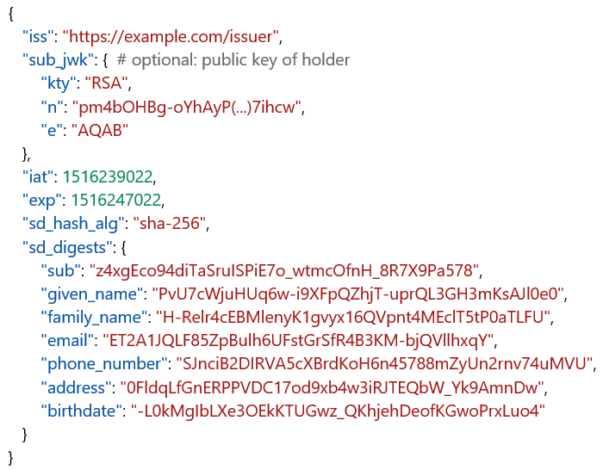
Issuance (1/2)
Issuer
SD-JWT
hashed claim values
Issuance
✓ signed by Issuer
End-User
(Holder)
Presentation
Verifier
Issuer hashes each claim value together with a random salt
-> "John" → hash(salt, "John") → "PvU7cWjuHUq6w-i9XFpQZhjT-uprQL3GH3mKsAJl0e0"
Issuer-signed credential only contains digests
-> "given_name": "PvU7cWjuHUq6w-i9XFpQZhjT-uprQL3GH3mKsAJl0e0"

Slide 10
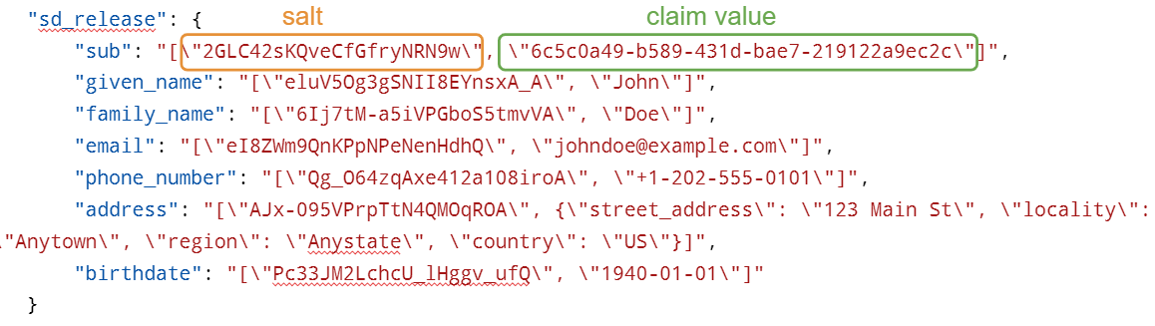
Issuance (2/2)
Issuer
SD-JWT
hashed claim values
Salt/Value Container (SVC)
mapping of plain-text claim values and unique salts used in hashing
Issuance
✓ signed by Issuer
End-User
(Holder)
Presentation
Verifier
Issuer sends a mapping of plain-text claim values and unique salts
-> given_name": "[\"eluV5Og3gSNII8EYnsxA_A\", \"John\"]

Slide 11
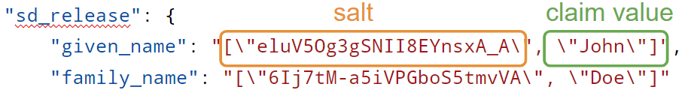
Presentation
Issuer
SD-JWT
hashed claim values
Salt/Value Container (SVC)
mapping of plain-text claim values and unique salts used in hashing
Issuance
✓ signed by Issuer
End-User
(Holder)
sent as-is
selectively disclosed
SD-JWT
hashed claim values
SD-JWT-Release
plain-text claim values and unique salts of selectively disclosed claims
Presentation
Verifier
✓ signed by Issuer
✓ optionally signed by holder
Holder selectively releases salt + plain-text value
-> "given_name" = hash("eluV5Og3gSNII8EYnsxA_A", "John")
Verifier checks by calculating hashes & issuer’s signature

Slide 12
Deep-dive

Slide 13
Deep-dive on SD-JWT
Issuer
SD-JWT
hashed claim values
Salt/Value Container (SVC)
mapping of plain-text claim values and unique salts used in hashing
Issuance
✓ signed by Issuer
End-User
(Holder)
sent as-is
selectively disclosed
SD-JWT
hashed claim values
SD-JWT-Release
plain-text claim values and unique salts of selectively disclosed claims
Presentation
✓ signed by Issuer
✓ optionally signed by holder
Verifier

Slide 14
Example: SD-JWT
Issuer creates & sends to holder:
{
"iss": "https://example.com/issuer",
"sub_jwk": { # optional: public key of holder
"kty": "RSA",
"n": "pm4bOHBg-oYhAyP(...)7ihcw",
"e": "AQAB"
},
"iat": 1516239022,
"exp": 1516247022,
"sd_hash_alg": "sha-256",
"sd_digests": {
"sub": "z4xgEco94diTaSruISPiE7o_wtmcOfnH_8R7X9Pa578",
"given_name": "PvU7cWjuHUq6w-i9XFpQZhjT-uprQL3GH3mKsAJl0e0",
"family_name": "H-Relr4cEBMlenyK1gvyx16QVpnt4MEclT5tP0aTLFU",
"email": "ET2A1JQLF85ZpBulh6UFstGrSfR4B3KM-bjQVllhxqY",
"phone_number": "SJnciB2DIRVA5cXBrdKoH6n45788mZyUn2rnv74uMVU",
"address": "0FldqLfGnERPPVDC17od9xb4w3iRJTEQbW_Yk9AmnDw",
"birthdate": "-L0kMgIbLXe3OEkKTUGwz_QKhjehDeofKGwoPrxLuo4"
}
}
Digests of all the claims issued to the holder by the Issuer

Slide 15
Deep-dive on SVC
Issuer
SD-JWT
hashed claim values
Salt/Value Container (SVC)
mapping of plain-text claim values and unique salts used in hashing
Issuance
✓ signed by Issuer
End-User
(Holder)
sent as-is
selectively disclosed
SD-JWT
hashed claim values
SD-JWT-Release
plain-text claim values and unique salts of selectively disclosed claims
Presentation
✓ signed by Issuer
✓ optionally signed by holder
Verifier

Slide 16
Example: Salt/Value Container
😱
JSON strings?!
Issuer creates & sends to holder together with SD-JWT:
{
"sd_release": {
"sub": "[\"2GLC42sKQveCfGfryNRN9w\", \"6c5c0a49-b589-431d-bae7-219122a9ec2c\"]",
"given_name": "[\"eluV5Og3gSNII8EYnsxA_A\", \"John\"]",
"family_name": "[\"6Ij7tM-a5iVPGboS5tmvVA\", \"Doe\"]",
"email": "[\"eI8ZWm9QnKPpNPeNenHdhQ\", \"johndoe@example.com\"]",
"phone_number": "[\"Qg_O64zqAxe412a108iroA\", \"+1-202-555-0101\"]",
"address": "[\"AJx-095VPrpTtN4QMOqROA\", {\"street_address\": \"123 Main St\", \"locality\": \"Anytown\", \"region\": \"Anystate\", \"country\": \"US\"}]",
"birthdate": "[\"Pc33JM2LchcU_lHggv_ufQ\", \"1940-01-01\"]"
}
}
Mapping of salts and claim values of all the claims issued by the Issuer
salt
claim value
JSON string literals…
…ensure all parties hash the same values
…obsolete canonicalization even for complex claim values
…with extremely simple implementation
Notes:
Side effect: They also avoid hash length extension attacks!

Slide 17
Deep-dive on SD-JWT-Release
Issuer
SD-JWT
hashed claim values
Salt/Value Container (SVC)
mapping of plain-text claim values and unique salts used in hashing
Issuance
✓ signed by Issuer
End-User
(Holder)
sent as-is
selectively disclosed
SD-JWT
hashed claim values
SD-JWT-Release
plain-text claim values and unique salts of selectively disclosed claims
Presentation
✓ signed by Issuer
✓ optionally signed by holder
Verifier

Slide 18
Example: SD-JWT-Release
Holder creates from SVC & sends to verifier together with SD-JWT:
{
"nonce": "XZOUco1u_gEPknxS78sWWg",
"aud": "https://example.com/verifier",
"sd_release": {
"given_name": "[\"eluV5Og3gSNII8EYnsxA_A\", \"John\"]",
"family_name": "[\"6Ij7tM-a5iVPGboS5tmvVA\", \"Doe\"]"
}
}
salt
claim value
Salts and claim values of the claims that the Holder is releasing to the Verifier
Verifier checks:
SD-JWT is valid (signature, etc.)
SD-JWT-Release is valid (if signed: signature, nonce, etc.)
digests in SD-JWT match hashes of released claims
Then: Extract plain-text values from released claims
Foot-gun: Verifier MUST calculate and check digests before using claims!

Slide 19
Granularity of hashing in SD-JWT
{
"address": {
"street_address": "123 Main St",
"locality": "Anytown",
"region": "Anystate",
"country": "US"
}
}
one digest per claim
or
digest per component of the claim
{
"sd_digests": {
"address": "0FldqLfGnERPPVDC17od9xb4w…",
}
}
{
"sd_digests": {
"address": {
"street_address": "O7_Isd6CmZqcSobPVpMgmJwB41hPUHHG8jg5LJ8YzfY",
"locality": "w-zTF6ljkQLTvVyp_JNyD3t5Waj-B2vb0AXH1q8OsjI",
"region": "nTvoKpGA6YQwEZipVBIM4WVH9KWEnwiqsRjEhrxhQz4",
"country": "u-O1yDQqDTTqOgUBSjWilgkMLzg_QOTELMfZrRT5e6k"
}
}
}

Slide 20
Works with Complex Objects!
{
"sd_digests": {
"verified_claims": {
"verification": {
"trust_framework": "w1mP4oPc_J9thBex0TaQi1vgxFmruQJxZYLFnkNFMaI",
"time": "Pu3i0CWrPVLJW-LT30yF1bFBPP15B6-uKk3PnGDflv8",
"verification_process": "8HqIXRmczsdYOZzGcLqI5-l9xN5QbK2XDtXmdfH7z-4",
"evidence": [{
"type": "TnLuqGGQm6jfeOoa5uX1diKANUPuh-zHrpBFdX9MR-g",
"method": "SagmakoSu-X-XUPIC3EgdrEEwIWxRWXX4-i68X9TyEo",
"time": "ld2c5oYDRtQcfU6PzogPkx_95WYqhqIJNVRMnfcsicY",
"document": {
"type": "ufWjDaAa54MnHeji2ZUUHDdnpZ9zx6CUG6uR28VMtsQ",
"issuer": {
"name": "a4GMucU7Zb060r0Svd7huY6Qho1bIf3v1U5BvPR8q6Y",
"country": "135k9M0m2SCnYRuOfHuYScYVS2q3eeY7IItgyRsaBT8"
},
"number": "cUvOxLUp8RV7TTVliEiu-TQIel-LsE8E-XfUgfqk5gk",
"date_of_issuance": "NIs8olJnJOv4J1qIEBKuTs2sEFs4fgGJhNqM6xdQt7E",
"date_of_expiry": "HTR37vLtANT6MWk-9dBqekFpCvaTG7zNf1ze56rnV64"
}
}]
},
"claims": {
"given_name": "NB9XH_yJKqKOhXDmXkZKpMCkRbOmOTd8bqJFYDJYQnQ",
"family_name": "hAUbJ66ZYL9VJLbjsDpmSs2e9Ff_Ohim_WR4bwZyvoQ",
"birthdate": "6XOR4k56BgWk5tnNismbmEHvoGX7RRfy6Z8HENl96cU",
"place_of_birth": {
"country": "CLTlhuy13WWc3_ISon1kEypFwvCmfhLSpGUMCyAUg68",
"locality": "AQoX8ixGpz-ipweEGlC-2umqwyQdhjIeiUB_TKWcE2E"
},
"nationalities": "nfoc__QKlMUHodmxwlY-Kp-6ewgX3CdK7Ia0RJHIXVo",
"address": "ngnO4uQeOktM7YdFD8x82doS7WJnlZnq-rQE_RfuBSI"
}
},
"birth_middle_name": "FeFSwd9drypEPtWVgIZ42N9j_yostt1Ds5PBpxT3Rng",
"salutation": "57CMhvASQMNuzuQ0a_B1_VX5XdH73TcuPxyWGiorj5g",
"msisdn": "leKbB0ro6q3jrVraCqt443uaGZVZisD3iGrKuKE2mqM"
}
}
Example of OpenID for Identity Assurance
For full example, see the spec

Slide 21
Running Code:
4 independent implementations!
### Produce SD-JWT and SVC
sdjwt = SDJWT(
user_claims,
issuer,
ISSUER_KEY,
HOLDER_KEY,
claims_structure,
blinded_claim_names,
iat,
exp,
)
Python: https://github.com/oauthstuff/draft-selective-disclosure-jwt
Kotlin: https://github.com/IDunion/SD-JWT-Kotlin
Rust: https://github.com/kushaldas/sd_jwt
TypeScript: https://github.com/christianpaquin/sd-jwt
Reference implementation in python: ~500 LoC.
Evolves with the spec.
Examples in the spec generated from the code.

Slide 22
Use-Case: W3C VC-Data-Model
JWT-VC (= SD-JWT)
JWT-VP (= SD-JWT-Release)
{
"sub": "did:example:ebfeb1f712ebc6f1c276e12ec21",
"jti": "http://example.edu/credentials/3732",
"iss": "https://example.com/keys/foo.jwk",
"nbf": 1541493724,
"iat": 1541493724,
"exp": 1573029723,
"vc": {
"@context": [
"https://www.w3.org/2018/credentials/v1",
"https://www.w3.org/2018/credentials/examples/v1"
],
"type": [
"VerifiableCredential",
"UniversityDegreeCredential"
],
“credentialSubject”: {
"sd_digests": {
"given_name": "fUMdn8aoyKTHrvZd6AuLmPraGhPJ0zF5r_JhxCVZs",
"family_name": "9h5vgv6TpFV6GmnPtugiMLl5tHeeb5X_2cKHjN7cw",
"birthdate": "fvLCnDm3r4VSYcBF3pIlXP4ulEoHuHOfG_YmFZEuxpQ"
}
}
}
}
{
"iss": "did:example:ebfeb1f712ebc6f1c276e12ec21",
"aud": "s6BhdRkqt3",
"nbf": 1560415047,
"iat": 1560415047,
"exp": 1573029723,
"nonce": "660!6345FSer",
"vp": {
"@context": [
"https://www.w3.org/2018/credentials/v1"
],
"type": [
"VerifiablePresentation"
],
"verifiableCredential": ["eyJhb...npyXw"]
},
"sd_release": {
"given_name": "[\"6Ij7tM-a5iVPGboS5tmvVA\", \"John\"]",
"family_name": "[\"eI8ZWm9QnKPpNPeNenHdhQ\", \"Doe\"]"
}
}
Note: specific syntax is under discussion.

Slide 23
Current Status &
Next Steps

Slide 24
Draft Status
Functional specification complete and somewhat stable
New: Approach to blinding claim names
Some missing parts in security and privacy considerations
Already considered a serious alternative to many existing formats
Adopted in EU-projects & by Microsoft

Slide 25
OAuth WG?
JWT was developed in OAuth WG
Expected usage in OAuth and OAuth-based technologies
SD-JWT is universal: Selectively disclosable access tokens?

Slide 26
Call for adoption?

Slide 27
Additional Slides

Slide 28
Blinding Claim Names
Hashing not only claim values but also claim names.
Credential
{
"iss": "https://server.example.com",
"sub": "some-user-identifier",
"aud": "s6BhdRkqt3",
"given_name": "John",
"family_name": "Doe",
"email": "johndoe@example.com",
"phone_number": "+1-202-555-0101",
"secret_club_membership_no": "42-23-23"
}
{
"iss": "https://server.example.com",
"sub": "some-user-identifier",
"aud": "s6BhdRkqt3",
"given_name": "John",
"family_name": "Doe",
"email": "johndoe@example.com",
"phone_number": "+1-202-555-0101",
"secret_club_membership_no": "42-23-23"
}
✓ signed by Issuer
✓ signed by Issuer

