Slide 1

RFC Artifacts
…or regenerating TXT, HTML, PDF

Slide 2
RFC 7990
“The canonical format for RFCs is XML“
… however…
RFC 7990 is not very clear about publication formats

Slide 3
There are three concepts here
Canonical: Of or appearing in the biblical canon
Authoritative: Having or arising from authority; official
Archival: Of, relating to, kept in, or suitable for archives

Slide 4
Let’s start with XML
(If we decide that XML can change,
changing publication formats seems unavoidable*)

Slide 5
Syntax and Semantics
Key property to retain is authority
Authority is carried in the expression of semantics
We use XML because better captures semantics
In contrast syntax changes might
…ensure consistency across the series
… retain agreed semantics (and maintain authority)
…or even better express semantics

Slide 6
Preserving semantics
Not always clear
Address changes arguably remove some semantics
But this should not affect what was agreed
Proposal:
offer only loose guidance to future RSWG
rely on future RSWG exercising good judgment

Slide 7

XML change options
No changes
Syntax changes only
Semantic changes (! seems unwise)

Slide 8
Archival
Proposal:
require archival of XML at each change
say nothing about archival of publication formats
Note that we might expect that, in practice:
publication formats will be archived as well
…but maybe not always

Slide 9
Publication formats
As a consequence:
Publication formats can be regenerated at will

Slide 10

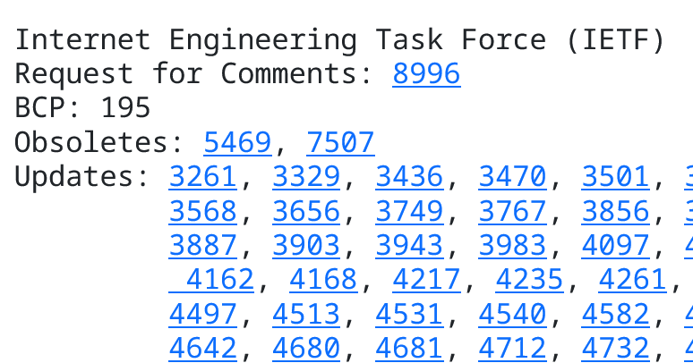
Problems
xml2rfc has been highly inconsistent over time
this makes uniform styling unreasonably difficult
examples: table of contents, figures, tables
also:
href="https://www.rfc-editor.org/rfc/rfc%E2%80%8B%204162"

