Slide 1




An overview of the AI4ME project and network requirements for the IETF CATS Working Group
Rajiv Ramdhany (BBC) Nick Race (Lancaster University) Daniel King (Lancaster University)
10 November 2023

Slide 2


Who are the BBC?
The British Broadcasting Corporation, is the United Kingdom's public service broadcaster.
Founded in 1922; one of the oldest and largest broadcasters in the world.
BBC R&D: research and innovation in on every aspect of the broadcast chain, from Audiences, Production and Distribution
Some of the major technology innovations and contributions by the BBC:
First Public Television Broadcast in the world (1936).
The first regular color television broadcasts in the world (1967).
BBC Microcomputer for early computer education of many British children and adults (1980s)
First Digital Satellite Television service in the world (1990)
First High-Definition Broadcasting
BBC iPlayer: First major catch-up TV service in the world (2007); set the standard for similar platforms.
Leading testing and adoption of 4K and Ultra-High Definition broadcast
Producing immersive VR and Immersive Content/Experiences
Binaural Audio for immersive spatial audio experiences for headphone listeners
TV, AR, VR, 360 trials over 5G and contributions of requirements to 3GPP
BBC micro:bit - entry-level programmable computer for children
Low-latency dynamic adaptive streaming over HTTP and QUIC
Hybrid Log Gamma (HLG) system for High Dynamic Range (HDR)

Slide 3

AI4ME Project
Future Personalised Object-Based Media Experiences Delivered at Scale Anywhere
Five-year collaborative project between the BBC, the University of Surrey, and Lancaster University
Develop AI-based capabilities to enable media experiences to be hyper-personalised
Three key focuses of AI4ME
Personalised
Media for All
Audio/Video
Object Capture and Representation
Object-Based
Production
Compute-Aware
Network Delivery
Objects
+ Scene Metadata
Objects
+ Production Metadata

Slide 4

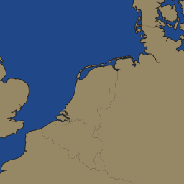




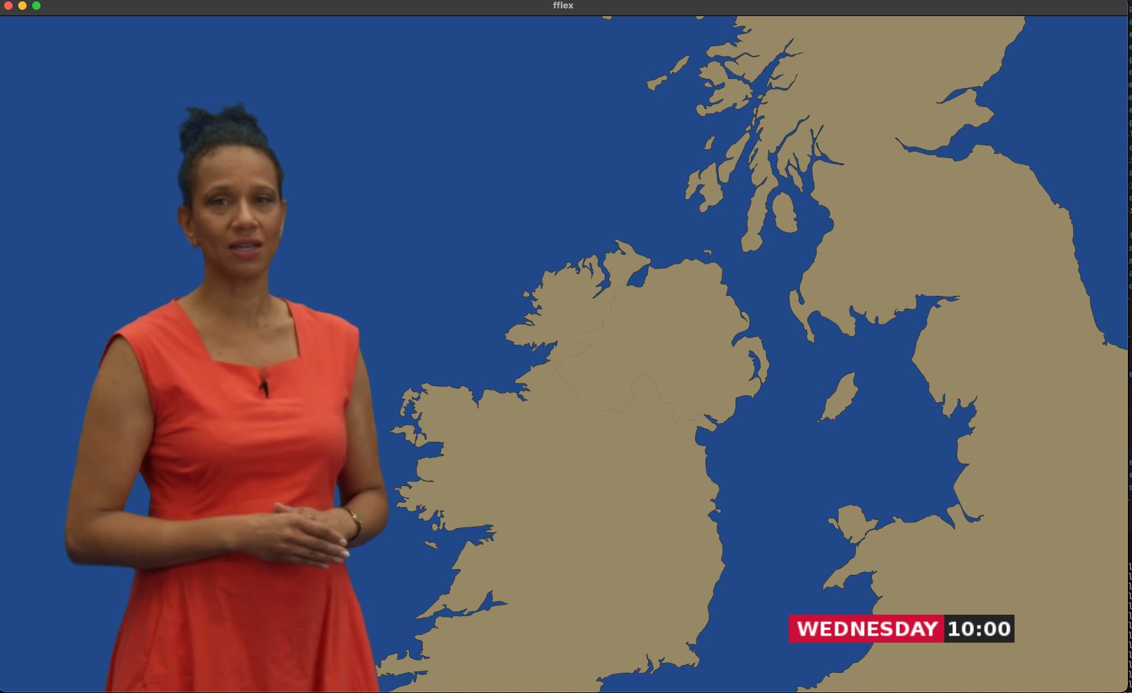

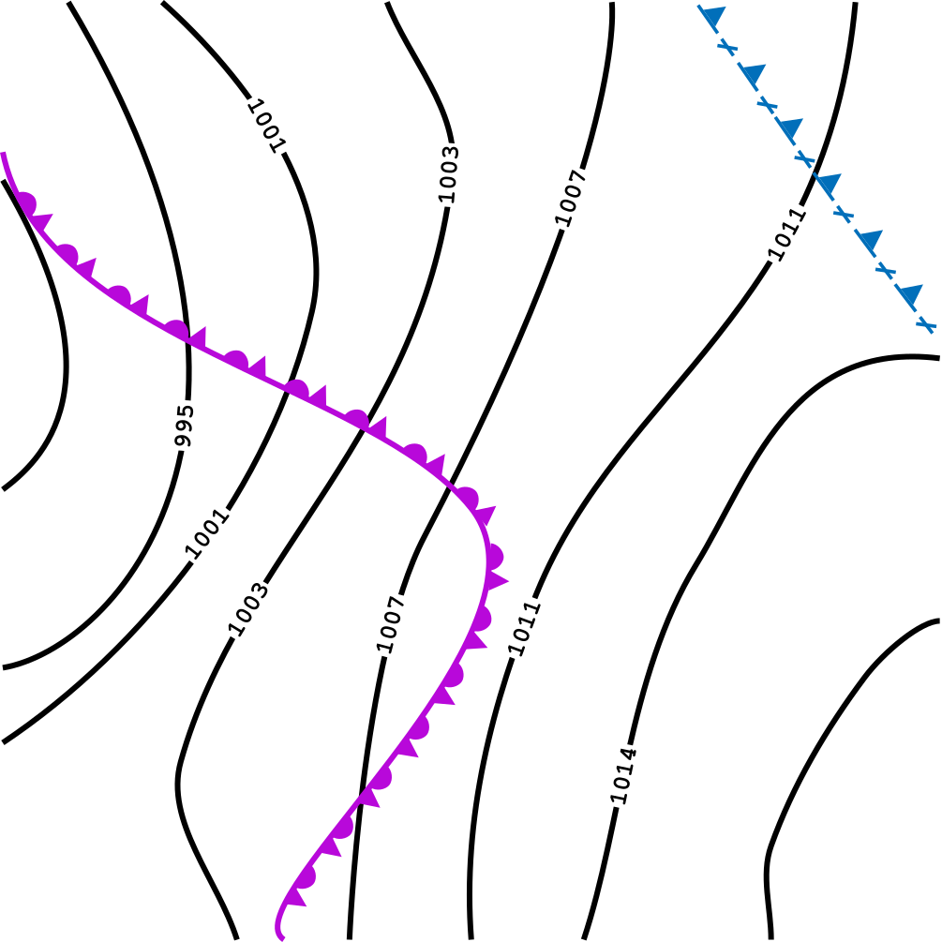

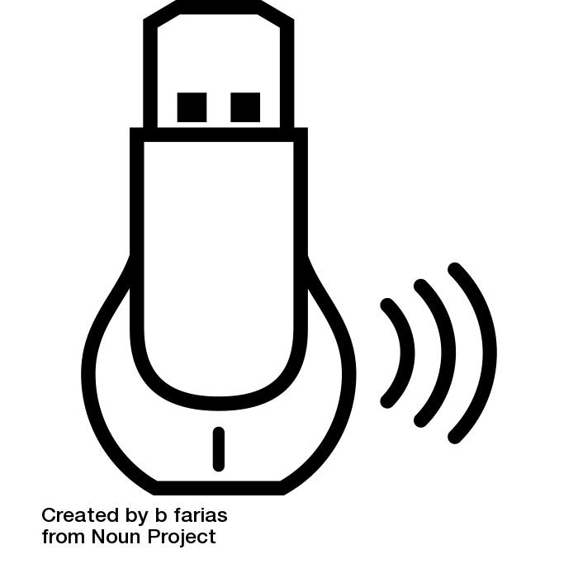
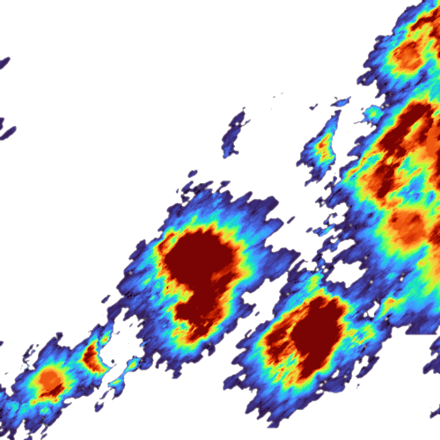
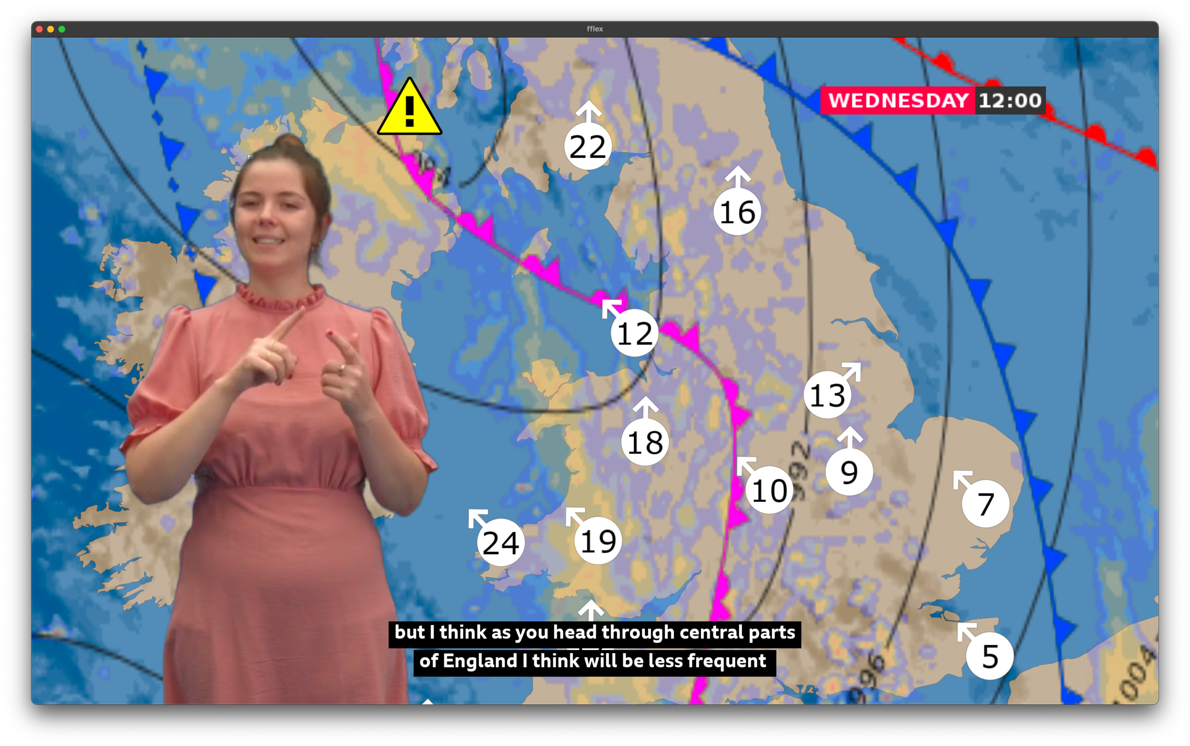
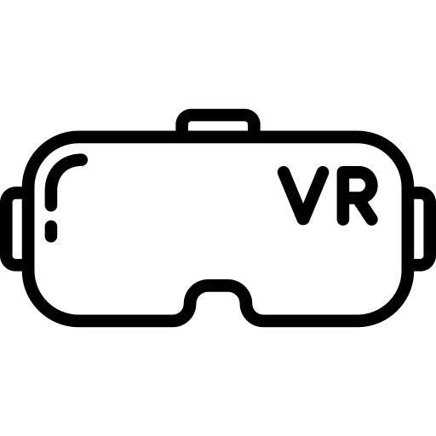
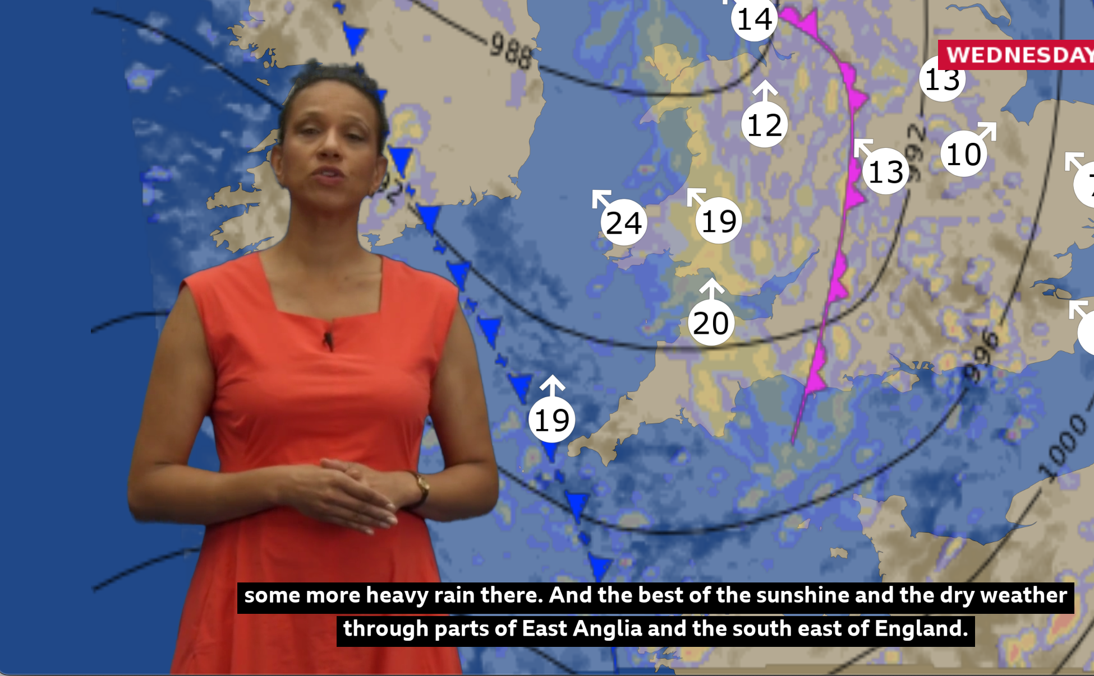

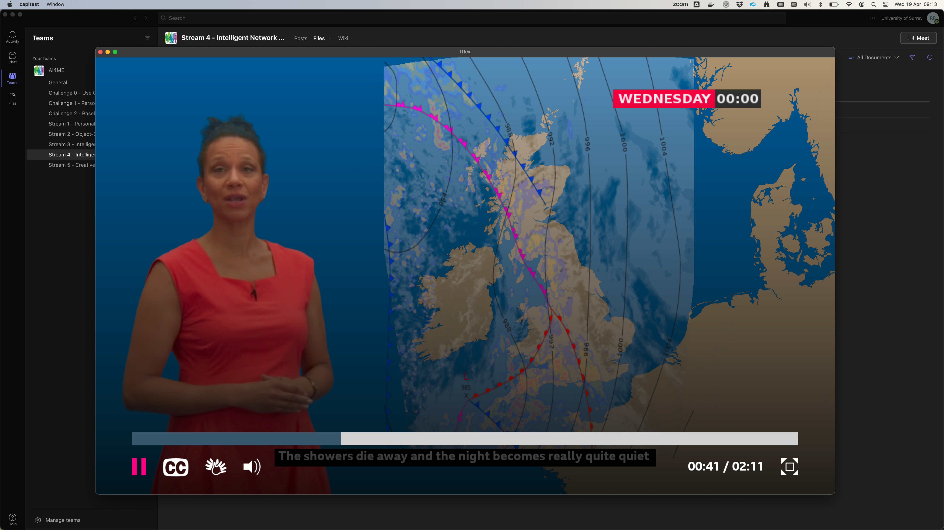
Object-Based Media Primer
Traditional linear broadcast
Object-Based Media allows the content of programmes to change according to the requirements of each individual audience member.
Media Objects – assets that make the content
Audio, video, graphics, captions, 3D models, data streams, textures
Code: shaders
Media objects assembly in production
Same assembly broadcast to everyone
Media Objects
Interactive Object-based Weather Forecast
Media objects assembly at point of consumption
based on user preferences and interaction
Media Objects, metadata

Slide 5
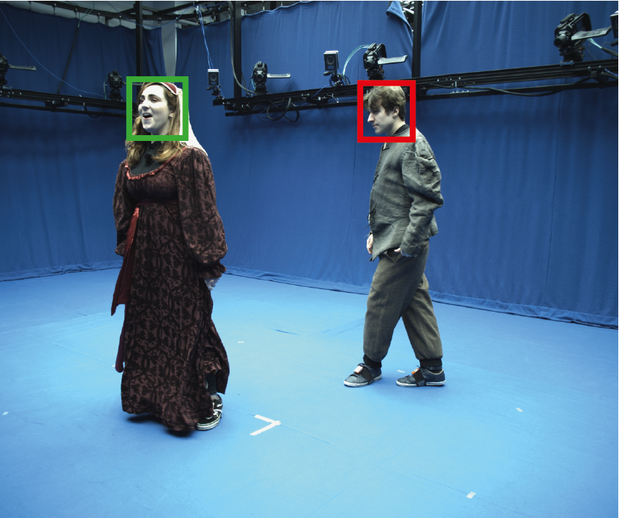
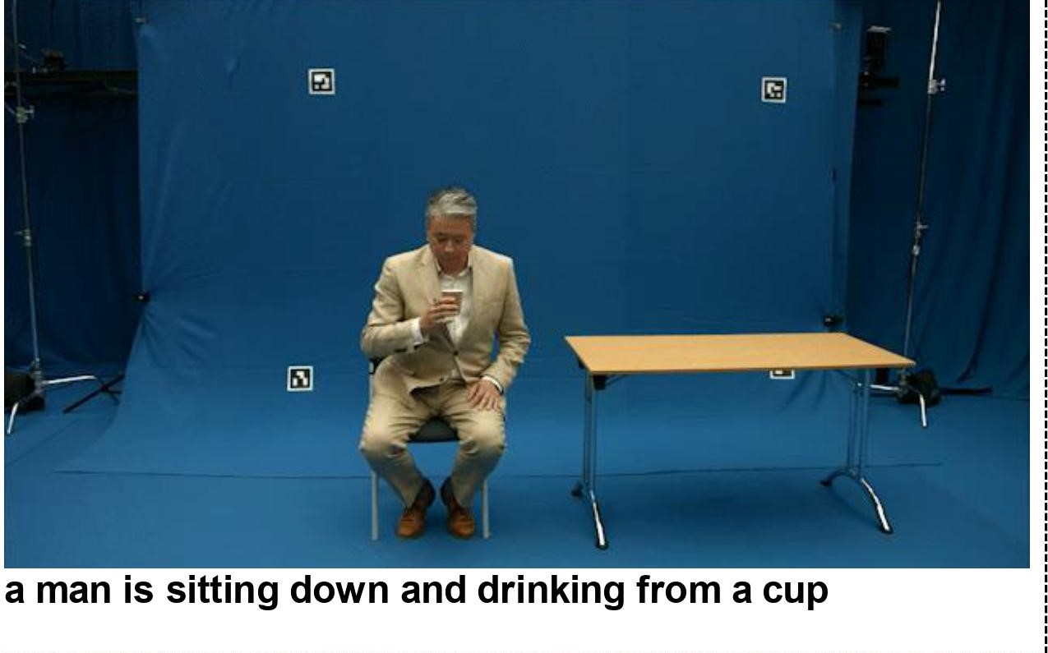
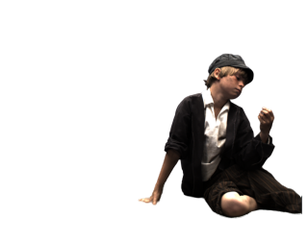

AI4ME Project
Future Personalised Object-Based Media Experiences Delivered at Scale Anywhere
Stream 2
Personalised
Media for All
Audio/Video
Object Capture and Represent-ation
Object-Based
Production
Compute-Aware Network Delivery
Objects
+ Scene Metadata
Objects
+ Production Metadata
Media Objects for Personalisation
New AI-based techniques to extract objects and metadata from Audio Visual streams
Efficient object representations to render and re-render the objects dynamically to create new views to suit user context
(x,y,z)
(x,y,z)

Slide 6
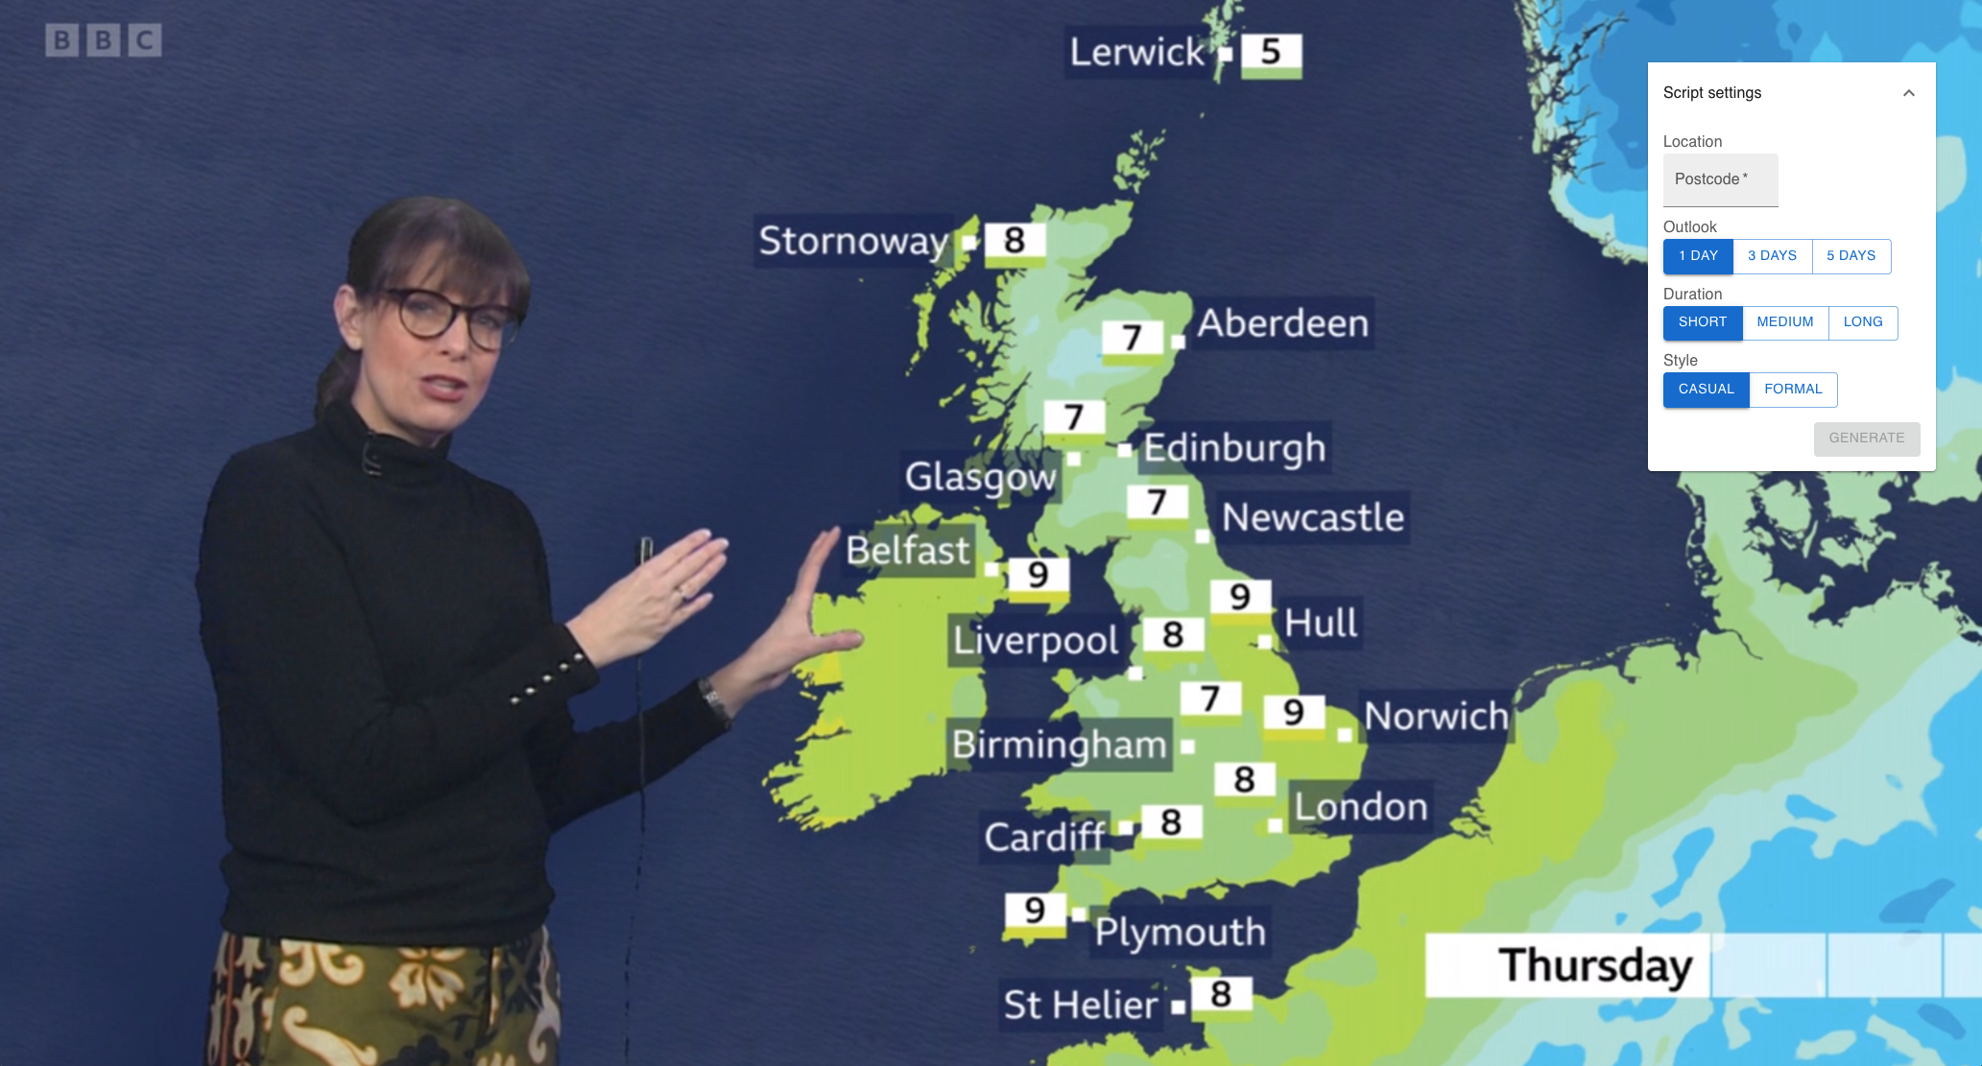
AI4ME Project
Future Personalised Object-Based Media Experiences Delivered at Scale Anywhere
Stream 2
Stream 3
Personalised
Media for All
Audio/Video
Object Capture and Represent-ation
Object-Based
Production
Compute-Aware Network Delivery
Objects
+ Scene Metadata
Objects
+ Production Metadata
Intelligent Production of Personalised Media Experiences
New AI-powered tools and techniques to help content creators produce personalised media experiences
Quality modelling and editorial intent encoding to guide experience adaptation
GPT-generated weather forecast

Slide 7
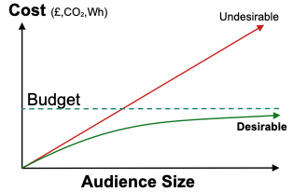
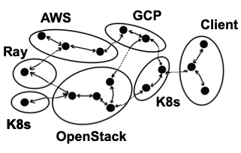
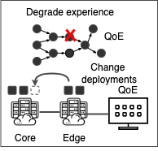
AI4ME Project
Future Personalised Object-Based Media Experiences Delivered at Scale Anywhere
AI Network Challenges
Stream 2
Stream 3
Stream 4
Personalised
Media for All
Audio/Video
Object Capture and Represent-ation
Object-Based
Production
Compute-Aware Network Delivery
Objects
+ Scene Metadata
Objects
+ Production Metadata
Intelligent Personalised Media Delivery at Scale
AI-powered technologies to deliver personalised media content cost-effectively and efficiently to mass audiences
Technologies for distributed execution and intelligent placement of media applications and rendering services
Intelligent provisioning &
Orchestration
Real-time adaption
& optimisation
Sub-linear scaling

Slide 8
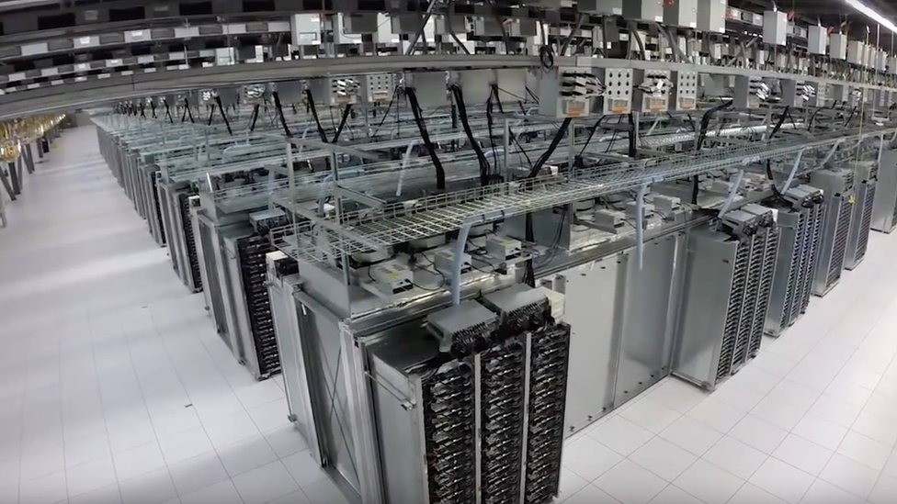
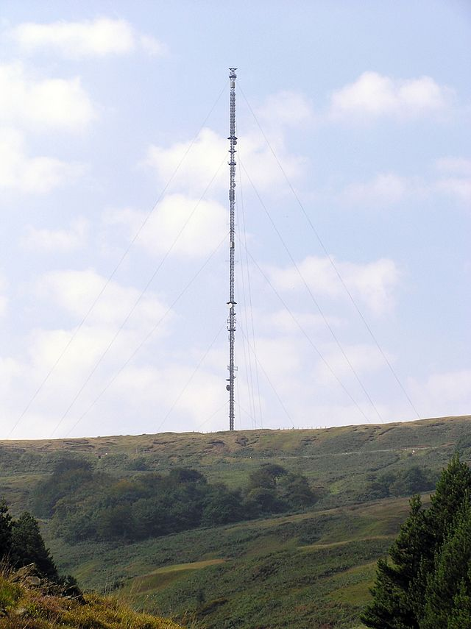
Intelligent Personalised Media Delivery at Scale
Context
Personalised media applications (= media objects + code) needs compute
Compute not materialising fast enough in TVs (but available in the cloud)
Achieve universal access by offloading compute to cloud …
… however scaling up compute in the cloud is prohibitively expensive for mass audiences
To deliver 1 hour per day of content to 20m people using cloud rendering service (Furioos, 0.04 Eur/min) would cost about £16Bn per year, i.e. over 80x the current distribution cost –
4x the BBC’s current total expenditure.
BBC distribution costs were £185m in 21/22
Notes:
Signpost CATS applicability

Slide 9
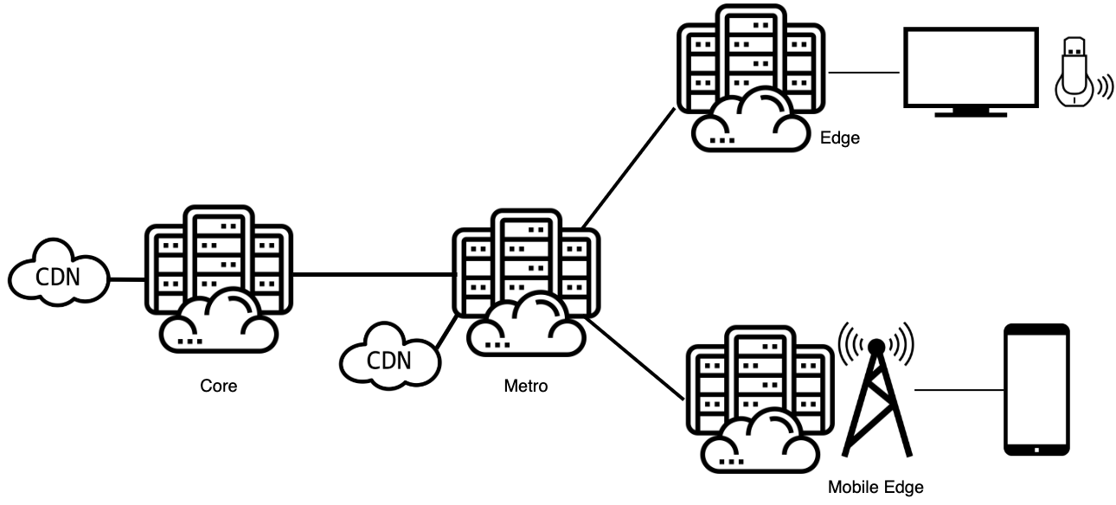
Flexible Compute and Delivery
Service
Compute
Compute Fragment
Compute Fragment
CPU
GPU
Compute
Service
Service
Compute
Compute
CPU
GPU
GPU
GPU
CPU
GPU
GPU
Compute Fragment
Compute Fragment
Compute
Compute
CPU
GPU
CPU
GPU

Slide 10
Network Challenges
AI4ME Compute-Aware Network Delivery Objectives
“Build a distributed self-adaptive platform for cost-effective/efficient delivery of personalised experiences to mass audiences”
Personalised OBM applications (= media objects + code) need predictable connectivity to compute resources for offloading compute fragments
Current approach of static assignment and centralised compute cloud to devices does not scale up efficiently and cost-effectively, for AI4ME services
Compute and storage nodes should be able to move very freely, throughout the entire delivery pipeline
Enablers: edge/metro DCs, virtualised GPUs, cloud-gaming, software-defined networking, traffic-steering for network predictability
Decision on where to move compute or when to provision more resources is complex in a large dynamic distributed system.
Need to adapt application and deployments to real-time availability of resources before and during execution

Slide 11
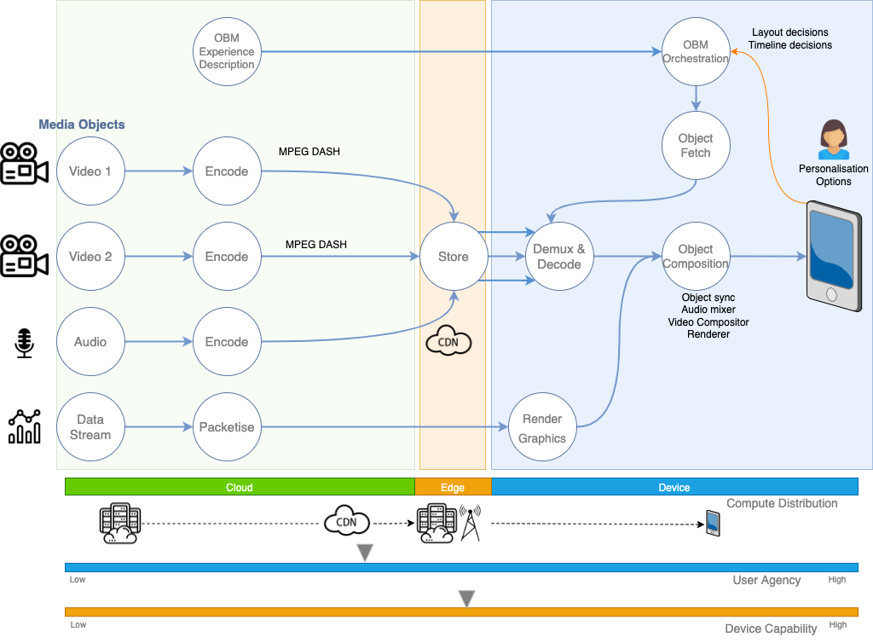
Typical OBM Deployment
Relatively powerful end-user device
Composition of media objects able to run on device
Moderate user agency
Production processes and media-object-conditioning run in the cloud
Scaling up: more CDN PoPs
Notes:
Update diagram

Slide 12
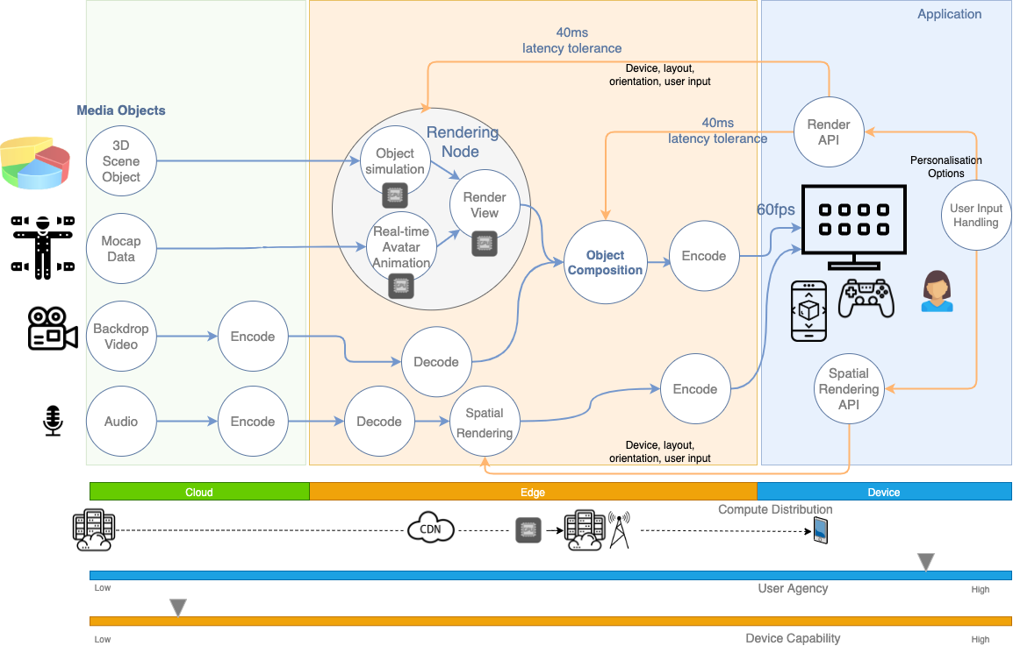
Personalised OBM Deployment
Low device capability
User navigating around 3D scene
Tasks likely to be compute-intensive and require accelerators
More user agency, low-latency constraints
Real-time rendering at edge DC
Notes:
Leave prev.and current slide for COIN

Slide 13
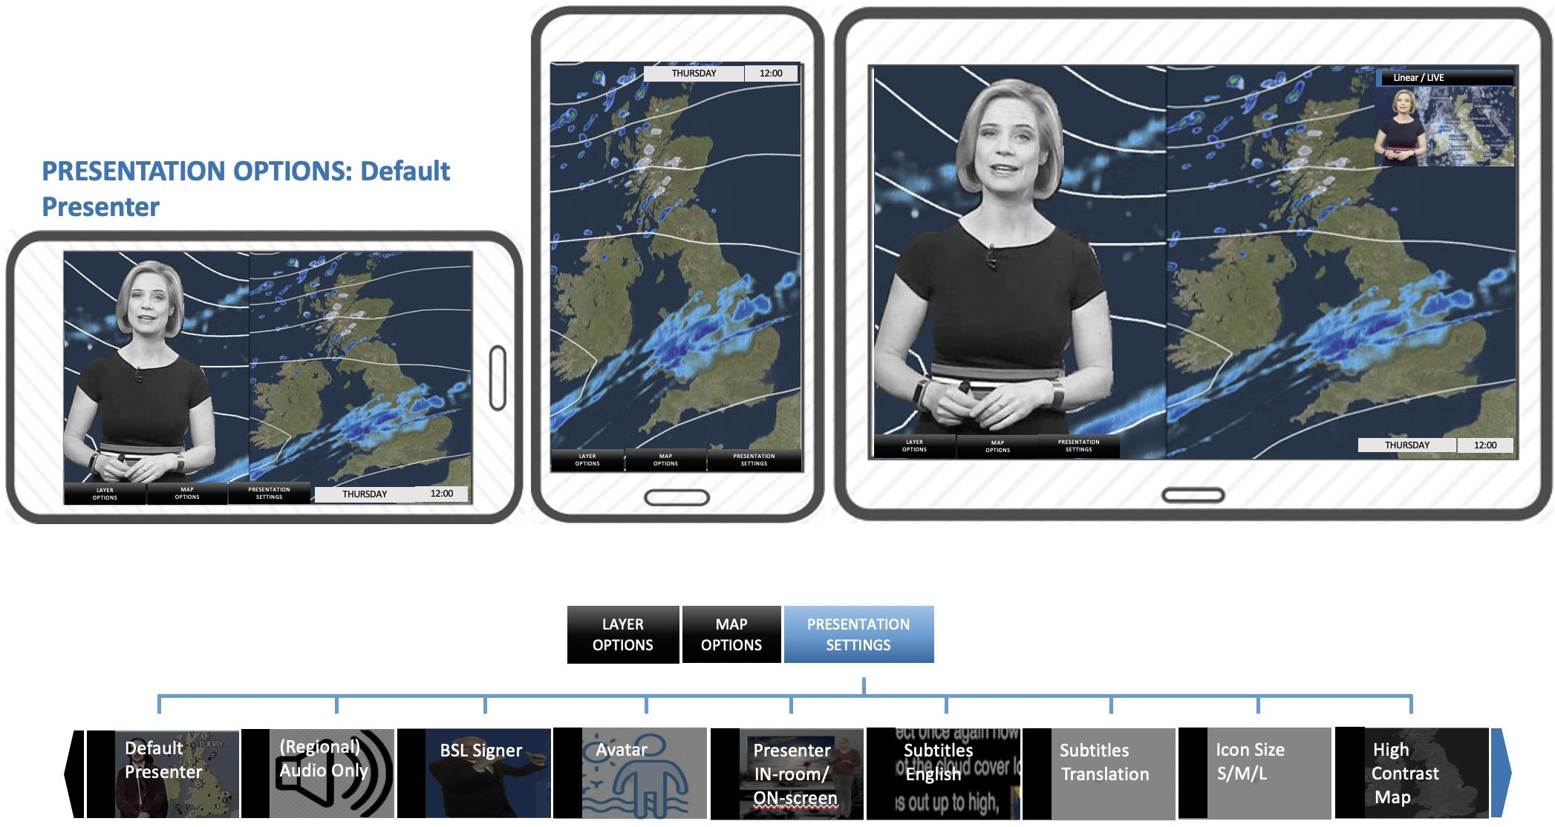
Use Case 1: Weather Forecaster
An audio-visual weather forecast with explicitly-controlled personalised layers and implicitly-controlled layout. The viewer can toggle the presenter and the signer on and off, and the layout of objects on the screen adapts to device orientation.
What objects are needed?
Foreground video and audio (people); (timed) foreground graphics; background; subtitles
Production requirements
On-demand; data-driven; timelines
Delivery requirements
CDN hosting of content; multiple video decode and chroma-keying; QoE metrics capture; intelligent compute placement and DASH feed generation; GPUs for map rendering and synthesising humans
Notes:
Possible to show a distributed pipeline of FFlex with the 3 different offloading scenarios

Slide 14
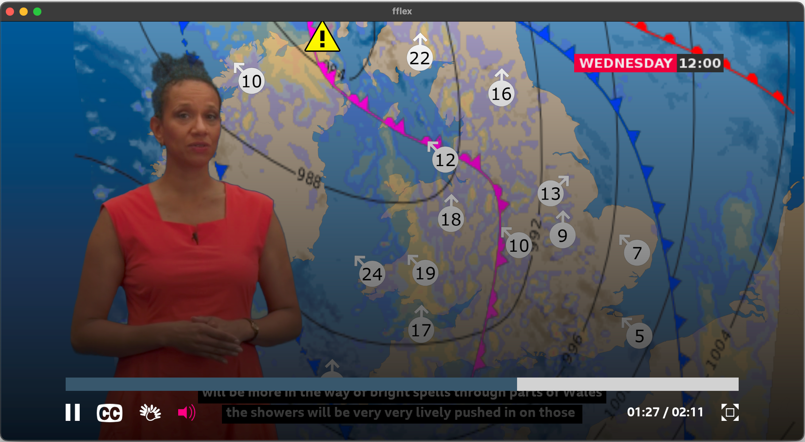
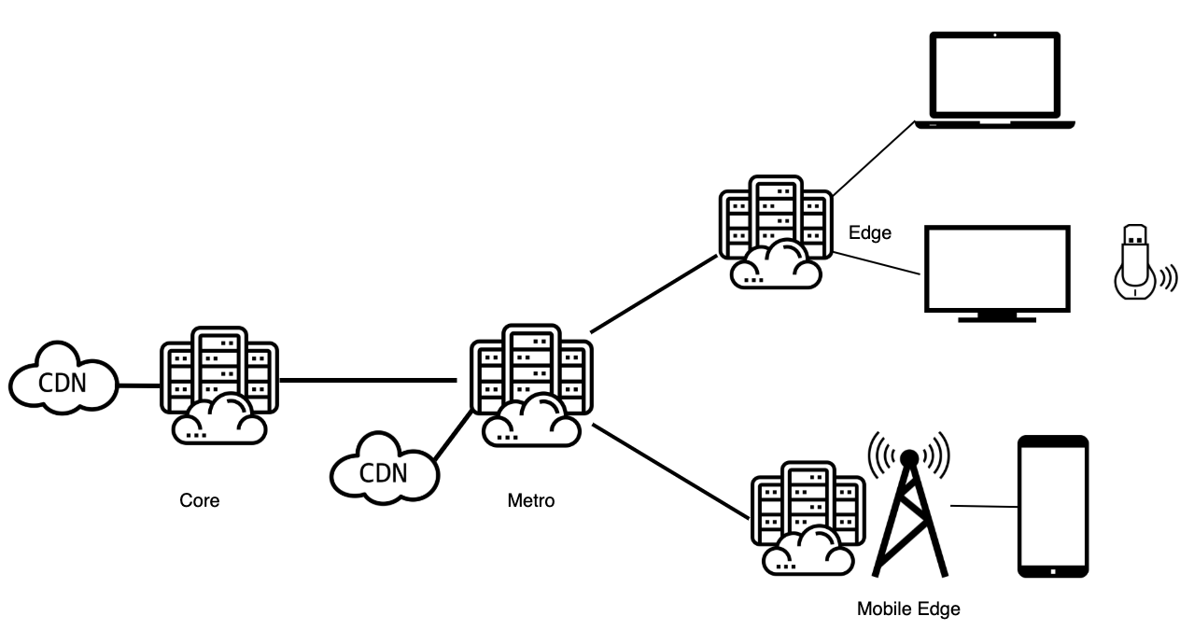

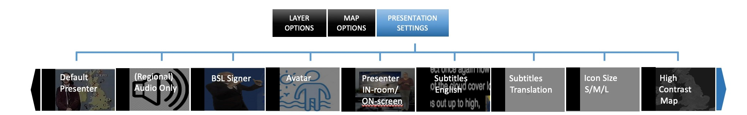
Use Case 1: Weather Forecaster
Subs
Image
Tiled Map
Video
Audio
Object Server
Appearance Calc.
Cmd-List Gen.
GUI
User Input
Compositor
Renderer
Presenter
Synth.
Subs
Image
Tiled Map
Video
Audio
GUI
User Input
Compositor
Renderer
Rendering and composition run on capable device
Compositor-Client
Regional Presenter
Synth.
Subs
Image
Video
Audio
Tiled Map
GUI
AV Player
All compute-intensive operations offloaded
and results are pixel-streamed
User Input
Compositor
Renderer
Pixel-Streaming-Client
Tiled Map
Renderer
Subs
Image
Video
Audio
Regional Presenter
Synth.
GUI
Only weather map rendering is offloaded
User Input
Compositor
Renderer
Map-Offloaded-Client
Notes:
Show coalescing pipelines

Slide 15
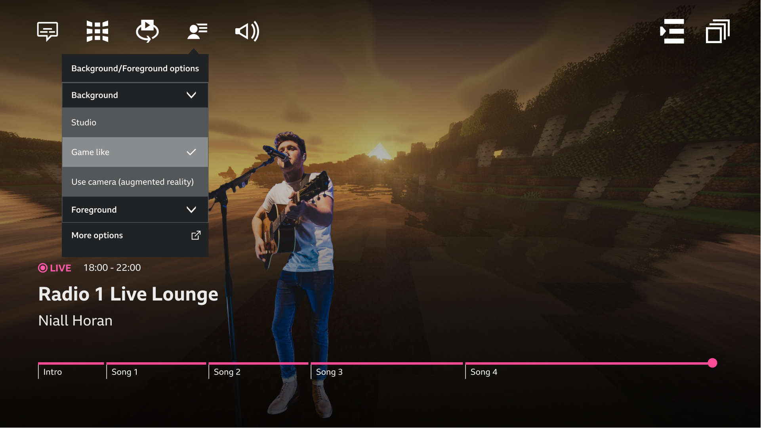
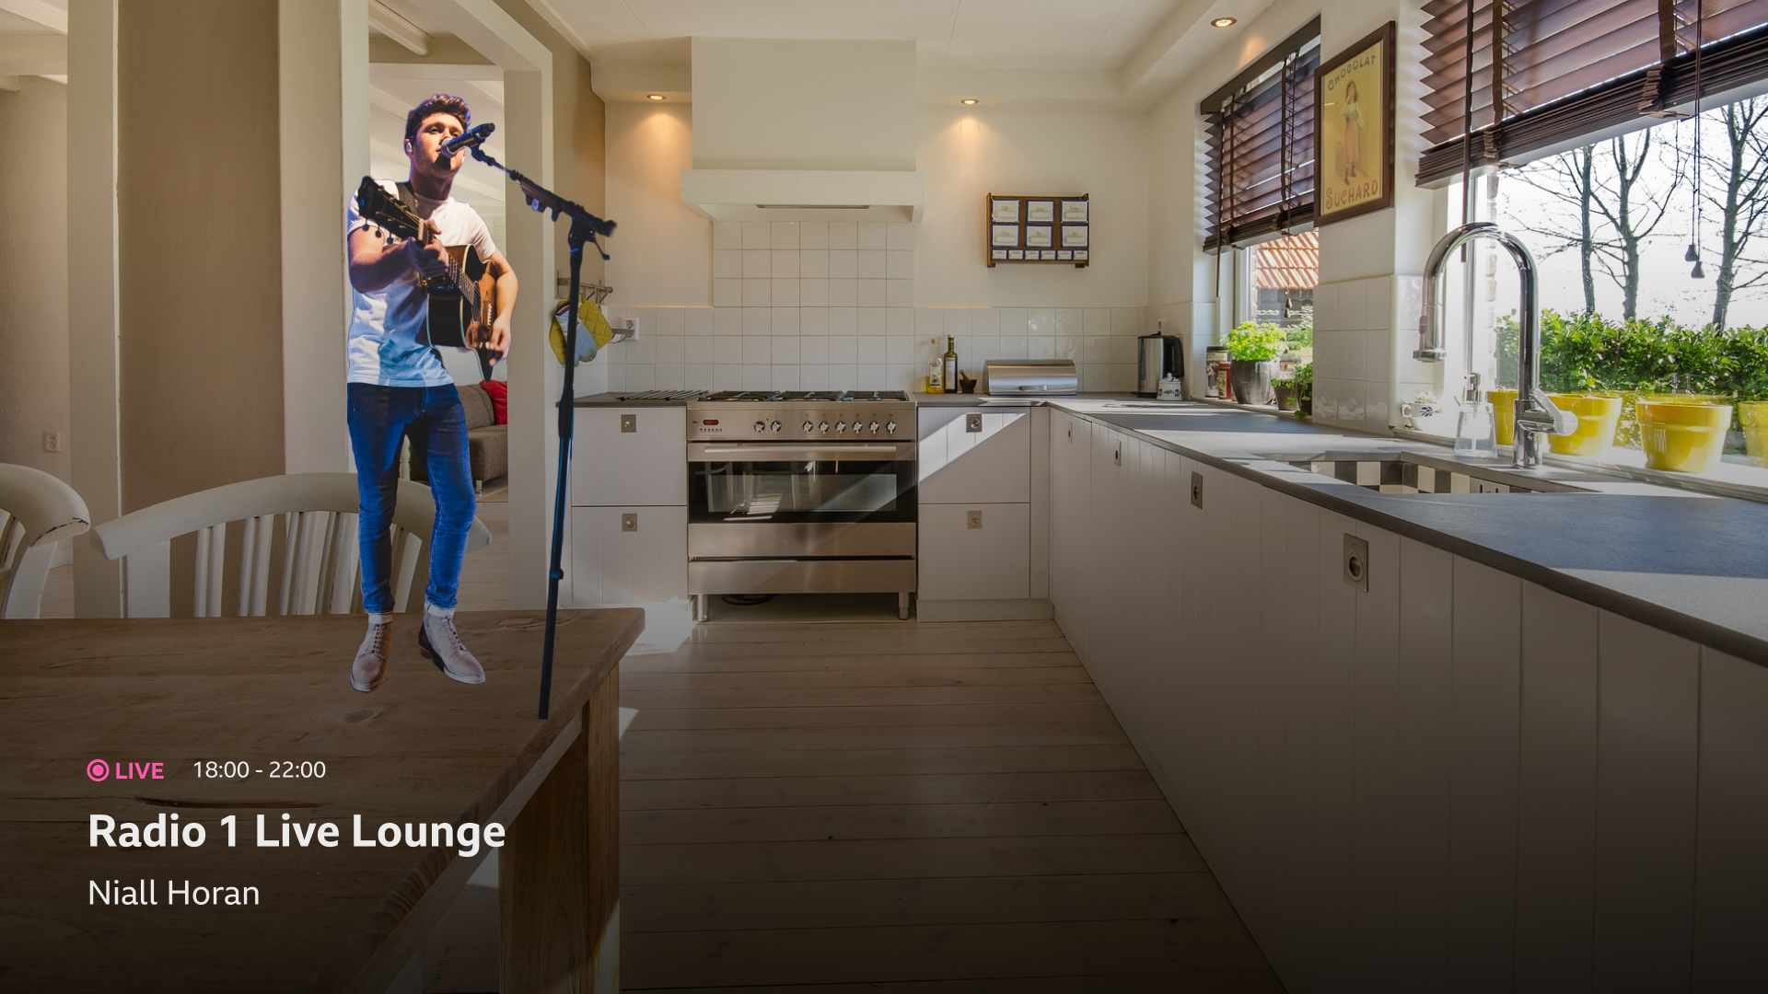
Use Case 2: Music Live Lounge
Change the background options
Place performer in 3D environment
Augmented reality
e.g., Volumetric capture of studio set; Synthetic environment (Band’s aesthetic).
e.g., User’s room/garden (‘Music Festival in your back garden’

Slide 16
AI4ME Service Resources
Streaming AI4ME OBM to many users requires a combination of hardware and software resources to ensure a smooth and high-quality streaming experience
The key types of software resources that are used for a service, include:
Content Servers (Cloud Containers): for OBM processing, generating additional content (titles, AR) and streaming
Content Storage: High-capacity storage to store UHD OBM video files – over a distributed file system
Content Management System (CMS): A CMS to organise and manage OBM content, including metadata, thumbnails, and access controls
CDN Components: Schedulers, load balancers, cataloguers, caching nodes
Content Encoders and Transport: Pixel streamers, low-latency bidirectional comms with users
GPU/CPU Resources: Rendering engine, ML-based inference and transcoding
Memory: Significant RAM is necessary to buffer and process video streams efficiently, at scale
DRM Services for content and copyright protection
Notes:
Delete slide

Slide 17
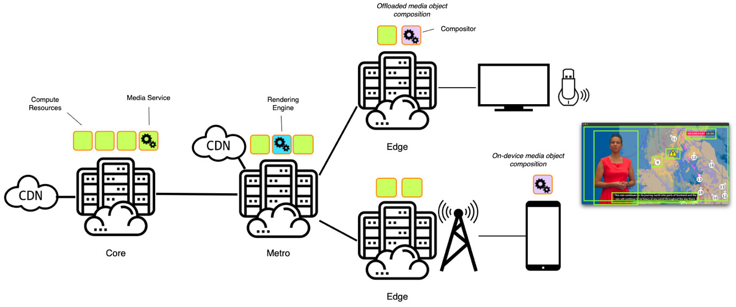
Network Architecture and Functions
AI4ME High-level Network Architecture

Slide 18
AI4ME Network and Service Metrics
Meeting the QoE objectives for the different type of AI4ME services will require cooperation of the AI4ME (Cloud) Orchestrator and Network Controllers, to create efficient Service Instances based on several multi-dimensional objectives and metrics
Cloud Resource Availability Metrics
Service Response Time
CPU and GPU Availability and Utilisation Metrics
Memory usage and Rendering Engine Load
Service Instance Latency Metrics
Existing Number of Users, Maximum Number of Users supported by a Service Instance
Storage Node Metrics
Capacity and Current Load
Maximum number of Connections Supported
Service Network Latency, Jitter, and Bandwidth
CDN Infrastructure Metrics
CFN Hit Rate, Miss Rate, Latency, Throughput, Bandwidth Usage, Error Rates

Slide 19


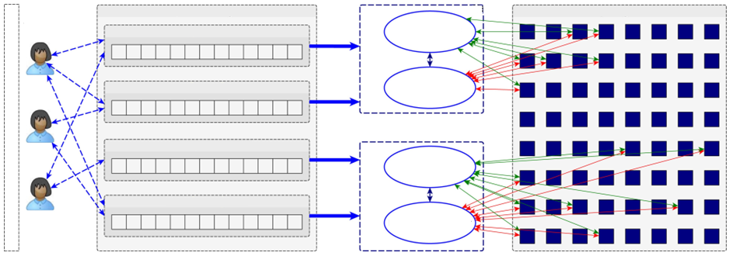


Placing Jobs
Cloud Orchestrator will create and manage AI4ME service instance deployments
As jobs are requested, the computational demands are also identified, and users are assigned to AI4ME service instances
Network Controller will direct traffic to an available Service Instance, optimising OBM content delivery and reducing user latency
Network Controller
AI4ME Cloud Orchestrator
Metro
Metro
Object Media Queue Manager
Job
Scheduler
Compute & Object Resource
Core
Personalised Media Queue 1
Resource
Allocator
Personalised Media Queue 2
Metro
Users
Personalised Media Queue 3
Job
Scheduler
Personalised Media Queue 4
Resource
Allocator

Slide 20
AI4ME and CATS Next Steps?
Can we agree Compute Metrics and methods for collecting and distribution?
What does the AI4ME Application need to know?
What can the Cloud Resources report?
Metrics might include:
CPU and GPU Availability and Utilisation
Storage Capacity, Current Load and Maximum number of Connections
Response Time
Can we also agree Network & Service Instance Metrics and Methods for Collecting and Distributing?
Service Instance Network Latency and Jitter
Does our network architecture and AI4ME services overlap with existing IETF CATS objectives?
Is there commonality with requirements?
Should we document our use case in an Internet-Draft or seek to provide a contribution to the existing use case document?

Slide 21
Questions/Discussion
Rajiv Ramdhany (BBC) – rajiv.ramdhany@bbc.co.uk
Nick Race (Lancaster University) - n.race@lancaster.ac.uk
Daniel King (Lancaster University) – d.king@lancaster.ac.uk

