Slide 1
Problem Statement and Requirements of end-to-end CATS
draft-yuan-cats-end-to-end-problem-requirement-01
Dongyu Yuan | ZTE Corporation
Huijuan Yao | China Mobile
Zhiqiang Li | China Mobile
Fenlin Zhou | ZTE Corporation
Xuewei Wang | Ruijie Networks Co.,Ltd
IETF-118, Nov 2023

Slide 2
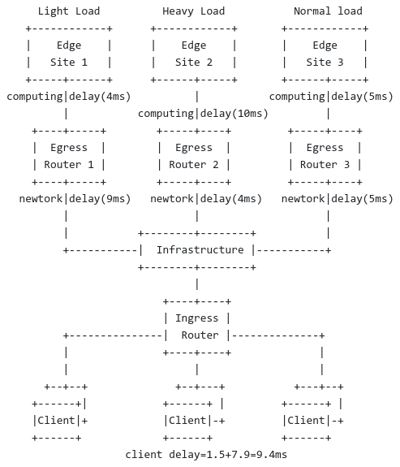
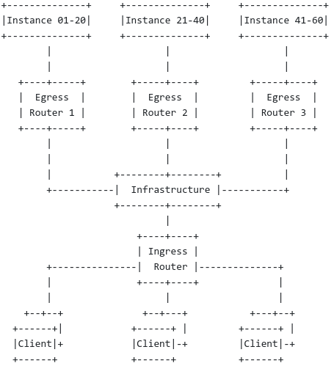
Usecase of distributed ubiquitous instances
Computing-Aware Traffic Steering (CATS) Problem Statement, Use Cases, and Requirements
draft-ietf-cats-usecases-requirements-01
large amount of ubiquitous service instances

Slide 3
Sample and Distribute
Instances | Metrics
Instance 1 | Metric₁(t₁) | Metric₂(t₁) | ...
 | Metric₁(t₂) | Metric₂(t₂) | ...
 | Metric₁(t₃) | Metric₂(t₃) | ...
 | ... | ... | ...
Instance 2 | Metric₁(t₁) | Metric₂(t₁) | ...
 | Metric₁(t₂) | Metric₂(t₂) | ...
 | Metric₁(t₃) | Metric₂(t₃) | ...
 | ... | ... | ...
<Computing Delay, Load, Connections, Bandwidth Utilization, ...>
CATS Routers × Average Instances per CATS Router
Problem 1. Large amount of dynamic entries are required to be recorded and maintained in the control plane for CATS routers.

Slide 4
RR for Load Balance among Instances
Instance 1
0-10s
Instance 2
10-20s
Instance 3
20-30s
Instance 4
30-40s
...
Instance
...
Instance
...
Time Slot 1
Time Slot 2
Egress Router 1
Egress Router 2
Time Slot = Time Slot 1+Time Slot 2+...
Ingress Router
Client
Problem 2. Quick updates for optimal service instance selection.

Slide 5
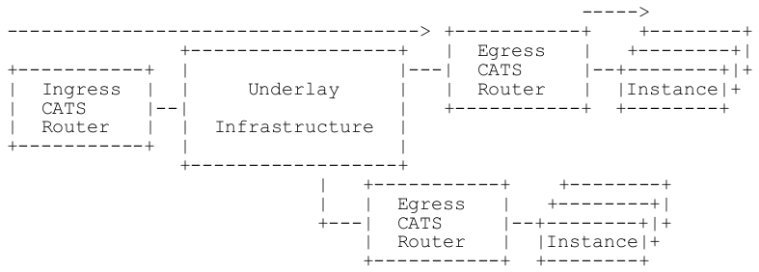
2)Distribute 1)Aggregate
Instance 1: Computing Delay
Instance 2: Computing Delay
Instance 3: Computing Delay
Instance 4: Computing Delay
......
Sample and Distribute
CATS Router
Best/Average/... Performance as the representative of a CATS Router
CATS Router 1:
Best/Average/... Computing Delay

Slide 6
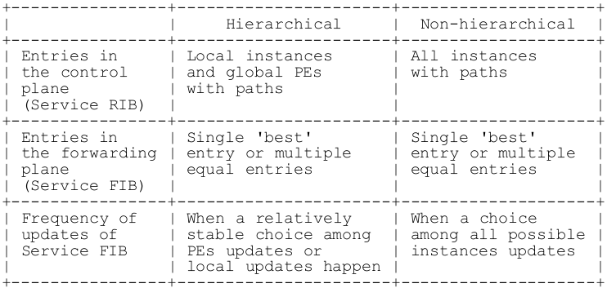
Requirements for CATS Network
R8: MUST provide mechanisms for metric collection.
R9: MUST provide mechanisms to distribute the metrics.
R10: MUST realize means for rate control for distributing of metrics.
Values and advantages：
Reduce the entries collected, stored and maintained in the control plane.
Decline the frequency of entry updates and damp service route recalculation.
R: SHOULD provide mechanisms to aggregate service metrics for distribution.

Slide 7
Next Steps
Refine the drafts upon comments and suggestions.
More comments, suggestions and contributions would be welcome.

