Slide 1
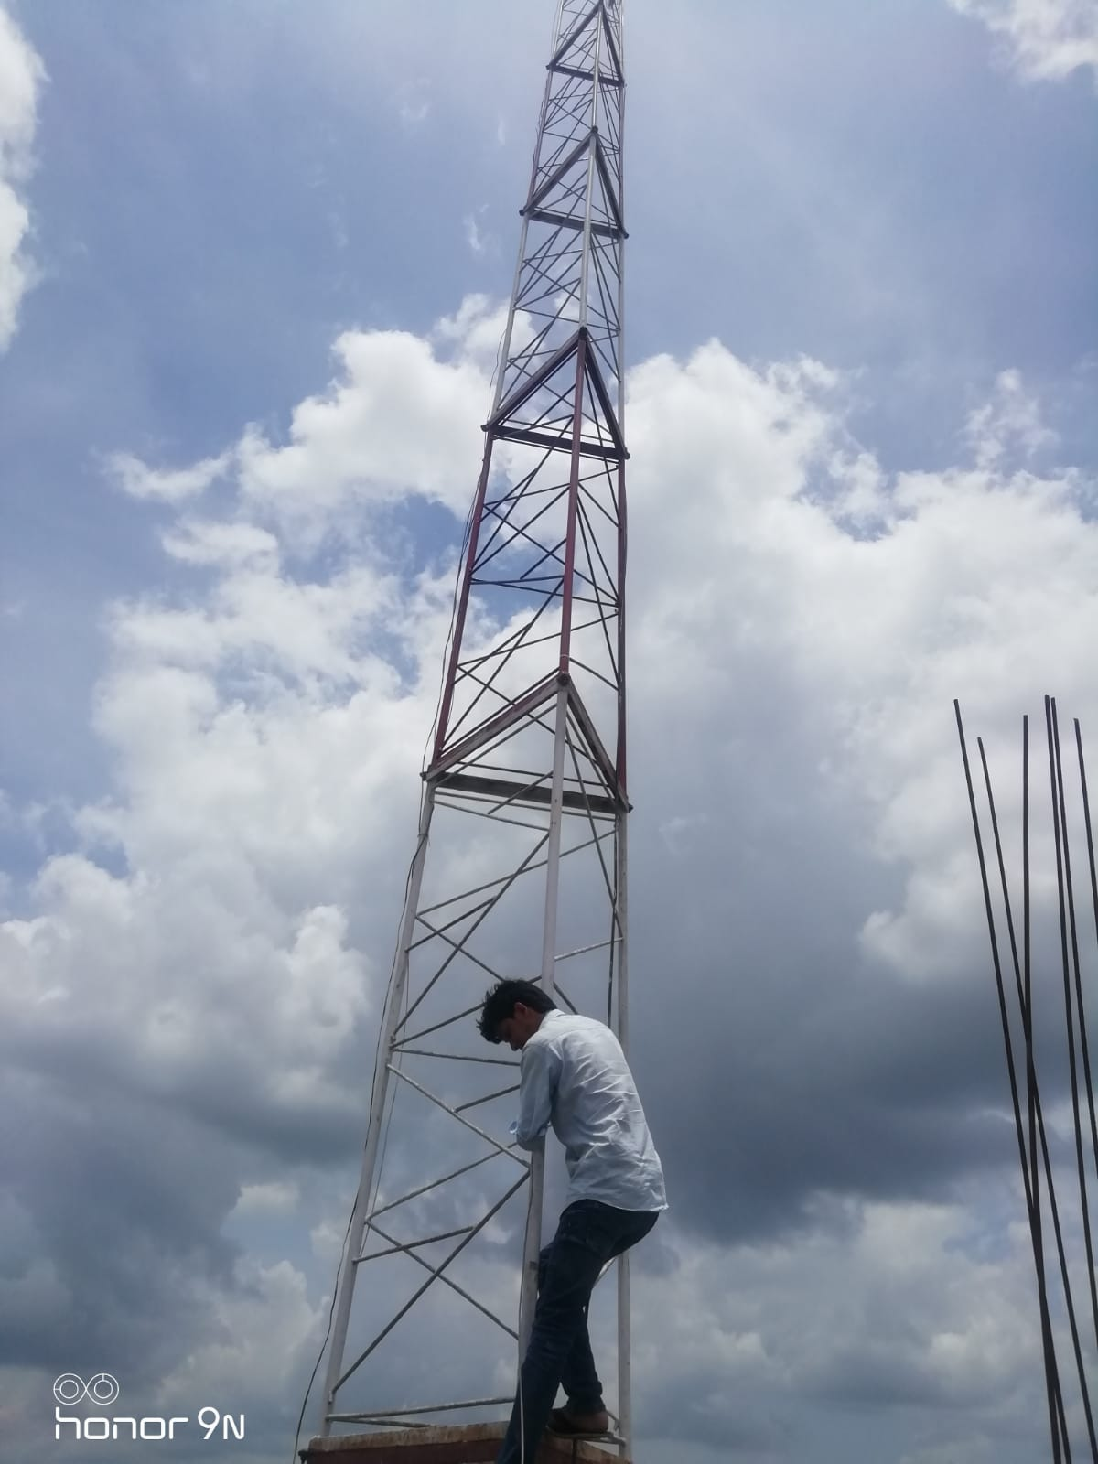
Community Radio and Community Networks
CR Bolo: Hybrid connectivity model to strengthen the rural connectivity
Global Access to the Internet for All (GAIA)
Ritu Srivastava
IEEE and Jadeite Solutions

Slide 2

1
Landscape of CRs and CNs
Over 40,000 community radio stations worldwide
India | 480+
Bangladesh | 18
Nepal | 360
Philippines | 1000
Thailand | 3900
South Africa | 290
Australia | 450
Ghana | 20
Kenya | 55+
Uganda | 22
So on… in other countries
There are over 100 community networks worldwide
India
Nepal
Philippines
Thailand
South Africa
Kenya
Uganda
Myanmar
Nigeria
Indonesia
So on… in other countries
Community Radio Stations are managed by the community owned organizations to generate and produce local content.
Community networks are bottom-up network approach based on community-driven infrastructure development to connectivity, and challenge the classic top-down operator-driven paradigm

Slide 3
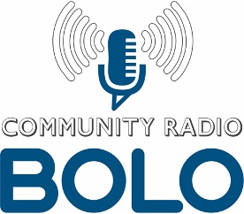
Community Radios Vs Community Networks
2
CRs
CNs
1. Local language and dialect
2 Able to create local content
3. Ability to have local partnerships
4. Skilled human resource who understands broadcasting and management of content
5. Technical infrastructure such as tower, local server space for storing local content
6. Have a license for broadcasting and SACFA clearance (India)
7. Have purpose/objectivity
1. Have local server to store user logs
2. Have backhaul internet lease line which can be distributed further in local communities
3. Ability to train local communities on digital skills and wireless networks
4. Ability to extend the connectivity
5. Ability to create local repository of local content
6.
Common Attributes between CRs Vs CNs in India
Infrastructure
Technology
Licensing
Local Content
Skilled Human Resource
Community Engagement
Challenges
Economic sustainability
Do not have reliable internet services
Challenges
Tech maintenance
Establishing local partnerships

Slide 4
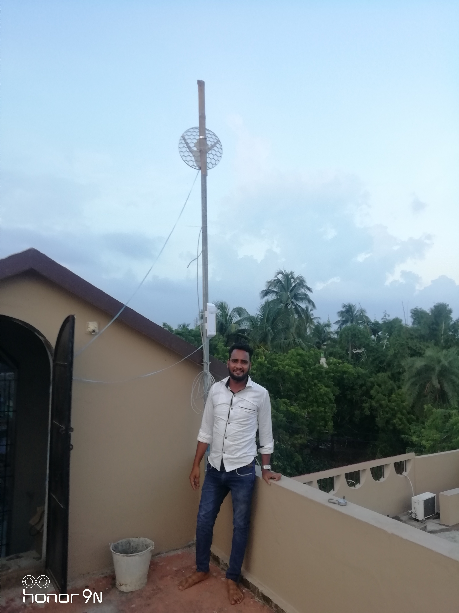
CR Bolo: A hybrid connectivity model for enabling meaningful connectivity and strengthen rural connectivity
3
A cost-effective and community-owned model designed for community radio stations where internet connectivity is scarcely available or telecom dark zones
CR Bolo project is established at Radio Bulbul, rural Orissa leveraging the existing local infrastructure available at CR station. It utilizes height of tower to set up router and other wireless devices and local server for storing the content for bringing the last-mile meaningful connectivity by transforming CR station into Network providers.
Established the P2P (point-to-point) wireless network connecting the Radio Bulbul to 3 schools and 4 SHGs within the radius of 5 to 7 kms by setting up APs (Access Points) in each locations.
Rural communities are able to create and share hyper local content with or without the internet, using the online-offline wireless mesh network.
Establishing a localised communication platform enabled with plug-in-play IVR operating on GSM band and the local network
Creating new possibilities of social and economic empowerment for rural communities while enabling employment opportunities

Slide 5
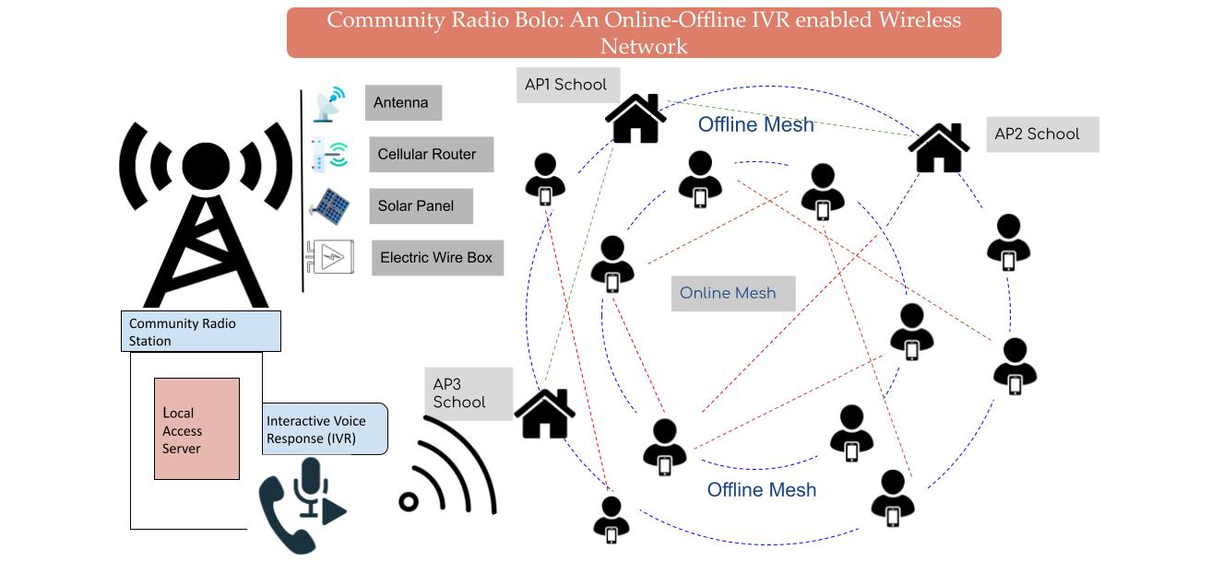
4
CR Bolo: Technical architecture
Low-cost wireless devices: The project uses the low-cost wireless devices such as Microtek, Ubiquity, Airgrid, etc which is easy to procure in the local region
Solar enabled router: Each access point backed up by solar backup router so that the access point received power if electricity is not available.
Using unlicensed spectrum 2.4 Ghz and 5.8 Ghz: for establishing point-to-point network
Open source IVR technology: Using open source IVR ASTERISK for setting up the IVR channel to be integrated with localised D2C platform
In order to establish localised communication platform, we will use tech tools such as Verboice, MojoBol IVR, Kolibri, Jellyfin, BigBlue Button, etc.

Slide 6
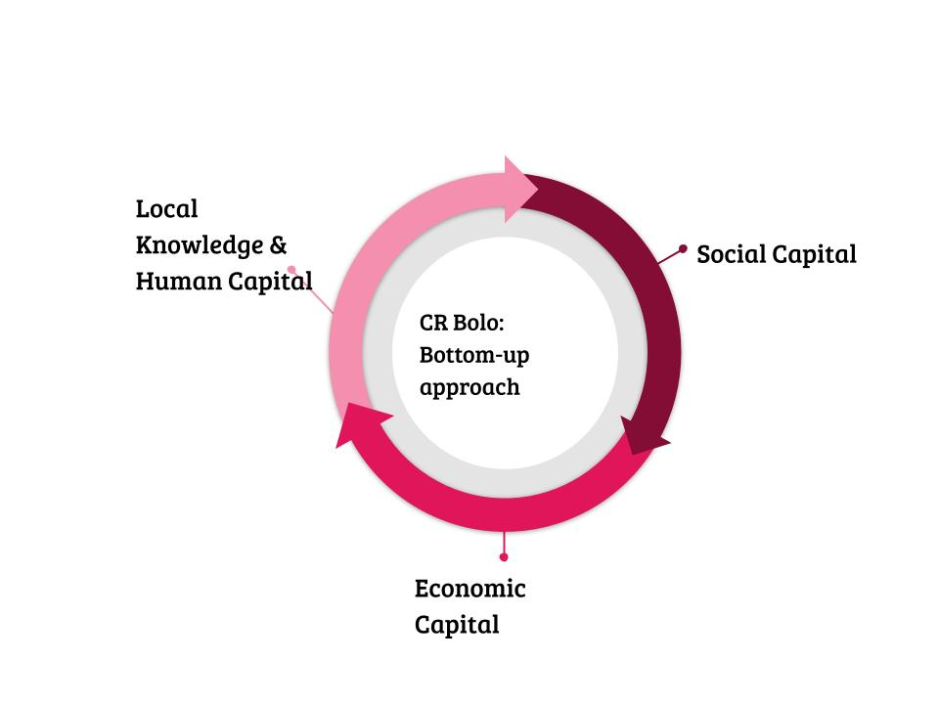
5
Cost and social and human capital
Cost of establishing connectivity in range of 3-5 kms
 | CR Bolo (hybrid network + IVR) |  | Traditional ISP
 | INR | USD | INR | USD
Capex | 28416.7 | 347 | 45833 | 559
Opex | 45000 | 256 | 75500 | 921
Total | 73417 | 603 | 121333 | 1480

Slide 7
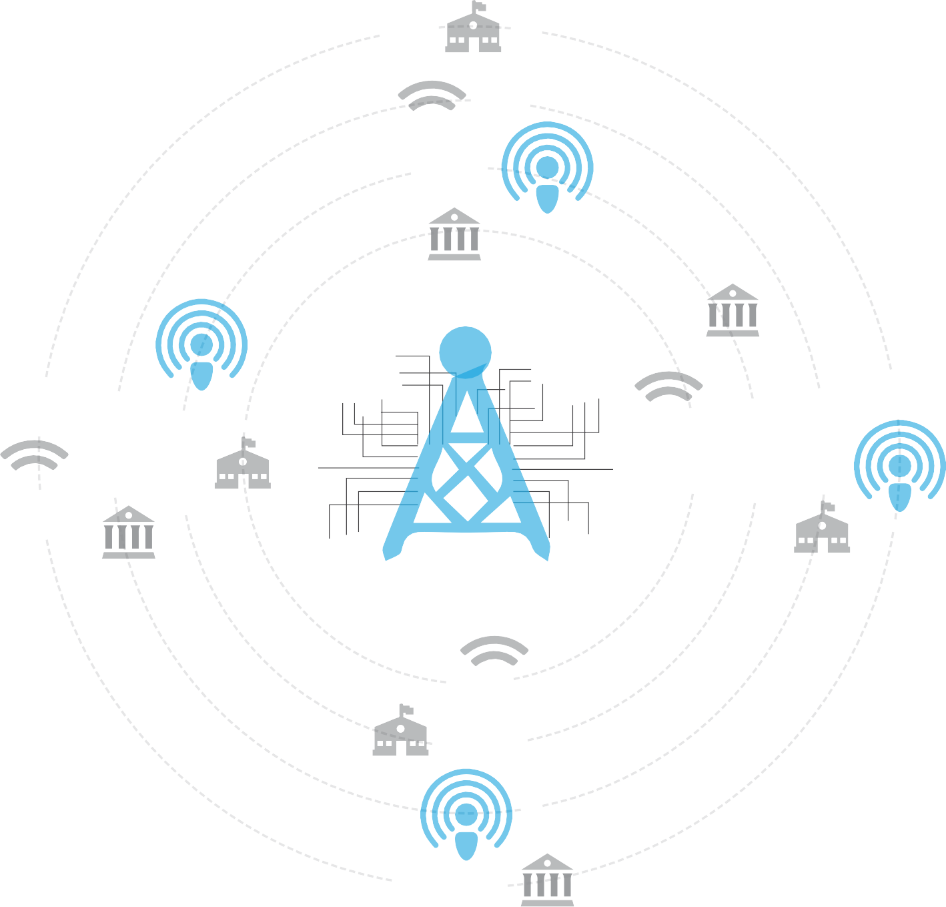


6
Community Radio Bolo: Community ecosystem
Educators
Students
SHGs
H
Outreach of digital literacy
Women
Entrepreneurs
Local NGOs
Staff
Panchayat members
WPAC
Wireless panchayat access point
WHAP
Wireless health access point
H
W PAP
Wireless public access point
Individuals
Households
Insititutions
SHGs
Micro Enterprises
Providing
H
access
connects
WSAP
Wireless school access point
H
Digital literacy centre
Information, entitlement service centre
Financial Inclusion
Digital service centre
Services
5-10 km radius

Slide 8
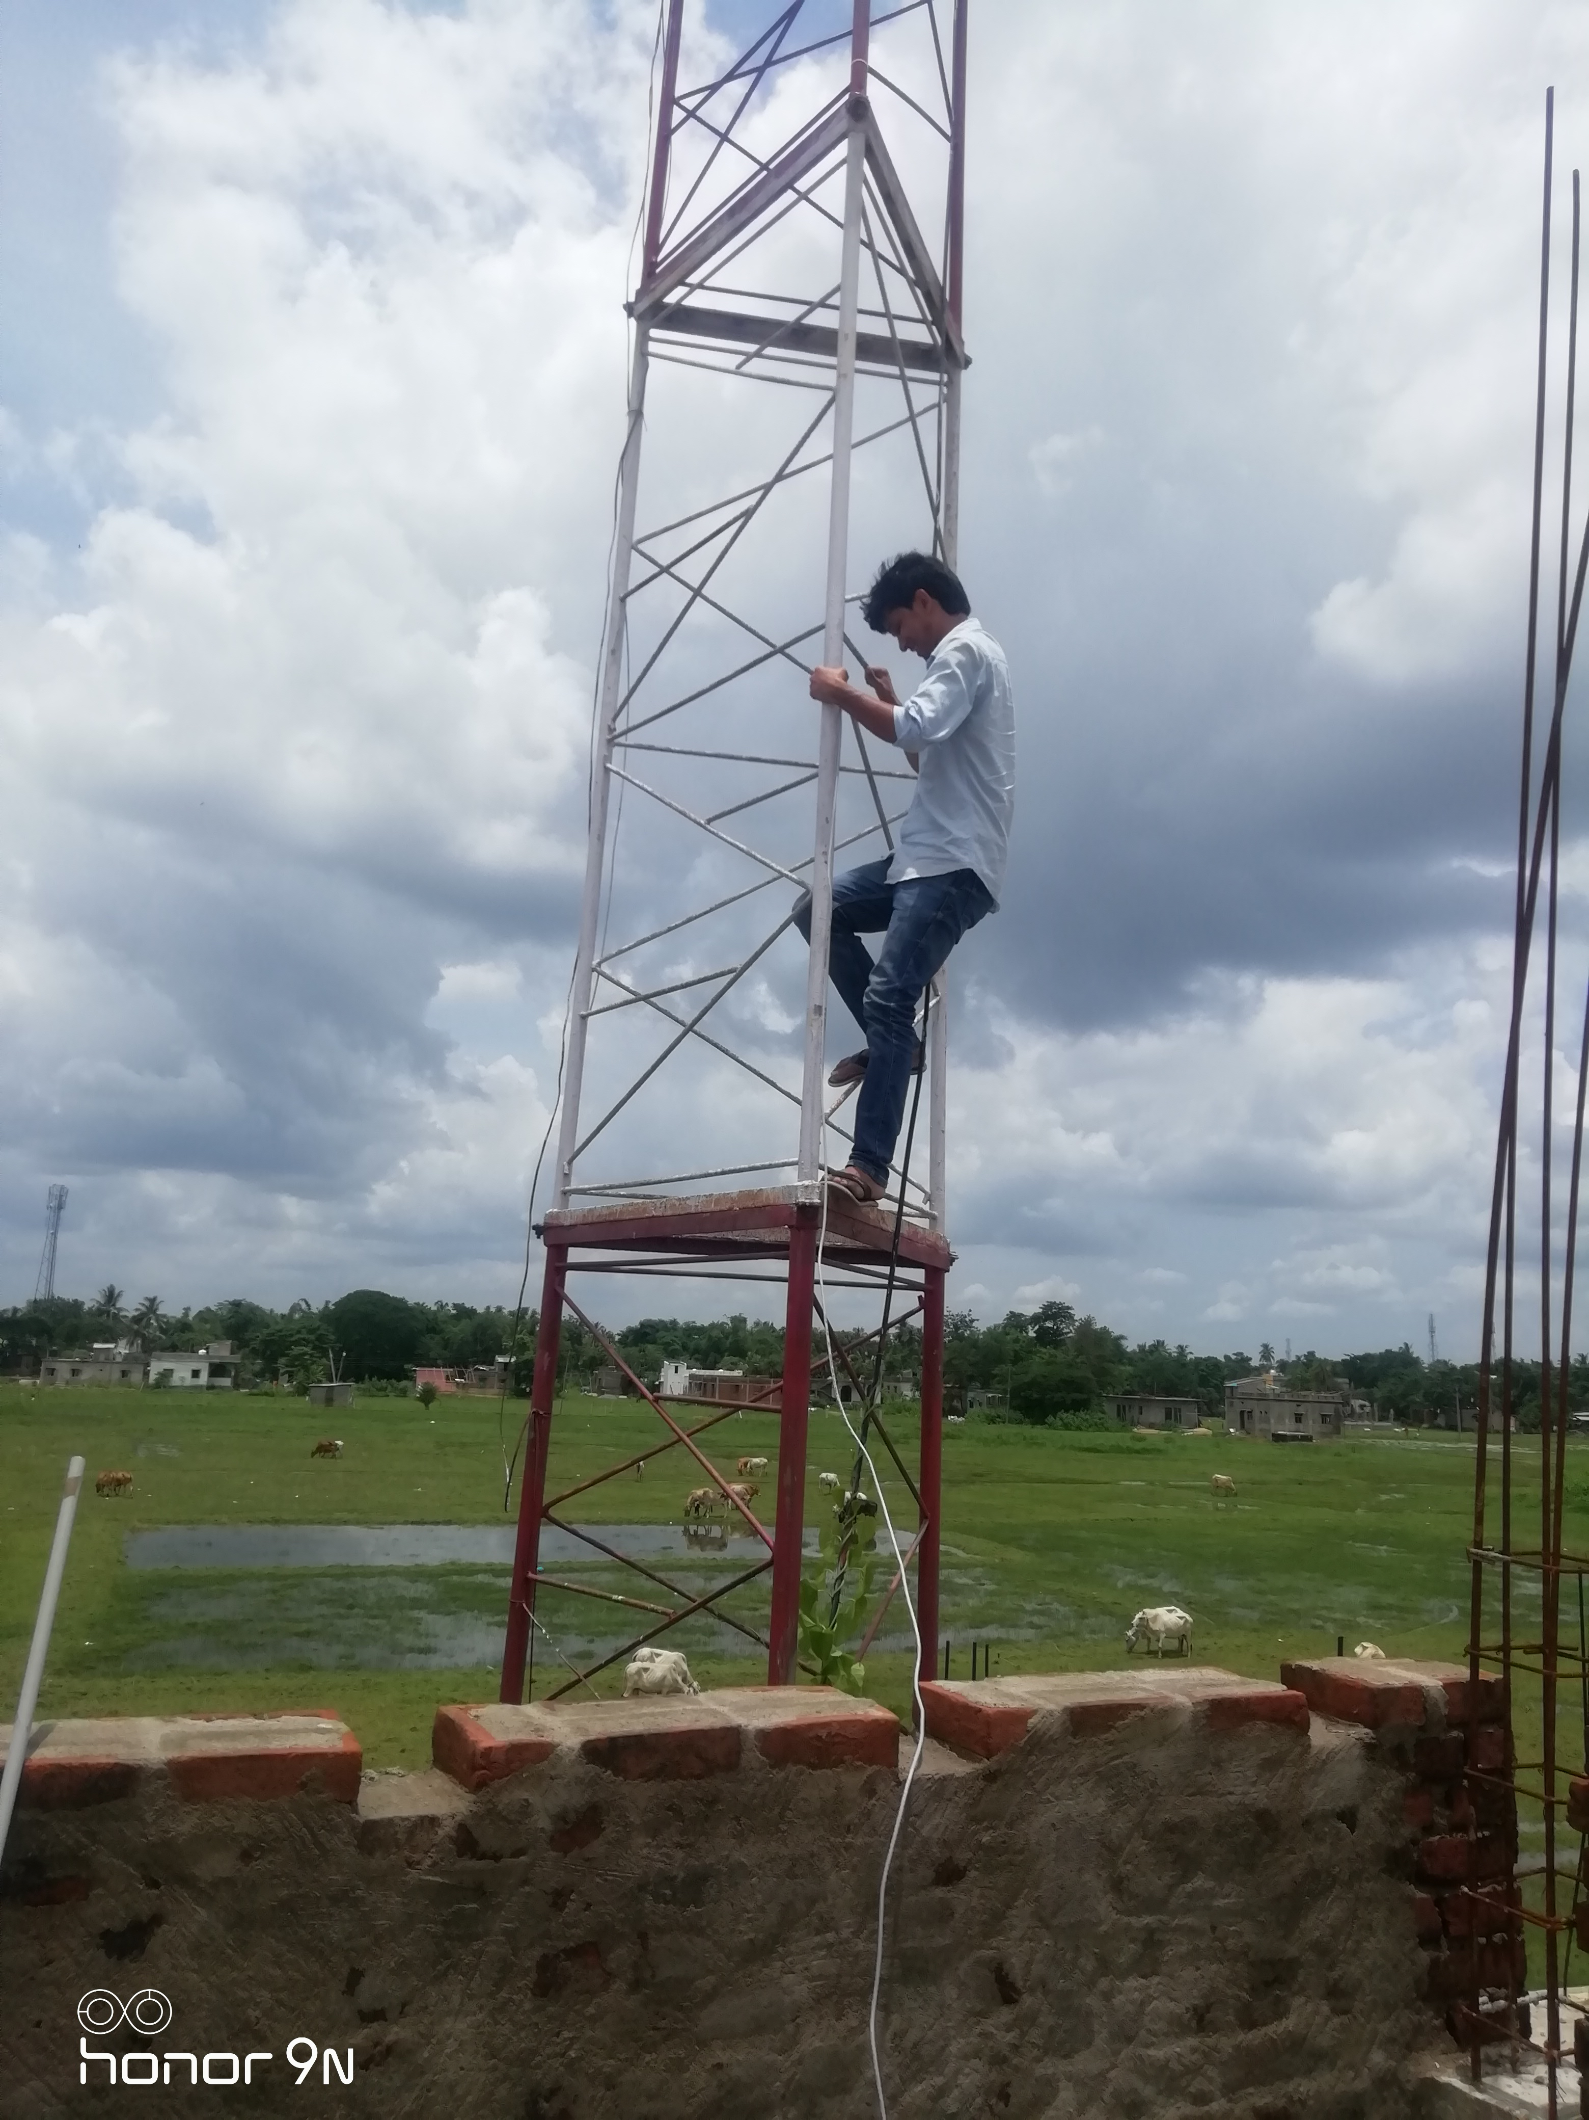
7

Slide 9
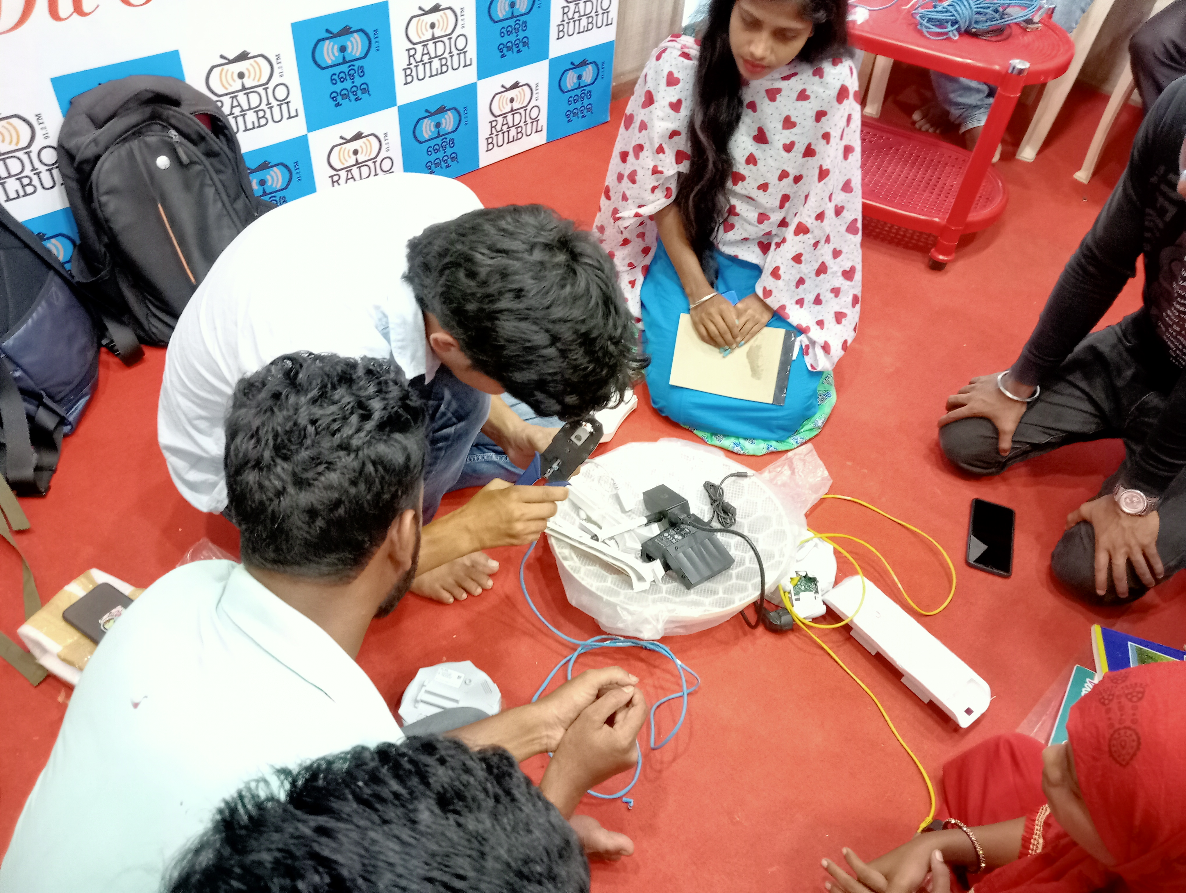
8
Wireless training with Radio Bulbul Staff members

Slide 10


Thank you
ritu.srivastava@ieee.org
ritu.instablogs@gmail.com;
Linkedin: ritusrivastava2208
Project film:
https://www.youtube.com/watch?v=f2eNHMTNI5U

