Slide 1



A Deep Dive into LEO Satellite Topology Design Parameters
Wenyi (Morty) Zhang* Zihan Xu* Sangeetha Abdu Jyothi

Slide 2
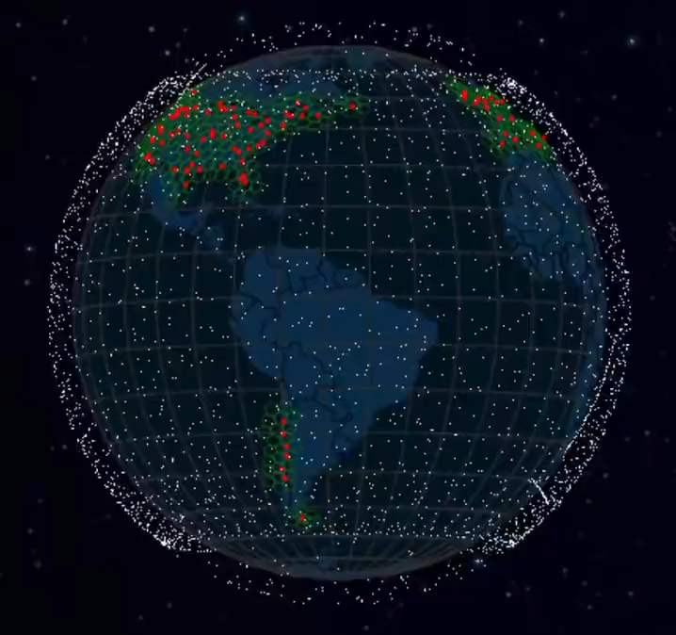
LEO Constellations are Rapidly Growing
Thousands of fast-moving Low Earth Orbit (LEO) satellites.
        Benefits
                High global coverage (especially for remote/marine/aviation users)
            Reasonable speeds (25-220 Mbps per user)
            Low latency & Cost-effective
            Advanced communication technology → Laser-based Inter Satellite Links (ISLs)

Slide 3
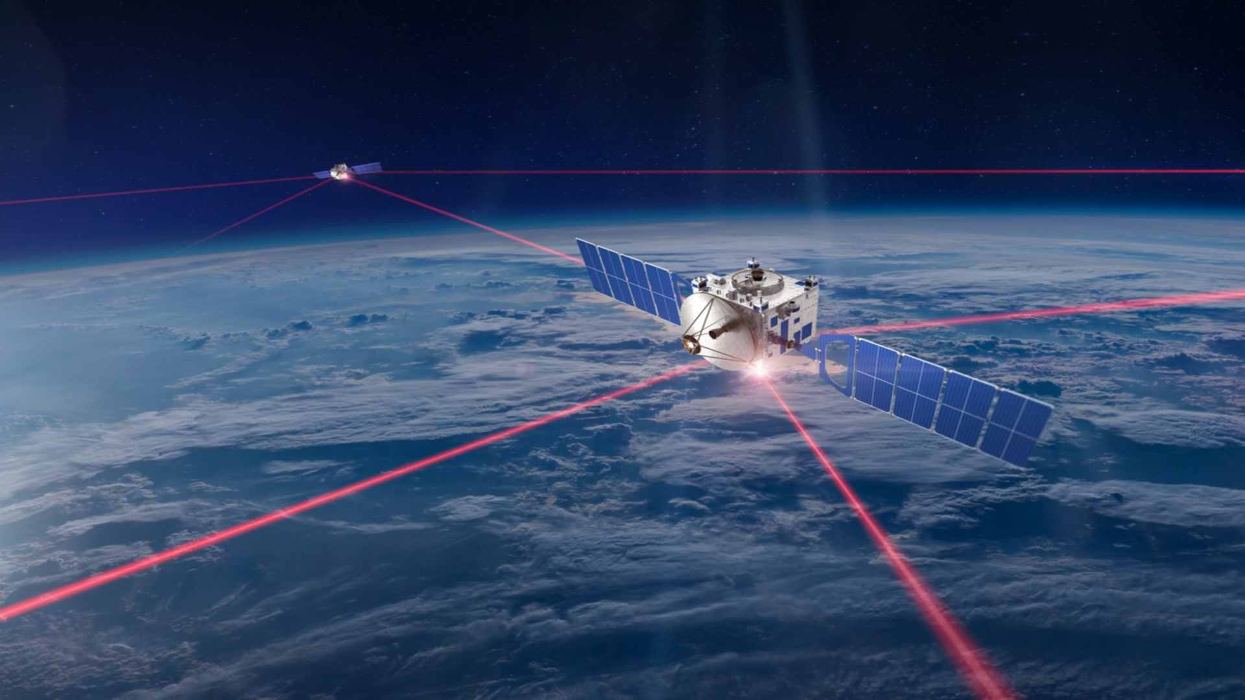
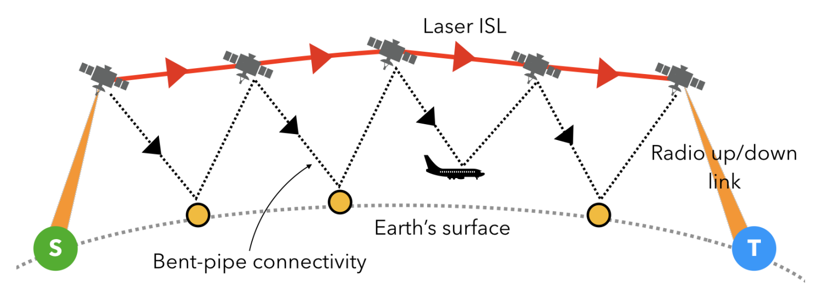
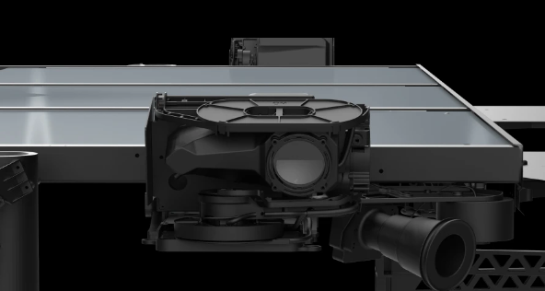
Inter-Satellite Links (ISLs)
“Bent Pipe”
vs
“Inter-satellite Links”
Our paper considers the ISL-based topology
Laser port of Starlink

Slide 4
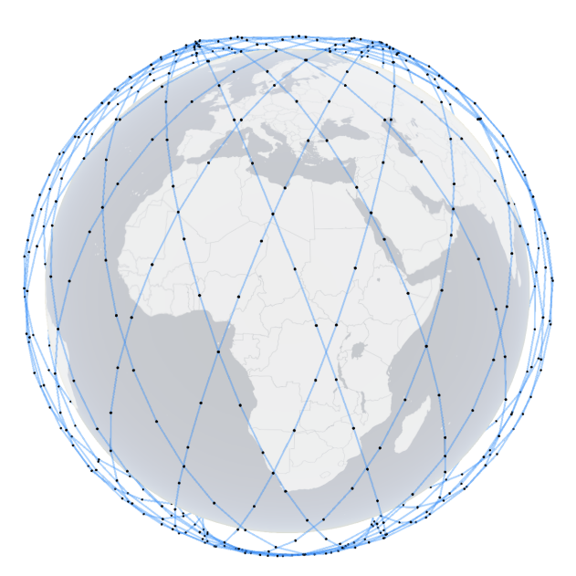

LEO constellations parameters
Satellites In the Same Orbit
Key Parameters
Altitude
Number of Orbits
Number of satellites per orbit
Inclination
Inclination
Equator

Slide 5
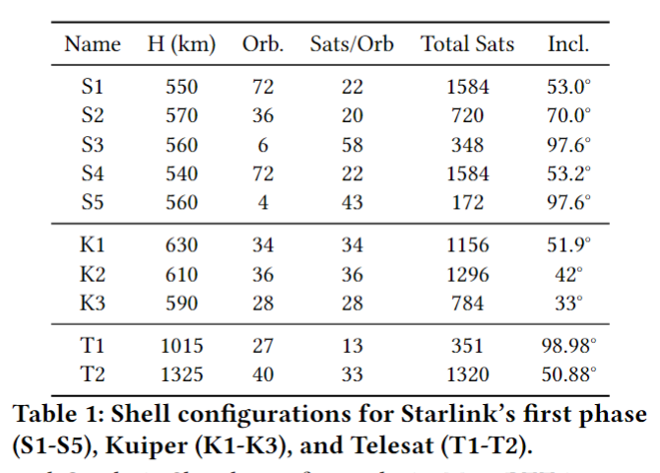
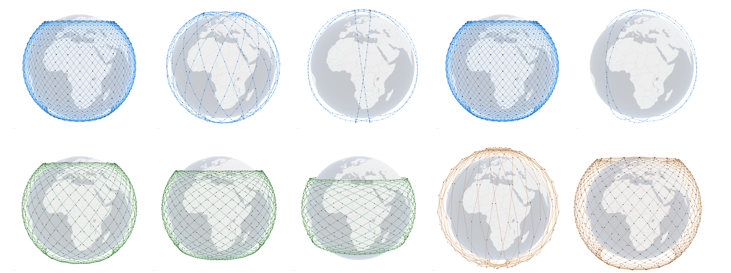
Why are LEO constellations parameters important?
Primary parameters for
different shells of LEO constellations
Visualization of LEO Constellations
Starlink
Kuiper
Telesat
What is the impact of LEO shell configuration parameters on network performance?

Slide 6
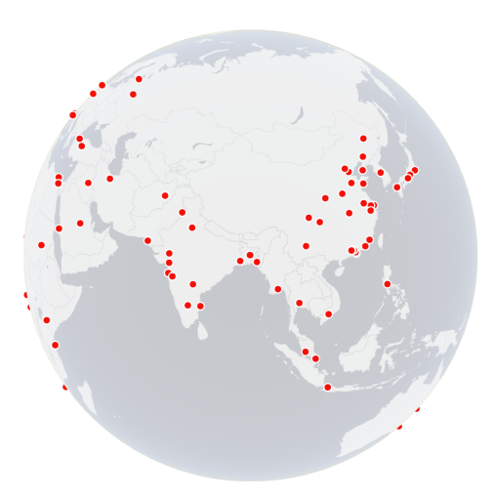
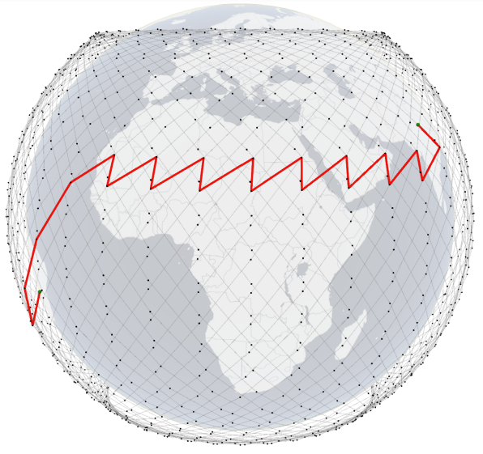
Experiment Setup
We utilize the open-source LEO satellite network analysis platform, Hypatia [IMC’ 20].
+Grid topology for ISLs. (One satellite connected with four satellites closest to it)
The user traffic is end-to-end traffic between 100 ground stations.
Each experiment runs for 400 seconds and we capture snapshots of satellite position every 1 second.
Delhi
Brasília
100 Ground Stations on earth.
Shortest path between Delhi and Brasília

Slide 7
Motivating Example
E1 is better than S1 ?!
Starlink shell 1 (S1) : 1584 satellites
Custom-designed example shell (E1): 720 satellites.
Same altitude but differ in:
Number of Orbits (S1: 72 vs E1: 20)
Number of Satellites per Orbit (S1: 22 vs E1: 36)
Inclination (S1: 53° vs E1: 70°)
Fewer satellites but better latency performance ？

Slide 8
Experiment Design Overview
Different shells of the existing LEO mega-constellations.:
                Starlink Phase 1 (5 shells)
                Kuiper (3 shells)
                Telesat (2 shells)
Experiments with Synthetic Configurations:
                Number of orbits (20, 33, 46, and 59)
                Number of satellites per orbit (20, 28, 36, and 44)
                Inclination (45°, 55°, 65°, and 75°)
Inclination & User Endpoints Experiment:
  Study the impact of alignment between satellite orbit inclination and geographic angle of user endpoints on latency performance

Slide 9
Experiment Design - Metrics
Round-Trip Time (RTT):
(a) Max. (Min.) RTT, which denotes the maximum (minimum) RTT observed
between the sender and the receiver during a specified period
(b) Max. RTT - Min. RTT, is the difference between the maximum RTT and
minimum RTT observed between the sender and the receiver during a specified
period. This metric reflects the fluctuations in RTT experienced by a connection.
Path Changes :
The number of path changes between two endpoints over a specified
period.

Slide 10
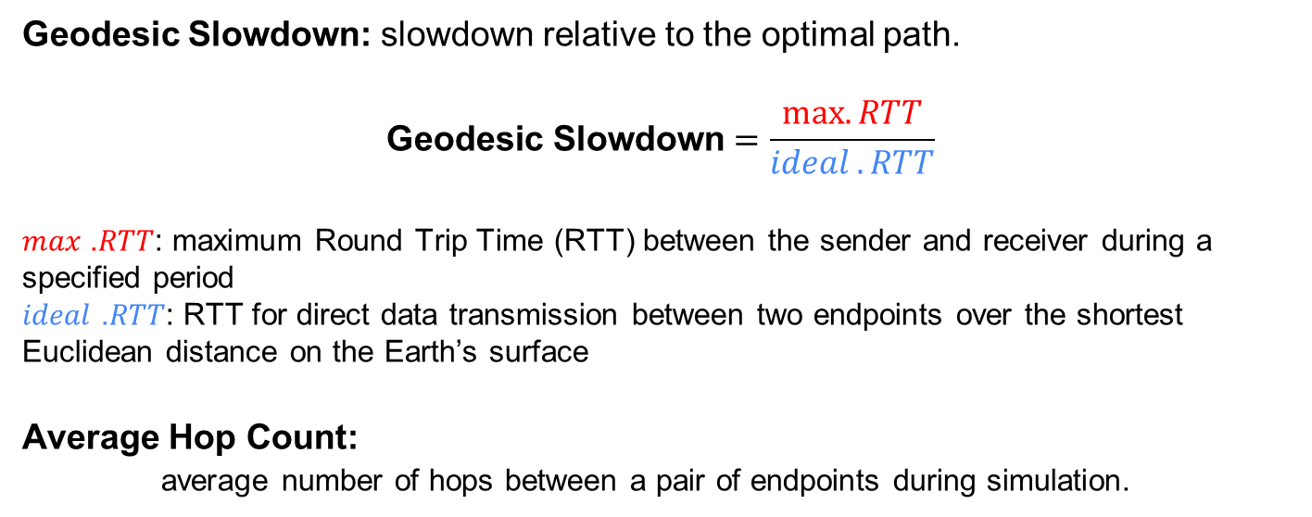
Experiment Design - Metrics
Geodesic Slowdown: slowdown relative to the optimal path.
$$\text{G}\text{eodesic} \text{Slowdown}=\frac{max⁡.RTT}{ideal .RTT}$$
𝑚𝑎𝑥 .𝑅𝑇𝑇: maximum Round Trip Time (RTT) between the sender and receiver during a specified period
𝑖𝑑𝑒𝑎𝑙 .𝑅𝑇𝑇: RTT for direct data transmission between two endpoints over the shortest Euclidean distance on the Earth’s surface
Average Hop Count:
average number of hops between a pair of endpoints during simulation.

Slide 11
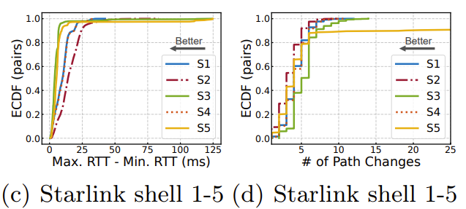

Real-World LEO Constellations’ Performance
Sparse shells lead to high RTT variance and frequent path changes. (S3 and S5)
Denser shells with more satellites and better coverage generally have lower RTT, lower geodesic slowdown, and more stable paths.
S2, K2, and T2 offer the best performance in each of the three constellations, respectively.

Slide 12
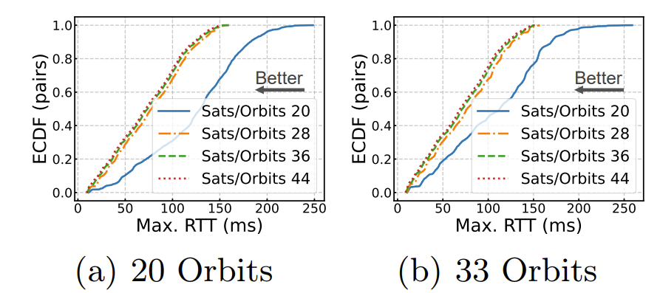
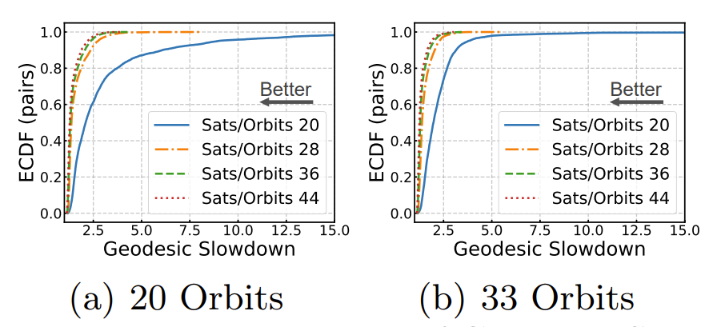
The Impact of the Number of Satellites per Orbit
Max. RTT
Geodesic Slowdown
threshold at 28
threshold at 28
threshold at 28
threshold at 28
As the number of satellites per orbit increases, the latency and geodesic slowdown in the network decrease.
We identify a threshold for the number of satellites per orbit, 28, below which the network performance degrades significantly.

Slide 13
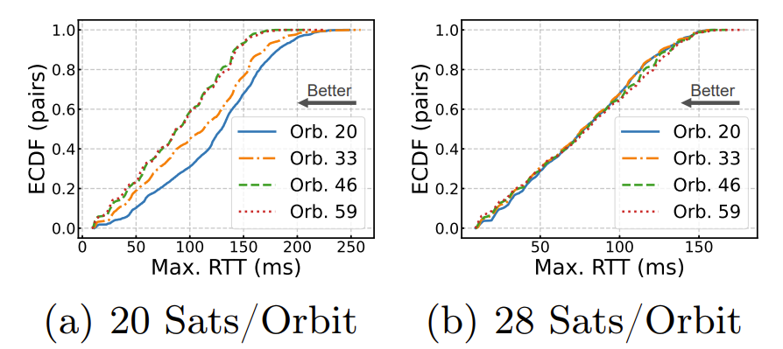
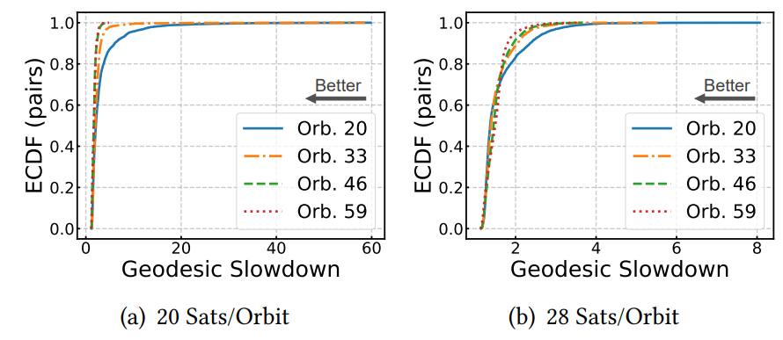
The Impact of the Number of Orbits
Max. RTT
Geodesic Slowdown
threshold at 20
threshold at 20
As the number of orbits increases, the latency will generally decrease.
Threshold: 20 orbits. Below this, network performance degrades significantly.
Number of Orbits matter less than Number of Satellites per orbit, as seen in the small Max RTT improvement gap of 28 satellites per orbit.

Slide 14
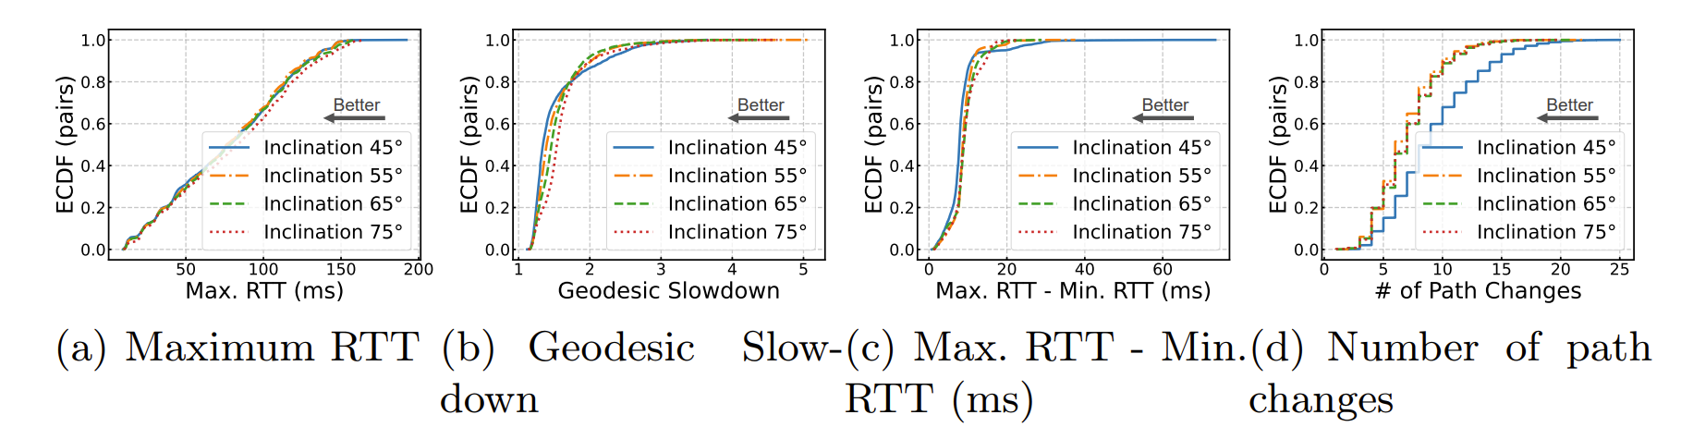
The Impact of Orbit Inclination
Hard to tell which one is better.

Slide 15
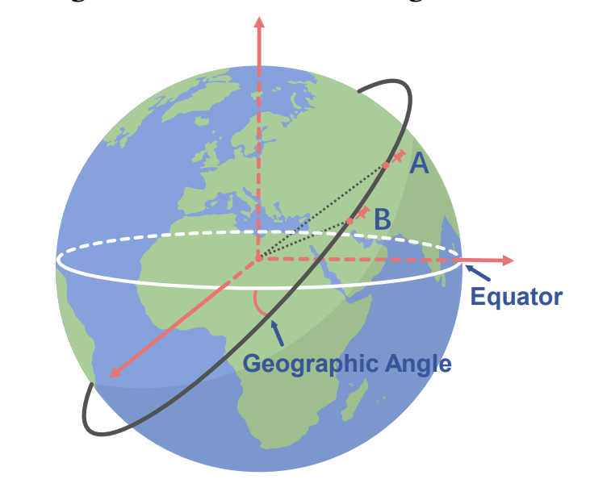
Geographic Angle of User Endpoints Pair
The angle between the Equator and the Plane contains the Earth Center, User Endpoint A, User Endpoint B.

Slide 16
Geographic Angle vs Inclination
The alignment between satellite orbit inclination and geographic angle of user endpoints affects the path’s latency performance.
Inclination

Slide 17
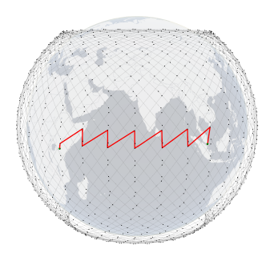

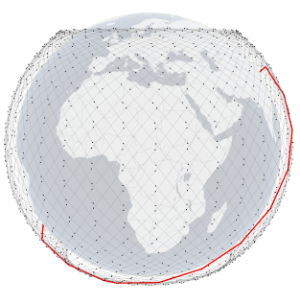
Geographic Angle vs Inclination
If the orbit inclination and geographic angle between endpoints A and B are not aligned, the path is more likely to follow a zig-zag pattern crossing multiple orbits.
If the geographic angle of endpoints is close to the inclination of the orbits, the shortest path is more likely to follow a single orbit for most of the distance.
B
A
B
A

Slide 18
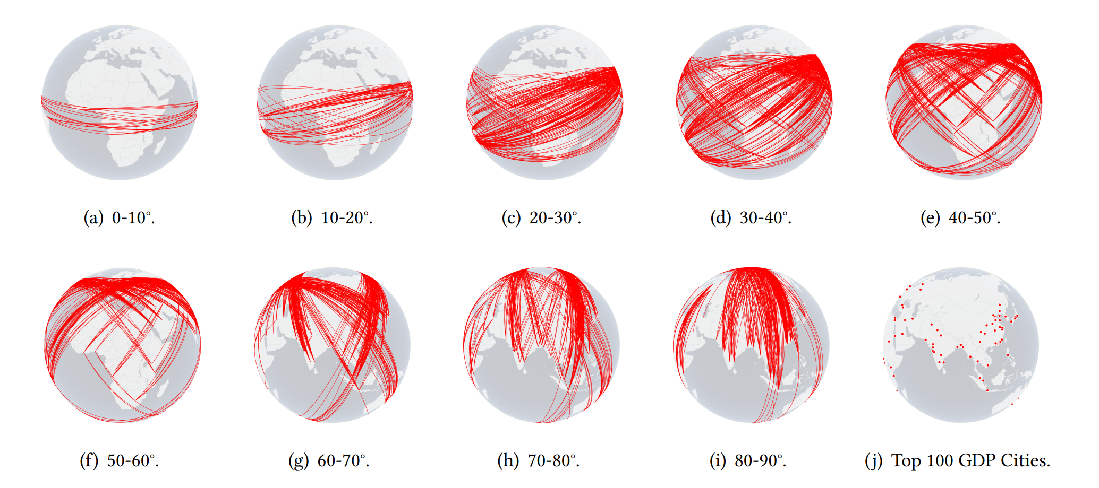
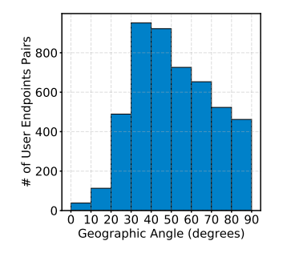
User Endpoints Traffic Distribution
We categorize user traffic into nine groups (10° intervals from 0° to 90° based on geographic angle)
    We evaluate performance under different inclination values (45°, 55°, 65°, and 75°) for synthetic constellations.
Nine groups user endpoint traffic based on their Geographic Angle
Number distribution of the user endpoint pairs

Slide 19
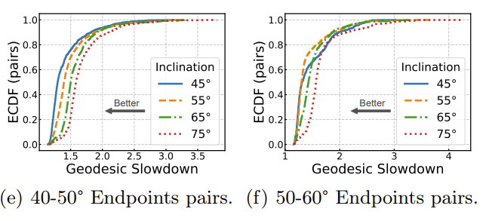
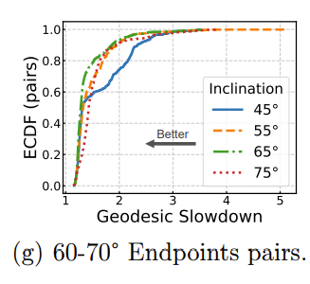
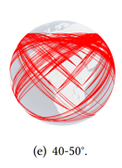
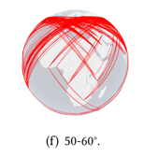
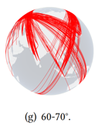
Evaluation - Inclination & User Endpoints
When the orbit inclination aligns with the endpoints' geographic angle, the latency performance is better.

Slide 20
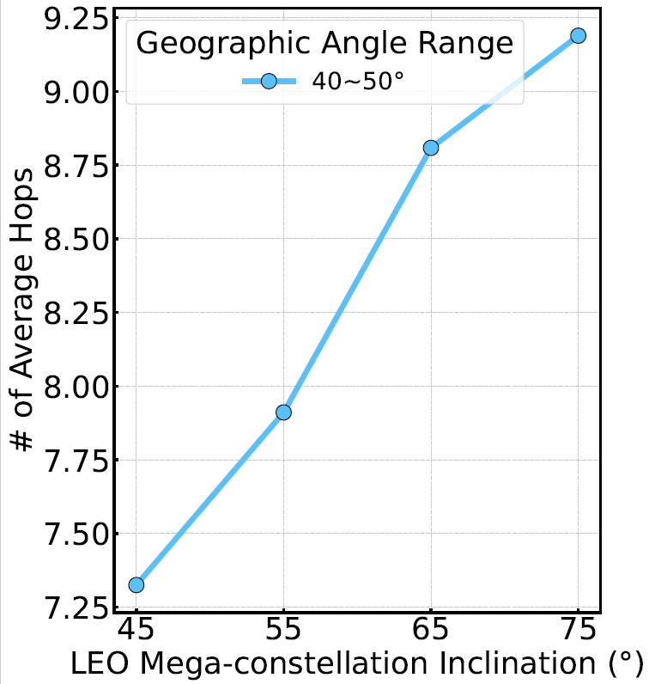
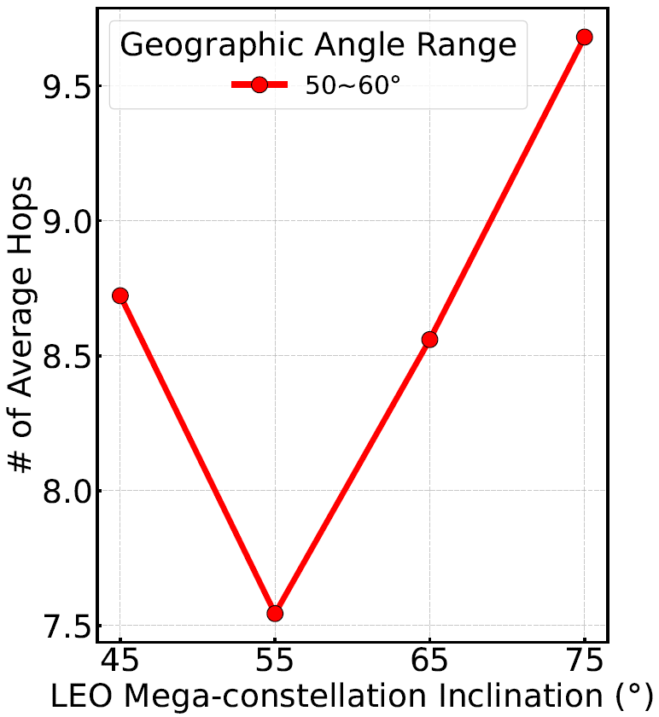
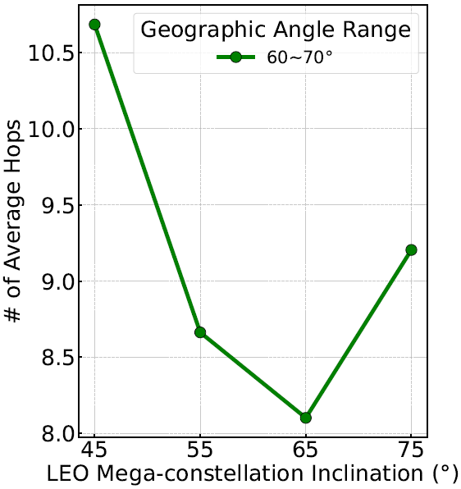
Evaluation - Inclination & User Endpoints
When the orbit inclination aligns with the endpoints' geographic angle, the average hop count performance is better.

Slide 21
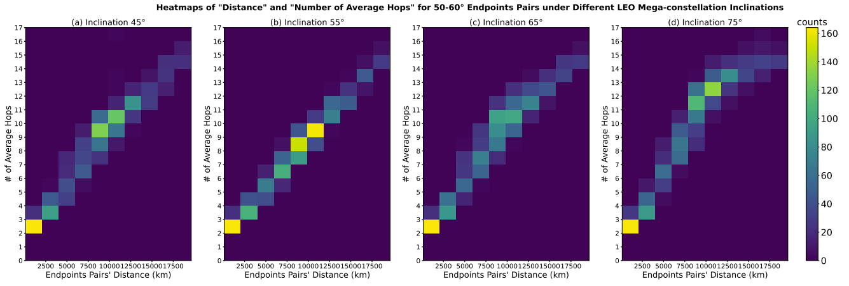
Evaluation - Inclination & User Endpoints
When the orbit inclination aligns with the endpoints' geographic angle, the latency and average hop count performance is better.

Slide 22
Conclusion & Future work
Summary of Findings
For the parameters number of orbits and number of satellites per orbit, there exist thresholds below which performance drops significantly.
Beyond the threshold, there is marginal improvement in performance as satellite density increases.
Alignment of satellite orbit inclination and user endpoints geographic angle can improve latency and hop count performance.
Considering both delay and link stability, S2, K2, and T2 offer the best performance in each of the three constellations, respectively.
Future Work
Alternative topologies with ISLs
Multi-shell analysis.
Incorporate real-world performance characteristics.

