Slide 1
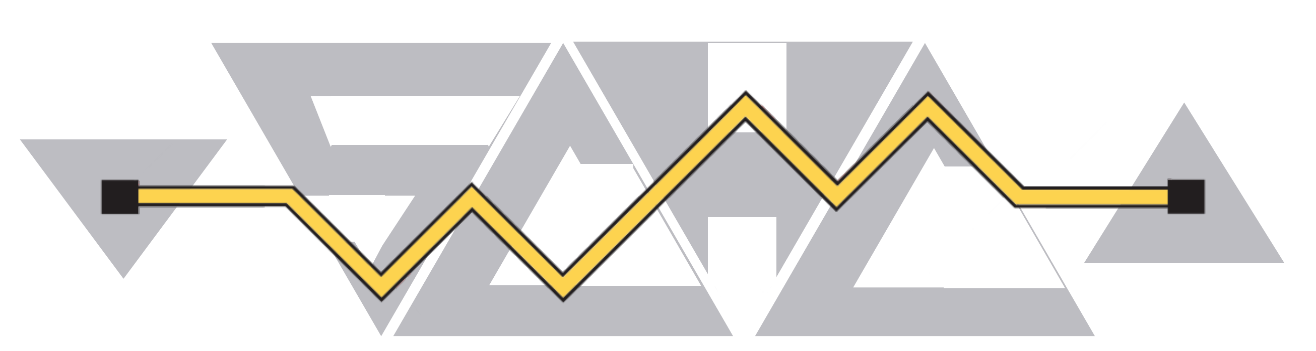
Use Cases and Requirements for
Network Admission of AI Agent Instances
July 2026
Chao Shang, weiyu Jiang, Liang Xia, Bizhu Wang, Mengying Sun
Huawei, BUPT
IETF 126, Vienna
Notes:
This presentation introduces draft-shang-agent-network-admission-01.
The document is an individual Informational Internet-Draft.
The focus is not a new Agent-ID or a new authentication protocol. The focus is a deployment gap: how to bind a specific running Agent Instance to network traffic that an enforcement point can control.

Slide 2
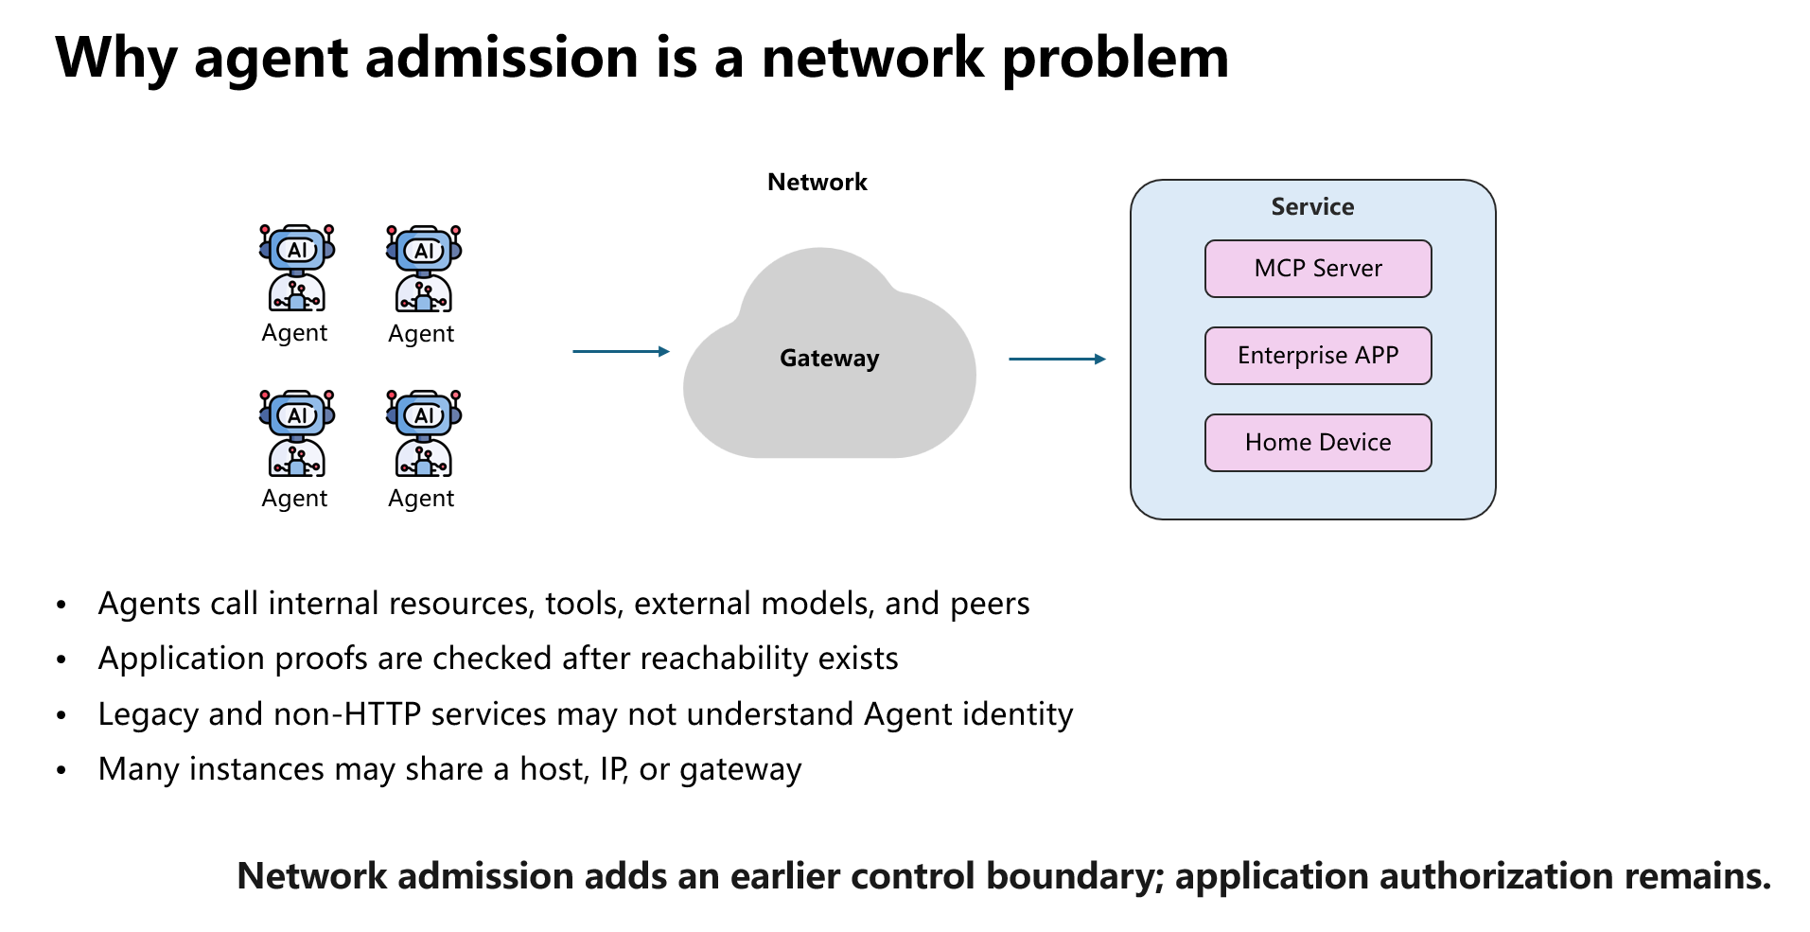
Notes:
Agents increasingly create network connections across campus, cloud, enterprise, and Internet boundaries.
Application authentication remains necessary, but it is normally evaluated only after a path already exists and it depends on each destination understanding the credential.
The draft asks what the network must know before granting general reachability, while keeping application authorization as a separate layer.

Slide 3
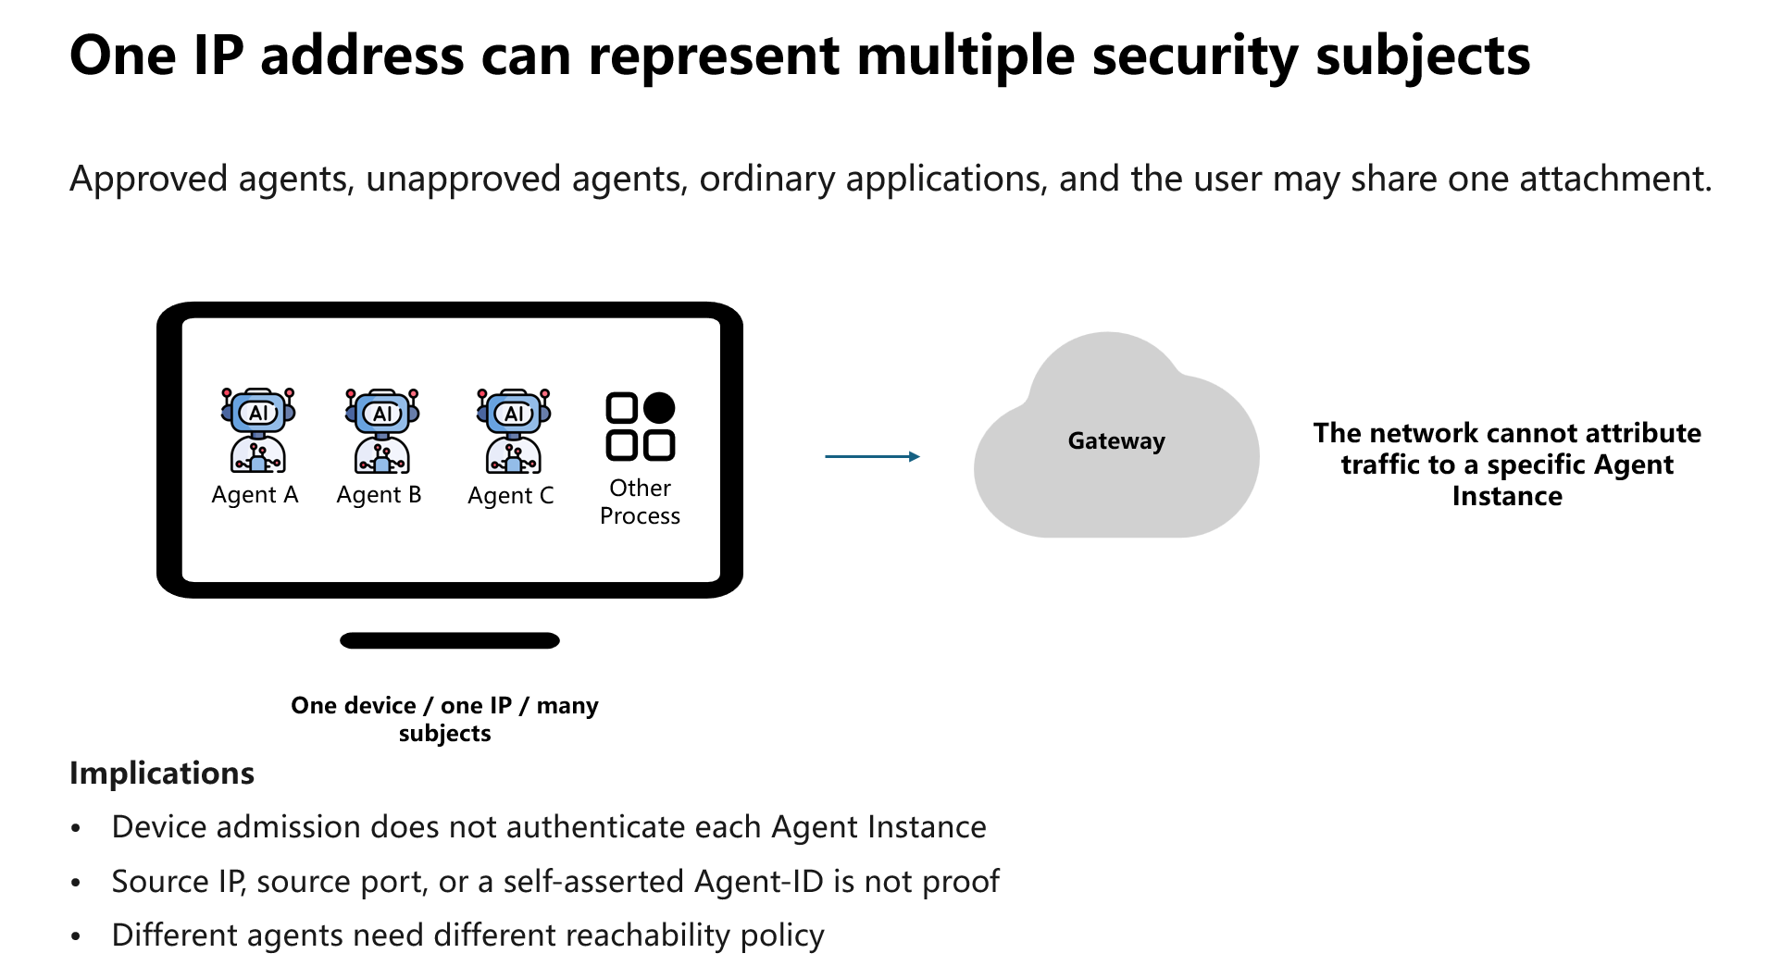
Notes:
This is the first core problem.
Traditional admission binds authorization to a device, user, interface, tunnel, or address.
But a single device can run several approved and unapproved agents alongside ordinary processes.
Therefore the source IP cannot be treated as the agent identity. A trusted per-Agent Network Context is required.

Slide 4
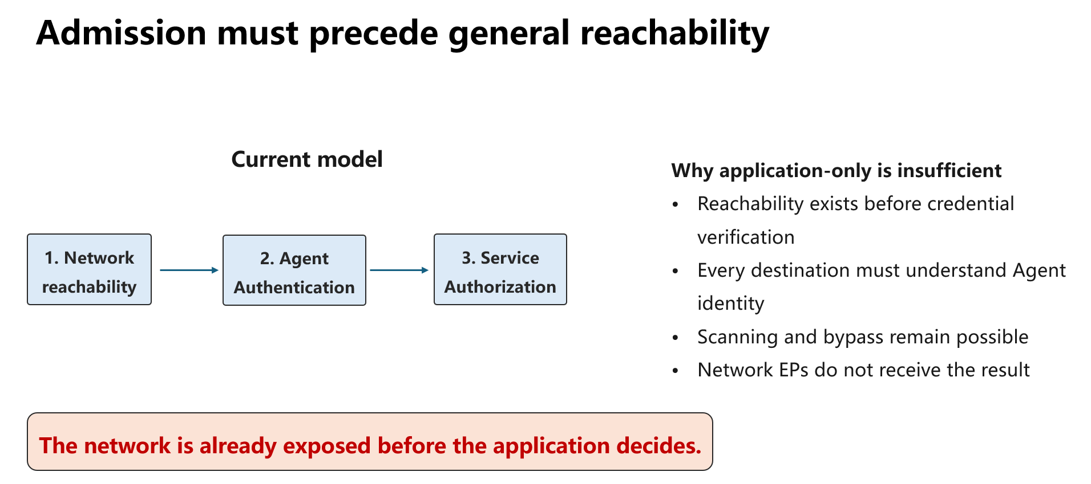
Notes:
The second gap is timing.
An agent needs limited connectivity to identity, credential, attestation, remediation, and admission services.
It should not receive unrestricted enterprise or Internet reachability before admission completes.
The desired transition is from a constrained pre-admission state to Agent-specific reachability after the binding is installed.

Slide 5
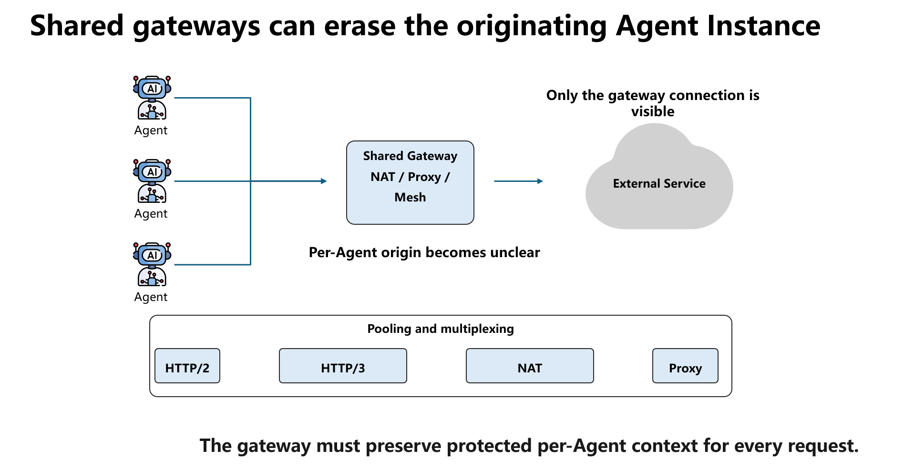
Notes:
The third gap appears at shared egress gateways.
Several agents may share one public address, a connection pool, or a multiplexed HTTP/2 or HTTP/3 connection.
Authenticating the gateway does not prove which Agent Instance caused a request.
The gateway must isolate per-Agent credentials and policy state, preserve the request-to-agent binding, and prevent bypass through another path.

Slide 6
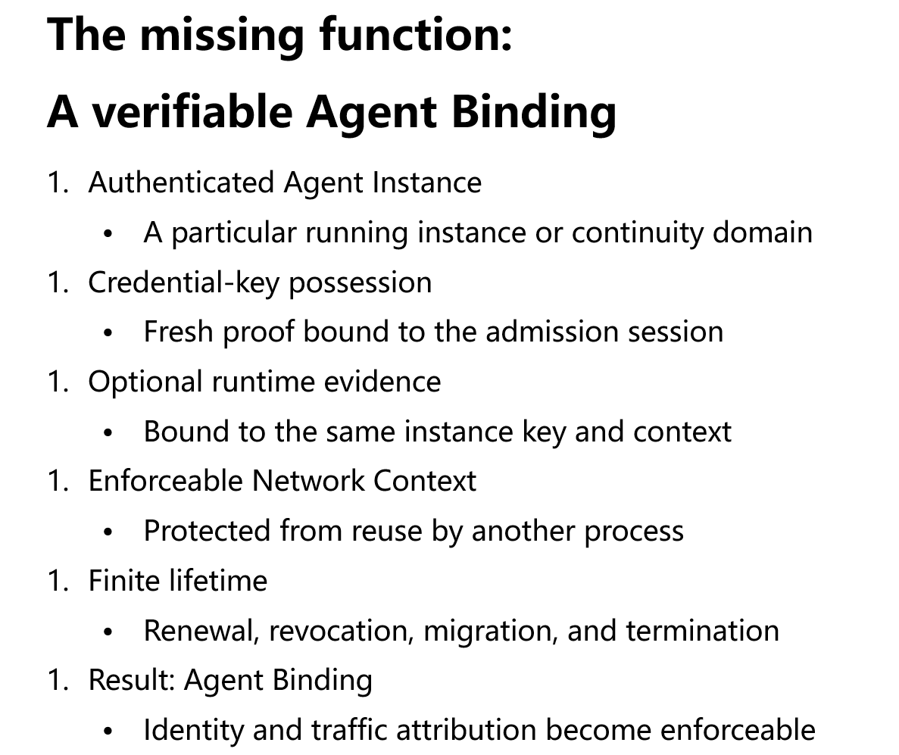
Notes:
This is the central definition in the draft.
An Agent-ID is only an assertion until it is cryptographically bound to an authenticated key.
The admission result must then be bound to a Network Context that another local process cannot reuse.
Optional runtime evidence can be included, but it must bind to the same key and admission context. The result is finite-lived Agent Binding state.

Slide 7
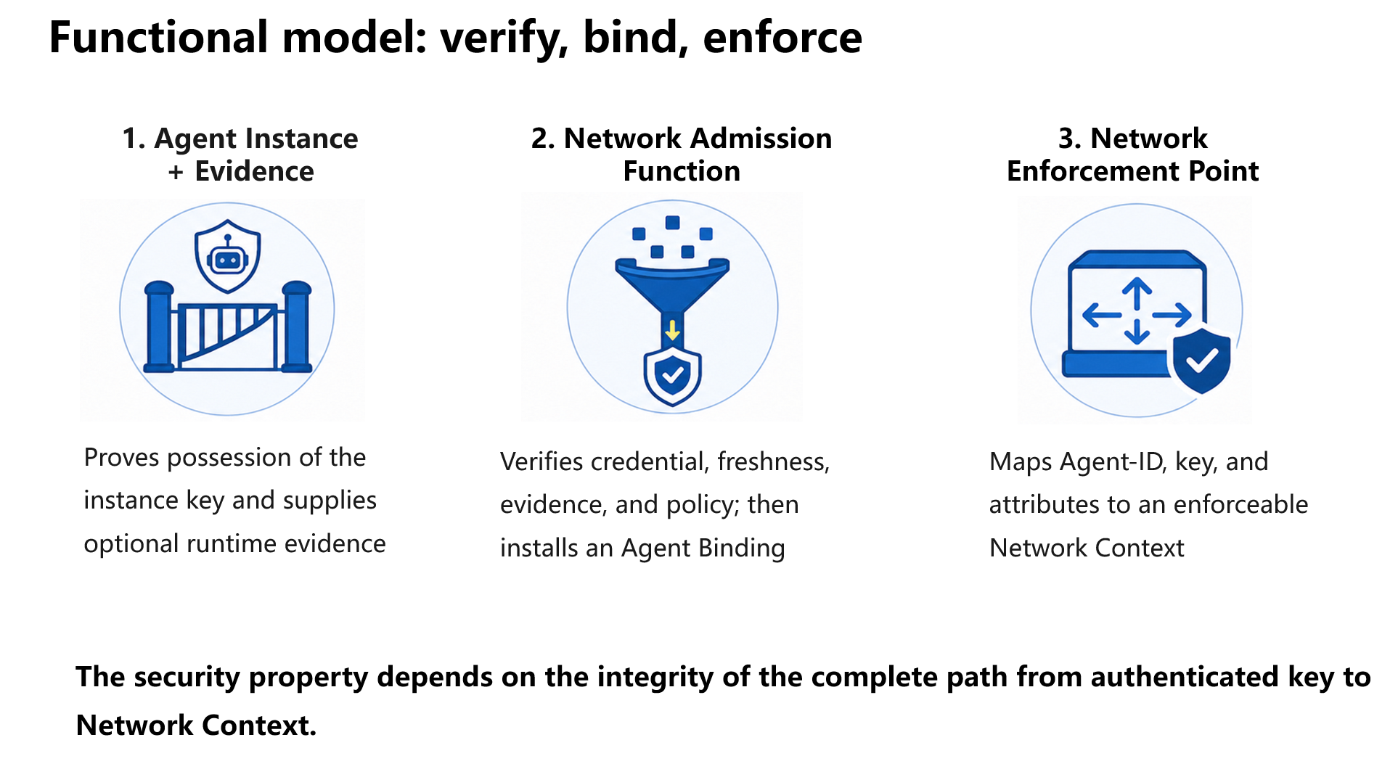
Notes:
The model has three logical roles.
The Agent Instance presents a fresh proof and optional evidence.
The Network Admission Function validates the material and decides whether to install a binding.
The Enforcement Point applies reachability policy using the Network Context.
These functions may be distributed across endpoint, controller, network device, and gateway; their physical location is not the defining property.

Slide 8
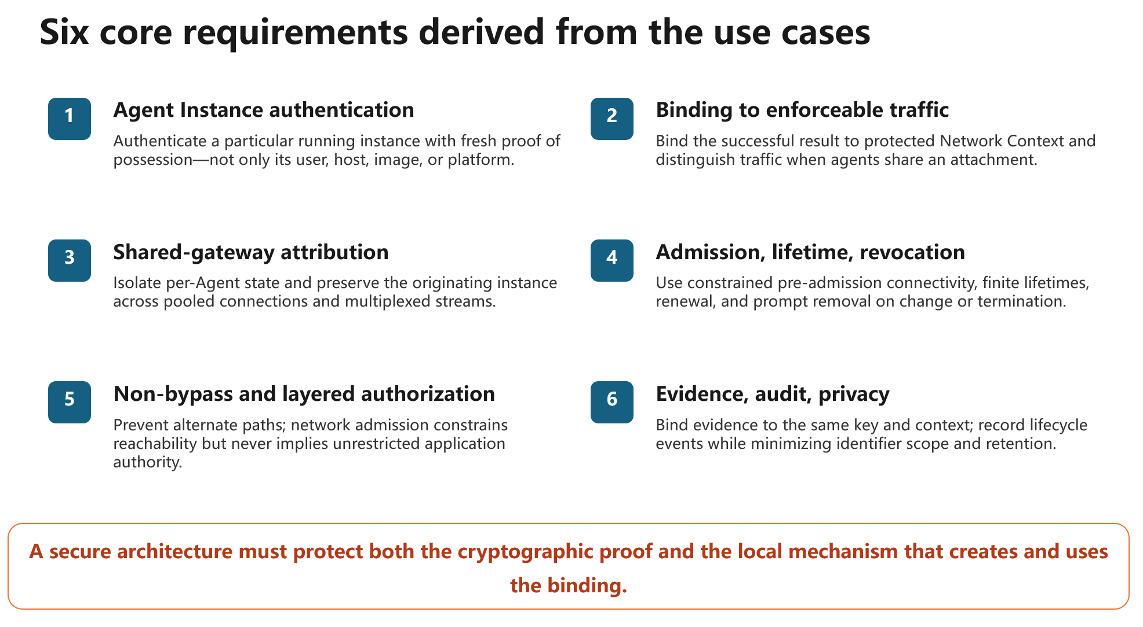
Notes:
The draft groups the requirements into six areas.
The key points are instance-level authentication, enforceable traffic binding, correct attribution through shared gateways, independent lifecycle, non-bypassability, and evidence with privacy-aware audit.
Importantly, successful admission means authenticated and constrained reachability. It does not grant broad application authority or automatically inherit all authority of the human principal.

Slide 9
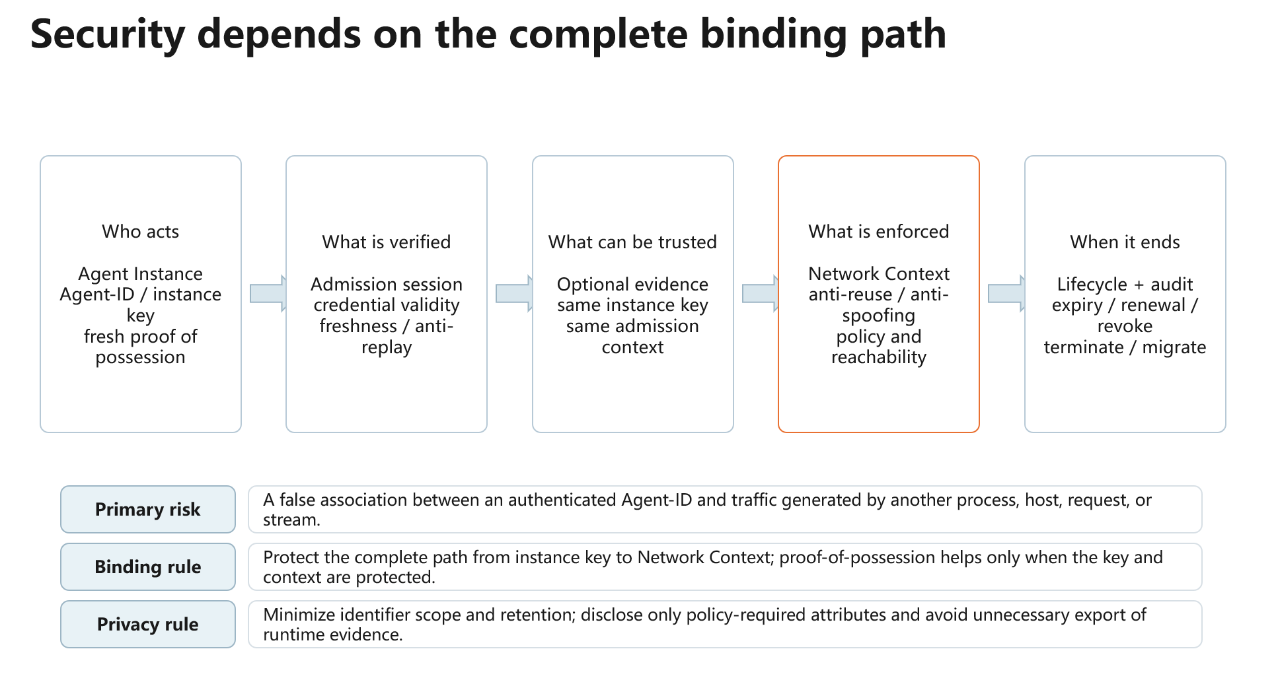
Notes:
The primary failure is false attribution: authenticated identity on one side, but traffic from a different entity on the other.
Proof-of-possession is insufficient if the private key can be copied or the Network Context can be reused.
The same binding discipline applies to attestation and to shared gateways.
Privacy also matters because stable identifiers can reveal relationships among a principal, agent, device, runtime, and destinations.

Slide 10
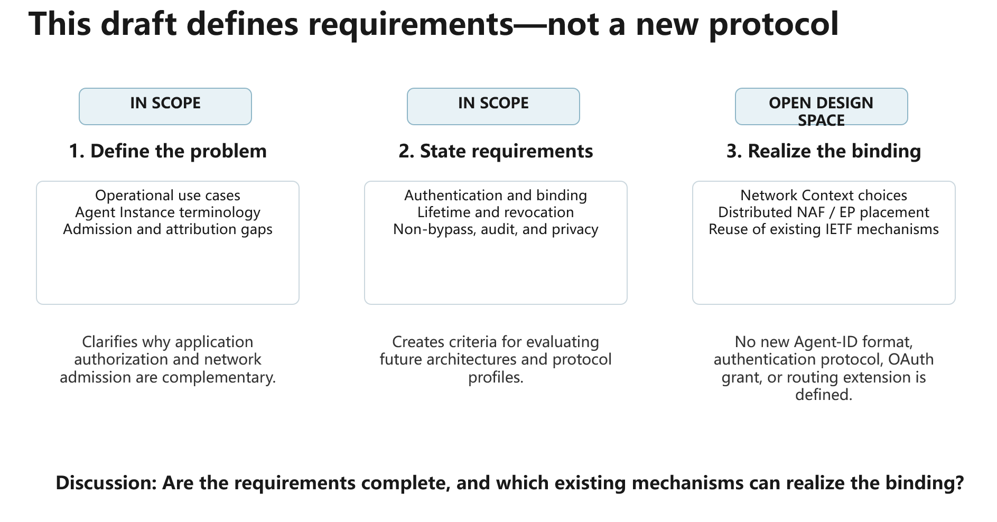
Notes:
To close, the draft is deliberately requirements-focused.
It defines use cases, terminology, the missing binding function, requirements, and a functional model.
It does not define a new identity format, authentication protocol, OAuth grant, or routing extension.
The discussion questions are whether the requirement set is complete and how existing IETF mechanisms can be composed to realize a non-bypassable, privacy-aware Agent Binding.

