Slide 1


Disaggregated Architecture for LLM Inference
Mingxing Zhang @ KVCache.AI
https://github.com/kvcache-ai

Slide 2
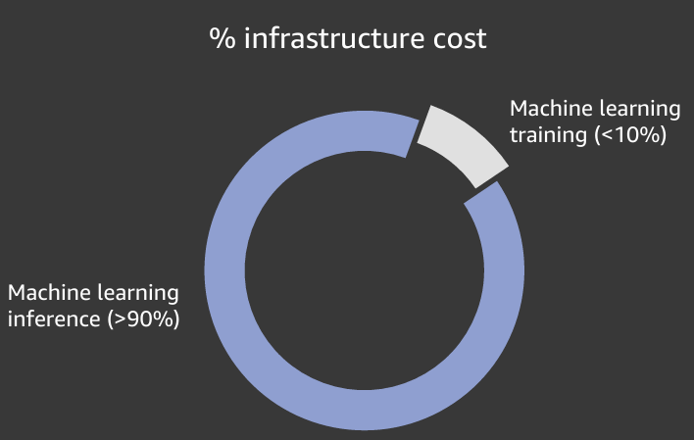
Background: Large Language Models (LLMs) Become Agents
Multi-turn, complex execution topologies, long inputs/outputs.
Single-turn,
short inputs/outputs
Inference dominates the cost
Notes:
Large Language Models are widely applied in industry and researched in academia. They have shown incredible generalization abilities, enabling them to handle a wide range of tasks. Applications like ChatGPT have already changed our lives.

Slide 3



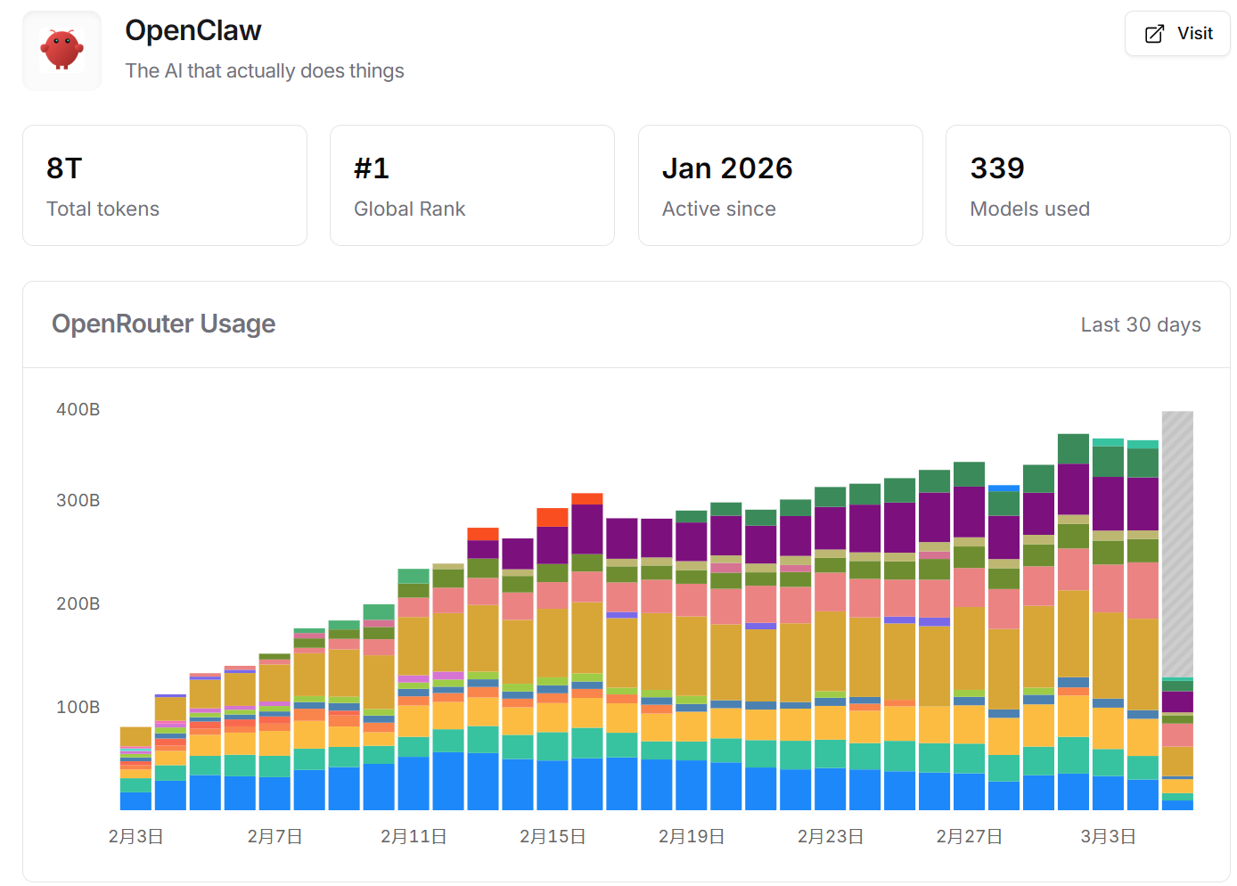
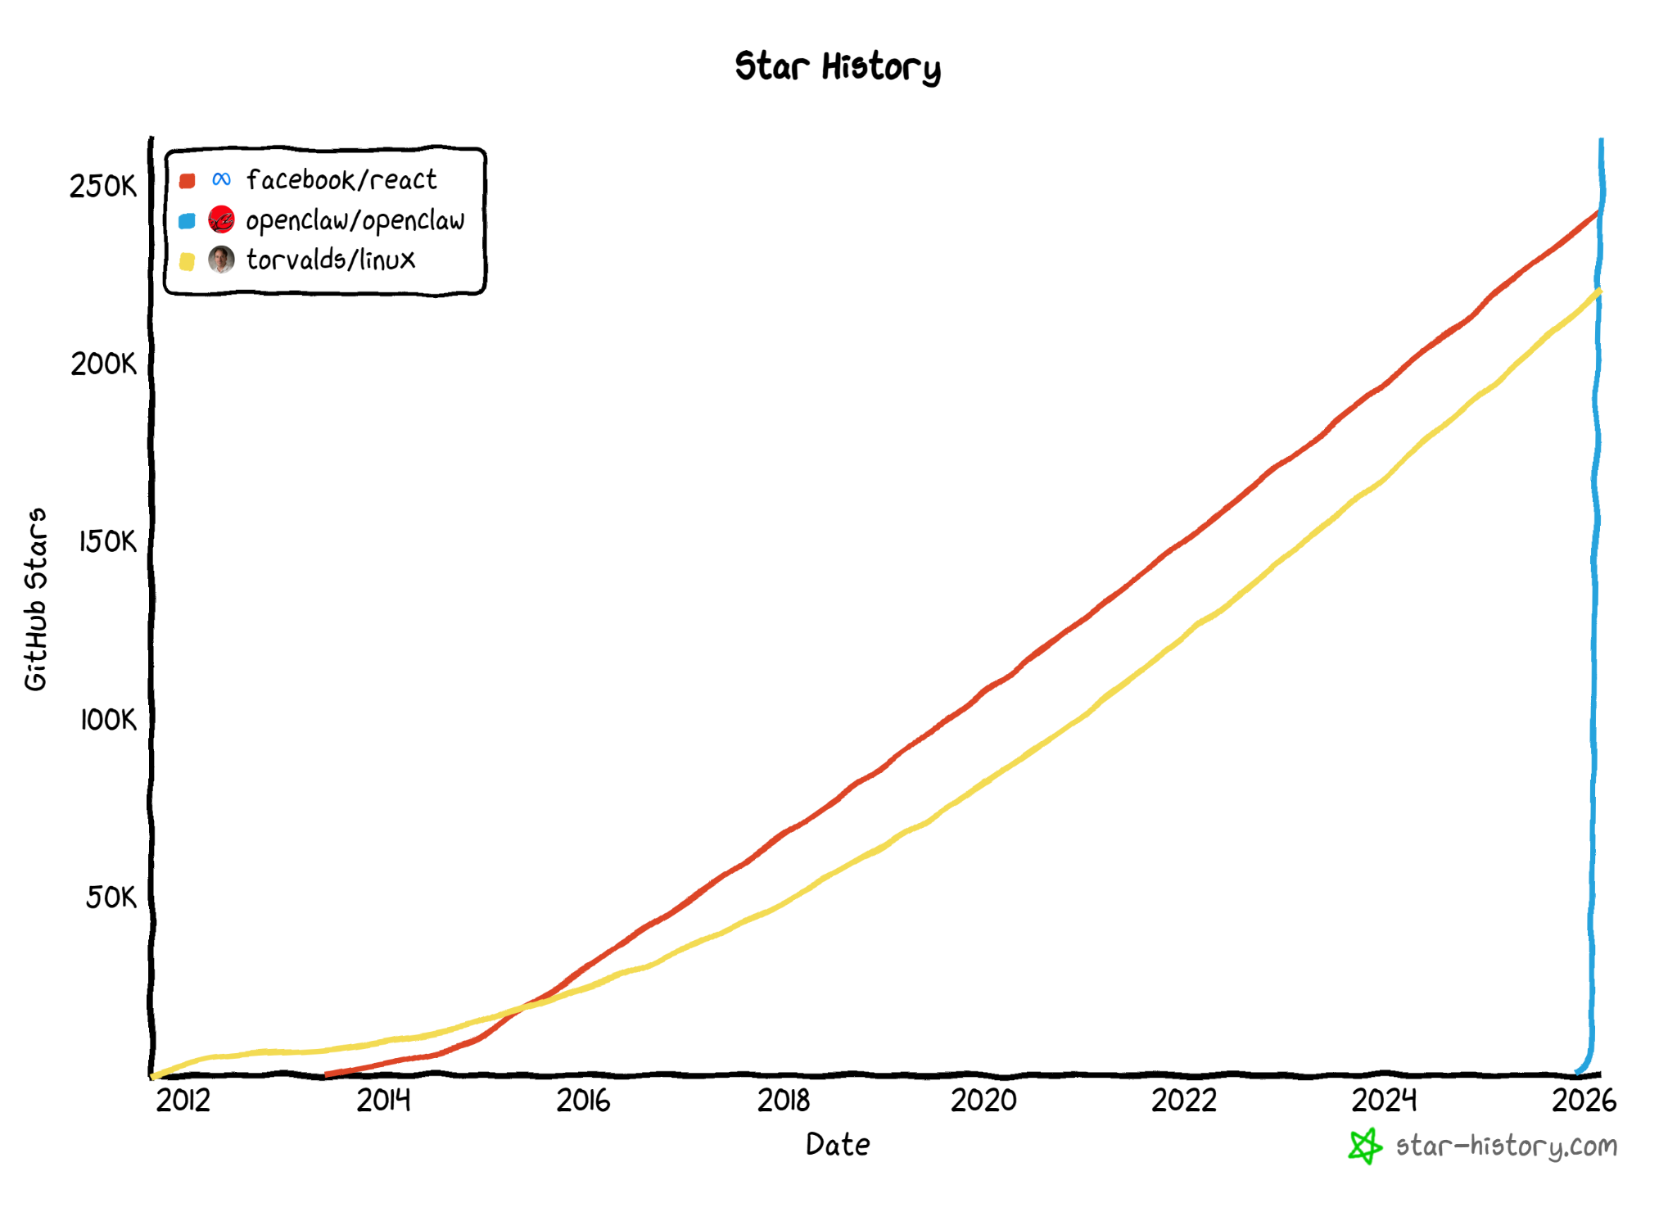


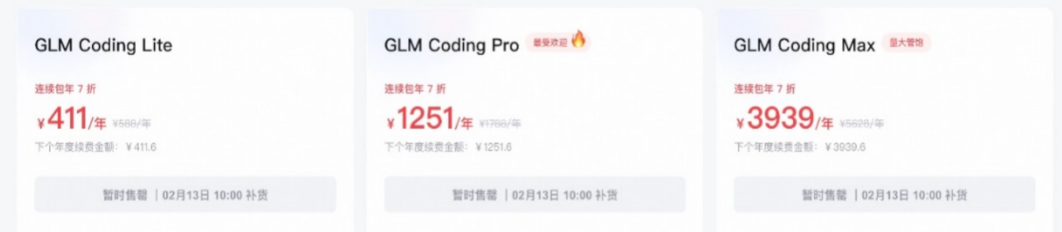
Token Demand Is Growing Exponentially
Average Daily Token Consumption
Train Models
Developer ecosystem explosion
2024: 100B
End-2025: 50T
Early-2026: 140T
JPMorgan 2030E: 10,000T
Inference Models
GPU count
300M Chips
Commercial demand surge
3M Chips
2024
2025
2026
2030
模型推理 = 用模性
Notes:
The first pressure is demand. Token consumption is growing extremely quickly. There are two main sources. One is the developer ecosystem. As open models, model APIs, and agent frameworks become easier to use, more developers build applications that call models continuously. The other is commercial demand. Production workloads now include search, customer support, coding assistants, research agents, document analysis, workflow automation, and many other tasks.
On the slide, we contrast model training and model inference with the iceberg metaphor. Training is visible and dramatic, but inference is the repeated, operational workload below the surface. In production, every user action can trigger model calls. Every agent step can add more input tokens, output tokens, cached tokens, and tool context.
That is why the average daily token consumption curve is so important. Even if chip supply increases dramatically, the token demand curve can increase even faster. The key infrastructure challenge is not simply acquiring more GPUs. It is improving the efficiency of token production so that every unit of compute and every unit of memory produces more useful work.

Slide 4
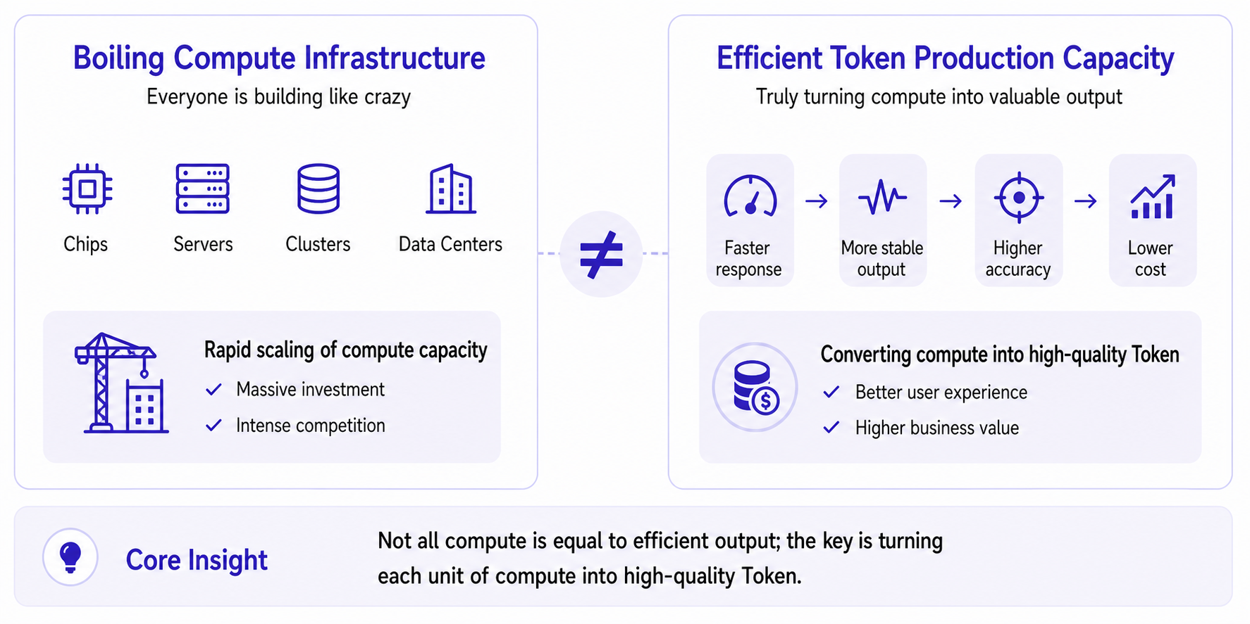
Compute Infrastructure ≠ Efficient Token Production
Notes:
A natural response to rising demand is to build more infrastructure: more chips, more servers, more clusters, more data centers. That is necessary, but it is not sufficient. Compute infrastructure does not automatically become efficient token production.
The right side of the slide shows what we actually want: faster response, more stable output, higher accuracy, and lower cost. Those are production qualities. They require converting raw compute into high-quality tokens.
The distinction is important. If a cluster is poorly scheduled, if prefill and decode interfere with each other, if KVCache is repeatedly recomputed, if memory bandwidth is the bottleneck, or if agent environments are rebuilt every time, then the infrastructure may be large but inefficient. The core insight is that not all compute is equal to efficient output. The key is turning each unit of compute into high-quality token delivery.
This is where the rest of the talk begins: how can we rebuild the inference stack so that token production becomes more efficient, more predictable, and better aligned with workload requirements?
A good mental model is a refinery. Crude oil has to be refined into products with different grades and quality requirements. Compute has to be refined into tokens that meet different SLOs. A raw GPU-hour is not the same as a useful answer delivered on time. Serving architecture is the refinery that turns raw compute into useful intelligence output.

Slide 5

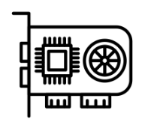


Challenge of Online Model as a Service System
More Data + Larger Model + Longer Context = Higher Intelligence
BUT
Lack of GPU Supply
Higer
Inference Cost
Longer Response Time
How to improve inference MFU? How to reduce the needed TFLOPS?
How to reach the above goals without sacrificing user experience?
Notes:
具体来说这一高启的推理成本主要体现在三个方面。一是用的数据越多数据需要的算力越多，在当前供应紧张的情况下缺口就越大。
二是越大的模型推理自然也就正比的在上升。同时支持越长的输入也意味着响应延迟越高用户的体验会变差。
所以自然的我们需要思考的问题就是如何尽可能提升算力的利用率，乃至于减少算力的使用量。
以及作为一个在线服务系统，如何在尽可能不影响用户体验的前提下达成上述目标同样是关键的问题。
https://thenounproject.com/icon/currency-6650543/
https://thenounproject.com/icon/time-6978044/
https://thenounproject.com/icon/gpu-6416108/

Slide 6
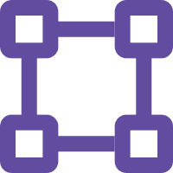

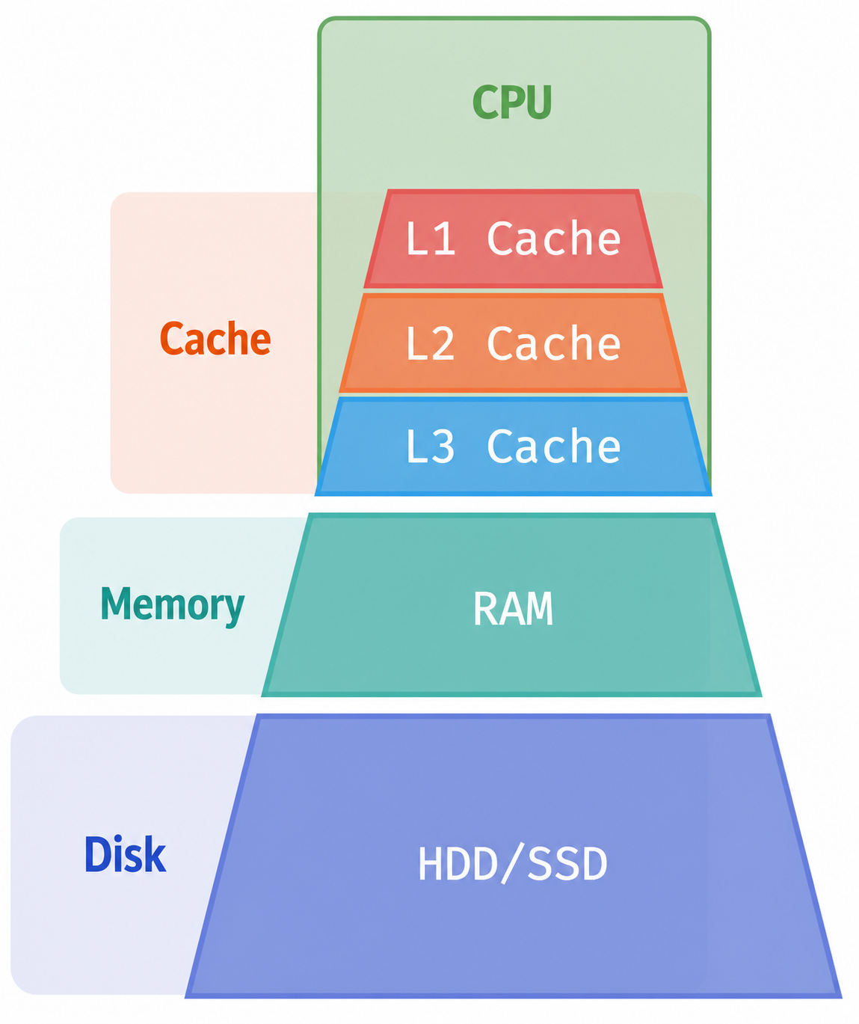
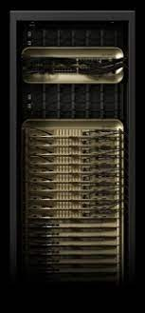
Rebuilding AI Inference: Hierarchical Compute
Supernode
"Classic" hierarchical architecture
Best Compute
+ Bandwidth
+ Interconnect
On-demand coordination
for best total cost
VS
Notes:
The next concept is hierarchy. Classic computer systems already use hierarchical architecture. A CPU has caches, memory, and disk. These layers differ in capacity, bandwidth, and cost. The operating system and hardware coordinate them on demand to achieve the best total cost.
In AI serving, we often start with the idea of a supernode: the best compute, the best bandwidth, and the best interconnect in one place. That is powerful, but it is not always economical. The classic hierarchy reminds us that high performance systems rarely rely on only one homogeneous resource. They combine different resources and place data or work where it makes the most sense.
The key transition is to ask: what is the equivalent hierarchy for AI inference? Where should prefill run? Where should decode run? Where should KVCache live? And how do we coordinate these layers to reduce total token cost?

Slide 7
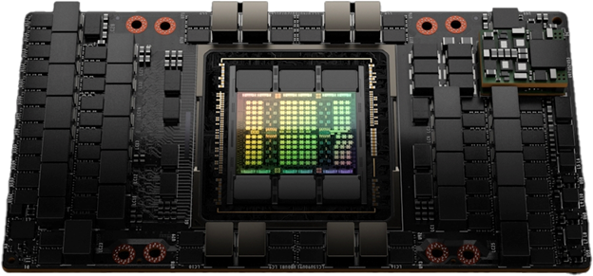
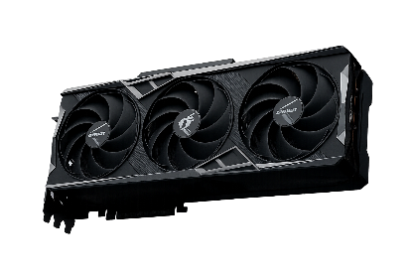
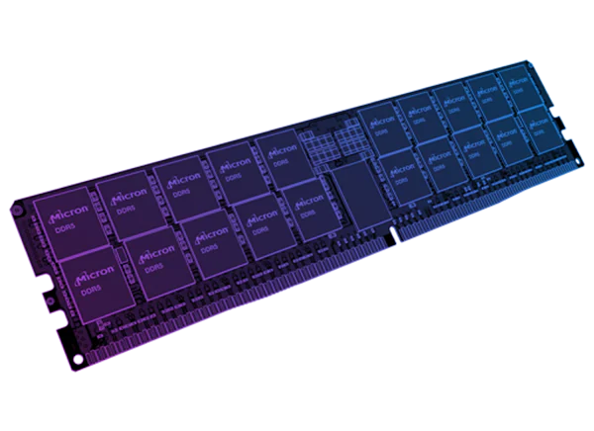
Rebuilding AI Inference: Hierarchical Compute
Supernode
Hierarchical architecture in AI compute
Best Compute
+ Bandwidth
+ Interconnect
On-demand coordination
for best total cost
High-end GPU/HBM
High cost, small cap.
High BW, limited supply
VS
Low-end GPU/GDDR
Moderate cost, small cap.
High BW, available
CPU/DRAM
Low cost, large capacity
Low bandwidth, available
Notes:
Here we map the classic hierarchy into AI compute. At the top, high-end GPUs with HBM provide very high bandwidth and strong compute, but they are expensive and limited in capacity. Below that, lower-end GPUs with GDDR may offer moderate cost and useful bandwidth. Below that, CPUs with DRAM provide much larger capacity at lower cost, but with lower bandwidth.
This hierarchy suggests a new serving design. Instead of forcing all inference work onto the same class of high-end GPU, we can coordinate heterogeneous resources. High-end GPUs can be used for the parts that truly need high compute density. Lower-cost GPUs or CPUs can handle tasks where bandwidth, capacity, or storage matter more.
The goal is not to replace GPUs. The goal is to use the right resource for the right part of inference. Once we break inference into prefill, decode, and KVCache management, the resource requirements become different enough that hierarchy becomes not only useful, but necessary.

Slide 8
Different Hardware are Good at Different Dimension
H800
H20
Xeon SPR + 8 * DDR5-4800
80GB VRAM，3.3 TBps
~ 1 PFLOPS
> $ 10,000
96GB VRAM，4 TBps
~ 200 TFLOPS
~ $50,000
8*64GB DRAM，8*40GB/s
< 20 TFLOPS
~ ¥60,000
Hardware
Spec
Best
for
Allround,
especially for TFLOPS/$
Bandwidth/$
Capacity/$
!!! The price numbers are not accurate, just a demonstration!

Slide 9
LLM Inference 101: Prefill & Decode
Prefill
Decode
LLM
iteration 1
LLM
iteration 2
LLM
iteration 3
LLM
iteration 4
What day is it today?
KV
Cache
KV
Cache
KV
Cache
Today
is
Friday
END
Time To First Token (TTFT)
Time Between Tokens (TBT)

Slide 10
LLM Inference 101: Prefix Caching
KVCache can be shared across requests with the same prefix, reducing computation
“What day is it today”
“What day is it tomorrow”
Prefill for Request I
Prefill for Request II
What
What
What
What
What
day
day
day
day
day
KVCache Reuse
is
is
is
is
is
it
it
it
it
it
today
tomorrow
tomorrow
today
tomorrow
(5 tokens computed)
(1 token computed)

Slide 11
Different Hardware are Good at Different Dimension
H800
H20
Xeon SPR + 8 * DDR5-4800
80GB VRAM，3.3 TBps
~ 1 PFLOPS
> $ 10,000
96GB VRAM，4 TBps
~ 200 TFLOPS
~ $50,000
8*64GB DRAM，8*40GB/s
< 20 TFLOPS
~ ¥60,000
Hardware
Spec
For Prefill!
For Decode!
For KVCache!
Best
for
Allround,
especially for TFLOPS/$
Bandwidth/$
Capacity/$
!!! The price numbers are not accurate, just a demonstration!

Slide 12
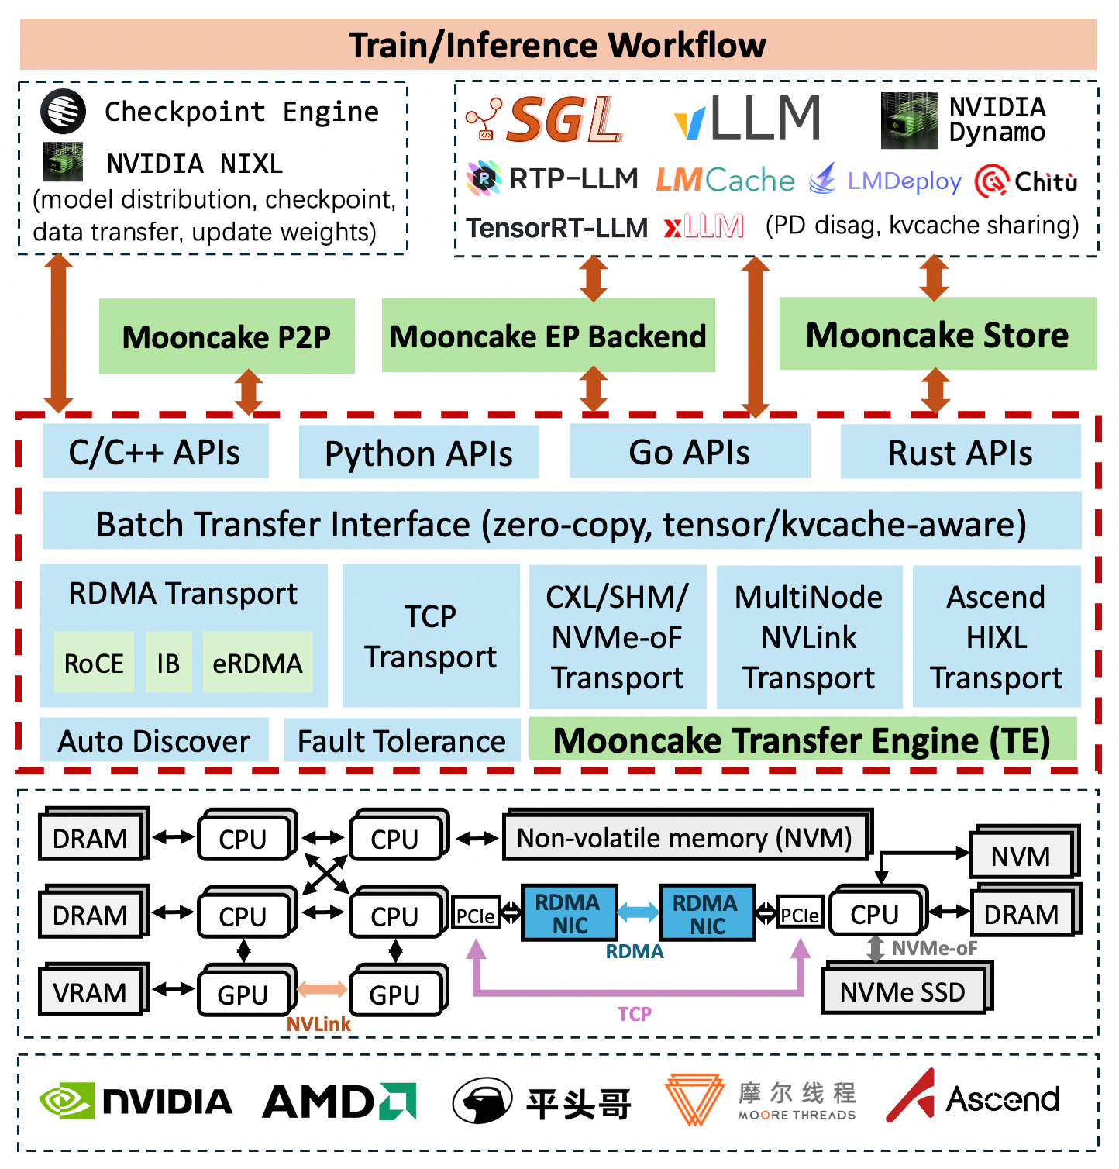
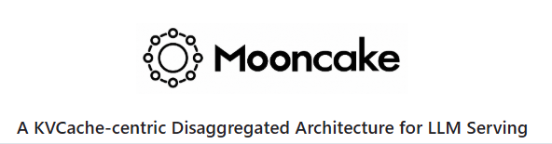
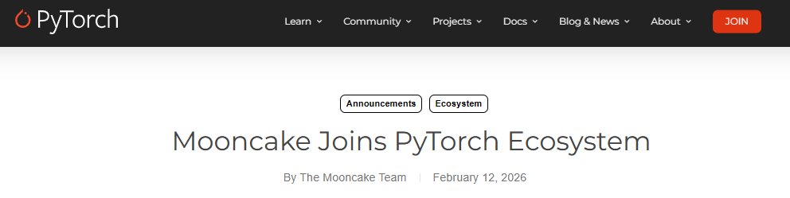
Core Technologies of Mooncake

Slide 13
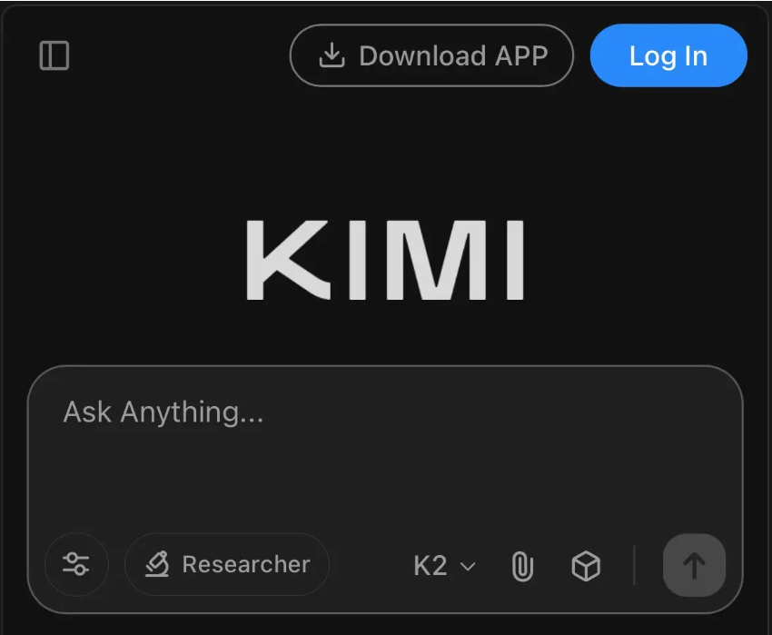

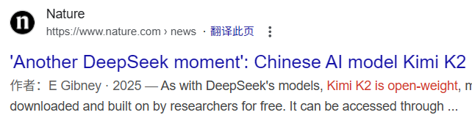
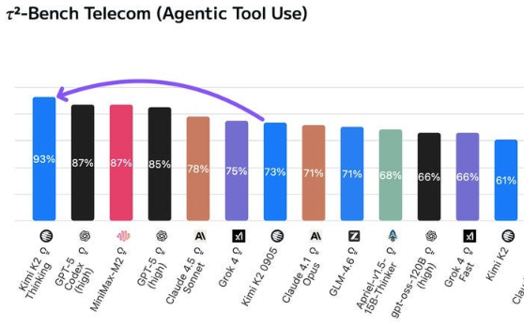
Kimi @ Moonshot AI

Slide 14



Mooncake：A KVCache-centric Disaggregated Architecture for LLM Serving
_ The serving platform of Kimi
P/D disaggregation architecture centered around the distributed KVCache pool
Trading more storage of less compute! Increase the throughput of Kimi by 75%
Meet SLO guarantee
KVCache-
centric
Conductor
Prefill Instance
Prefill Instance
GPU/VRAM
GPU/VRAM
Prefill Pool
Local
Chunked
Prefill
Scheduler
PP/SP
Local
Chunked
Prefill
Scheduler
Cache-aware
Prefill Scheduler
Paged KVCache
Paged KVCache
CPU/DRAM/SSD
CPU/DRAM/SSD
Distributed KVCache Pool
Distributed KVCache Pool
KVCache
Balance Scheduler
RDMA
RDMA
KVCache Pool
Inter-node KVCache Transfer
RDMA
RDMA
CPU/DRAM/SSD
CPU/DRAM/SSD
Distributed KVCache Pool
Distributed KVCache Pool
Load-balance
Decoding
Scheduler
GPU/VRAM
GPU/VRAM
Paged KVCache
Paged KVCache
Decoding Pool
Local
Scheduler
Local
Scheduler
Moonshot AI + KVCache.AI @ Tsinghua
More：https://github.com/kvcache-ai/Mooncake
Mooncake (1): 在月之暗面做月饼，Kimi 以 KVCache 为中心的分离式推理架构
Decoding Instance
Decoding Instance

Slide 15
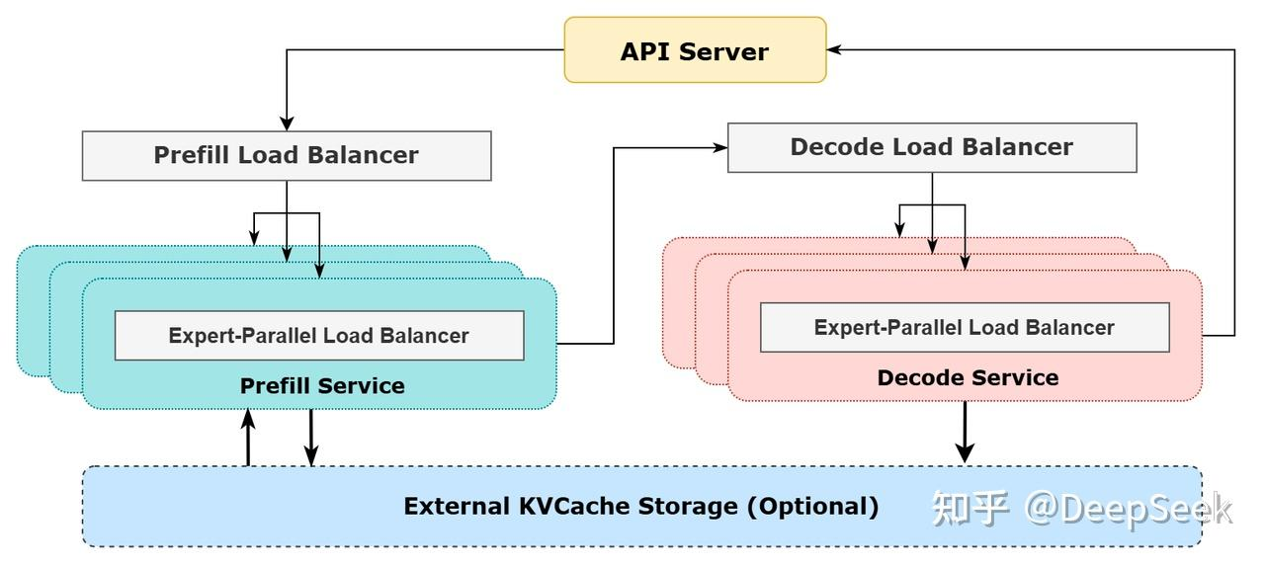
P&D Disaggregation Becomes a Necessary
Prefill and decode needs different parallelism strategy, e.g., DeepSeek V3/R1
Notes:
更进一步的，如果说在去年 Kimi 的场景下 P/D 分离还只是一个为了在对于用户体验高要求的前提下有效的策略的话.
当前随着以 DeepSeek 为代表的巨大的稀疏模型的推出，P/D 分离就成为了一个高效推理的必选项。
因为只有这样才能够在 Prefill 和 Decode 阶段使用不同的分布式并行策略，从而得到更好的吞吐。

Slide 16
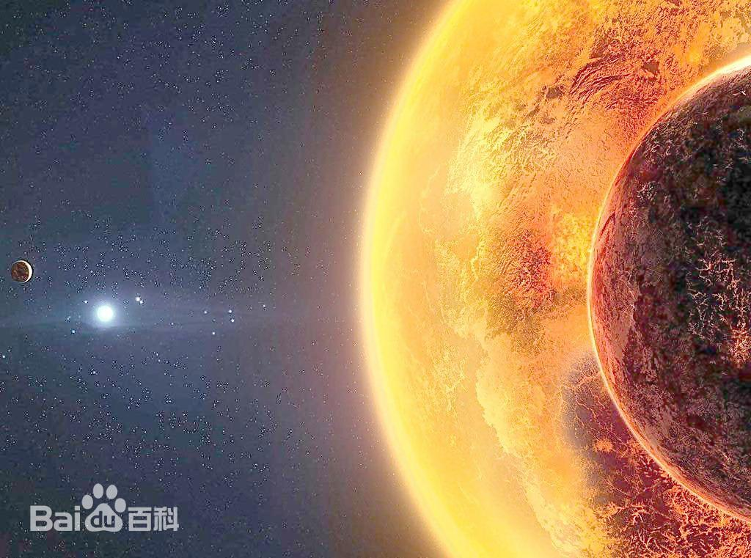

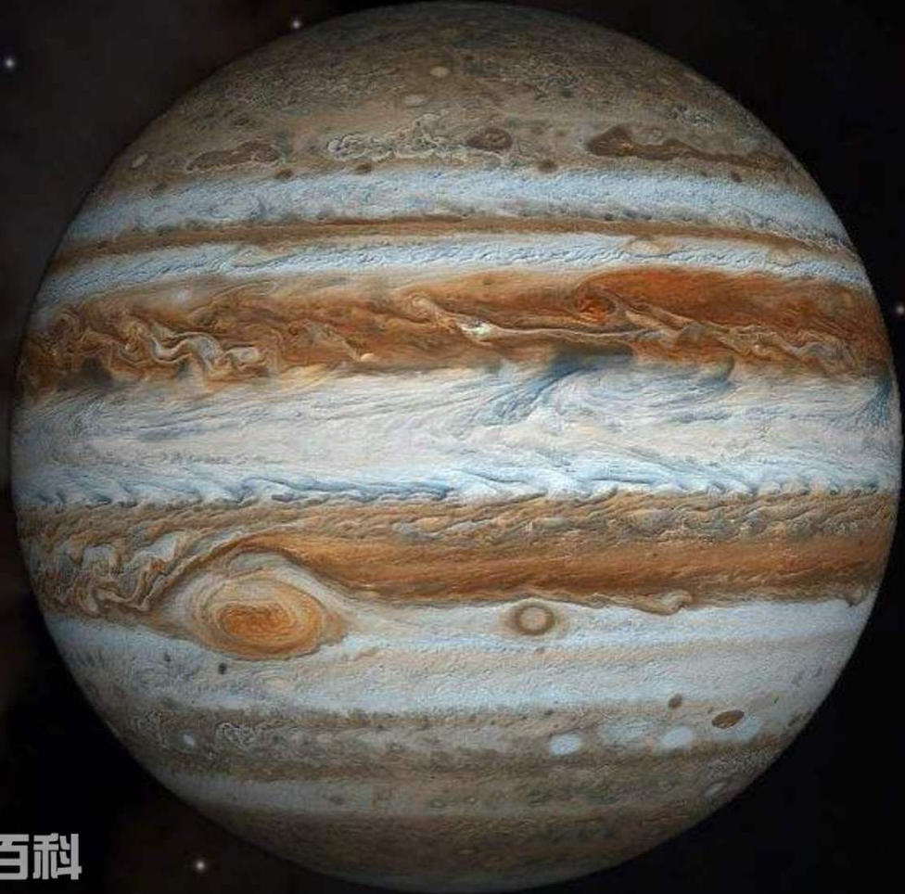


KVCache Cache introduces High Challenges to Storage System
Each 1 token -> 2 * layers * hidden dimension = tens of KB KVCache
Not only the size of KVCache is large, it also requires high transfer bandwidth to avoid stall of GPU
Reusable KVCache
(Hundreds of TB ~ PB)
KVCache of
TB Model
(tens of TB)
TB Model
(TB)
100B+ Model
(Hundreds of GB)
10B+ Model
(GB)
Notes:
虽然原理简单，但 KVCache 缓存和传统缓存相比提出了两个更大的挑战。
一是数据量更大，毕竟每一个只要几个 byte 的 token 在经过大模型处理后的 KVCache 会方法数万倍达到数十乃至数百 KB 的量级。
同时 KVCache 传输的速度要求也非常之高，不然一旦 IO 成为瓶颈就会导致宝贵的 GPU 资源空转造成浪费。

Slide 17
KVCache Cache：Local or Global
Cache hit ratio grows proportional to the size of the cache
Different scenarios has different settings
Overall, we need PB-level cache that exceeds to size of a single machine
Notes:
虽然原理简单，但 KVCache 缓存和传统缓存相比提出了两个更大的挑战。
一是数据量更大，毕竟每一个只要几个 byte 的 token 在经过大模型处理后的 KVCache 会方法数万倍达到数十乃至数百 KB 的量级。
同时 KVCache 传输的速度要求也非常之高，不然一旦 IO 成为瓶颈就会导致宝贵的 GPU 资源空转造成浪费。

Slide 18
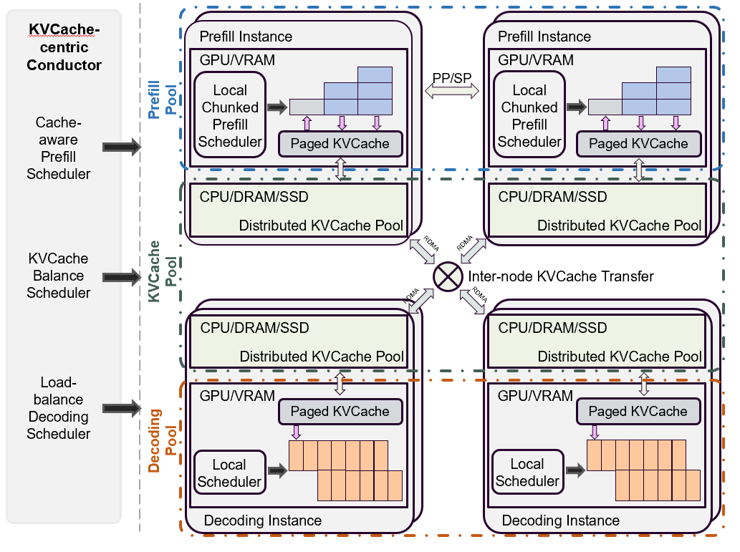
Mooncake Store：Distributed Multi-layer KVCache Cache
Key of KVCache Cache：Large size and bandwidth
Utilize high performance connection like (GPUDirect) RDMA/Storage
Will be open sourced soon!
Pooled memory as KVCache cache
Independent to specific inference engine
Optimized for multi-NIC scenario

Slide 19
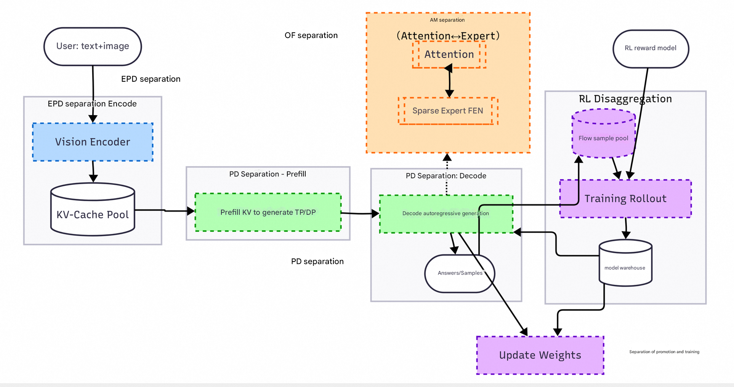
Mooncake is Used in Various Scenarios of LLM
EPD Disaggregation
Elastic Large EP
Mooncake EP
Mooncake TE
Distributed KVCache Pool
Mooncake Store
Model Weight Loading
Mooncake TE
PD Disaggregation
Mooncake TE
RL Disaggregation
Model Weight
Mooncake Store
Mooncake TE

Slide 20
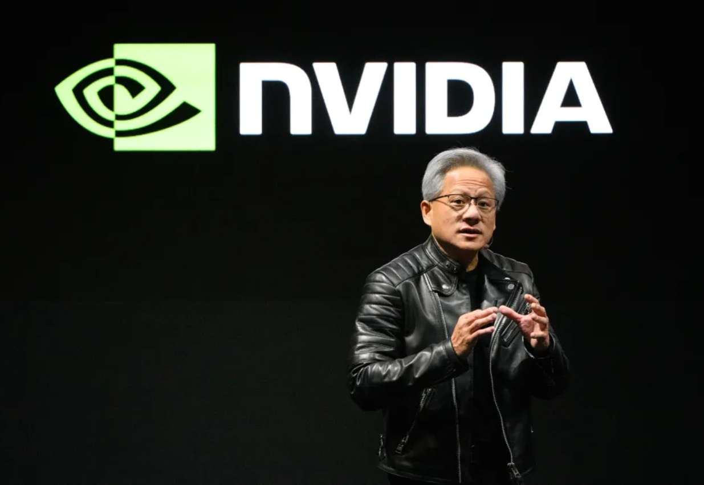
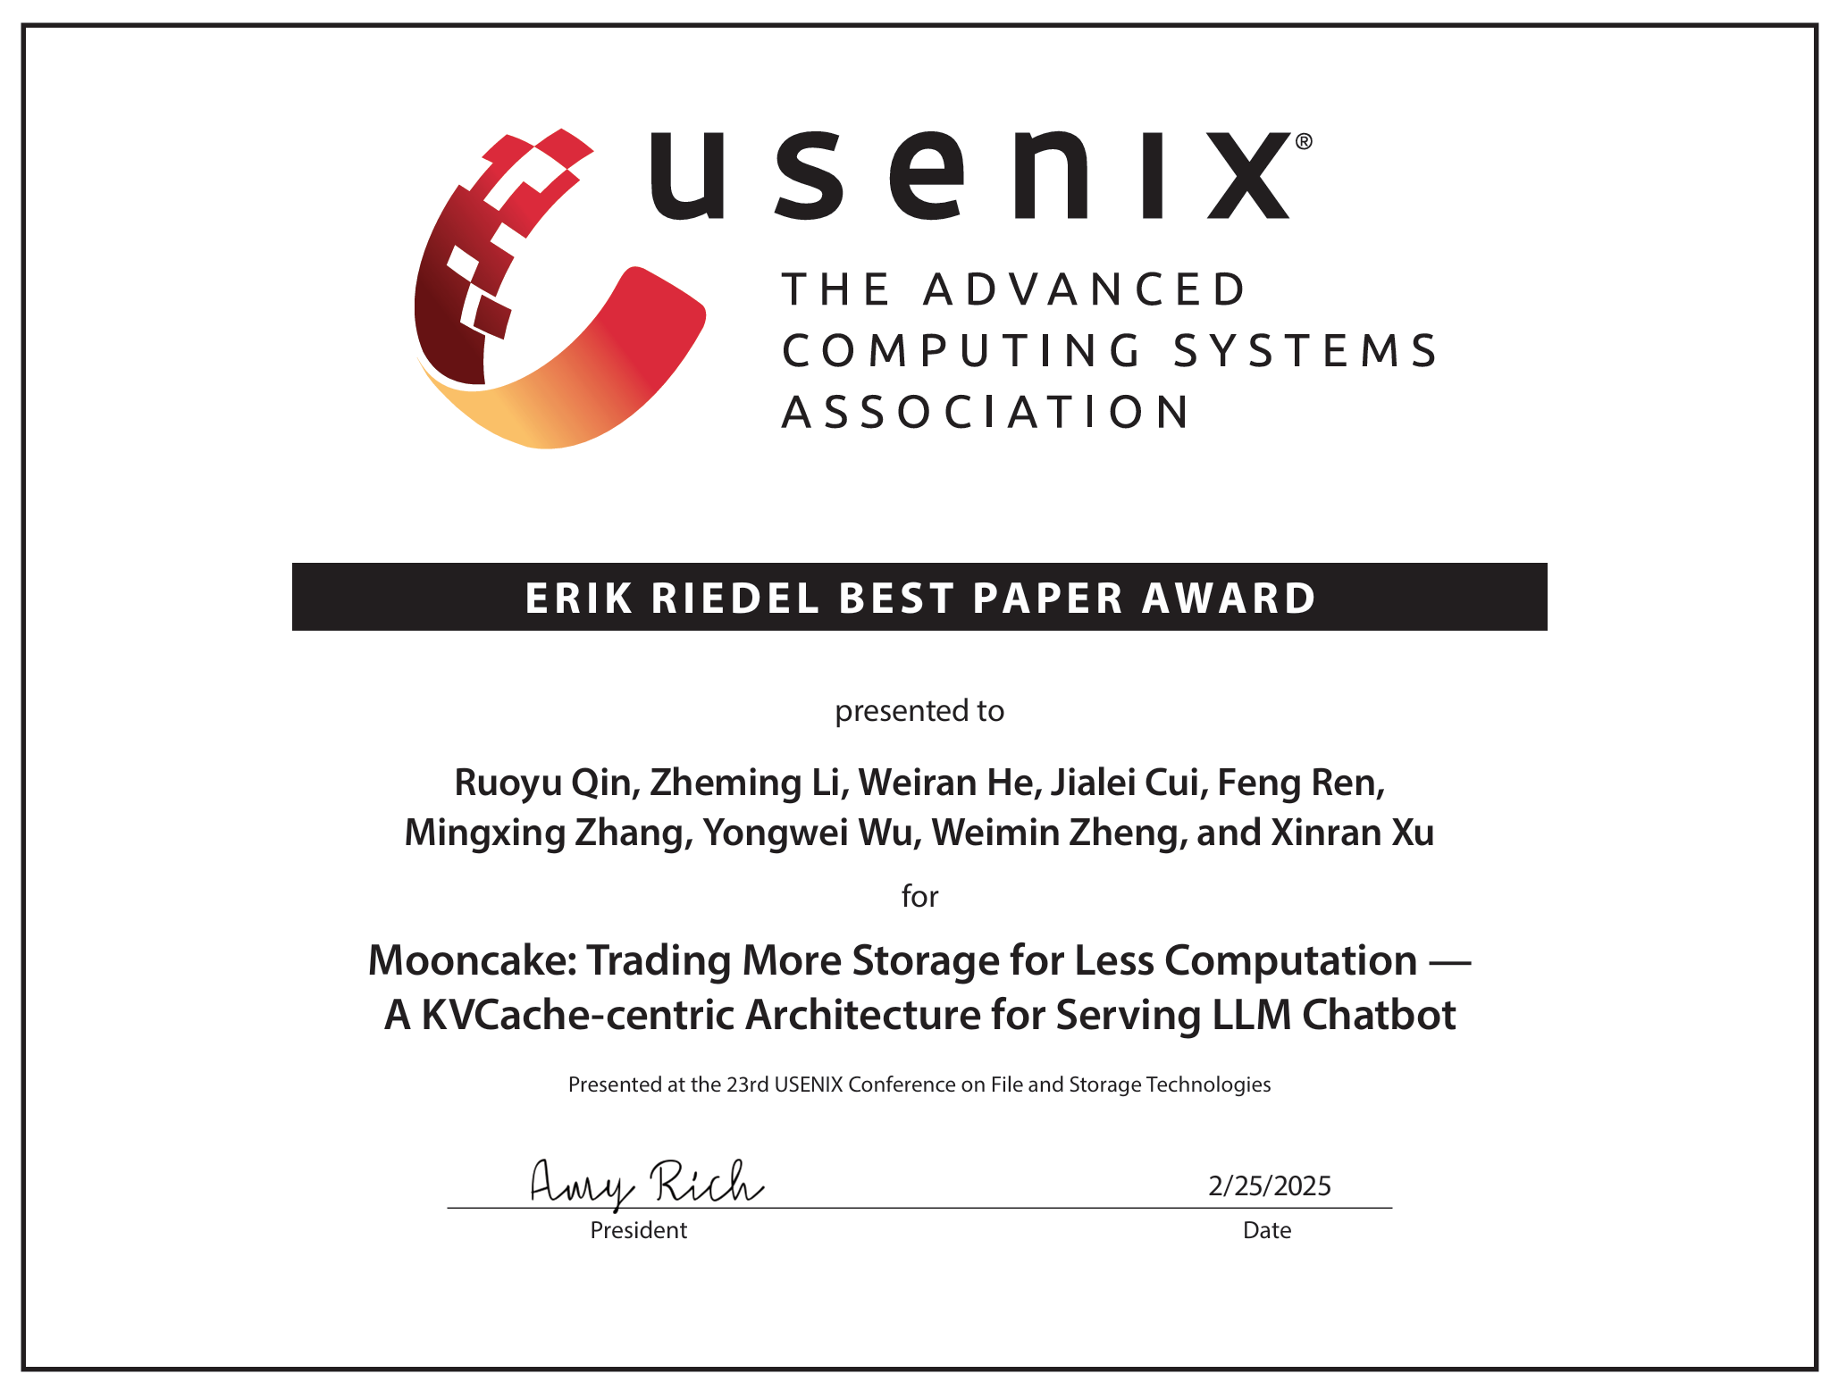







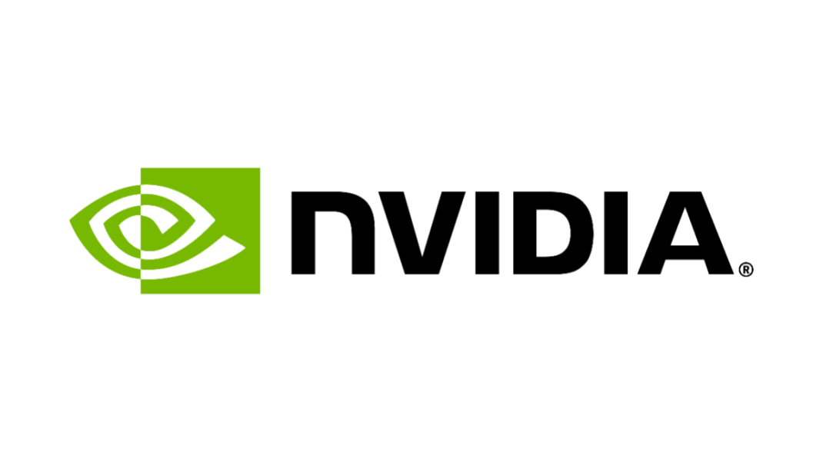
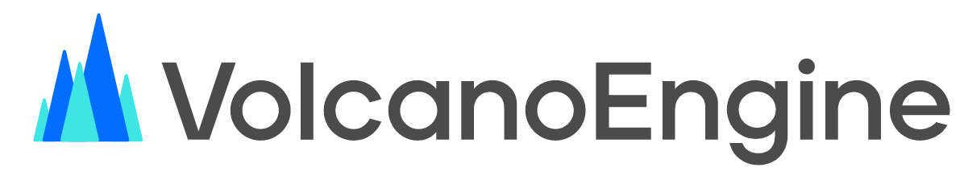


Mooncake – Open Sourced and Build with the Community
From flagship applications
To industry-wide adoption
2024.3 Kimi went viral for its long-context capabilities, using Mooncake to handle surging traffic
2024.11 Mooncake open-sourced;
adopted by Alibaba and Ant Finance
Used in Dynamo, the distributed inference system highlighted at GTC 2025 Keynote
2024.6 Mooncake tech report sparked wide industry discussion
2025.2 USENIX FAST Best Paper Award
kvcache-ai/Mooncake -- An open-source initiative co-launched by Moonshot AI and Tsinghua University, with collaboration from various large model and infrastructure providers
and more …
USENIX FAST2025 Best Paper
Notes:
Once we published this results it quickly spark a wide discussion among the industry and we are also honored to receive the Best Paper award from USENIX FAST.
Thus, in order to make this technique more accessible to the industry we open source the main components of Mooncake and collaborate with a lot of companies to build a community.
Now it is also deployed in both Alibaba and Ant finance.

Slide 21

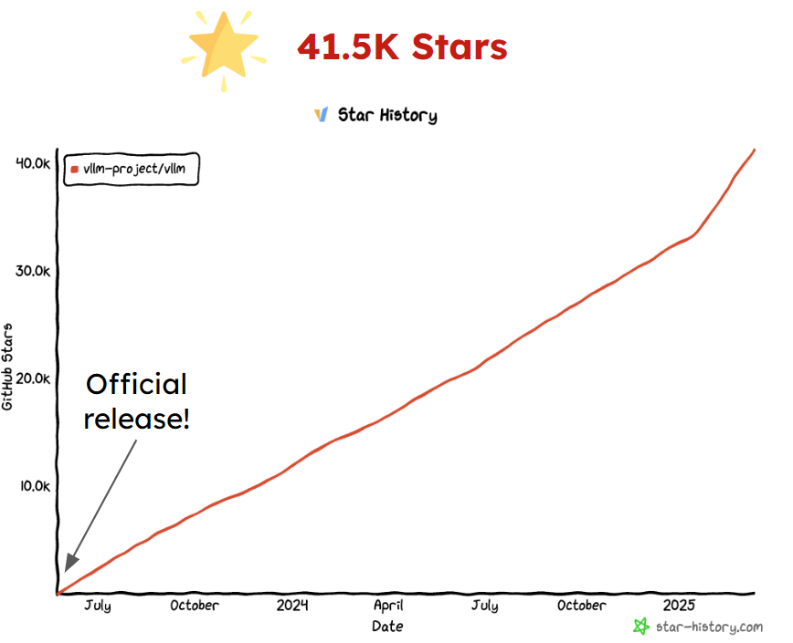

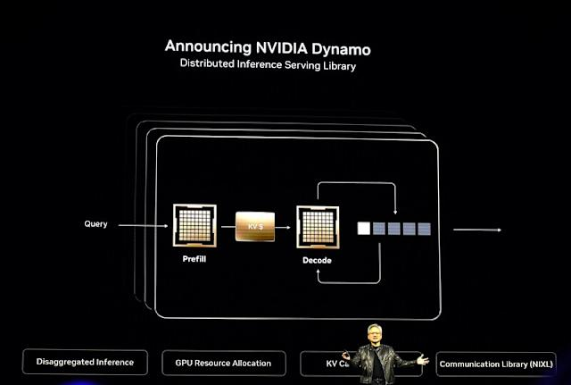
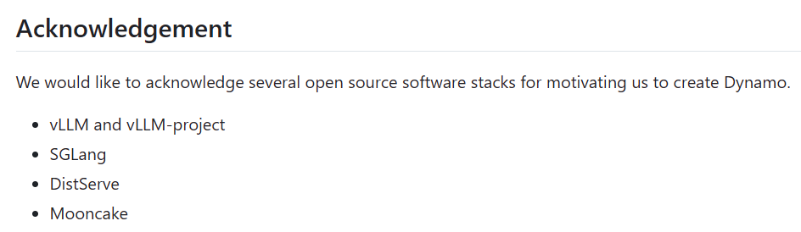
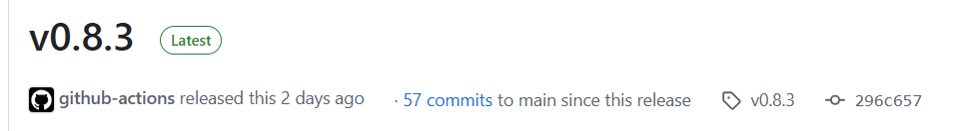

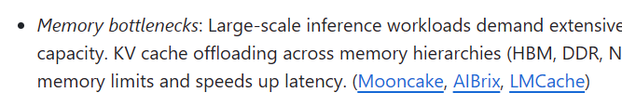

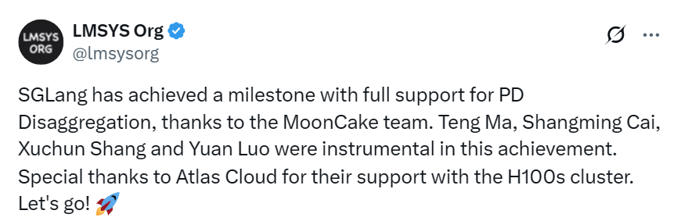
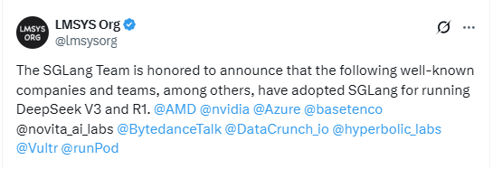
Mooncake – Adopted/Collaborated with Other Famous Communities
NVIDIA Dynamo
Spotlighted by Jensen Huang at GTC 2025 Keynote
Its architecture is inspired by Mooncake, with explicit acknowledgments
One of the most widely used inference engines, adopted by major cloud providers
Its distributed inference is built on Mooncake
Inference engine of xAI, widely used in DeepSeek inference
Distributed architecture was co-developed with Mooncake
Notes:
More importantly, we are now collaborating with other important communities in LLM serving to build a common standard of distributed serving of LLM.
For example vLLM and SGLang are two of the most popular open source LLM serving projects. They both use our Mooncake as the backbone of implementing there distributed serving framework.
Also n this year’s GTC Jensen Huang publish the Dynamo system in his keynot, which is also based on our Mooncake’s architecture and we are collaborating.

Slide 22

Key to KVCache
Mooncake Transfer Engine
End-to-end zero-copy
⚡ Transfer Fast
High-performance distributed
KV cache storage
📚 Store More
✅ Easy to Use
Elastic, Shared, and Multi-layer KV Cache
Memory Allocator Optimized for LLM Inference
Extensive and user-friendly APIs

Slide 23
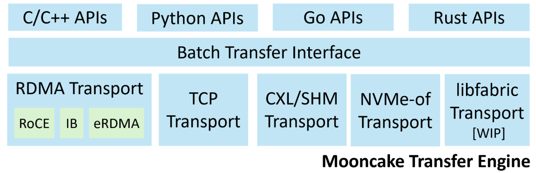
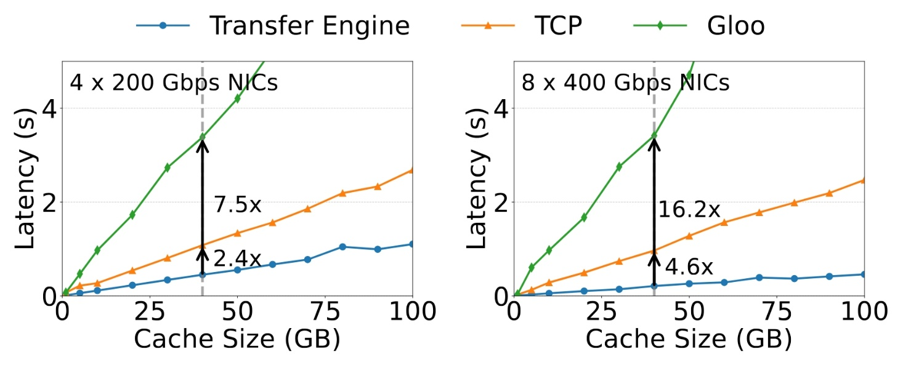
Transfer Fast: Mooncake Transfer Engine
Key features
  Topology-aware path selection
  Multi-NIC pooling
  Supports multiple protocols and provides unified interfaces.
  Multi-language APIs
Lightening fast over RDMA
40 GB KVCache (128k tokens, LLaMA3-70B)
87 GB/s @ 4×200 Gbps, RoCE
190 GB/s @ 8×400 Gbps, RoCE

Slide 24
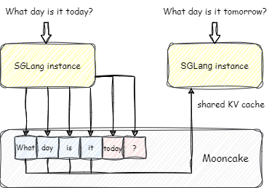
Store More: Elastic Shared Multi-layer KV Cache
Key features
  Distributed KV cache sharing: storing one and usable by all
  Dynamic resource scaling: dynamically adding and removing store nodes (startup in <80s for 500GB memory and 8 RDMA NICs)
  Multi-layer storage (WIP): offloading cached data from RAM to SSD

Slide 25
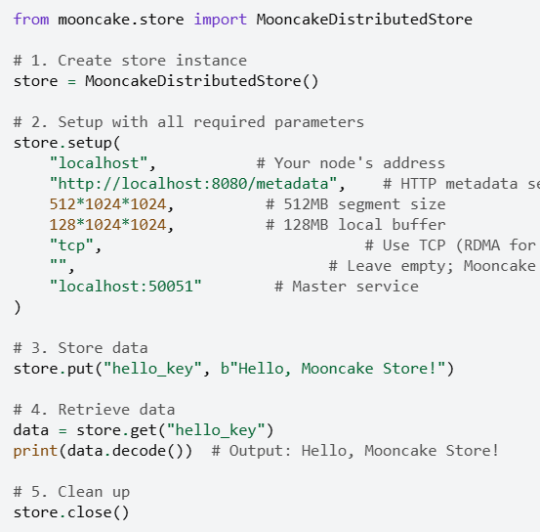
Extensive APIs, Easy to Use
Put/Get APIs
Put/Get single object
Batch Put/Get
(Batch) Zero-copy Put/Get: recommended
(Batch and zero-copy) Put/Get from/into multi-parts
Hello world example
Configurable KV cache placement
Replica number
With soft pin
Preferred segment

Slide 26
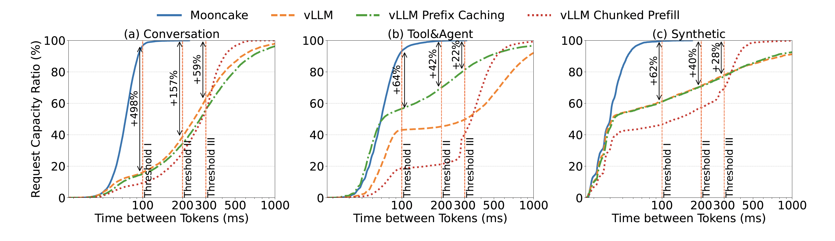
Evaluation: Effective Request Capacity
Effective request capacity: Number of requests that meet the latency requirements
Achieve up to a 498% increase in effective request capacity compared to vLLM, vLLM with prefix caching and with chunked prefill
Better
Better
Better

Slide 27
Heterogeneous GPU Interconnects
Multiple paths coexist within the same cluster
Node 1
Node 2
DRAM
UPI
DRAM
CPU
DRAM
CPU
CPU
DRAM
CPU
DRAM
DRAM
PCIe Switches
PCIe Switches
PCIe Switches
PCIe Switches
PCIe Switches
GPU
NIC
NVMe SSD
GPU
NIC
GPU
NIC
GPU
NIC
GPU
NIC
GPU
NIC
GPU
NIC
GPU
NIC
NIC
GPU
NIC
GPU
NIC
GPU
NIC
GPU
DRAM
DRAM
GPU-Direct Storage
NVMe-of Attached
SSD
NVLink Switches
NVLink
GPU-Direct RDMA
RDMA Network

Slide 28
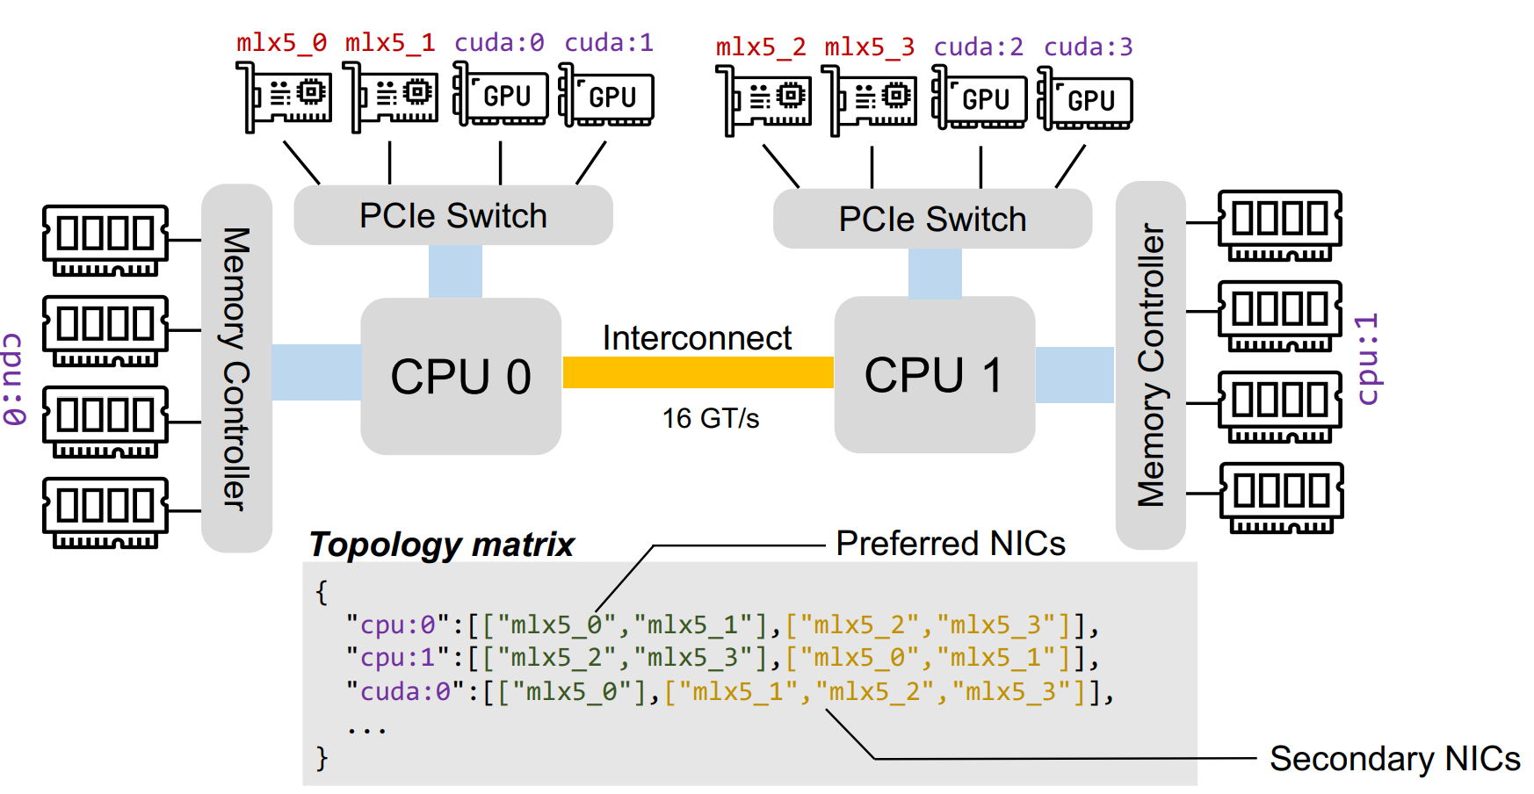
Hidden Risks of Mooncake TE
auto engine = new TransferEngine();
engine.installTransport(“rdma”, args);
auto id = engine.allocateBatch();
engine.submitTransfer(id, reqs);
while (true) engine.getStatus(id, st);
engine.freeBatch(id);
The Imperative Path Selection Paradigm
  made static binding decisions once at startup
  executed a fixed, state-blind path scheduling policy
  executed fragilely, and lacks mechanisms to detect & bypass unavailable paths

Slide 29

Challenges from Imperative Path Selection
Static Binding
  Creates communication silos
Data Plane Path
Without GPU-Direct
(e.g., GTX series)
Physical Node
With GPU-Direct
GPU
GPU
NIC
NIC
NIC
NIC
GPU
GPU
GPU
GPU
NIC
GPU
NIC
GPU
NIC
NIC
NVLINK
GDU Direct RDMA
RDMA Network
RDMA Network
RDMA Network
???
GDU Direct RDMA
Different workloads, different transports
Different hardware, different transports

Slide 30
Challenges from Imperative Path Selection
State-Blind Scheduling
  Increases latency and wastes bandwidth
Slices from this request
Slices from concurrent requests
A transfer request with 2560 KB
40 slices in total (each 64KB)
Topology matrix snippets:
“cpu:0”: {[NIC0, NIC1, NIC2, NIC3], […]}
NIC0
NIC1
NIC2
NIC3
Transfer Latency

Slide 31
Challenges from Imperative Path Selection
Fragile Execution
  Requires manual intervention and heavy troubleshooting
Process 1
Process 2
  What if a single RDMA fabric failed?
NIC
NIC
NIC
NIC
NIC
NIC
NIC
NIC
  What if a single process crashed?
RDMA Switches
  What if the RDMA switch failed?

Slide 32
TENT: Transfer Engine NT
(New Technology)
Goal: Make all transports first-class citizens
vLLM
SGLang
Dynamo
LMCache
Checkpoint Engine
NIXL
Mooncake Store
...
Transfer Engine APIs
Orchestration
Unified Segment Abstraction
Discover
Routing
Staging
Buffers
Devices
Plugin Loaders
Error Handling
Topology
Transport Plugins (load all if possible)
Control Plane Plugins
RDMA (with GDR/eRDMA)
NVLink
MNNVL
TCP
RoCM
P2P
etcd
SHM/CXL
GDS
io_uring
HIXL
...
Redis
HTTP
Heterogeneous GPU Interconnects

Slide 33
Features of Mooncake TENT
Dynamic Orchestration
  Unified Segment Abstraction
  Application-Oblivious Topology Discovery
  Dynamic Per-Request Orchestration
Adaptive Slice Spraying
  Latency Prediction based NIC Selection
  Cross-Process Fairness
Resilient Self-Healing
  Link-Level Resilience
  Transport-Level Resilience

Slide 34
Unified Segment Abstraction
(applicable to all transports)
0
UINT64_MAX
Logical View
cpu:0
cpu:1
cuda:0
name: node050:12345
This segment can be referred as the engine’s host and port
Metadata View
type: memory
location: cpu:0
location: cpu:0
location: cpu:0
topology
tier 1 devices: [mlx5_0, …]
address
tier 1 devices: [mlx5_0, …]
address
tier 1 devices: [mlx5_0, …]
buffers
address
tier 2 devices: []
length
tier 2 devices: []
length
tier 2 devices: []
devices
length
tier 3 devices: [mlx5_4, …]
location: cpu:0
tier 3 devices: [mlx5_4, …]
location: cpu:0
tier 3 devices: [mlx5_4, …]
location: cpu:0
transports: [nvlink, rdma, tcp]
name: mlx5_0
transports: [nvlink, rdma, tcp]
Topology
name: mlx5_0
transports: [nvlink, rdma, tcp]
nvlink/handle
transport
specific
data
nvlink/handle
type: rdma
transport
specific
data
nvlink/handle
type: rdma
transport
specific
data
rdma/rkeys
rdma/rkeys
transport
specific
data
rdma/rkeys
rdma/{lid,gid}
transport
specific
data
rdma/{lid,gid,props}
…
…
…
…
…
Buffers
Devices

Slide 35
Application-Oblivious Topology Discovery
Step 1: Probe hardware information
  List of memory/NIC devices
  Their NUMA affinity, PCIe Bus ID
  Capabilities: bandwidth, direct-access, etc.
  MEM:
  cpu:[0-1],
  cuda:[0-7]
  NIC:
  mlx5_[1-8]
DRAM
UPI
DRAM
DRAM
CPU
CPU
DRAM
DRAM
cpu:0
DRAM
cpu:1
PCIe Switches
PCIe Switches
PCIe Switches
PCIe Switches
ssd:0
cuda:0
mlx5_5
cuda:1
mlx5_6
cuda:2
mlx5_7
cuda:3
mlx5_8
mlx5_1
cuda:4
mlx5_2
cuda:5
mlx5_3
cuda:6
mlx5_4
cuda:7

Slide 36
Application-Oblivious Topology Discovery
Step 1: Probe hardware information
Step 2: Maps NICs for each MEM
  Tier 1: NIC(s) with the shortest PCIe hop
  Tier 2: same NUMA but not in tier 1
  Tier 3: cross NUMA
:{
[ , ],
[ , ],
[ , , , ]}
cuda:0
mlx5_5
mlx5_6
…………….
…………….
mlx5_7
mlx5_8
mlx5_1
mlx5_2
mlx5_3
mlx5_4
DRAM
UPI
DRAM
DRAM
CPU
CPU
DRAM
DRAM
cpu:0
DRAM
cpu:1
PCIe Switches
PCIe Switches
PCIe Switches
PCIe Switches
ssd:0
cuda:0
mlx5_5
cuda:1
mlx5_6
cuda:2
mlx5_7
cuda:3
mlx5_8
mlx5_1
cuda:4
mlx5_2
cuda:5
mlx5_3
cuda:6
mlx5_4
cuda:7

Slide 37
Application-Oblivious Topology Discovery
Step 1: Probe hardware information
Step 2: Maps NICs for each MEM
Step 3: Load transports
  Runtime support and transports can be dynamic libraries
  They can be loaded on runtime (e.g., if CUDA is enabled)
DRAM
UPI
DRAM
DRAM
CPU
CPU
DRAM
RDMA (with GDR)
DRAM
cpu:0
DRAM
cpu:1
NVLink
PCIe Switches
PCIe Switches
PCIe Switches
PCIe Switches
TCP
ssd:0
cuda:0
mlx5_5
cuda:1
mlx5_6
cuda:2
mlx5_7
cuda:3
mlx5_8
mlx5_1
cuda:4
mlx5_2
cuda:5
mlx5_3
cuda:6
mlx5_4
cuda:7
Ascend NIXL
Not loaded

Slide 38
Dynamic Per-Request Orchestration
Opcode
Opcode
Opcode
RDMA (with GDR)
Local address
Orchestration
Local address
Local address
Target Segment ID
Routing
NVLink
User Request
Target Segment ID
Remote segment ID
Target Offset
Target Offset
Staging
Remote offset/addr
TCP
Length
Length
Length
Decide transports for each request using the Unified Segment
  Local address
  find local MEM type
  find local installed transports
  Remote segment ID & offset/address
  find remote MEM type
  find remote installed transports
Prefer to use a transport with the highest speed, and supported by both sides

Slide 39
Features of Mooncake TENT
Dynamic Orchestration
  Unified Segment Abstraction
  Application-Oblivious Topology Discovery
  Dynamic Per-Request Orchestration
Adaptive Slice Spraying
  Latency Prediction based NIC Selection
  Cross-Process Fairness
Resilient Self-Healing
  Link-Level Resilience
  Transport-Level Resilience

Slide 40
Telemetry-Driven Adaptive Scheduling
Static path selection → suboptimal performance in heterogeneous environments
How to reduce transfer latency and avoid bandwidth waste
  Predict: select local-remote NIC pair based on historical telemetry
  Feedback: use measured latency to update prediction parameters

Slide 41
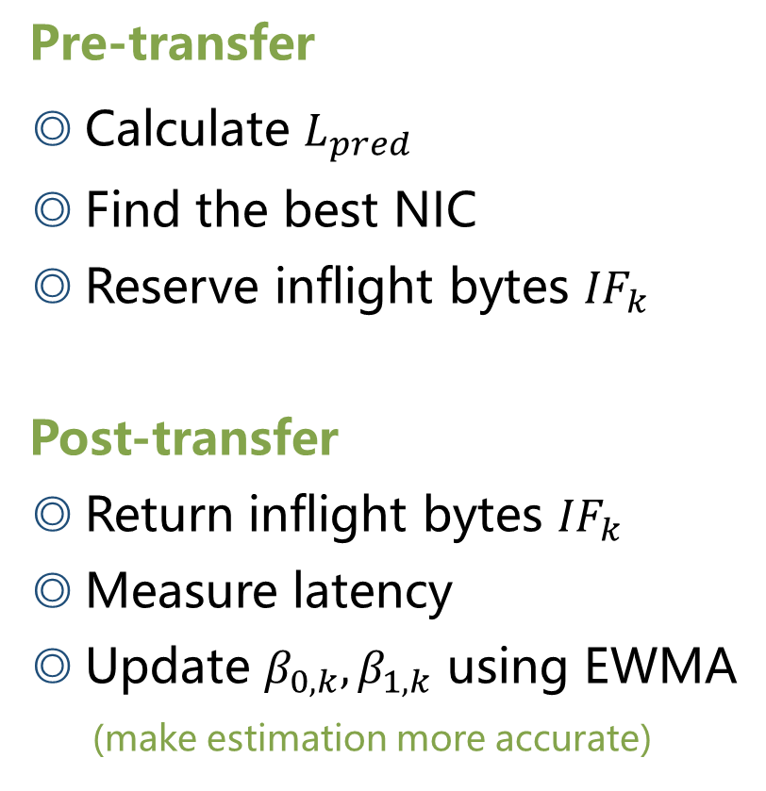
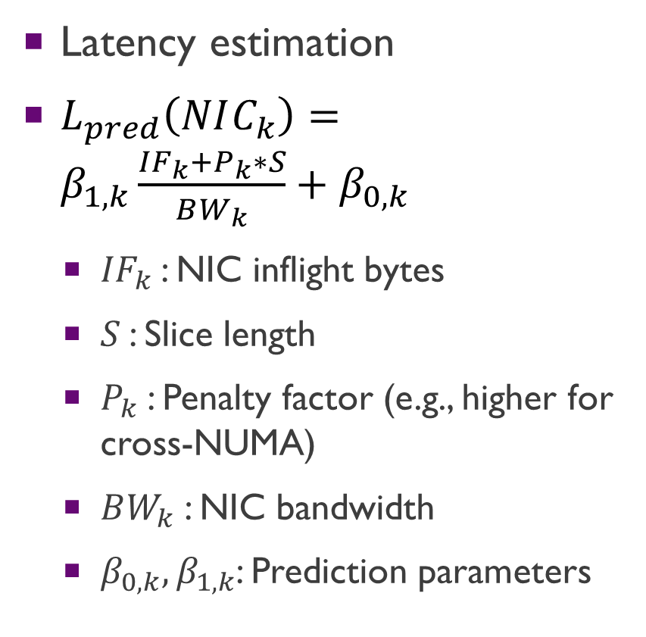
Local NIC Selection
Latency estimation
$L_{pred}\left(NIC_{k}\right)=β_{1,k}\frac{{IF}_{k}+P_{k}∗S}{BW_{k}}+β_{0,k}$
  ${IF}_{k}$: NIC inflight bytes
  $S$: Slice length
  $P_{k}$: Penalty factor (e.g., higher for cross-NUMA)
  $BW_{k}$: NIC bandwidth
  $β_{0,k},β_{1,k}$: Prediction parameters
  Pre-transfer
  Calculate $L_{pred}$
  Find the best NIC
  Reserve inflight bytes ${IF}_{k}$
  Post-transfer
  Return inflight bytes ${IF}_{k}$
  Measure latency
  Update $β_{0,k},β_{1,k}$ using EWMA
  (make estimation more accurate)

Slide 42
Cross-Process Fairness
How to avoid any single process from saturating NICs?
  Coarse-grained quota allocation
Decentralized, shared-memory implementation
  Not every scheduling task enters the global level
  Interval: ~tens of milliseconds
  Tolerant shutdown/crashes of any process
/dev/shm/mooncake
NIC1
NIC2
Lock Manager
...
NIC8
Local NIC Scheduler
Local NIC Scheduler
Local NIC Scheduler

Slide 43
Features of Mooncake TENT
Dynamic Orchestration
  Unified Segment Abstraction
  Application-Oblivious Topology Discovery
  Dynamic Per-Request Orchestration
Adaptive Slice Spraying
  Latency Prediction based NIC Selection
  Cross-Process Fairness
Resilient Self-Healing
  Link-Level Resilience
  Transport-Level Resilience

Slide 44
Proactive Dual-Layer Resilience
RDMA Resource Lifecycle
  Endpoint == NIC-to-NIC connection
EP: NIC 1 – Proc 2 NIC 1
EP: NIC 3 – Proc 2 NIC 3
QP
QP
QP
EP: NIC 2 – Proc 2 NIC 2
QP
QP
QP
QP
QP
QP
QP
QP
READY
Process 1
Process 2
Link-Level Resilience
  Detect failed/unstable link: PAUSE, CLOSE or TERMINATE
  Allow suboptimal path
NIC1
NIC2
NIC3
NIC1
NIC4
NIC2
NIC3
NIC4
RDMA Switches

Slide 45
Proactive Dual-Layer Resilience
Transport-Level Resilience
  Transparent fallback to other transports
  (e.g., RDMA→TCP)
  Driven by Dynamic Per-Request Orchestration
Recovery
  Transport/path will be reused after link recovery
Process 1
Process 2
NIC
NIC
NIC
NIC
NIC
NIC
NIC
NIC
RDMA Switches
TCP link(s)

Slide 46
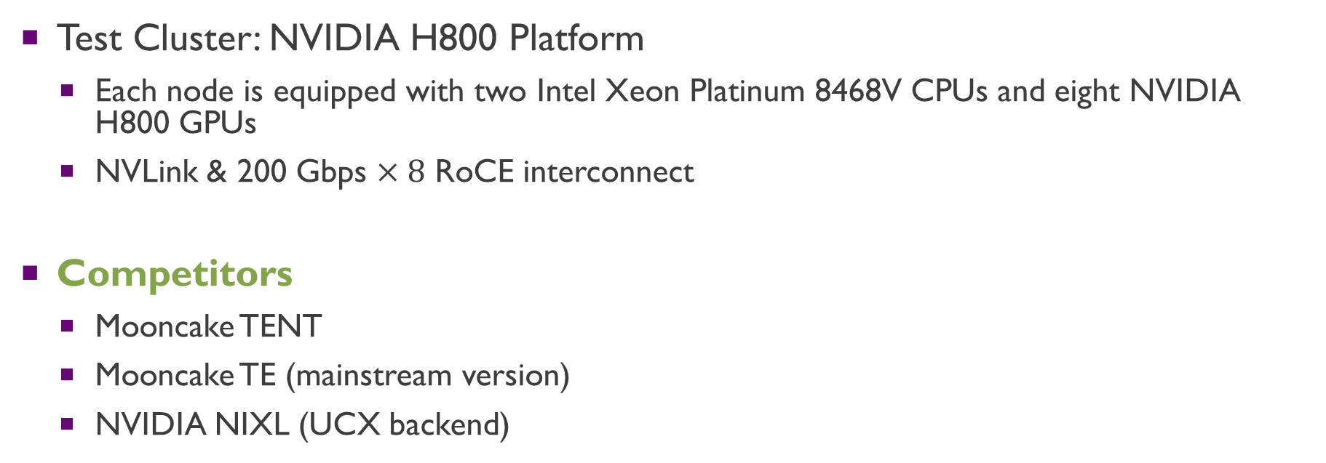
Evaluation
Test Cluster: NVIDIA H800 Platform
  Each node is equipped with two Intel Xeon Platinum 8468V CPUs and eight NVIDIA H800 GPUs
  NVLink & 200 Gbps $×8$ RoCE interconnect
Competitors
  Mooncake TENT
  Mooncake TE (mainstream version)
  NVIDIA NIXL (UCX backend)

Slide 47
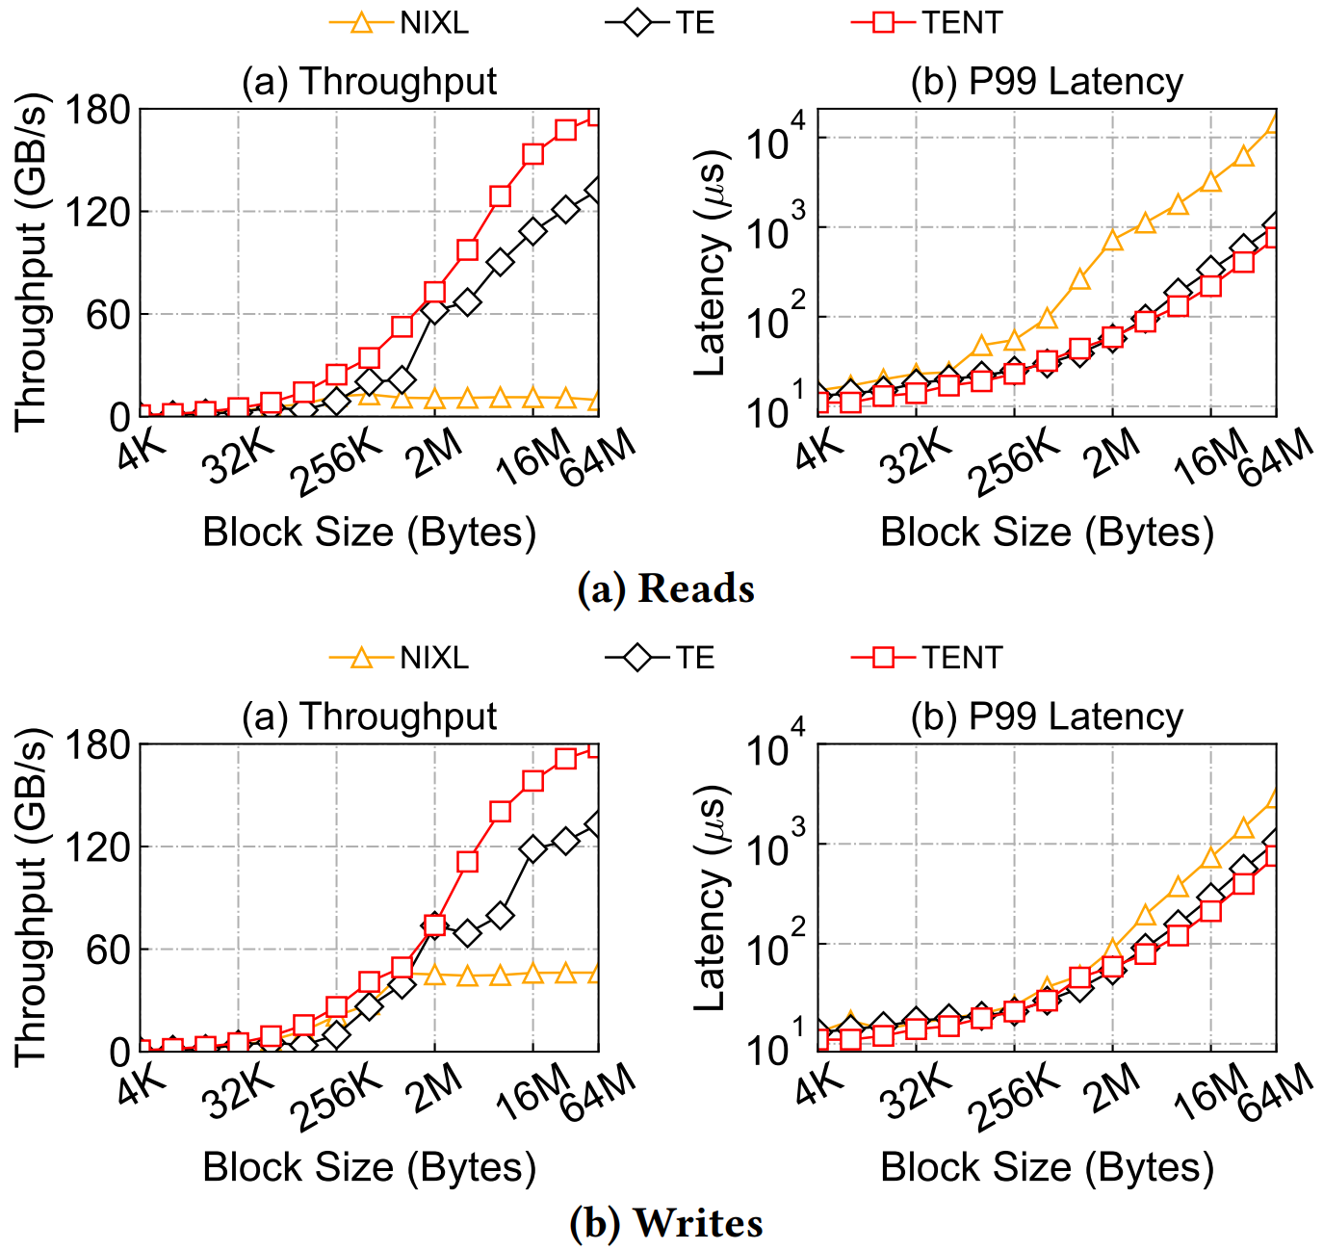
Evaluation
Synthetic Workload
  Block size range from 4KB to 64MB
  Two concurrent threads, 8 NICs are fully utilized

Slide 48
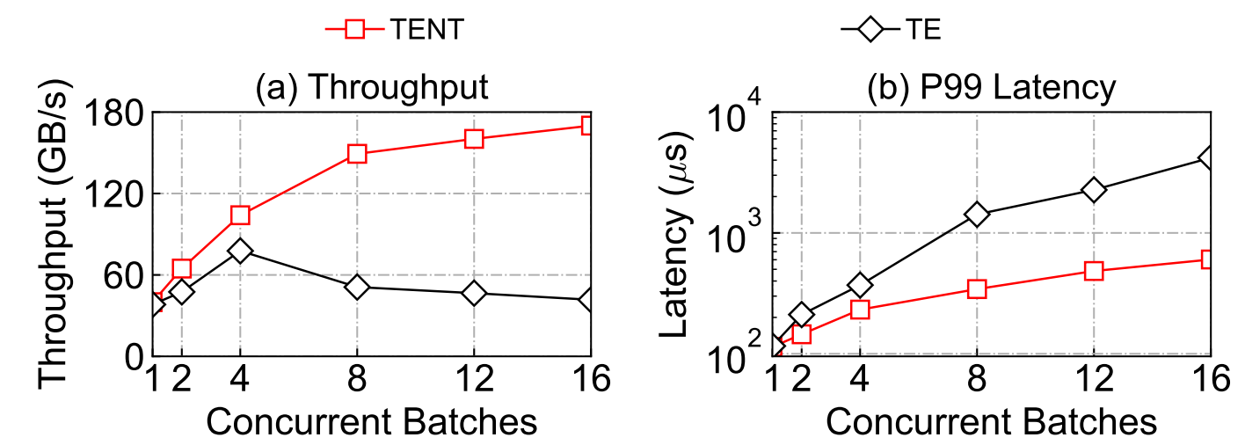
Evaluation
KVCache Transfer Benchmark
  Workload: DeepSeek-R1-W8A8 model with a 4K input
  Comprises 61 layers, each containing 32 blocks of 144 KB, consisting of a 128 KB NoPE block and a 16 KB RoPE block

Slide 49

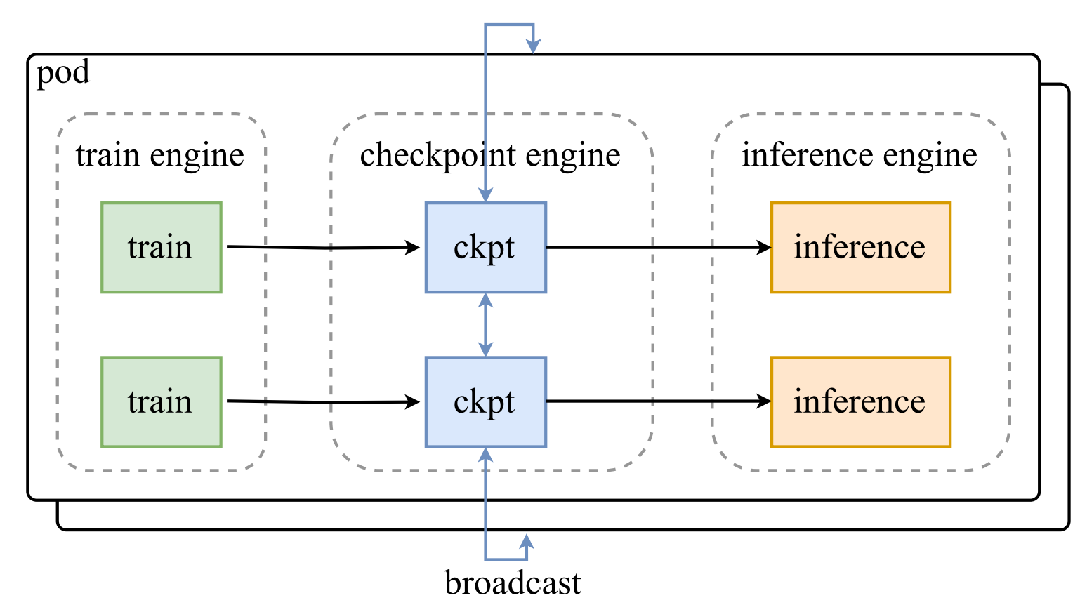
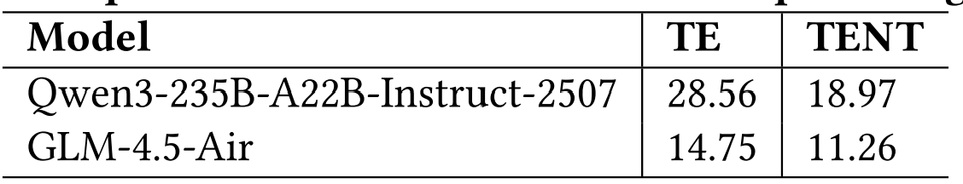
Evaluation
Case Study: Moonshot AI Checkpoint Engine
  Open source with Kimi K2
  Update model weights in LLM
  inference engines
  Update time ∝ transfer latency

Slide 50
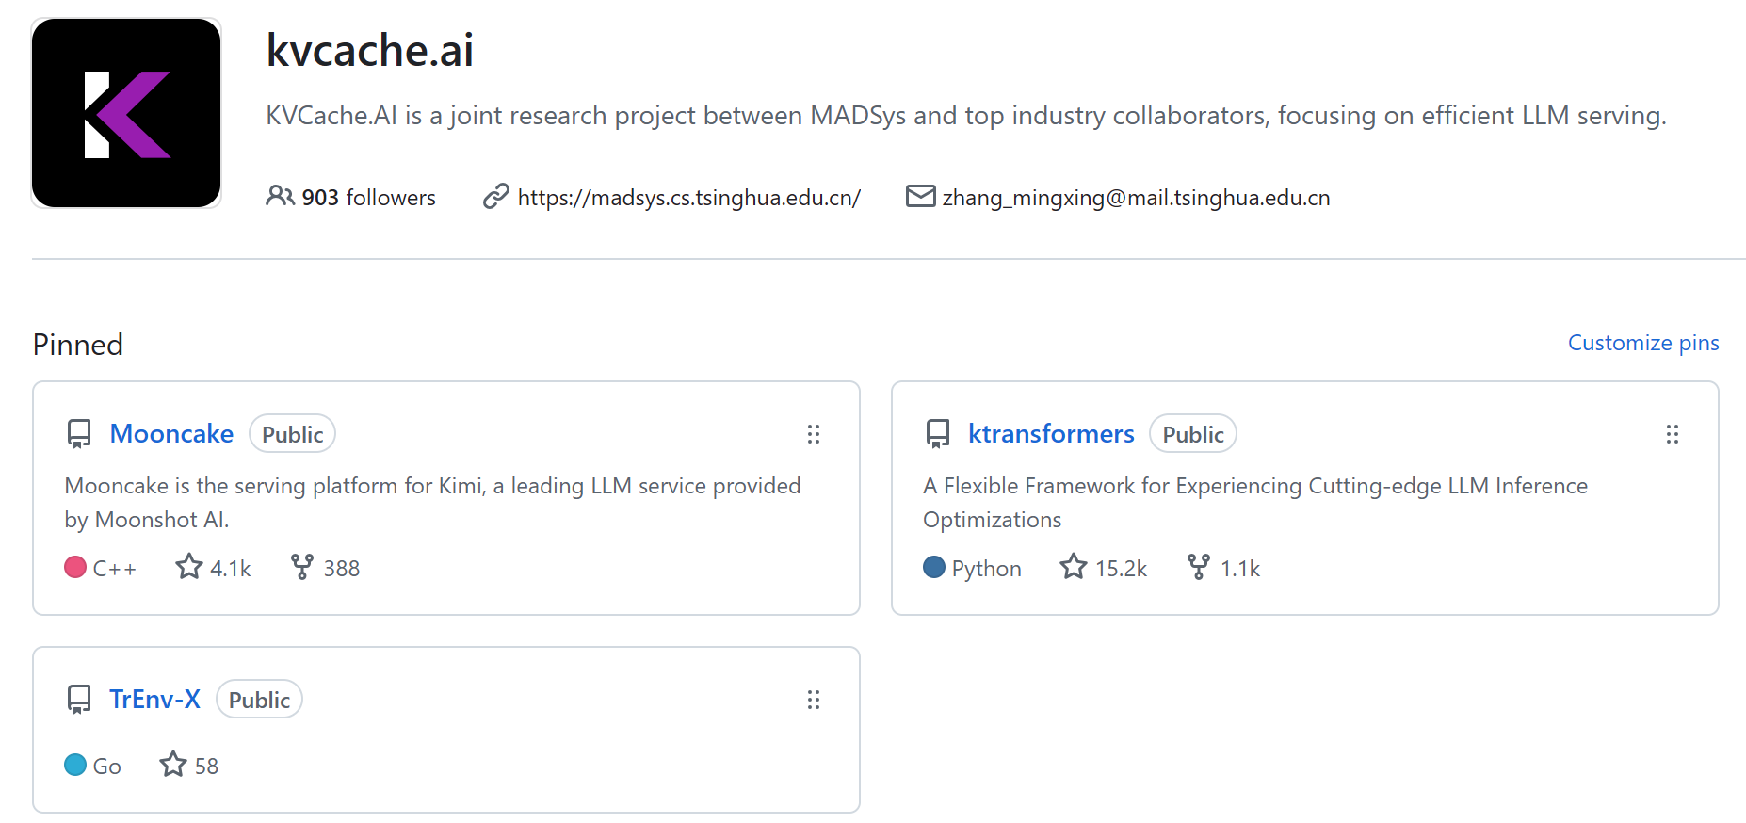
Thanks!
https://github.com/kvcache-ai

