Slide 1

CCAMP Working Group
IETF 97th
Online Agenda and Slides at:
http://www.ietf.org/proceedings/97/agenda/agenda-97-ccamp
Data tracker: http://datatracker.ietf.org/wg/ccamp/
Tools page: http://tools.ietf.org/wg/ccamp

Slide 2
IETF Note Well
This summary is only meant to point you in the right direction, and doesn't have all the nuances. The IETF's IPR Policy is set forth in BCP 79; please read it carefully.
The brief summary:
By participating with the IETF, you agree to follow IETF processes.
If you are aware that a contribution of yours (something you write, say, or discuss in any IETF context) is covered by patents or patent applications, you need to disclose that fact.
You understand that meetings might be recorded, broadcast, and publicly archived.
For further information, talk to a chair, ask an Area Director, or review the following:
BCP 9 (on the Internet Standards Process)
BCP 25 (on the Working Group processes)
BCP 78 (on the IETF Trust)
BCP 79 (on Intellectual Property Rights in the IETF)
Also see: http://www.ietf.org/about/note-well.html:

Slide 3
Administrative
Audio Streaming/Recording
  Please speak only using the microphones
  Please state your name before speaking
Minute takers & Etherpad
Jabber
97th IETF CCAMP Working Group
3

Slide 4
Sessions
Session I: Monday, Joint session with TEAS, MPLS, and PCE
  15:50-17:50 Monday Afternoon
  Park Ballroom 2
Session II: Thursday
  13:30-15:00 Thursday Afternoon
  Studio 2
Details:
https://datatracker.ietf.org/meeting/97/materials.html
97th IETF CCAMP Working Group
4

Slide 5
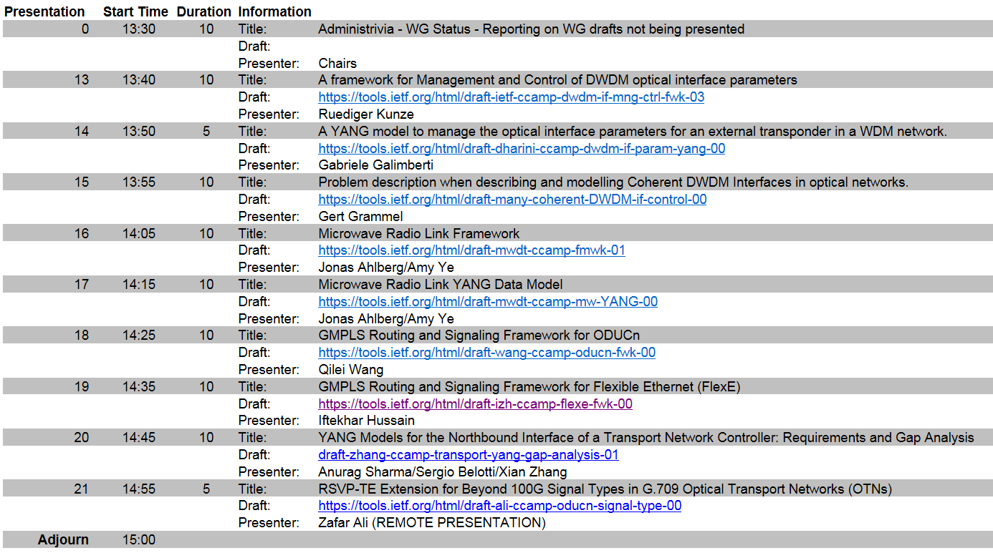
Agenda – Session II

Slide 6
Reminder: IPR Process
Polling of draft authors & contributors
  Prior to moving to next step in WG process
    e.g., before an individual draft becomes a WG document or a WG document goes to last call
  Requires IPR compliance statement from all listed in draft

Slide 7
Reminder - Utilizing Mailing List
We strongly encourage the mailing list to be more actively used for all Working Group discussions
  Open issues
  Introducing new drafts
  Potential new Working Group topics
Reminder – Working Group Consensus is determined on the mailing list
Future meeting time will be scheduled relative to mailing list discussion
7

Slide 8
CCAMP Working Group
Status
Chairs:
Daniele Ceccarelli <daniele.ceccarelli@ericsson.com>
Fatai Zhang <zhangfatai@huawei.com>
Secretary:
Oscar Gonzalez de Dios
<oscar.gonzalezdedios@telefonica.com>
Responsible AD:
Deborah Brungard <db3546@att.com>
8

Slide 9
Document Status – RFCs
New Errata:
  None
Recent RFCs:
  RFC 7963: Resource ReserVation Protocol-Traffic Engineering (RSVP-TE) Extension for Additional Signal Types in G.709 OTN
RFC Editor’s Queue:
  None
IESG processing
  draft-ietf-ccamp-ospf-availability-extension
97th IETF CCAMP Working Group

Slide 10
Document Status –
Post/Pre WG Last Call
  Waiting for authors
  None
  WG LC (including IPR poll before WG LC)
  None
  Post WG LC – Publication requested
  draft-ietf-ccamp-flexible-grid-ospf-ext
97th IETF CCAMP Working Group
10

Slide 11
Document Status –
WG Drafts on Agenda
draft-ietf-ccamp-dwdm-if-mng-ctrl-fwk
97th IETF CCAMP Working Group
11

Slide 12
Document Status –
WG Drafts Not on Agenda
draft-ietf-ccamp-flexible-grid-ospf-ext
  Post WG LC
draft-ietf-ccamp-grid-property-lmp
  Progress after flexible-grid-OSPF
draft-ietf-ccamp-rsvp-te-bandwidth-availability
  Progress after OSPF-TE bw availability
draft-ietf-ccamp-wson-iv-info
  Recently refreshed
draft-ietf-ccamp-wson-yang
97th IETF CCAMP Working Group
12

Slide 13
Liaisons and Communications
From ITU-T SG15
  Title: LS on SG15 OTNT Standardization Work Plan
  Submission Date: 2016-10-05
  URL of the IETF Web page:
  https://datatracker.ietf.org/liaison/1494/
To ITU-T SG15
  Title: Reply to SG15 Liaison regarding OTNT Standardization Work Plan
  Submission Date: 2016-10-14
  URL of the IETF Web page:
  https://datatracker.ietf.org/liaison/1497/
Please review incoming documents and comment on ccamp@ietf.org
13

Slide 14
Design Team – Transport NBI
Problem Statement:
Transport networks, such as Optical Transport Network (OTN) and Wavelength Division Multiplexing (WDM) networks, are built using equipment from a single vendor and are managed using proprietary interfaces to dedicated Element Management Systems (EMS) / Network Management Systems (NMS).
A common open interface to each domain controller/management system is pre-requisite for network operators to control multi-vendor/multi-domain networks and enable also service provisioning coordination/automation. This can be achieved by using standardized YANG models, used together with an appropriate protocol (e.g., RESTCONF).
However, there is no common understanding and often confusion of how the existing models in IETF can be used for transport networks. Furthermore, there is no clear answer to the question of whether there is missing information in the existing models (available in IETF or other SDOs) or even missing models since existing drafts focus on providing only the YANG models and explanation around them.
draft-zhang-ccamp-transport-yang-gap-analysis-00 already provides an overview of the problem.
Goals/Deliverables:
  Use cases and Gap analysis: identify a set of use cases and providing a gap analysis against existing models (both IETF and non-IETF models).
  Missing YANG models: provided as new models or, where possible, as augmentation of existing IETF models
  Guidelines: Providing guidelines in terms of how all the related models can be used in a step-wise manner, using a couple of well identified transport network use cases.
Relationship with other work:
The Transport NBI is applicable to the ACTN (Abstraction and Control of TE Networks) architecture defined in the TEAS WG, and the models produced by the DT will need to be applicable to the technology specific extensions of the ACTN MPI interface (MDSC-PNC interface).
97th IETF CCAMP Working Group
14

Slide 15
Design Team – Transport NBI
Daniel King d.king@lancaster.ac.uk
Italo Busi Italo.Busi@huawei.com
Luis Miguel Contreras Murillo luismiguel.contrerasmurillo@telefonica.com
Oscar González de Dios oscar.gonzalezdedios@telefonica.com
Zhangxian zhang.xian@huawei.com
Tara Cummings tara.cummings@ericsson.com
Yan Shi shiyan49@chinaunicom.cn
Monali Chakrabarty MChakrabarty@advaoptical.com
Rod Lu lu.rongduo@zte.com.cn
Carlo Perocchio carlo.perocchio@ericsson.com
Qilei Wang wang.qilei@zte.com.cn
Xing Zhao zhaoxing@ritt.cn
Yunbin Xu xuyunbin@ritt.cn
Zheng Haomian zhenghaomian@huawei.com
Dieter Beller dieter.beller@nokia.com
Sergio Belotti sergio.belotti@nokia.com
Michael Scharf michael.scharf@nokia.com
Young Lee ylee@huawei.com
Anurag Sharma ansharma@infinera.com
97th IETF CCAMP Working Group
15

