Slide 1
Microwave Radio Link Framework
draft-mwdt-ccamp-fmwk-00
IETF 97 - Seoul – CCAMP WG
Microwave Design Team
J. Ahlberg (Ericsson) J. Tantsura (Individual)
LM. Contreras (Telefonica) K. Kawada (NEC)
A. Ye Min (Huawei) X. Li (NEC)
M. Vaupotic (Aviat Networks) I. Akiyoshi (NEC)
CJ. Bernardos (UC3M)

Slide 2

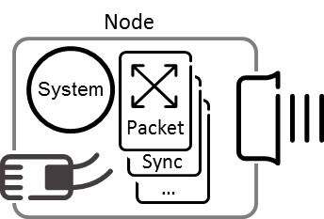
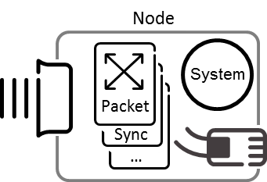
SCOPE
Replaces draft-mwdt-ccamp-problem-statement-00
Framework for management & control of radio link interfaces including their relationship to other packet interfaces in a microwave node.
The basis for draft-mwdt-ccamp-mw-yang-00
Microwave & millimeter wave - 6 GHz to +100GHz
Access technologies such as 3G/4G/5G and WiFi base stations are outside the scope
For traditional NMS & unified management within SDN
NMS/SDN
NETCONF YANG
Radio Link
Interfaces

Slide 3
Status
1st revision presented at IETF 96
Comments received & incorporated in this new revision of the document
Updated
Terminology
Introduction
Approaches to manage & control radio link i/f
Use cases
Added
Requirements
What to be fulfilled by the YANG Data Model
Gap Analysis
Recommend what existing/draft models to support the use cases and requirements
Recommend how gaps should be filled, including the need for new models and evolution of existing models and drafts

Slide 4
Conclusion
A Microwave Radio Link YANG Data Model should
support the use cases and requirements defined
use the structure in the [I-D.ahlberg-ccamp-microwave-radio-link]
use the [I-D.ahlberg-ccamp-microwave-radio-link] and the ONF Microwave Models as the basis for the data nodes and proposing new ones to cover identified gaps
add the required data nodes to describe the interface layering for the packet & TDM capacity provided by a radio link terminal
support configuration of microwave specific alarms
rely on a generic models such as [I.D.vallin-netmod-alarm-module] and [I-D.ietf-netmod-entity] for notifications, alarm synchronization and physical/equipment inventory.
be validated by both operators and vendors as part of the process to make it stable and mature.

Slide 5
Way Forward
To be adopted by WG
Seeking for review and comments

