Slide 1
A YANG Data Model for Microwave Radio Link draft-mwdt-ccamp-mw-yang-00
J. Ahlberg(Ericsson)
M. YE (Huawei)
X. Li(NEC Laboratories Europe)
CJ. Bernardos(UC3M)
IETF 97 CCAMP November 2016 Seoul

Slide 2
Overview
The draft defines a YANG data model in order to control and manage the radio link interfaces, and the connectivity to packet (typically Ethernet) interfaces in a microwave/millimeter wave node.
  follows the framework in [draft-mwdt-ccamp-fmwk-00], which defines the use cases and requirements, and provides detailed gap analysis of the current existing/drafts models
  augments RFC 7223 to align with the same structure for management of the packet interfaces.
  use the structure in the [draft-ahlberg-ccamp-microwave-radio-link-01]
  use the [draft-ahlberg-ccamp-microwave-radio-link-01] and the ONF Microwave Models as the basis for the definition of the detailed configuration parameters and proposing new ones to cover the identified gaps that are analyzed in [draft-mwdt-ccamp-fmwk-00]

Slide 3
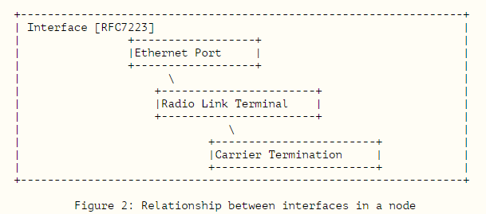
Main scope of the model
RLT (Radio link termination)- config/state
CT (Carrier termination) - config/state
Protection - config/state
XPIC(Cross Polarization Interference Cancellation) – config
MIMO (Multiple-Input Multiple-Output)- config
draft-mwdt-ccamp-fmwk-00

Slide 4
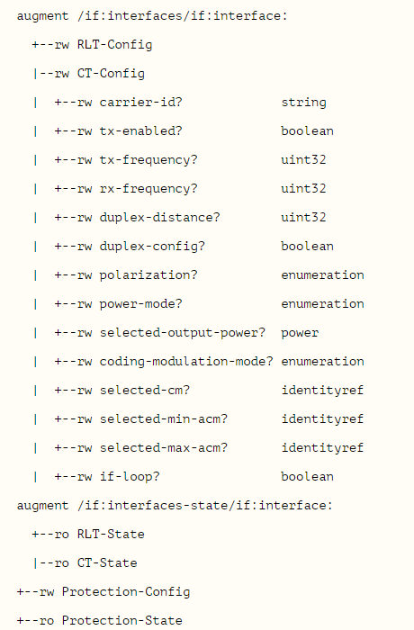

MW YANG module
  module: ietf-microwave-radio-link
the current version only includes model definitions of CT-Config. The rest is to be provided.

Slide 5
Next steps
To be adopted by WG?
Continue working to finalize the model
Seeking for review and comments
Side discussion during this week, welcome to join

