Slide 1
dnssd WG
Chairs:
Ralph Droms, rdroms@cisco.com
Tim Chown, tim.chown@jisc.ac.uk
(Tim Wicinski is deputising for Ralph)
IETF 97, Seoul, 17th November 2017

Slide 2
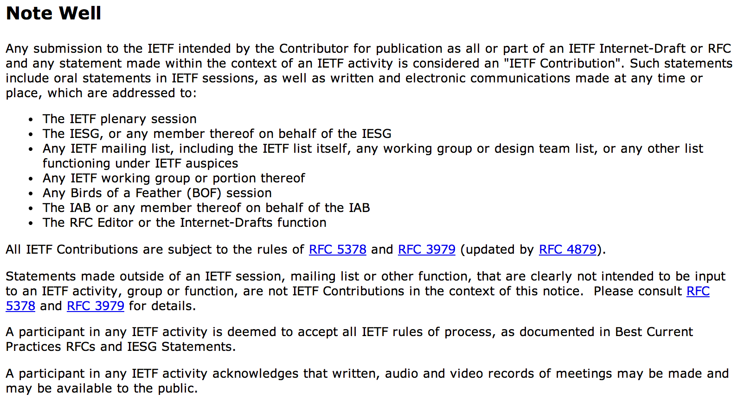

Slide 3
Minute taker & Jabber relay
Jabber relay
  Volunteer please?
  dnssd room on jabber.ietf.org server
Minute taker
  Volunteer please?
  Suggest collaborative use of etherpad-97 link at http://tools.ietf.org/wg/dnssd/minutes
  It’s primed with the agenda topics
  (others are welcome to help ☺)

Slide 4
WG info
Charter:
  http://datatracker.ietf.org/wg/dnssd/charter/
Status pages for drafts:
  https://datatracker.ietf.org/wg/dnssd/documents/
Meeting materials:
  https://datatracker.ietf.org/meeting/96/materials.html/#dnssd
Mail list:
  dnssd@ietf.org
  To join: https://www.ietf.org/mailman/listinfo/dnssd

Slide 5
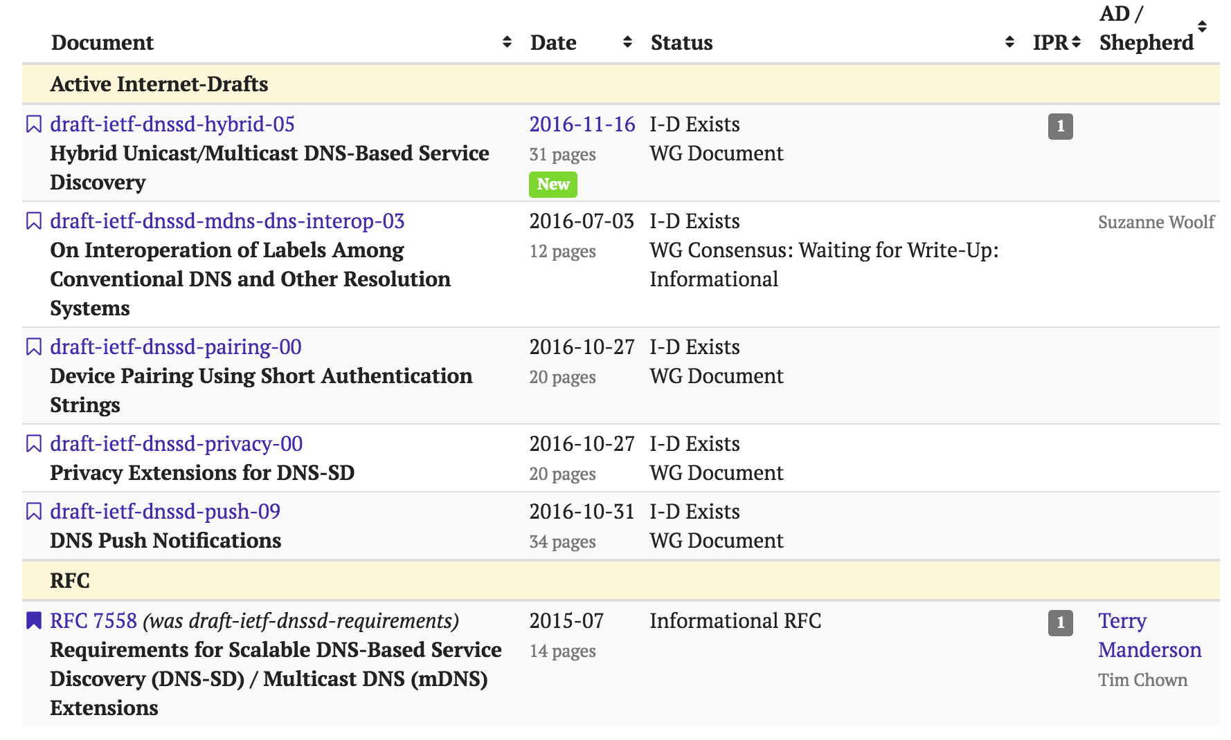
Document statuses
Notes:
We will talk later about dnssd-hybrid
Dnssd-mdns-dns-interop waiting for shepherd’s cover sheet and submissino to IESG
Dnssd-push discussed here

Slide 6
Goals for this session
The main goals of this session are to:
  Check OK to send Hybrid Proxy draft to the IESG
  Determine the remaining work for DNS Push
  Ensure WG is supportive of the DNS Signalling work now progressing in the dnsop WG
  Discuss the DNSSD privacy work, and the associated new device pairing draft
  Consider stateful multi-link DNS-SD extensions
  Review other drafts/work, and WG milestones

Slide 7
Agenda bashing
Chairs’ Introduction, Chairs, 5 mins
Hybrid Unicast/Multicast DNS-Based Service Discovery, Chairs, 5 mins
https://tools.ietf.org/html/draft-ietf-dnssd-hybrid-05
DNS Push Notifications, Stuart Cheshire, 15 mins
https://tools.ietf.org/html/draft-ietf-dnssd-push-09
DNS Session Signalling, Stuart Cheshire, 10 mins
https://tools.ietf.org/html/draft-ietf-dnsop-session-signal-01
Privacy Extensions for DNS-SD, Chairs, 15 mins
https://tools.ietf.org/html/draft-ietf-dnssd-privacy-00
Device Pairing Using Short Authentication Strings, Chairs, 15 mins
https://tools.ietf.org/html/draft-ietf-dnssd-pairing-00
Stateful Multi-Link DNS Service Discovery, Ted Lemon, 15 mins
https://tools.ietf.org/html/draft-lemon-stateful-dnssd-00
Discussion: Other drafts, implementations, and next steps Chairs, 5 mins
Close and summary of actions Chairs, 5 mins

Slide 8
Hybrid Proxy draft
Updates are done, many thanks Stuart ☺
Can we confirm submission to the IESG?
(open question also on the WG mail list)
https://tools.ietf.org/html/draft-ietf-dnssd-hybrid-05

Slide 9
DNS Push
Discussion.
Signaling work now split out and progressing in dnsop WG.
Stuart Cheshire, 15 min
https://tools.ietf.org/html/draft-ietf-dnssd-push-09

Slide 10
DNS Session Signalling
Discussion.
Review of progress in dnsop WG.
Ray Bellis, 10 min
https://tools.ietf.org/html/draft-ietf-dnsop-session-signal-01

Slide 11
Privacy Extensions for DNS-SD
Draft review
TBC, 15 mins
https://tools.ietf.org/html/draft-ietf-dnssd-privacy-00

Slide 12
Device Pairing Using Short Authentication Strings
Draft review
TBC, 15 mins
https://tools.ietf.org/html/draft-ietf-dnssd-pairing-00

Slide 13
Stateful Multi-Link DNS Service Discovery
Discussion.
An extension to DNS-SD for automated multi-link support.
Ted Lemon, 15 min
https://tools.ietf.org/html/draft-lemon-stateful-dnssd-00

Slide 14
Other drafts?
Using the hybrid proxy in large campus/enterprise environments
  Tom Pusateri and Ralph Droms
  Draft coming soon, as per discussion at IETF96; important work
  Partly based on https://github.com/pusateri/draft-pusateri-hybridproxy-impl/blob/master/draft-pusateri-dnssd-hyp-impl.txt
draft-otis-dnssd-scalable-dns-sd-threats-03
  Open questions on lists remain unresolved; thus in stasis – drop?
draft-ietf-homenet-hybrid-proxy-zeroconf-02
  Homenet WG doc, awaiting publication of hybrid proxy draft
draft-aggarwal-dnssd-optimize-query-00
  Still could be revisited?

Slide 15
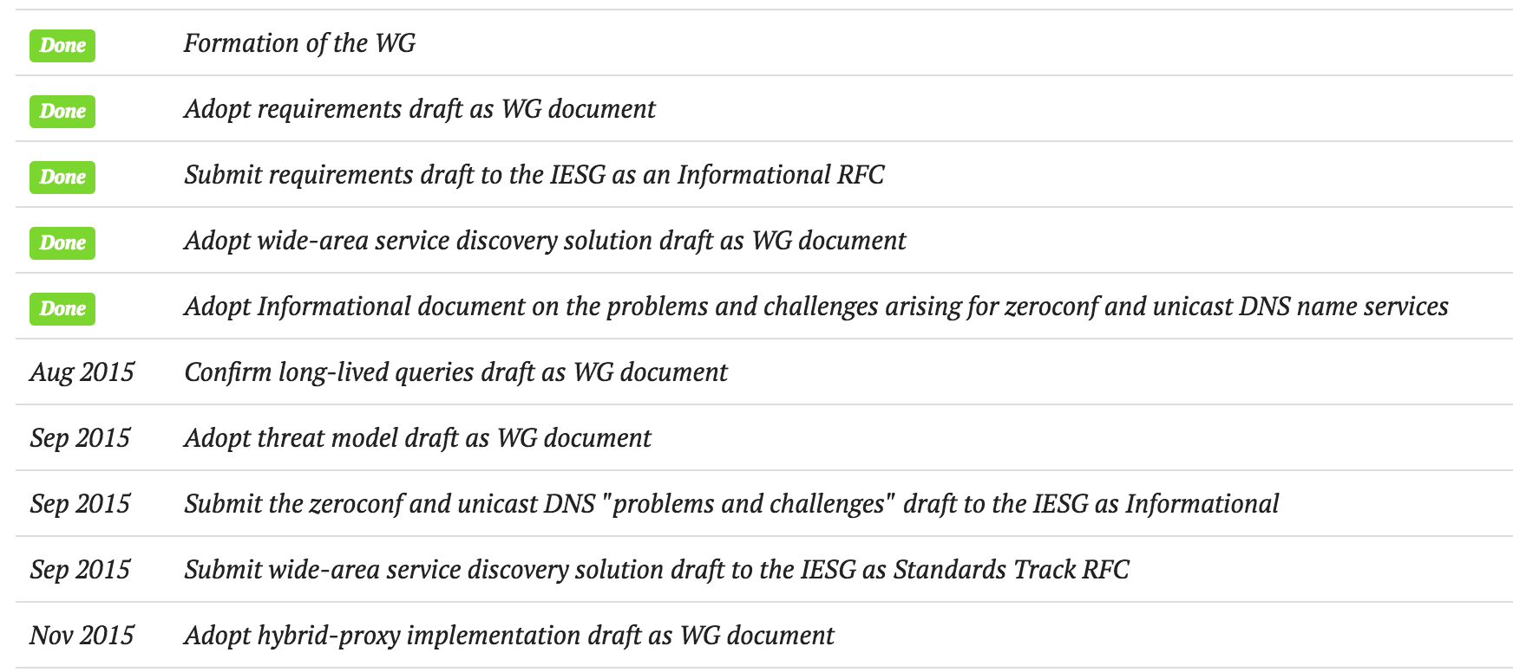
Updating our milestones
See https://datatracker.ietf.org/wg/dnssd/milestones/

Slide 16
AOB
Anything else to be raised?

Slide 17
Summary of actions
Recap of agreed actions

