Slide 1
Asynchronous Mgmt Architecture (AMA) & Asynchronous Mgmt Protocol (AMP)
Updates
Edward Birrane
Edward.Birrane@jhuapl.edu
443-778-7423

Slide 2
Agenda
Background
Motivation, Timeline, Vision
AMA Overview and Updates
Service Definitions, Desirable Properties
Core concept, logical: ADM
Current Status
ADM Overview and Updates
Concept of overarching Data Model
Current Status
AMP Overview and Updates
Core concept, physical: MID
Current Status

Slide 3
Motivation
We cannot deploy challenged internetworks until we can manage them.
Use cases for DTNs are emerging:
Handle signal propagation delay (space and some underwater).
Mostly for space and underwater scenarios
Handle frequent link disruptions.
Mostly for disaster and some vehicular scenarios.
Handle frequent link-access disruptions.
Mostly for oversubscribed/congested links.
Link removed as matter of policy/administration and not physics.
All preclude human-in-the-loop network management
Nodes operate on “far side” of delayed/disrupted links.
Disruptions occur from attenuation, tasking, power, and pointing
Network management starts looking more like fault management.
Maintain ability to relay information from critical assets both on-board and remotely without access to direct operator intervention.

Slide 4
Timeline
Examined uniqueness of the problem, 2011-2013
Some early pubs defining the problem as related to DTN
At that time, SNMP, NETCONF, RMON not sufficient
Reviewed popular engineering approaches
Autonomous fault protection schemes, Mobile code/scripting schemes, rule-based, etc.
Delay-Tolerant Network Management Protocol (DTNMP) 2013
Published to DTNRG, Initial implementation by NASA
Utility outside of NASA network management
Renamed as Asynchronous Management Protocol (AMP) 2015
Submitted as set of IDs to DTNWG.
Initial implementation published in the ION open-source code-base
Some discussion with OPS area members looking at RESTful interfaces. 2016
Focus on an asynchronous data model
4

Slide 5
Vision
A definition/architecture to asynchronously manage resources
Accepting autonomy where challenged deployments require autonomy
Extensible, where new applications or protocols can be added without much ado
The AMA attempts to address this.
A common data model that can be implemented by a variety of devices
Supporting bit-efficiency where necessary
Independent of transport protocol, but perhaps highly useful for DTN
The ADM template and individua ADMs attempts to address this
A protocol suitable for resource constrained systems
Where appropriate, re-usable in more richly resourced systems
Bit and bandwidth efficient. Designed to limit round-trip comms.
The AMP attempts to address this
5

Slide 6
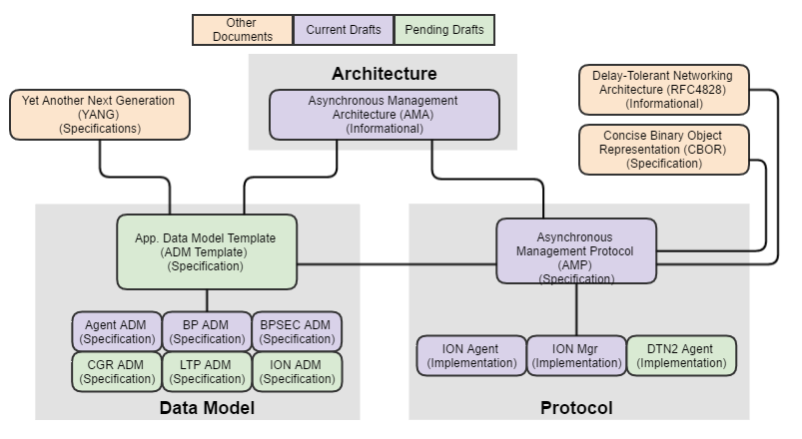
Vision
6

Slide 7
AMA: Overview
Service Definitions
Configuration: Change settings on an Agent manually or autonomously.
Reporting: Receive performance information from an Agent.
Autonomous Parameterized Control: Change Agent Behavior based on local time/state.
Administration: Fine-grained access to abilities.
Desirable Properties
Intelligent Information Push: Can’t rely on others to know what to ask for.
Minimize Message Size: Increase probability of delivery, different payloading schemes.
Absolute Data Identification: Pre-shared, global naming when appropriate.
Custom Data Definition: Only send what is necessary.
Autonomous Operation: Management continues even when managers are not around.

Slide 8
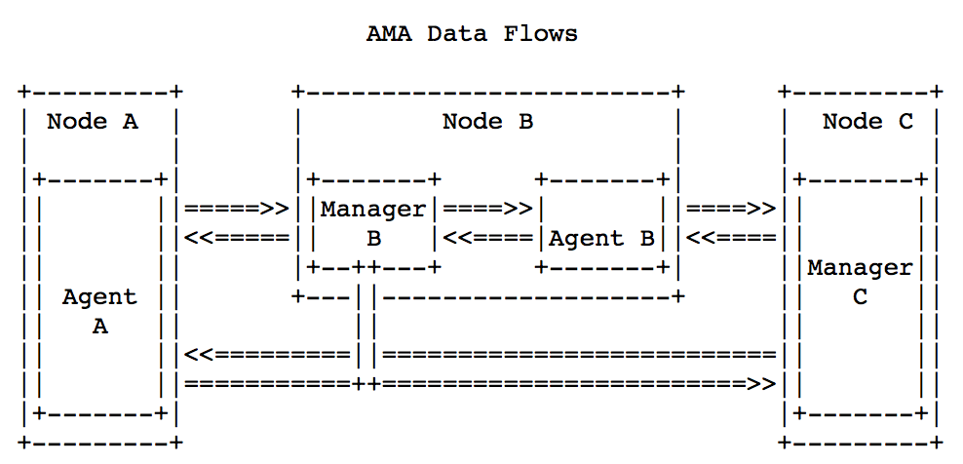
AMA: Roles and Responsibilities

Slide 9
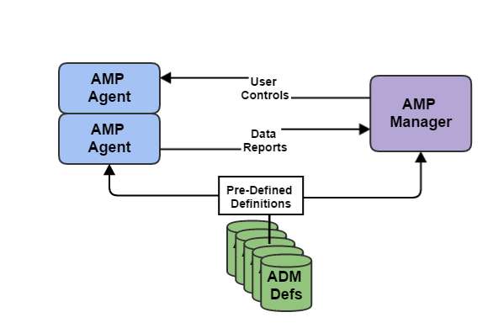
AMA: The Simple System Model
From draft-birrane-dtn-ama-03
Agents
Run on Managed Devices
Configure/Report on devices
Heavy autonomy and parameterized control
Manager(s)
Collect/Fuse data from Agents
Configure Agent behavior
Open-loop control
ADMs
Well-named Data and Controls
Superset of MIB
Move to describe them in YANG
Preconfiguration reduces msg size

Slide 10
AMA: Status and TODO
The AMA appears to be a fairly complete capture of the asynchronous management model. Last several revisions have been largely editorial.
AMA Current Status
Version -04 published.
Minor Terminology and Definitions Updates
Mostly wordsmithing based on feedback.
Changed some terminology for clarity.
Some expanded text around parameterization and motivation for the approach.
AMA TODO
Some information re-organization to pull some data out of the AMA document and into an ADM document.
Review with other potential stakeholders, including members of the OPS area.
Remove legacy references to SNMP for management.

Slide 11
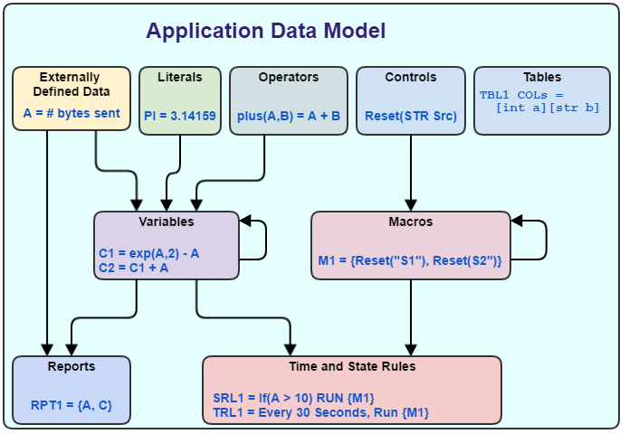
ADM: Common Data Model
“Atomic” Elements
Solely defined by their ADM.
EDDs: collected by agents.
Literals: useful constants.
Ops: opcodes for math functions.
Ctrls: opcodes for agent behavior.
“Variable” Elements
Defined by ADM or by User
ADM definitions are immutable.
Vars: strong-typed variables, including a type for “expression”.
Macro: Ordered set of Ctrls.
Rpts: Ordered sets of data
Rules: Time or State based autonomy.
An ADM defines 9 types of data for each application/protocol managed in the AMA.

Slide 12
ADM Listing
Published ADMs
AMP Agent ADM
Update to account for TABLE data structure, terminology changes
BP ADM
Update to terminology changes. Update for BPBis.
BPSEC ADM
Revisit Rule and Key controls in light of ION ADM.
Emerging ADMs
ION ADM
Capture of ION administrative command-line utilities.
LTP ADM
Capture of existing LTP instrumentation from ION.
CGR ADM
Some work performed by DLR.

Slide 13
ADM: Status and TODO
ADMs Current Status
Complete a refresh of ADMs to standardize on terminology
Incorporate TABLE structure type
Migrate existing ADMs to YANG.
With eye towards CBOR encoding
ADM TODO
Extract ADM specification from the AMA and AMP documents and publish an ADM document and associated template.
Detail data model items (EDDs, VARs, etc…) and guidance on what to use for what data.
Discussion on naming of ADM elements.
Registry of ADM identifiers.

Slide 14
AMP: Overview
AMP being evaluated by space and non-space users. NASA providing an open-source reference implementation in ION.
Protocol conformant to the architecture/requirements of AMA.
Implements Agents, Managers, ADM structures.
Defines specific data models to implement AMA structures
Defines messages to capture AMA controls/reports/administration
Defines on-the-wire encodings
Data Models
Basic Types: Numeric types, strings, etc…
Compound Types: BLOBs, (Typed) Data Collections, Tables, Identifiers, Collections, Expressions, Predicates
Functional Specification
AMP Message Groups: Common headers and trailers
Three messages: RegisterAgent, PerformControl, DataReport

Slide 15
AMP: Updates (1/2)
From -02 to -03
Minor Terminology and Definitions Updates
Wordsmithing based on feedback.
Reduced redundancy between AMP and AMA specs.
Clarifications
Clarified Report Templates vs Report Entries vs Reports.
Clarified State vs Time-based Rules.
Corrected AMP Epoch time.
Added rationale for design of TDCs.
Clarified that OID Nicknames are registered values.
Clarified OID Parameterization Approach
Clarified definition of Variables and their initializing expression.

Slide 16
AMP: Updates (2/2)
From -02 to -03
Additions/Updates
Added Table AMP structure.
Added Result Type to Expression structure.
Added required levels of Macro nesting.
Updated type enumerations.
Added allowed numerical promotions
Added rules for numeric conversions
Updated format of DataReport message.
Removals
Removed draft design of N of M counts for SRLs.
Removed enable/disable from SRL and TRL structures

Slide 17
AMP: TODO
From -02 to -03
Upcoming Spec Changes
How best to add N of M and enabled/disabled to SRL/TRLs
Change TDC column IDs to be of any type, not just string.
Add Access Control Lists (ACLs) and describe behavior.
Transition to CBOR for encoding.
Add guidance in ADM section on when to define TABLEs versus EDDs vs Controls that return data.
More Review from Reference Implementations
Continued support of reference implementation efforts
At last count there were 4 separate implementation efforts
Discussions on 2 additional efforts.

Slide 18
Current Status
NASA building out AMP for deployment to ISS and other infusion targets
Reference implementation in ION open source this year.
Supporting AMP protocol messages, Agent, BP, BPSEC ADMss.
NASA supporting AMA/AMP ongoing work
Writing ADMs for BP, BSP, CGR, LTP, and ION.
Several non-NASA efforts ongoing.
AMP is not directly tied to BP or DTN, though it is very helpful for DTN use cases.
Finalizing AMA and AMP specs for consideration in DTNWG
As novel intersection between performance monitoring and safing autonomy
Meeting with OPS AD people as they are identified to discuss AMP vs RESTful NETCONF and YANG Push.

Slide 19
Backup

Slide 20
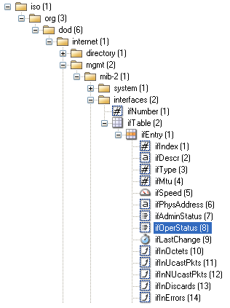
Compatibility with existing mechanism
SNMP Uses OIDs as IDs
Global, Managed Tree Structure
“Path to data” is concatenation of #s.
ifSpeed = 1.3.6.1.2.1.2.2.1.8
Supports Binary Encoding (BER)
Compress first 2 #s: 1.3 => 43
SDNV-encode rest
SNMP Identifier: <type> <length> <value>
Type 6 -> OID
Length (in this case) = 9 bytes
ifSpeed = 0x06092C0601020102020108
AMP Uses MIDS (Managed IDs)
MIDS encapsulate OIDs (less <type> field)
Option to compress OID
Makes easy to interoperate with SNMP
20

Slide 21
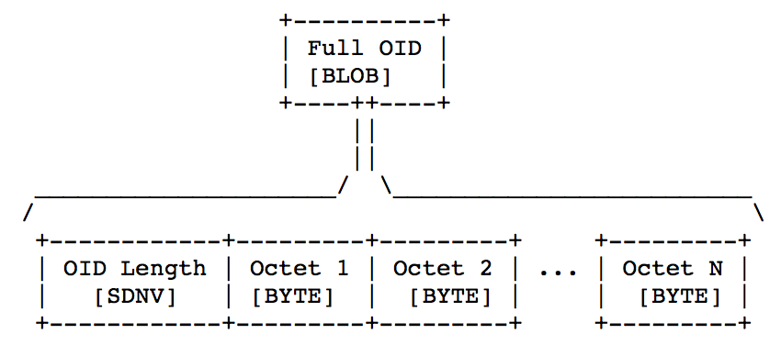
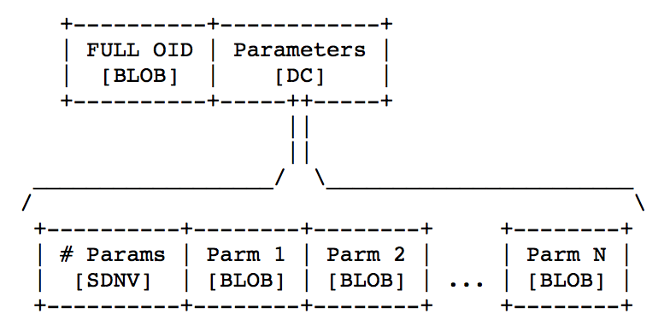
OID Types (1/2)
Full OID
Length + Octets
Not interpreted by AMP. Used as a unique bitstream.
Encoded in ASN.1 BER for now, assuming SNMP Type 6.
Parameterized OID
Full OID followed by AMP Data Collection (DC).
DC is a count followed by a series of TLV.
Time, Length, Value
Type is data type (string, int)

Slide 22
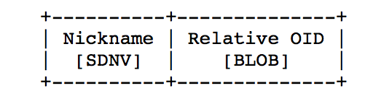
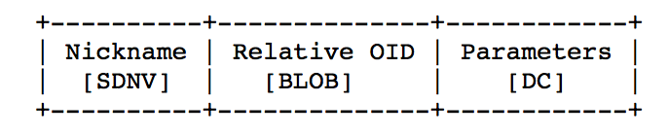
OID Types (2/2)
Compressed OID
AMP supports managed registry of common OID sets.
OIDs can be very long and the portion up to your relative subtree can be reused a lot.
Nickname is an integer that maps to a well-known node in an OID tree.
Relative OID is subtree rooted at that node.
Compressed, Parameterized OID
Compressed OID followed by a Data Collection of Parameters
Very similar to a Parameterized OID.

Slide 23
AMP Agent ADM
From draft-birrane-dtn-adm-agent-00
Captures all behavior of an AMP Agent
Keeps AMP functional specification simple
Items available to AMA/AMP ecosystem because this ADM must be implemented by any deployed AMP agent.
Primitive Values
Counters, number of AMP types created, active, etc…
Reports
Full report definitions. Users may customize their own.
Controls
All functions to create, update, delete, and other wise manage reports, rules, macros, and other AMA types.
Operators
Full math function spec
+, -, *, /, %, ^, &, |, &&, ||, !, abs(), <, >, <=, >=, !=, ==, >>, <<

Slide 24
Thank you!
Questions?
24

