Slide 1

IETF Hackathon
IETF 97, November 12-13
Seoul, Korea

Slide 2
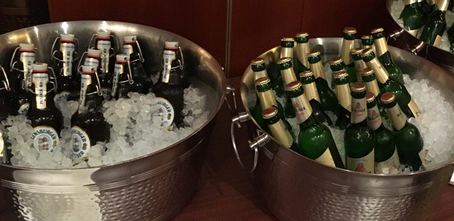
Goals
Running Code (RFC 6982)
Open Source
Speed and Relevance of Standards
Collaborate and Learn
Have Fun
Cookies!
and BEER!!!

Slide 3
Note Well
Any submission to the IETF intended by the Contributor for publication as all or part of an IETF Internet-Draft or RFC and any statement made within the context of an IETF activity is considered an "IETF Contribution". Such statements include oral statements in IETF sessions, as well as written and electronic communications made at any time or place, which are addressed to:
  The IETF plenary session
  The IESG, or any member thereof on behalf of the IESG
  Any IETF mailing list, including the IETF list itself, any working group or design team list, or any other list functioning under IETF auspices
  Any IETF working group or portion thereof
  Any Birds of a Feather (BOF) session
  The IAB or any member thereof on behalf of the IAB
  The RFC Editor or the Internet-Drafts function
All IETF Contributions are subject to the rules of RFC 5378 and RFC 3979 (updated by RFC 4879).
Statements made outside of an IETF session, mailing list or other function, that are clearly not intended to be input to an IETF activity, group or function, are not IETF Contributions in the context of this notice. Please consult RFC 5378 and RFC 3979 for details.
A participant in any IETF activity is deemed to accept all IETF rules of process, as documented in Best Current Practices RFCs and IESG Statements.
A participant in any IETF activity acknowledges that written, audio and video records of meetings may be made and may be available to the public.

Slide 4
IPR and Code Contribution Guideline
Hackathon participants free to work on any code
Rules regarding that code are what each participant's organization and/or open source project says they are
The code itself is NOT an IETF contribution
Discussions, presentations, and demos done as part of the hackathon are the same type of IETF contributions as those made in working groups; therefore, the usual IETF copyright and/or IPR disclosure rules apply

Slide 5
Collaborate on Code https://github.com/ietf-hackathon
Git/GitHub commonly used for open source projects
Getting started:
  Install Git on laptop https://help.github.com/articles/set-up-git/
  Join Hackathon repo https://github.com/ietf-hackathon
  Fork a project, or the repo, to work on an existing project or add a new one https://help.github.com/articles/fork-a-repo/
  “Follow” team members and “watch” project(s) https://help.github.com/articles/be-social/
More info: http://gitref.org

Slide 6
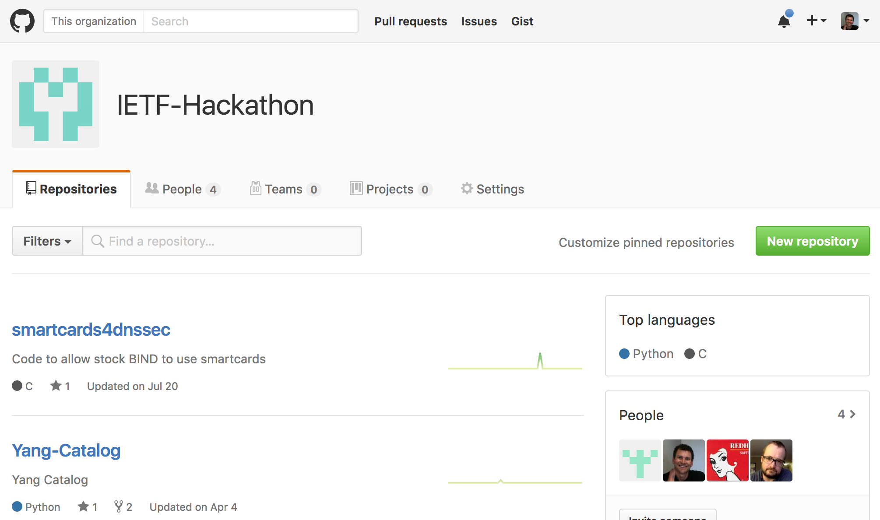
https://github.com/ietf-hackathon

Slide 7
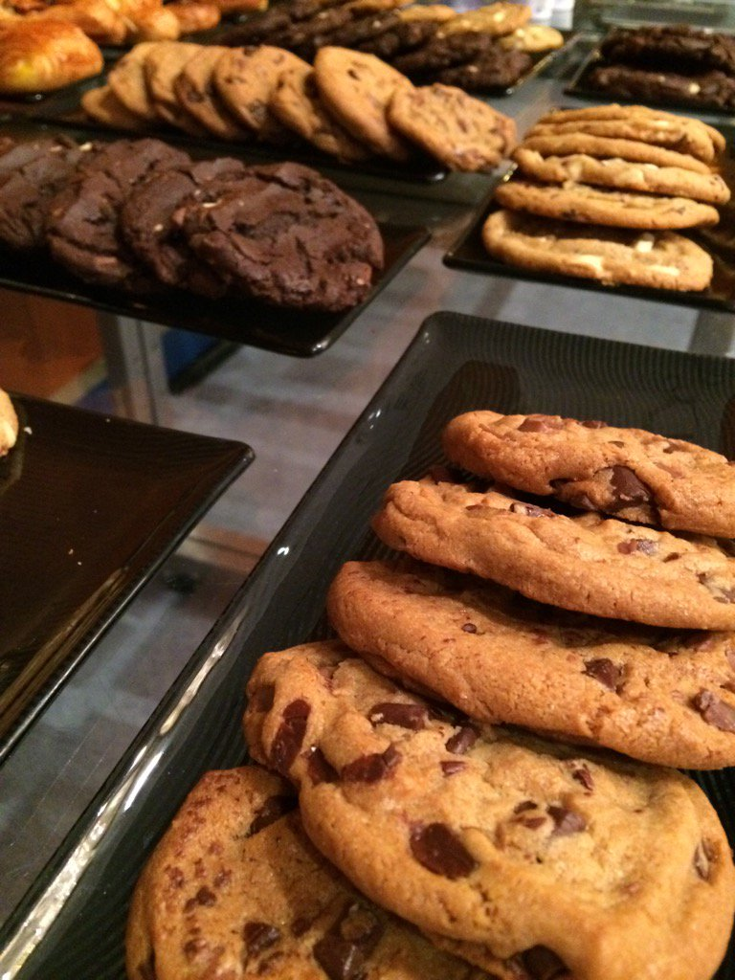
Agenda - Saturday
09:00: Room opens – Pastries, coffee
09:00: Posters of technologies displayed
09:30: Hackathon kickoff
09:45: Form Teams
12:30: Lunch
15:30: Afternoon break - Snacks
18:30: Progress check and sharing
19:00: Dinner
22:00: Room closes and is locked

Slide 8

Agenda - Sunday
09:00: Room opens – Pastries, coffee
12:30: Lunch
13:30: Hacking stops, prepare brief presentation of project
14:00: Project presentation to other participants and judges
15:00: Recap and suggestions for improvements
15:30: Awards presented, prizes given
16:00: Hackathon ends

Slide 9
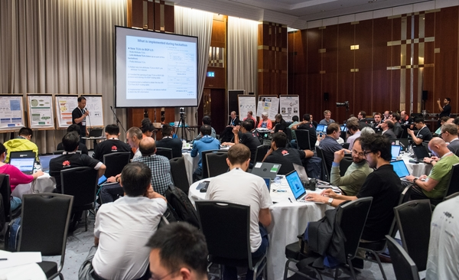
Project Presentations
What is the problem you are solving?
How do you plan to solve it?
What did you achieve?
One or two highlights, discoveries, etc.
4 minute time limit

Slide 10
Judging Criteria
Advance pace and relevance of IETF standards
  Bring speed and collaborative spirit of open source software into the IETF
  Flush out ideas, feed into WG session
  Produce sample code/reference implementations
  Create useful utilities
Attract developers, young people to IETF
  There’s cool shit at IETF
  #IETFhackathon, #IETF97

Slide 11
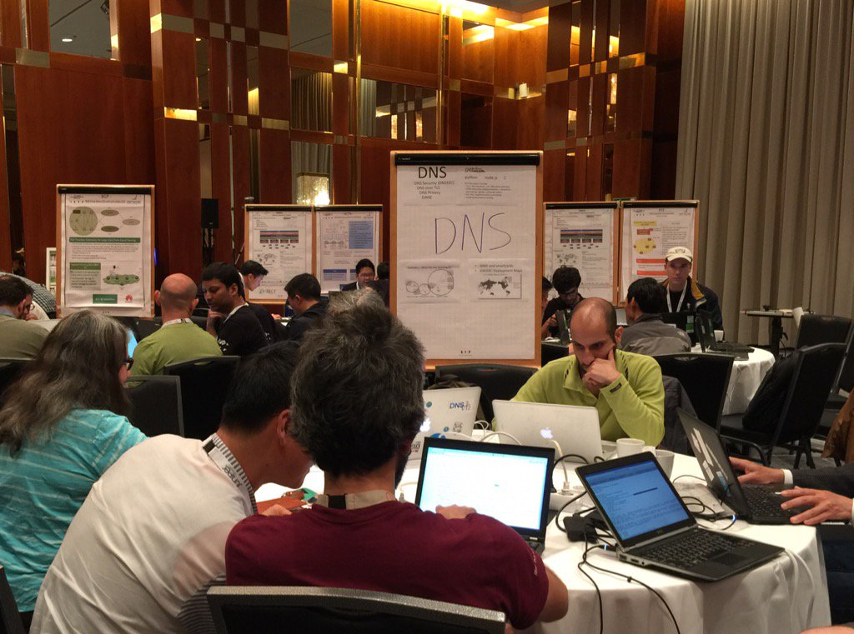
#IETFHackathon Photo Contest
Best IETF Hackathon Photo
Post to Twitter
  #IETFHackathon
  #IETF97

Slide 12

Prizes

Slide 13
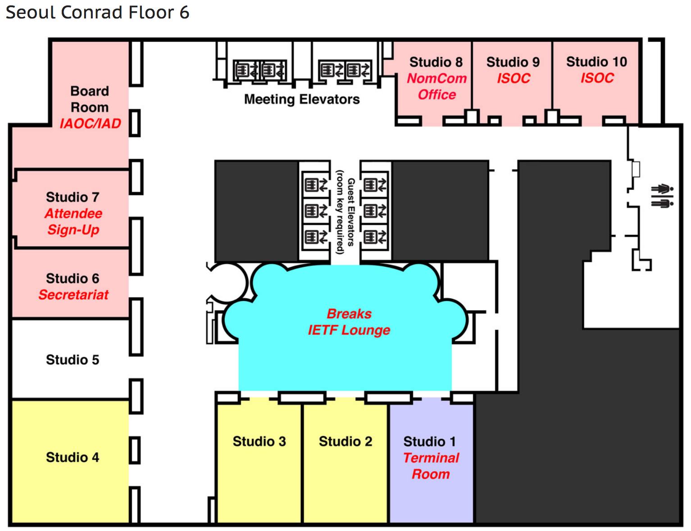
Hackathon Corner in IETF Lounge
Designated area in IETF lounge
Monday – Friday
Space to gather
Continue work on hackathon projects
Work on running code

Slide 14
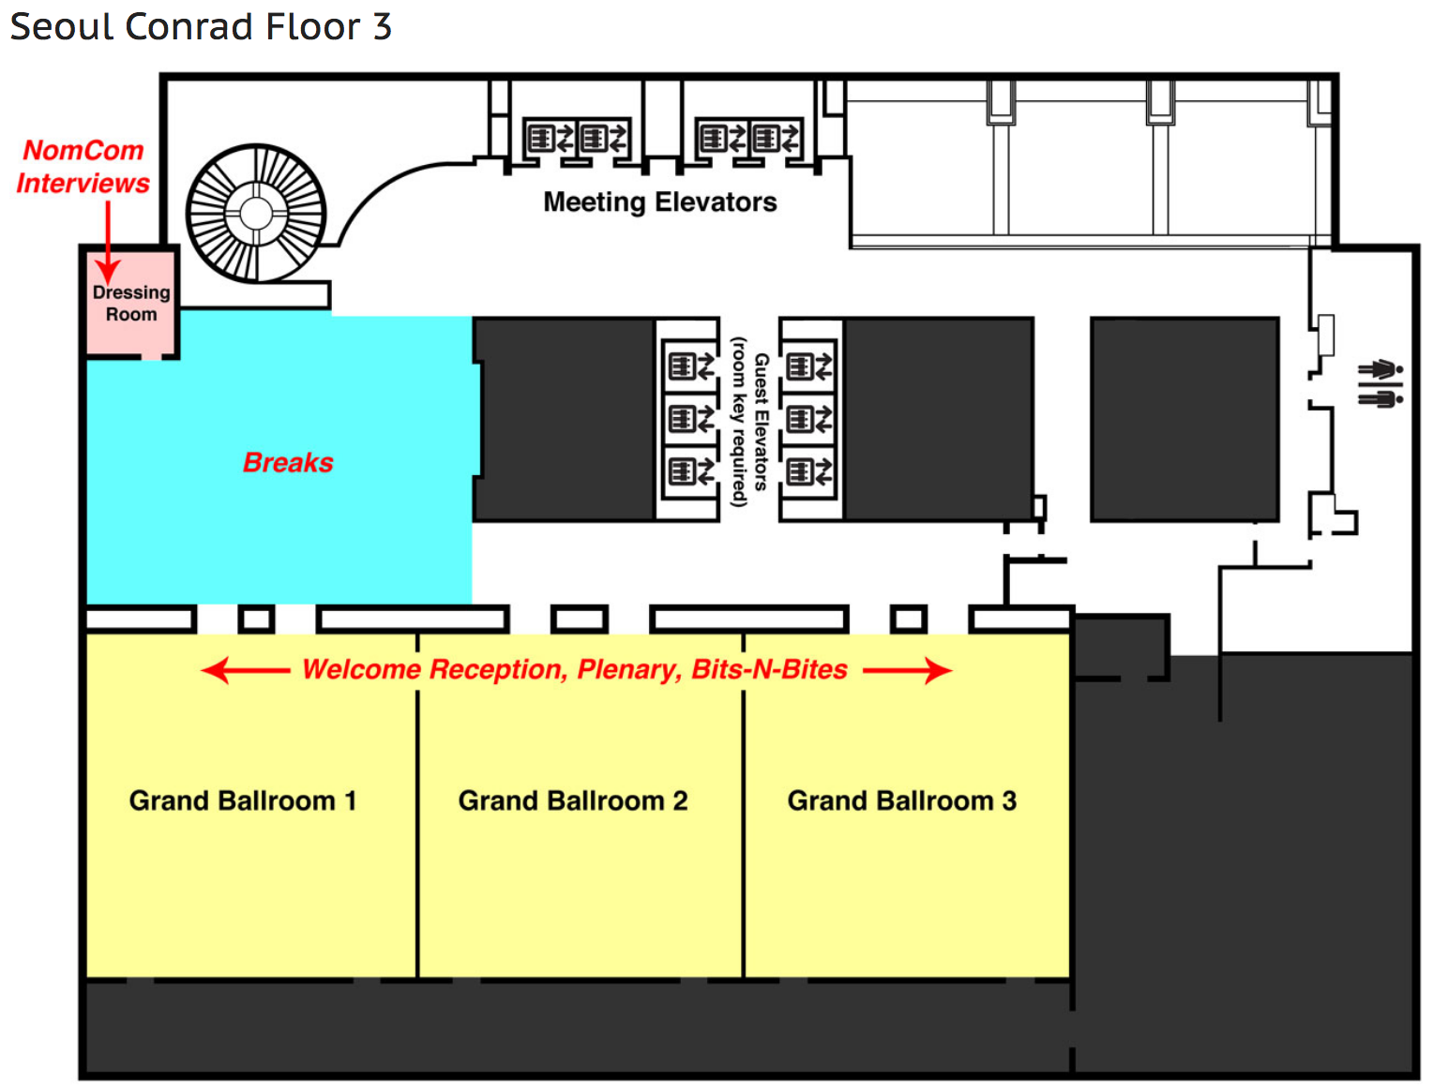
Bits-N-Bites
Table for Hackathon Projects
Show off what you did
Thursday, 19:00– 21:00
Grand Ballrooms
Food and drinks

Slide 15
Project List
ACTN
Capturing and analyzing network data features – Joy
COSE/JOSE
DDoS Open Threat Signaling (DOTS)
DNS/DPRIVE/DNSSEC/DANE
Interface to Network Security Functions (I2NSF) Framework
Interface to the Routing System(I2RS)
LoRaWAN Wireshark dissector
Multipath TCP
PCE
SFC
SFC Service Function
TLS 1.3
Vector Packet Processor (VPP)
YANG/NETCONF/RESTCONF

Slide 16
Questions?

Slide 17
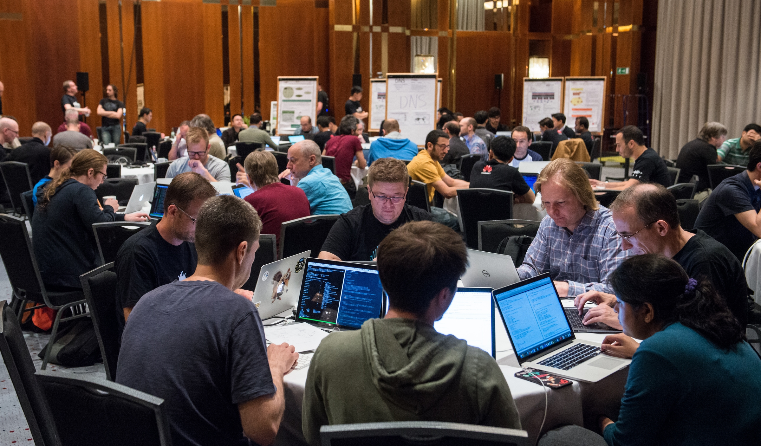
Let’s Get Hacking!

