Slide 1
I2NSF Project @ IETF-97 Hackathon
Jaehoon (Paul) Jeong
Sungkyunkwan University
pauljeong@skku.edu

Slide 2
Why Do We this Project?
I2NSF: Chartered to use NETCONF/RESTCONF + Data Models
  Is this approach reasonable for management of security devices?
  Is it better than writing another security protocol?
  Can we get I2NSF Key Data Model (Capability) refined, and put open source code for VOIP/VoLTE and Firewall?
Result: I2NSF WG approach works, fast time to market
  NM/OPS should expand their work into Security
  I2NSF follows up with MILE, SACM, DOTS, and SECEVENTs
Does this work for a student project – Yes!!
  25 new 1st timers at IETF
  Put Code on Web
Notes:
NM: Network Management
OPS: Operations

Slide 3
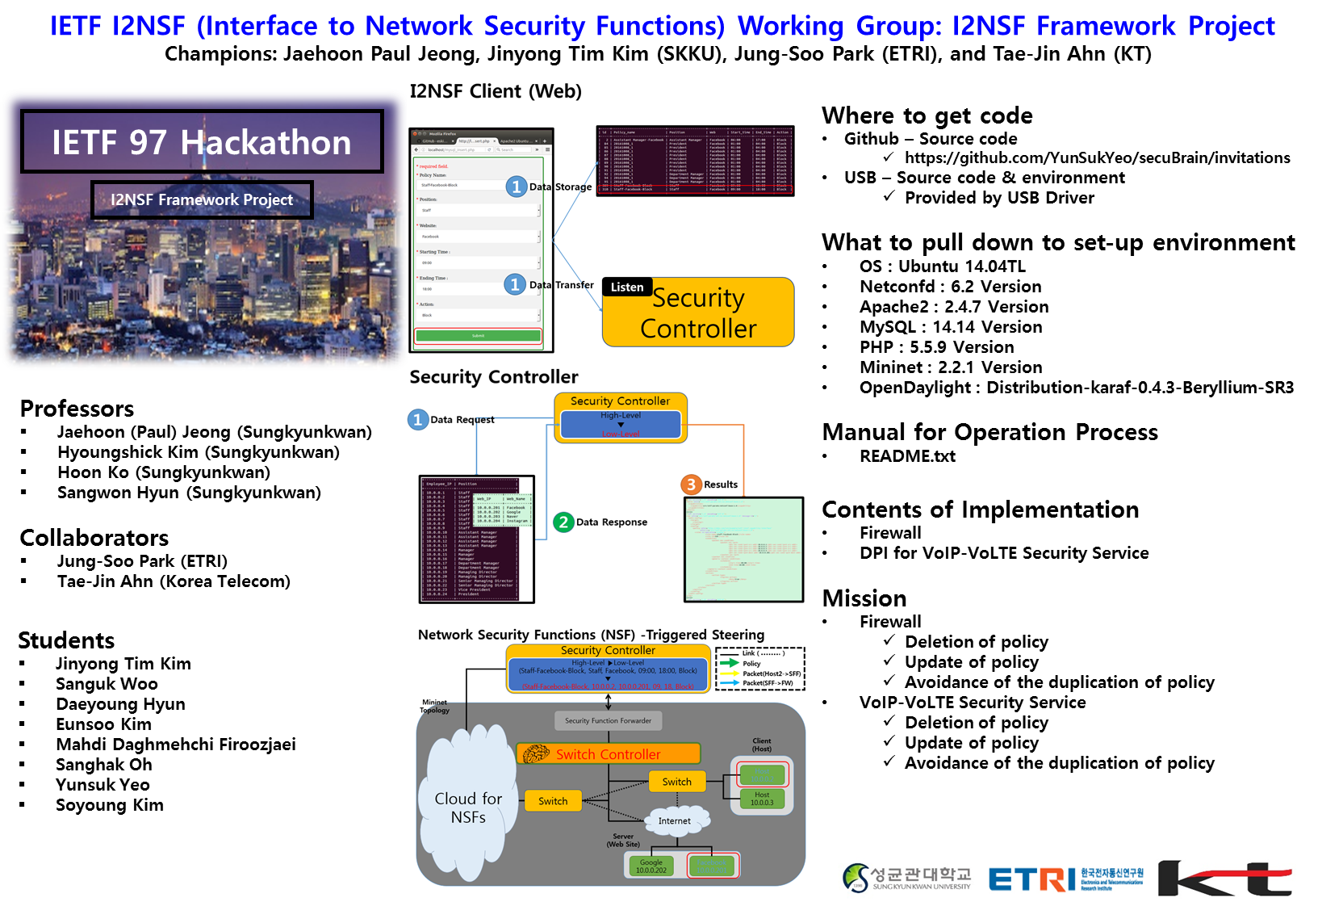

Slide 4

What are Network Security Functions (NSFs)?
Enterprise Network
*NSF: Network Security Function
NSF1
(Firewall)
No
NSF2
(DPI)
Enough?
Valid Packet?
Yes
packet
Switch
Forward
How to do?
Destination Host

Slide 5
Goal of I2NSF Project
Given the code base of I2NSF Framework for provisioning Network Security Functions (NSFs), we implemented two things:
  (i) Firewall for Web-filtering in I2NSF Framework using SDN and
  (ii) Deep Packet Inspection (DPI) for VoIP/VoLTE Security Service in I2NSF Framework.

Slide 6
Contributions for the Goal
Proof of Concept (POC) of I2NSF Framework using Open Sources.
2. Validity of I2NSF Interface Design for I2NSF Framework.
3. Feasibility of Data-driven Approach (YANG) for Network Security Services.

Slide 7

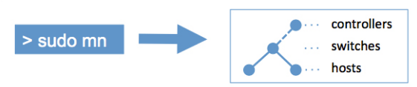




Hackathon Development
Building Environment
OS
  Ubuntu 14.04TL
Netconfd
  6.2 Version
Apache2
  2.4.7 Version
MySQL
  14.14 Version
PHP
  5.5.9 Version
Mininet
  2.2.1 Version
OpenDaylight
  Distribution-karaf-0.4.3-Beryllium-SR3

Slide 8
Scenario of Security Services in I2NSF Testbed
*NSF: Network Security Function
*NSFF: NSF Forwarder for Traffic Steering
Enterprise
Network
with I2NSF
I2NSF User
(security policy)
1. Time-dependent Firewall
e.g.) 09:00 – 18:00 => Block
18:01 – 08:59 => Unblock
Security Controller
2. VoIP/VoLTE Filtering Rule
e.g.) Blacklist of SIP URI and User Agent
NSF1
(Firewall)
NSFF
NSF2
(DPI)
SDN Network
Facebook
10.1.1.10
Host
10.0.0.1
(Employee)
Internet
Switch
Switch
Switch
Switch
Switch
Switch
Youtube
10.2.1.20
Hacker
Gateway
at Africa

Slide 9
Lessons from the Implementation @ Hackathon
Proof of Concept (POC) of I2NSF Framework using Open Sources:
  Confd for NETCONF
  OpenDaylight for SDN Controller
  Mininet for SDN Network
  RestAPI for I2NSF Interface
Validity of I2NSF Interface Design for I2NSF Framework:
  Firewall for Web Filtering
  DPI for VoIP/VoLTE (e.g., Blacklist and Whitelist)
Feasibility of Data-driven Approach (YANG) for Network Security:
  YANG Data Models for I2NSF Interfaces among
  System Entities (I2NSF User, Security Controller, NSFs).

Slide 10
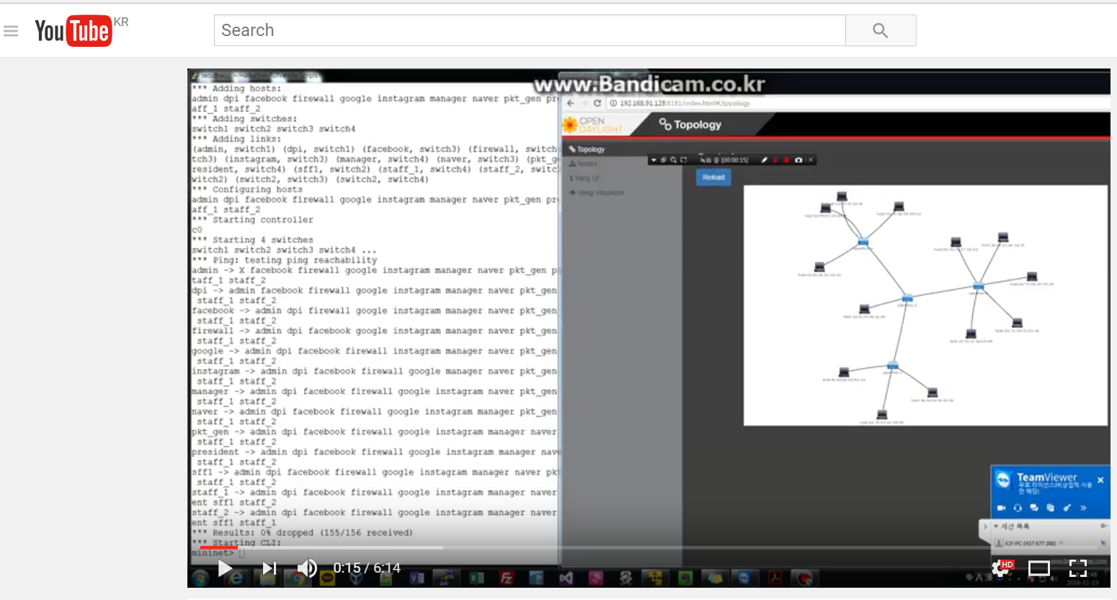
Demonstration of I2NSF Implementation
YouTube Videoclip:
https://www.youtube.com/watch?v=5iflpVt4l6U&feature=youtu.be

