Slide 1
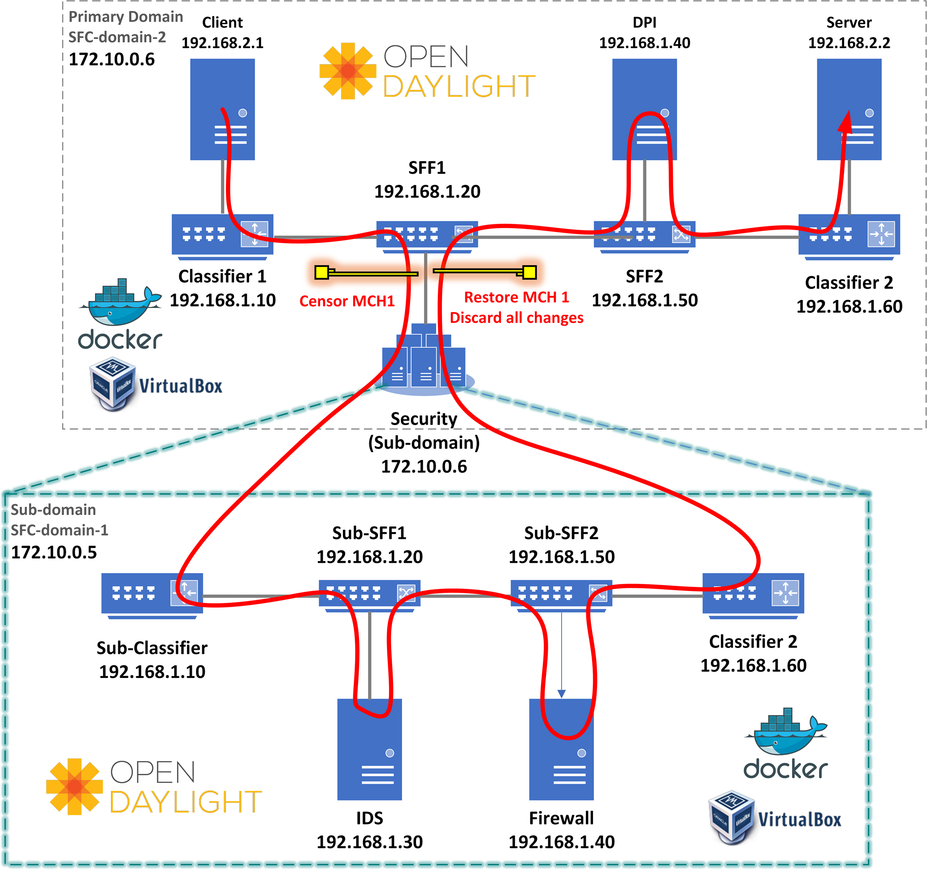
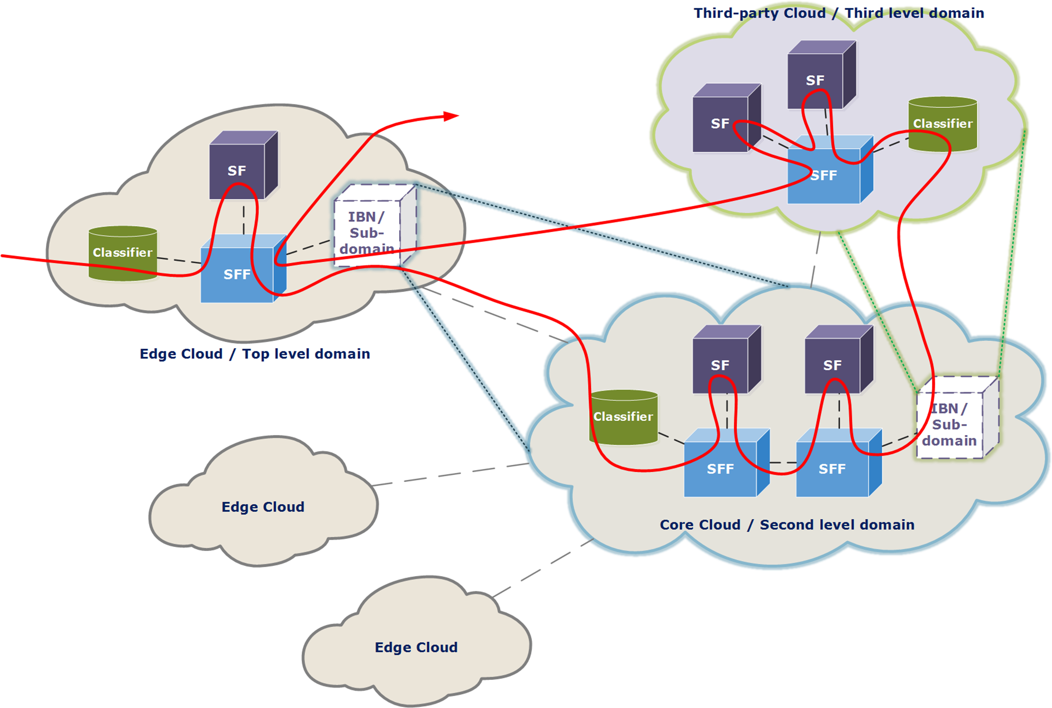
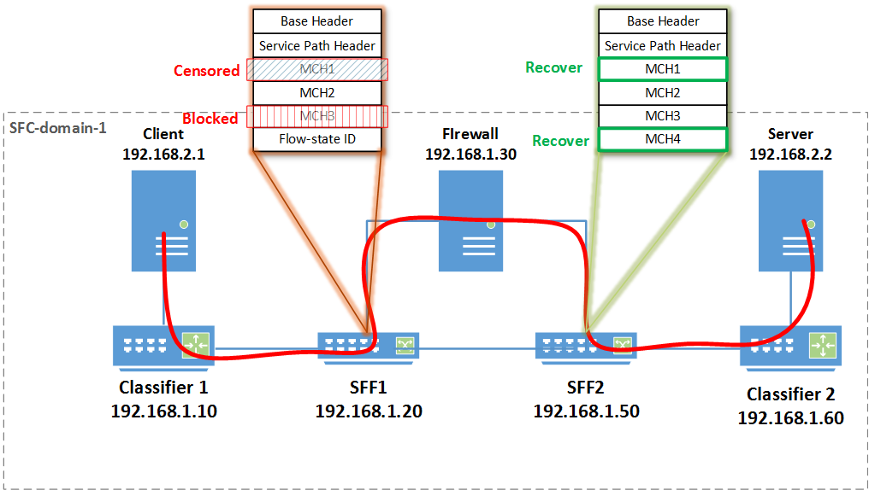



Multi-domain hierarchical SFC with access control to NSH
IETF 97 Hackathon - SFC

