Slide 1
Trusted Execution Environments (TEE) and the Open Trust Protocol (OTrP)
Hannes Tschofenig and Mingliang Pei
16th July 2017 -- IETF 99th, Prague

Slide 2
What do we mean by security?

Slide 3
Communication Security
Aims
Prevent eavesdropping on communication
Solution: Encryption
Prevent spoofing of end point/server
Solution: Authentication
Components Required
Standards based encryption/decryption & authentication algorithms
True random number generator
Strong key provisioning, management, and storage
Strong identity provisioning, management, and storage

Slide 4
Software Security
Aims
Protect device/system from rogue software
Downloaded software
Remote software
Prevent access to certain assets & data
Reading data
Alteration of data
Allow recovery from attack
Note: access can be remote or via local connector
Components Required
Isolation of and restricted access to certain data, resources and code
Secure storage
Trusted boot
Immutable device identity
Separation of monitoring & recovery functionality

Slide 5
Physical Security
Aims
Protecting against hardware attacks.
Intrusive attacks
Semi Intrusive attacks
Side Channel attacks
Examples include:
Differential power analysis
Cutting internal chip tracks
Fault injection
Voltage variation
etc
Components Required
Specialised anti-tampering technology. E.g.
Deducing power and timing traces
Randomization of the pipeline
Encrypted memory interfaces

Slide 6
Security Principles

Slide 7

Security Principles: Isolation and Least Privilege
Isolation
Isolate trusted resources from non-trusted
Access to trusted software only through APIs
Non-trusted software run at lowest privilege possible
Reduce attack surface of key components
non-trusted
trusted

Slide 8
Security Principles: Isolation and Least Privilege
Non-Trusted
Majority of software
Operating system
Graphics
Applications
Data processing
etc
non-trusted
trusted
Trusted Software
Provision of security services
Small, well reviewed code
Trusted Software
Crypto functions
Key management
Attack detection
Sensitive data
Notes:
The fundamental security principles of isolation and least privilege are reinforced within a root of trust. This gives us a set of essential features every secure system needs such as:
Root keys
Secure Boot into a known state
Validating a secure clock and counters
Using a Chain of Trust, from secure kernel to boot a TEE and bring in trusted device drivers signed with certificates in secure key store
Secure memory partitions
Once a root of trust is established only then is it safe to start the applications themselves

Slide 9
Security Profiles
Cost/Effort
To Attack
Invasive HW Attacks
Well resourced and funded
Unlimited time, money & equipment.
Value to attacker
Non-invasive HW Attacks
Physical access to device: JTAG, Bus Probing, IO Pins, Side Channels etc.
Software Attacks
Malware, Viruses, Root Kits
Social engineering
Cost/Effort
to Secure

Slide 10
TEE Solutions

Slide 11
Trusted Execution Environment: Why?
Internet protocols today all rely on security protection
Use security protocols requiring cryptographic keys
Utilize cryptographic algorithms
Operating systems (OSs), such as Android/Linux, are complex and sophisticated.
Solution is to augment the OS with a more restrictive, and environment
And extract the security components from applications / OS into this environment
Trusted Execution Environments provide such an environment

Slide 12
Trusted Execution Environment: What is needed?
Lightweight OS that can support mutually distrusting Trusted Apps
Isolated environment for the execution of trusted code
Private memory spaces for code and data
Cannot be snooped or modified by other system agents
Well defined entry and exit interfaces
Designed to retain secrets when clients are fully compromised
Trusted Boot ROM*
Trusted boot process*
Cryptographic services
Symmetric Private Key
Asymmetric Public Key
Random Number Generator
Cryptographic key store
Unique and shared keys
Secure storage
For persistent data, such as keys
(*) Needed for ARM TrustZone but not for other TEEs (e.g., Intel SGX)

Slide 13
Security Profiles
Secure Elements / HSMs
Cost/Effort
To Attack
TrustZone based TEE
Invasive HW Attacks
Well resourced and funded
Unlimited time, money & equipment.
Value to attacker
Non-invasive HW Attacks
Physical access to device: JTAG, Bus Probing, IO Pins, Side Channels etc.
Software Attacks
Malware, Viruses, Root Kits
Social engineering
Cost/Effort
to Secure

Slide 14



ARM Architecture Profiles
Application Profile ARMv8-A
32-bit and 64-bit
A32, T32 and A64 instruction sets
Virtual memory system
Supporting rich operating systems
Real-time Profile
ARMv8-R
32-bit
A32 and T32 instruction sets
Protected memory system
(optional virtual memory)
Optimized for real-time systems
Microcontroller Profile
ARMv8-M
32-bit
T32 / Thumb® instruction set only
Protected memory system
Optimized for microcontroller applications
Notes:
With the launch of ARMv8-M, ARM has now completed all three profiles for the 8th generation of the ARM architecure.
Just to remind you, these are the application profile with architecure ARMv8-A, like the Cortex-A57, A72 and A35 processors used in mobile devices and servers.
Then there is the Real-time profile with the ARMv8-R architecture that is targetted at real-time applications, for example in cars, but also in hard disk controllers.
Finally, the microcontroller profile with the ARMv8-M architecure is designed for resource constrained microcontroller applications.

Slide 15
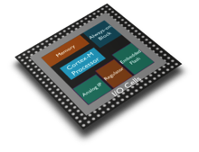
TrustZone for ARMv8-A TrustZone for ARMv8-M
NON-SECURE STATES
SECURE STATES
NON-SECURE STATES
SECURE STATES
Rich OS, e.g.Linux
Secure App/Libs
Non-secure App
Secure App/Libs
Secure OS
Non-secure OS
Secure OS
Secure Monitor
TrustZone for ARMv8-M
Secure transitions handled by the processor to maintain embedded class latency
Notes:
About TZ-M
Just like TZ, there’s a safety barrier between software domains
You have Secure and Non-Secure code running on the same processor
Unlike TZ, there’s no SM, improving interrupt latency as NS apps can call S apps directly
Secure Monitor is an execution level only in TZ. Makes transition between SC and NS state. Downside is this makes interrupt latency high. With TZ-M, non-secure app can call secure app directly.
Part of new ARMv8-M architecture
Security architecture for deeply embedded processors
Enables containerisation of software
Simplifies security assessment of embedded devices
Conceptually similar to ARM TrustZone technology, but...
New architecture tailored for embedded devices
Preserves low interrupt latencies
Better cross-domain calling performance
Foundation for high-level security features
Secure remote firmware update
Secure manufacturing
Safe crypto implementations
Secure Thread – Trusted code/data
Secure Handler – Trusted device drivers,

Slide 16
Secure Memory Map
Secure
NS=0
Non-Secure
NS=1
0xFFFFFFFF
DRAM
Code
&
Data
Normal physical memory map contains
DRAM for code and data
I/O peripherals
On chip ROM and SRAM
The Secure state acts like “33rd address bit”
Doubling size of physical address map
Key resources become secure only
Boot ROM and internal SRAM
I/O devices are segregated
Secure only, Non-Secure or shared access
DRAM can be partitioned
Using address space controller
DRAM
Code
&
Data
0xFFFFFFFF
0x90000000
Secure DRAM
0x80000000
0x80000000
FUSES
0x60000000
0x60000000
I2C
I2C
I2C
I2C
0x50000000
0x50000000
UART
UART
0x40000000
0x40000000
0x20000000
0x20000000
SRAM
SRAM
SRAM
0x10000000
0x10000000
Boot ROM
Boot ROM
Boot ROM
0x00000000
0x00000000

Slide 17
Example System on Chip (SoC)
CPU cluster
MMUs and caches
Bus mastering devices
GPU and Display controller
Boot ROM and SRAM
Memory Controller to DRAM
Peripheral bus
Standard peripherals
CPU 0
CPU 1
Debug
GPU
MMU
MMU
Display
Controller
L1I$
L1D$
L1I$
L1D$
MMU
L2$
L2$
MMU
System Bus
SRAM
ROM
Memory Controller
Peripheral Bus
I2C
GIC
RTC
UART
Timer
Flash
DRAM
Flash
Memory

Slide 18
Example SoC with TrustZone
KEY:
Trusted
Normal
Secure state added to CPU
MMU and Caches
NS tags in buses
Boot ROM and SRAM secured
Debug and profiling secured
Secure only peripherals added
Shared peripherals modified
DRAM partitioned for Secure
Crypto HW accelerator
External Secure Peripherals
Existing Non-Secure HW remains unchanged
Never able to generate NS=0 transactions
Note: Secure resources not to scale
CPU 1
CPU 0
CPU 1
CPU 0
Debug
GPU
Debug
MMU
Display
Controller
MMU
MMU
NS
MMU
NS
NS
NS
L1I$
NS
L1I$
L1I$
L1I$
L1D$
L1D$
L1D$
L1D$
NS
MMU
L2$
L2$
NS
Crypto
MMU
NS
System Bus
SRAM
SRAM
ROM
ROM
Memory Controller
TZASC
Peripheral Bus
Peripheral Bus
NS
Timer
Fuses
I2C
GIC
RNG
I2C
GIC
RTC
UART
Timer
Flash
DRAM
Finger
Print
Flash
Memory
Secure Partition

Slide 19
TrustZone Software Stack
Trusted Execution Environment
Light-weight operating system offering security services:
Key Store, Crypto,
Random Numbers
Secure Store
Secure Device Drivers
Enables Trusted Apps, which can be installed, updated and deleted
EL3 Monitor provides Secure / Non-Secure switching
OS integration requires TEE driver issues SMCs to TEE
Non-Secure
Secure
EL0
Media
Player
Web
Browser
TA 1
TA 2
S-EL0
TEE
Rich OS
Event
Handler
EL1
TEE Driver
S-EL1
Crypto Driver
Finger Print Driver
Hypervisor
EL2
EL3
Monitor . .
SMC
Dispatch
Crypto
Keys
Finger
Print Reader
Hardware

Slide 20

FIDO Use Case
FIDO is an attempt to replace username/password-based authentication with something strong.
Process:
Web service challenges device
Challenge passed onto FIDO authenticator
Performs user verification (e.g., fingerprint)
Cryptographically sign the challenge
Send response to web service
User now securely logged in
For transaction confirmation, trusted display is used.
Software and hardware stack needed for operation
Networking, Rich OS, Secure OS, HW
FIDO Authenticator functionality in TEE; FIDO private key and fingerprint never leaves the TEE
Non-Secure
Secure
Web
Browser
FIDO
TA
EL0
S-EL0
FIDO plugin
TEE
Event
Handler
Trusted Display
Rich OS
S-EL1
EL1
TEE Driver
Crypto
Driver
Finger Print
Driver
Hypervisor
EL2
EL3
Monitor
SMC
Dispatch
Crypto
Finger
Print
Keys
Trusted Display
Hardware

Slide 21
Running Code

Slide 22
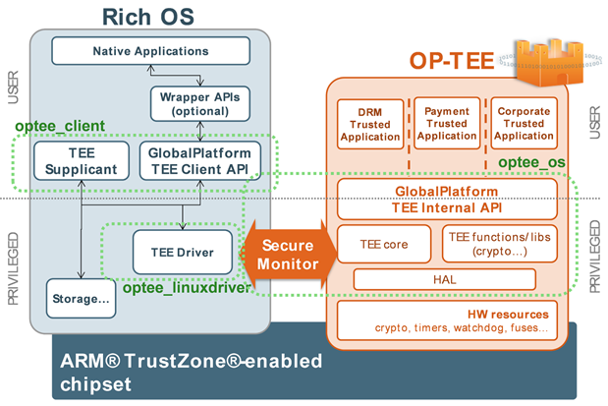
Open Source Software Available
Many developers of TEE technology
Chip companies, OEMs, OS platform owners, Independent Software Vendors, OSS
ARM Trusted Firmware:
Link: https://github.com/ARM-software/arm-trusted-firmware
AArch64 reference implementation containing trusted boot, monitor and runtime firmware
OP-TEE
Link: https://github.com/OP-TEE/
Reference implementation of secure world OS.
GlobalPlatform provides common set of API’s and services

Slide 23
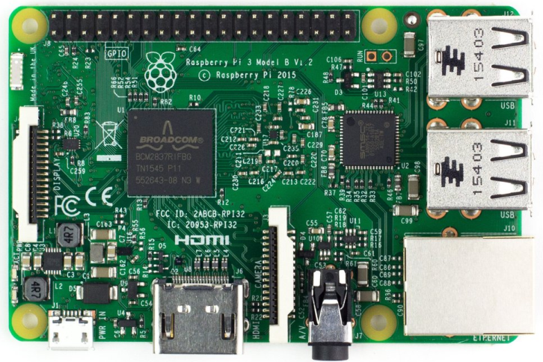
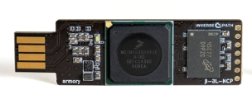
Trying TrustZone @ Home
TrustZone on Raspberry Pi3
USB Armory
Sequitur Labs port of Linaro’s OP-TEE environment to the Raspberry Pi 3
Press release:
http://linuxgizmos.com/trustzone-tee-tech-ported-to-raspberry-pi-3/
Code:
https://github.com/OP-TEE/build/blob/master/docs/rpi3.md
Video: https://www.youtube.com/watch?v=3MnLrHoQcyI
Hardware: http://inversepath.com/usbarmory.html
~100 EUR
The USB armory from Inverse Path is an open source hardware design, implementing a flash drive sized computer with TrustZone.
Example apps available: https://github.com/inversepath/usbarmory/wiki/Applications

Slide 24
Summary
Isolation helps to improve security for software.
TrustZone provides the CPU and system isolation.
Open source code available for you to play with.

Slide 25
Open Trust Protocol (OTrP):
Problem Statement

Slide 26


Demand of hardware based security with TEE and TA
SP
Device with TEE
Normal World
Secure World
TAM
SD
SD
OTA Provisioning and Management
Client
Applications
TA
TA
Create
Trusted
Applications
(TA)
Rich OS
TEE
Payment App
Providers
Security App
Providers
Game App Providers
Enterprise App Providers
Hardware Platform

Slide 27
The Challenge
Adoption gap for service providers
Gap between devices with hardware security and a wish to push Trusted Apps to devices with different TEEs and vendors
Fragmentation is growing - IoT accelerated that fragmentation
Lack of standards to manage TAs
Devices have hardware based Trusted Execution Environments (TEE) but they do not have a standard way of managing those security domains and TAs

Slide 28



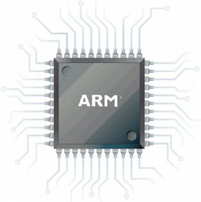
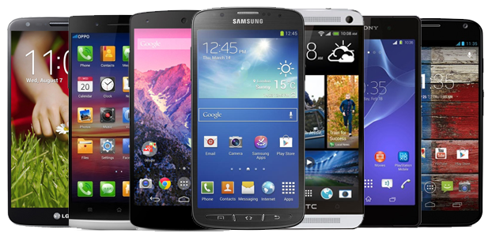
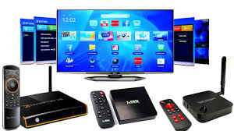
Gaps to utilize hardware based security
Devices with TEE
Many
Service
Providers
Client Applications
Key
Management
Trusted Applications
?
Trusted
Applications
TEE
Providers
Multiple OSs
Payment App
Providers
What protocol to install, update, and delete TAs? (with attestation feature)
Firmware X, Y, Z
Security App
Providers
Chip/Firmware
Providers
Game App Providers
Device Hardware
Enterprise App Providers
Device
Manufactures

Slide 29
Open Trust Protocol (OTrP)

Slide 30
Open Trust Protocol (OTrP)
An interoperable Trust Application Management protocol across broad application providers and diverse TEE OS providers
Designed to work with any hardware security based TEE that aims to support a multi-vendor environment
Focus on re-use of existing schemes (CA and PKI) and ease of implementation (keeping message protocol high level)

Slide 31

Overview
CAs issue certificates to OTrP actors (TEE, TAM, SP)
TAM and TEE exchange messages
An OTrP Agent relays the OTrP message between TAM and TEE
Device
Secure World
Normal World
Trusted App
Client App
TAM
Service Providers (SP)
Secure World
OS
OTrP Agent
Normal World OS
Certification Authorities for Devices
Certification Authorities for TAM and SP
Hardware
Open Trust Protocol

Slide 32
Design Choices
Uses asymmetric keys and PKI
Manufacturer-provided keys and trust anchors
Enables attestation between TAM and TEE-device
JSON-based messaging between TAM and TEE
Messages for attestation
Messages for security domain management and TA management
Use JOSE (JSON signing and encryption specifications) – CBOR alternative spec available.
OTrP Agent in REE relays message exchanges between a TAM and TEE
Device has a single TEE only

Slide 33

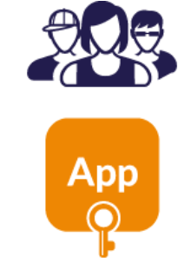







Envisioned User Experience
End user enjoys a rich Android experience and the security of a TEE backed trusted component
App developer uploads their Android app to a suitable app store and securely sends their trusted app to their TAM provider
End user downloads Android app from an app store
App developer builds two components:
Android App &
Trusted App
Developer includes a TAM library to handle the OTrP transport
App on first start communicates to TAM provider and installs trusted app into the TEE using OTrP
TAM

Slide 34
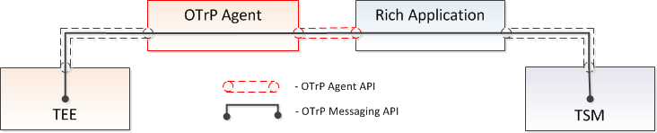
OTrP Agent
Responsible for routing OTrP messages to the appropriate TEE
Most commonly developed and distributed by TEE vendor
Implements an interface as a service, SDK, etc.
TAM

Slide 35
Scope
PKI
Certification Authority
Certification Authority
Device
Software
OTrP
Agent
Client App
TEE
TAM
Service Provider
OTrP
Device
Hardware Platform
OTrP Message
OTrP Agent API
Certificate Enrollment API
Implementation Specific API

Slide 36
Operations and Messages
Remote Device Attestation
Command | Descriptions
GetDeviceState | Retrieve information of TEE device state including SD and TA associated to a TAM
Security Domain Management
Command | Descriptions
CreateSD | Create SD in the TEE associated to a TAM
UpdateSD | Update sub-SD within SD or SP related information
DeleteSD | Delete SD or SD related information in the TEE associated to a TAM
Trusted Application Management
Command | Descriptions
InstallTA | Install TA in the SD associated to a TAM
UpdateTA | Update TA in the SD associated to a TAM
DeleteTA | Delete TA in the SD associated to a TAM

Slide 37




Keys
Certificate Authority
Service Provider
TAM
Device TEE
Keys
CA Certificate
SP Key pair
and Certificate
TAM Key pair
and Certificate
TEE Key pair
and Certificate
TFW Key pair
and Certificate (optional)
Trust Anchors
Trust Anchors: trusted Root CA list of TEE certificates
Trust Anchors: trusted Root CA list of TAM & TFW
Usage
* Key pair and Certificate:
used to issue certificate
* Key pair and Certificate:
used to sign a TA
* Key pair and Certificate:
sign OTrP requests to be verified by TEE
* Key pair and Certificate:
device attestation
to remote TAM and SP.
* SP AIK in runtime
for use by SP (encrypt TA data / verify)
* Key pair and Certificate:
evidence of secure boot
and trustworthy firmware
* AIK: Attestation Identity Key, TFW: Trusted Firmware

Slide 38
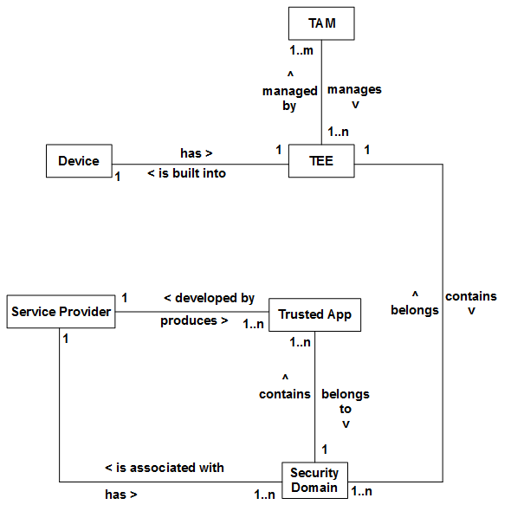
Entity Relationships

Slide 39
Sample Protocol Usage Flow
Security of the Operation Protocol is enhanced by applying the following three Measures:
Verifies validity of Message Sender’s Certificate
Verifies signature of Message Sender to check immutability
Encrypted to guard against exposure of Sensitive data
TAM
Client App
TEE
Phase#1
“Device Attestation”
Operation request triggered and verify Device state information
Request to TSM for TA installation
Send [GetDeviceState] to TEE
Return DSI as a response to [GetDeviceState]
Phase#2
Prerequisite operation
(if Security domain doesn’t exist where the TA should be installed)
Send [CreateSD]to create SD where the TA will be installed
Create new SD
Send other prerequisite commands (if necessary)
Decrypt TA binary and its
personal data.
Install TA into target SD.
Store personal data in
TA’s private storage.
Phase#3
Perform Operation requested by SP or Client Application
Send [installTA] with encrypted TA binary and its data

Slide 40
Summary
Some TEEs, such as TrustZone, are open to companies to install their favorite secure world OS.
Vendors want to have a choice regarding Trusted Application Managers.
This creates an interoperability challenge for managing (installing, updating, deleting) Trusted Applications on a TEE.
OTrP provides a protocol for such a TA management (offering attestation capabilities).

