Slide 1
The Unbearable Futility of Data Privacy in Content-Centric Networking
Cesar Ghali, Gene Tsudik, Christopher A. Wood
University of California Irvine
{cghali,gene.tsudik,woodc1}@uci.edu
ACM WPES 2016, to appear

Slide 2
Outline
IP privacy recap
CCN privacy recap
What wrong?
Can we fix it?
Should we fix it?

Slide 3
IP Privacy
Turns this…
C
GET /a/b/c
S
RESPONSE: <data>

Slide 4
IP Privacy
Into this… (with IPSec or TLS)
secure channel
C
GET /a/b/c
S
RESPONSE: <data>
What’s revealed?
Source and destination addresses and port #
Timing
Packet sizes

Slide 5
CCN Privacy
Turns this…
C
Interest: /a/b/c
P
Content: <data>

Slide 6
CCN Privacy
Into this…
C
Interest: /a/b/c
P
Content: <data>
encrypted content?
What’s revealed?
Consumer and producer locations
Timing
Packet sizes
Interest name
Producer identity
…
Properties of the (application) data

Slide 7
Privacy Parity
CCN privacy < IP privacy
What’s the “delta”?
Interests for same content can be correlated
Interest names reveal information about content
Content carries explicit names
+ Location of content not (always) apparent
BTW:
Anonymity<>privacy
Anonymity is out of scope here

Slide 8
Privacy Attacks
Correlation: learn when two requests correspond to same content
Identification: learn when specific content was requested
Leakage: learn anything from a request or response

Slide 9
Adversaries
Eavesdropper: a passive interceptor
On-path HbC: router that forwards interest and content packets
Distributed: at least two on-path: one near producer, one near consumer
Active & Scary: as above, also generates its own probes

Slide 10
Main Questions
What properties must responses have to prevent privacy attacks?
What about requests?
What about both?

Slide 11
Weak & Strong Privacy
Weak: Adv can not learn anything from a request or response, but can correlate packets
Strong: Adv can not learn, identify, or correlate

Slide 12
Weak Privacy Requirements
Responses must be protected via IND-secure encryption
Why? To prevent information leakage in the simplest of ways
Requests must be transformed by a deterministic cryptographic PRF that is not length preserving
Why? Length can be used to distinguish requests from one another and the “network” representation must appear random to Adv
Why deterministic? How to route otherwise? Also: how to preserve the interest collapsing feature?

Slide 13
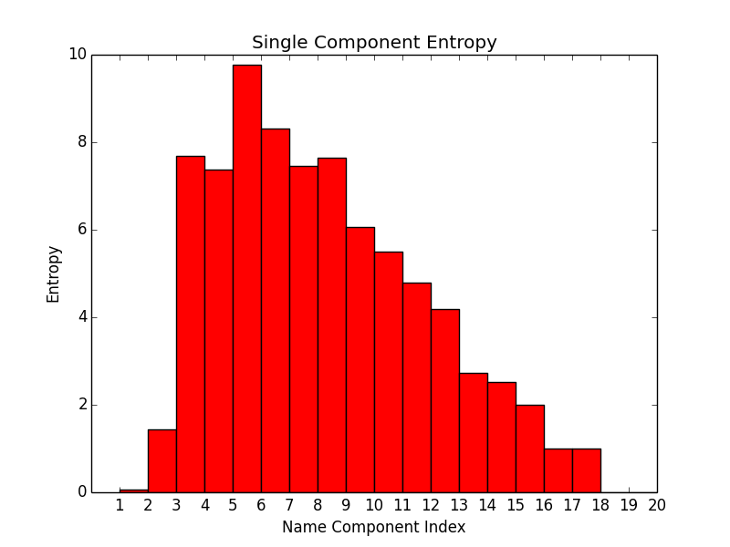
Hash Functions Are Not Enough
Source: Cisco URI dataset

Slide 14
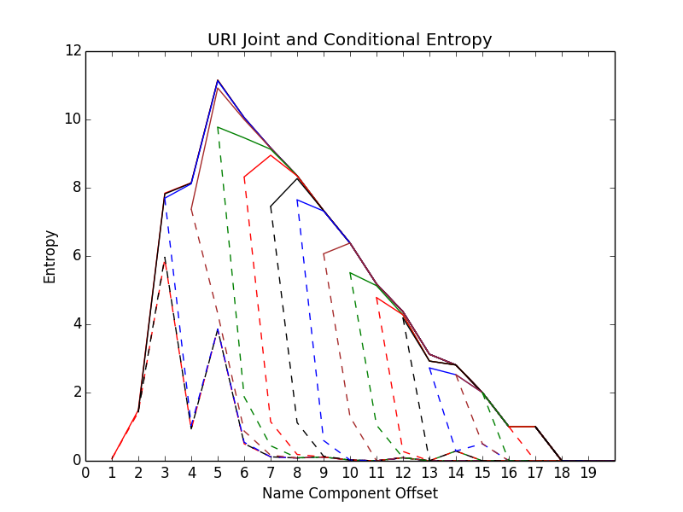
Hash Functions Are Not Enough
Prefix leaks information
about the suffix!

Slide 15
Design Patterns
So… many consumers share the same secret?
Shared Secret? | Strategy
Yes | Consumer and producer: derive ephemeral shared key from secret, use it to encrypt request and response
No | Consumer: generate random key, encrypt request with producer’s public key Producer: decrypt random key, use it to encrypt response
But what about caches?

Slide 16
Strong Privacy Requirement
Requests and responses must be protected with IND-CCA or semantically-secure encryption
Why? To prevent correlation attacks
Design Pattern
Create a session (as in TLS) and use it to transfer requests and responses

Slide 17
Outcomes?
Any realistic form of data privacy complicates CCN request-response m.o.
It’s no longer a simple request-response!
In most circumstances, privacy inhibits caching
How important is caching in CCN?
For proper data privacy, CCN would become not very different from IP+TLS
So what are we doing here?

Slide 18
Open Question
Will
CCN privacy
remain forever elusive
or at least
inferior to IPsec?

Slide 19
Questions?
Thanks!

