Slide 1




Information-Centric Mobile Edge Computing for Connected
Vehicle Environments: Challenges and Research Directions
Dennis Grewe ٭, Marco Wagner ٭, Mayutan Arumaithurai†, Ioannis Psaras ‡ and Dirk Kutscher ₸
٭ Robert Bosch GmbH, Corporate Sector Research, Renningen, Germany
† Institute of Computer Science, University of Göttingen, Germany
‡ University College London, UK
₸ Huawei German Research Center, Germany

Slide 2
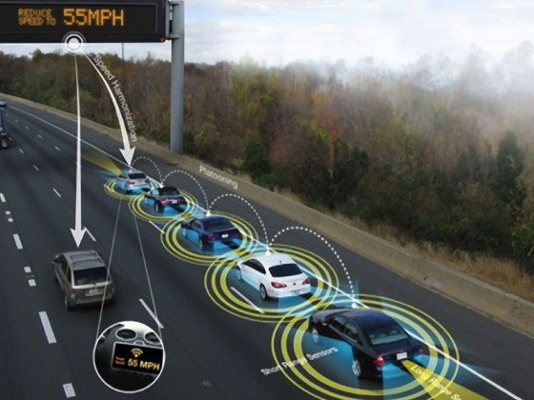
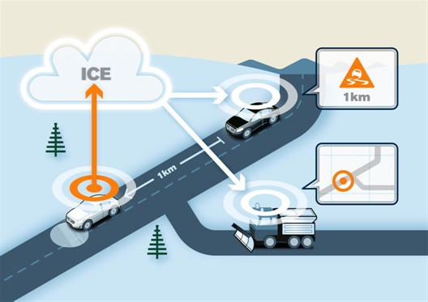
http://www.montana.edu/news/16120/msu-researchers-to-collaborate-on-automated-and-connected-vehicle-research-opportunities
http://www.autoconnectedcar.com/2014/03/volvo-new-connected-car-features-magnets-real-time-cloud-road-data-driver-sensing/
Connected automated driving
- is one of the major technological drivers in the automotive domain today

Slide 3
Exemplary use case:
Electronic Horizon

Slide 4
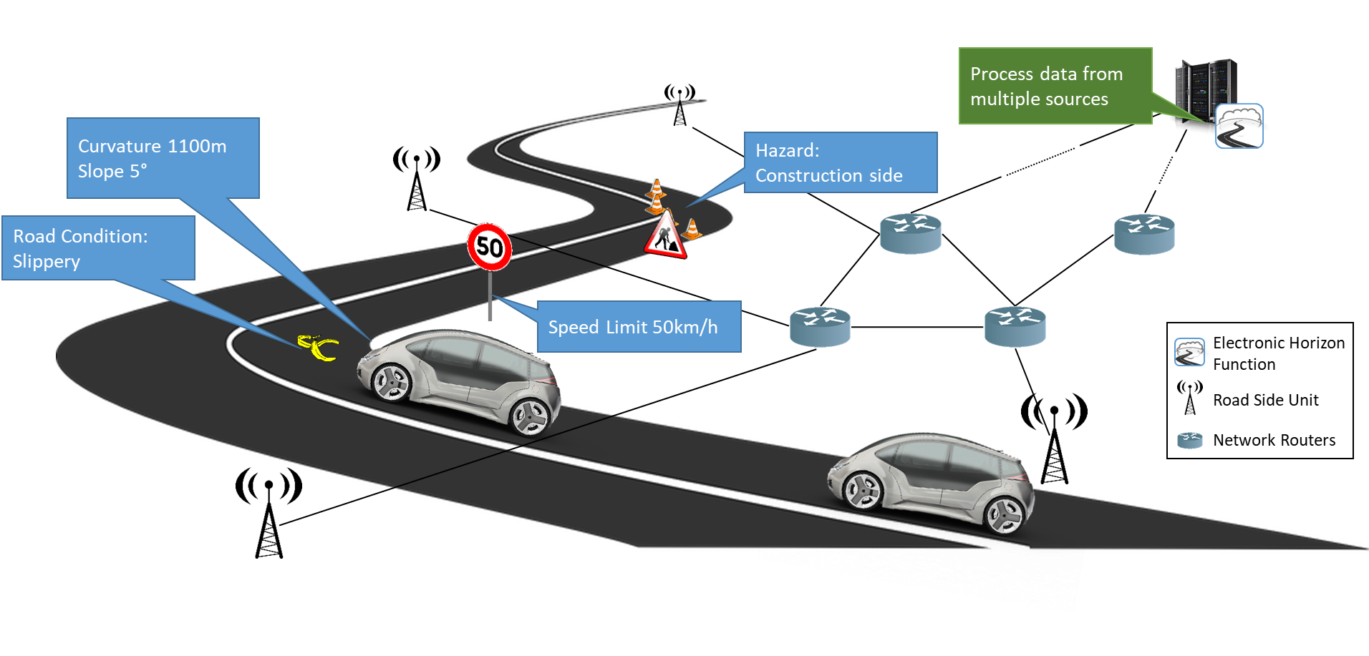
Use Case
Electronic Horizon
Notes:
Will heavily rely on information from cloud backends
real-time maps
street condition information
from in-vehicle systems such as sensors
personalized data from other domains, such as smart city or smart home environments

Slide 5
Use Case
Electronic Horizon
Environmental
model
Dynamic: traffic, hazards, Road conditions
Static Info: Map Data, topographical Information
Vehicles’ Mobility Model
Notes:
Based on the fusion of all data, an environment model is computed in the cloud backend by the electronic horizon function to provide a detailed preview of the road ahead. It allows for new features and functions such as adaptive cruise (e.g. reduce velocity to catch next green light) and predictive power-train control (e.g. gear up and down to reduce fuel or battery consumption), adaptive navigation (e.g.based on the trac ahead) or adaptive headlight adjustment (e.g. to spot to a hazard).

Slide 6
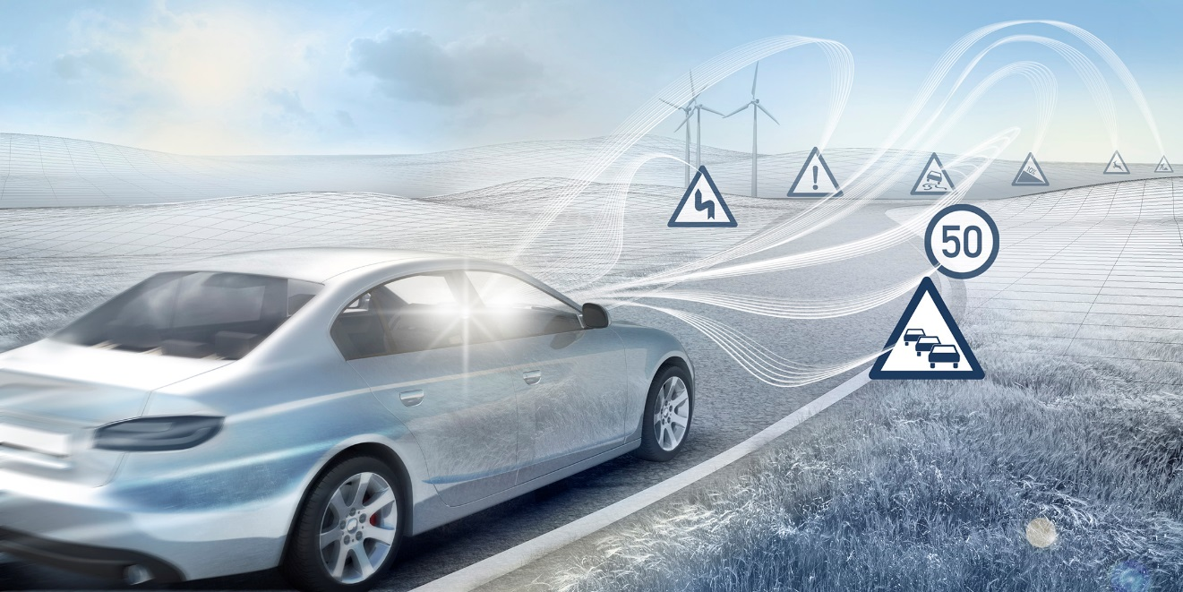
Use Case
Electronic Horizon
Environment model
  provide a detailed preview of the road ahead
Picture: Bosch http://www.bosch-presse.de/pressportal/de/media/dam_images/pi9512/header-connectedstudy_img_w386.jpg
Notes:
Based on the fusion of all data, an environment model is computed in the cloud backend by the electronic horizon function to provide a detailed preview of the road ahead. It allows for new features and functions such as adaptive cruise (e.g. reduce velocity to catch next green light) and predictive power-train control (e.g. gear up and down to reduce fuel or battery consumption), adaptive navigation (e.g.based on the trac ahead) or adaptive headlight adjustment (e.g. to spot to a hazard).

Slide 7
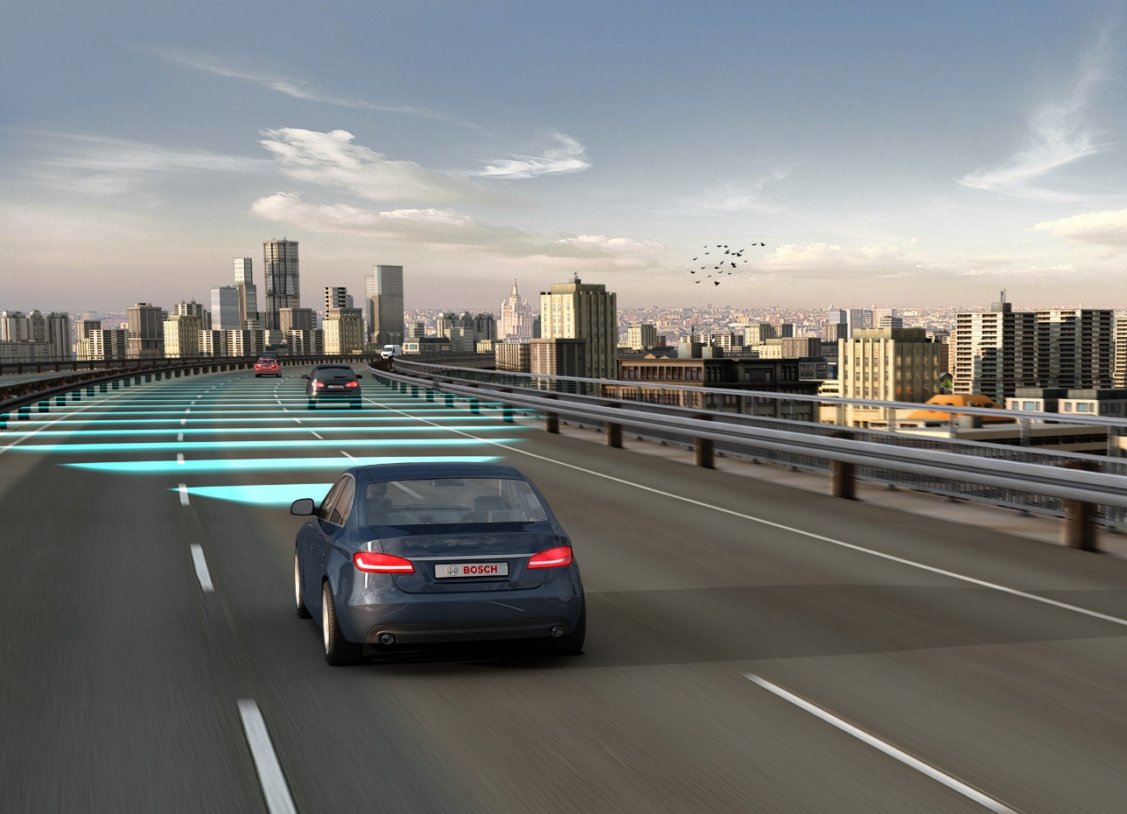
Use Case
Electronic Horizon
Environment model
  It allows for new features and functions such as
    adaptive cruise
      e.g. reduce velocity to catch next green light
    predictive power-train control
      e.g. gear up and down to reduce fuel or battery consumption
    adaptive navigation
      e.g.based on the traffic ahead
Picture: Bosch http://www.bosch-presse.de/pressportal/de/media/migrated_media/pi8704/1-cc-20576_img_h720-2.jpg
Notes:
Based on the fusion of all data, an environment model is computed in the cloud backend by the electronic horizon function to provide a detailed preview of the road ahead. It allows for new features and functions such as adaptive cruise (e.g. reduce velocity to catch next green light) and predictive power-train control (e.g. gear up and down to reduce fuel or battery consumption), adaptive navigation (e.g.based on the trac ahead) or adaptive headlight adjustment (e.g. to spot to a hazard).

Slide 8
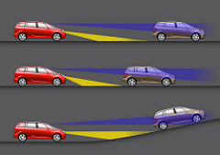
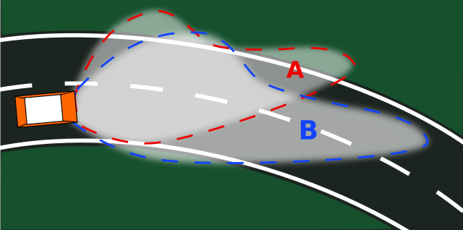
Use Case
Electronic Horizon
Environment model
  It allows for new features and functions such as
    adaptive headlight adjustment
      e.g. to spot hazard
Notes:
Based on the fusion of all data, an environment model is computed in the cloud backend by the electronic horizon function to provide a detailed preview of the road ahead. It allows for new features and functions such as adaptive cruise (e.g. reduce velocity to catch next green light) and predictive power-train control (e.g. gear up and down to reduce fuel or battery consumption), adaptive navigation (e.g.based on the trac ahead) or adaptive headlight adjustment (e.g. to spot to a hazard).

Slide 9
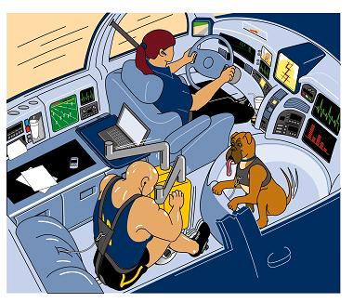
Use Case
Electronic Horizon
Environment model
  Mix of personalized and common information
Under the personalized production paradigm, consumers can personalize their cars with accessories to fit their lifestyles.
Source: https://me.engin.umich.edu/news-events/news/koren-appointed-distinguished-university-professorship
Notes:
Based on the fusion of all data, an environment model is computed in the cloud backend by the electronic horizon function to provide a detailed preview of the road ahead. It allows for new features and functions such as adaptive cruise (e.g. reduce velocity to catch next green light) and predictive power-train control (e.g. gear up and down to reduce fuel or battery consumption), adaptive navigation (e.g.based on the trac ahead) or adaptive headlight adjustment (e.g. to spot to a hazard).

Slide 10
Use Case
Electronic Horizon
Nowadays, services are running in the cloud
Notes:
Will heavily rely on information from cloud backends
real-time maps
street condition information
from in-vehicle systems such as sensors
personalized data from other domains, such as smart city or smart home environments

Slide 11
Motivation for Edge Computing
Accessing cloud based services
  total latency in the range of 30-100ms [1]
Unacceptable for many latency-critical mobile applications
  autonomous driving, realtime online gaming, virtual sports
  may require tactile speed with latency approaching 1ms [2]
[1] M. Satyanarayanan, P. Bahl, R. Caceres, and N. Davies, “The case for VM-based cloudlets in mobile computing,” IEEE Pervasive Comput.,vol. 8, no. 4, pp. 14–23, 2009.
[2] G. Intelligence, “Understanding 5G: Perspectives on future technological advancements in mobile,” London, UK, 2014.
Notes:
Tactile speed: identify speed via touching
The latency of a 4G network cannot meet this requirement. With the latency of 4G network, a car driving at 100 km/h still moves 1.4 m from the time it finds a obstacle to the time when the braking command is executed.
Under the same condition, with the latency on a 5G network, the car will move just 2.8 cm, and this performance is comparable with the standard of an anti-lock braking system (ABS).

Slide 12
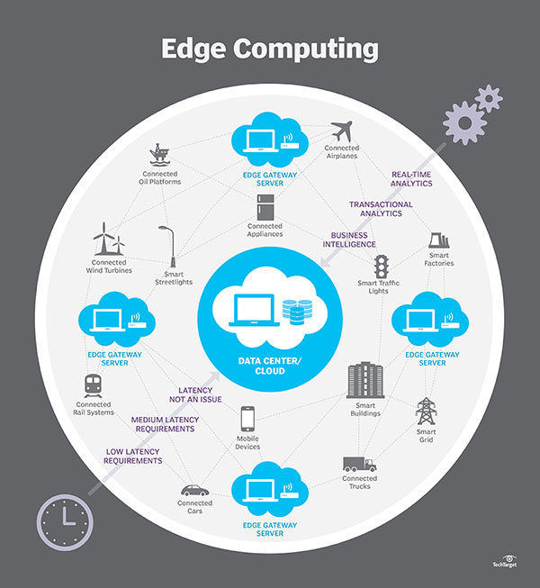
(Mobile)Edge Computing
Bring computational resources, storage and services closer to the consumers
Edge computing helps ensure that the right processing takes place at the right time
Benefits
  Latency & bandwidth reduction
  Computation offloading
    IoTs, cameras, cars might not have sufficient computing power
    need to collect data from other sources
  Context awareness due to proximity
Source: http://searchdatacenter.techtarget.com/definition/edge-computing
Source: cisco 2014.
Notes:
Computation offloading: IoT devices (IoTs, cameras, even cars) might not have sufficient computing power
Might also need to collect data from other sources

Slide 13
(Mobile)Edge Computing
However, current deployment
  is based on coarse-grained virtual machines (VM)
  heavily relies on the underlying host-centric networking model
Data dissemination is still challenging
  between the highly mobile participants
  nodes constantly joining and leaving the network.
How to find the closest instance of an edge cloud in dynamic networks.
In this work, we argue that Information Centric Networking (ICN) could enhance the capability of (M)EC

Slide 14
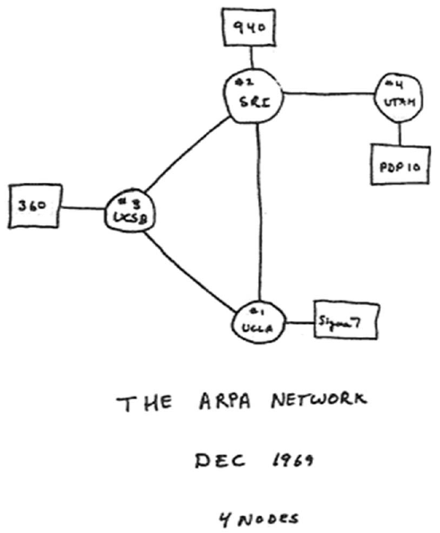

Information Centric Networking (ICN)
TCP/IP
The Internet was initially designed for host-centric communications
  Remote login, file transfer
  Conversations
TCP/IP is well suited for communications between two stationary hosts
Source: Scientific American - Early sketch of ARPANET's first four nodes
http://www.scientificamerican.com/gallery/early-sketch-of-arpanets-first-four-nodes/

Slide 15




Information Centric Networking (ICN)
Currently
Connect me with host 66.45.78.89
Give me today’s issue of Time Magazine
DNS
Current Network
Information Centric Network
Today, the communication pattern has changed significantly
  Nodes are mobile and unstable in their connectivity
  Users care about content, independent of its location
This fits with current solutions such as CDNs, distributed cloud, load-balancing and etc.
ICN puts data as first class citizen in the network

Slide 16
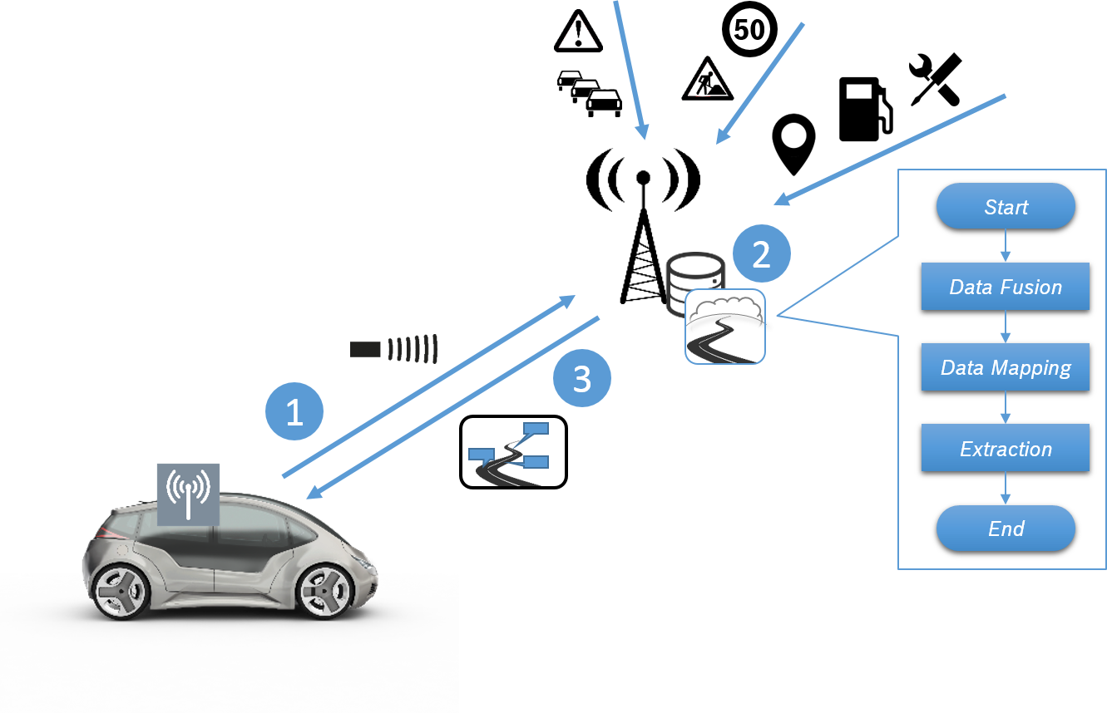
Information-Centric Mobile Edge Computing
Electronic Horizon via ICN + MEC
Single abstraction of available data and computing resources
  They can be accessed in one universal way (name does not change)
  The resources may be on the local machine (in the car), on road-side units or in the edge/cloud
Consumer Mobility
Better integrate virtualization
  instantiation, removal, migration
Disentangle network connectivity from access control
  E2E security could be detrimental for MECs
  It does not matter where data and computation results come from
  Access control is implemented through data encryption
  which would be “orthogonal” to accessing the bits
Notes:
Access control
-- say e2e is not good. Since you want to be able to access any MEC (especially since you are moving)
1)Helps obtain data from the closest MEC
2) Helps MEC obtain relevant info from the closest sources
ICN edge computing could be useful to easier leverage all available data and computing resources and provide a single abstraction for it.
The resources may be on the local machine (in the car), on road-side units or in the edge/cloud — they can still be accessed in one universal way (name does not change).
- In an MEC scenario that includes mobile nodes, turning away from depending on physical locations of data simplifies the communication.
In ICNs, a vehicle sends an Interest packet to the network asking for some data independently of its current physical location, rather than resolving the address of a specific network node providing the data. The actual content resolution and transport to the vehicle is performed by the network. In a connected vehicle scenario, this concept ensures that the data is retrieved from the closest producer, cache, or MEC instance.
Figure 2 illustrates the operational steps of the electronic horizon making use of the edge computing paradigm. A vehicle requests for data about a detailed preview of the road ahead (Figure 2 step 1). This includes static named common data (e.g. traffic situation, speed limit or hazards) as well as dynamic computed results including personalized data (e.g. fuel consumption or point of interests).
The electronic horizon service instance aggregates such data from multiple sources in the network and computes the results of the electronic horizon individually (Figure 2 step 2). Finally, the result is delivered back to the vehicle (Figure 2 step 3).
Better Integrate Virtualization: Since the network nodes have visibility to the demands of the vehicles, they could provide support by: a) route the requests to the best MEC device; b) instantiate/migrate the network function to an MEC that is closer to the demand; and c) remove unwanted network services to free up valuable resources.

Slide 17
Research Directions

Slide 18




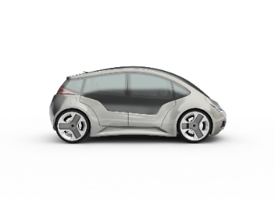


Research Direction: Mobility
Consumer Mobility
Producer mobility (data-source is moving)
  Some early works dealing with producer mobility [2,3]
    Anchor based [4,5]
      Synchronization of anchor(s)
    Anchorless [1]
      Router updates
Function/service mobility
  Migration
Best not to change solution based on the scenario
WLAN-based Connectivity Unit
Road Side Unit
WiFi range
C
Data Consumer
Migrate function/service
C
V
[1] J. Augé, G. Carofiglio, G. Grassi, L. Muscariello, G. Pau, and X. Zeng. , MAPMe: Managing Anchor-less Producer Mobility in Information-Centric Networks, CoRR abs/1611.06785 (2016).
[2] Y. Zhang, A. Afanasyev, J. Burke, and L. Zhang. 2016. A Survey of Mobility Support in Named Data Networking. In Proceedings of the Workshop on Name- Oriented Mobility: Architecture, Algorithms and Applications (NOM 2016).
[3] Z. Zhu, R. Wakikawa, and L. Zhang. 2011. A Survey of Mobility Support in the Internet. Request for Comments RFC 6301. IRTF.
[4] Mobilityfirst, http://mobilityfirst.winlab.rutgers.edu/
[5] PURSUIT, http://www.fp7-pursuit.eu/PursuitWeb/
Notes:
4] J. Augé, G. Carofiglio, G. Grassi, L. Muscariello, G. Pau, and X. Zeng. 2016. MAPMe:
Managing Anchor-less Producer Mobility in Information-Centric Networks.
CoRR abs/1611.06785 (2016).
[33] Y. Zhang, A. Afanasyev, J. Burke, and L. Zhang. 2016. A Survey of Mobility
Support in Named Data Networking. In Proceedings of the Workshop on Name-
Oriented Mobility: Architecture, Algorithms and Applications (NOM).
[34] Z. Zhu, R. Wakikawa, and L. Zhang. 2011. A Survey of Mobility Support in the
Internet. Request for Comments RFC 6301. IRTF.

Slide 19

Research Direction: Caching
Prefetching popular common data and store it within ICN caches
  reduces computation time and therefore latency
  But where and when to place it?
Predictive (proactive) caching/fetching strategies for computation results
Cache Revocation
Cache data to serve personalized, E.g.,
  Precomputed screen
  Netflix
Monetization
Assurance
  That this is the latest data
WLAN-based Connectivity Unit
Road Side Unit
WiFi range
C
Data Consumer
prefetch
Proactive result placement
C
V

Slide 20
Research Direction: Naming
Naming is a major/fundamental component
More info => more visibility of what is needed
  What do we put in the name
    And what should go as attributes or in the pay-load
    E.g., while accessing named functions/services, should the variables be in the name?
      Function add(a+b)
  Tradeoffs: forwarding efficiency vs ICN benefits
Should it be hierarchical or flat or … [1]
schemes to access functions/services or specific instances
schemes to query for results (e.g. personalized)
How to provide additional context info (via name, attributes)
Need to perform a lot of application driven design and testing
[1] «Comparison of Naming Schema in ICN», Sripriya Srikant Adhatarao, Jiachen Chen, Mayutan Arumaithurai, Xiaoming Fu, K. K. Ramakrishnan, the 22nd IEEE International Symposium on Local and Metropolitan Area Networks (LANMAN 2016), Rome, Italy, IEEE, June 2016.

Slide 21
Research Directions (Others)
Security & Privacy, e.g.,
MEC‘s will require access to data to use it for computation
Data Dissemination, e.g.,
MEC synchronization
Pub/sub, push from/to MEC
Naming
Caching
Routing & Forwarding,
MEC or cloud
Which MEC to connect to
Switch MECs as vehicle is moving
Mobility
Deployment and Orchestration, e.g.,
fast deployment of function/service (e.g. unikernel) on seeing the name
Notes:
: double check and connect these issues to MEC, not general ICN

Slide 22
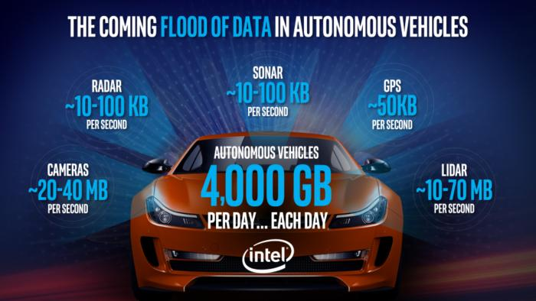
Research Direction: Large scale data
Future vehicles will be equipped with connectivity units to provide/consume data
“Just one autonomous car will use 4,000 GB of data/day”
“Each car driving on the road will generate about as much data as about 3,000 people”
http://www.networkworld.com/article/3147892/internet/one-autonomous-car-will-use-4000-gb-of-dataday.html
ICN can help, but naming, caching, mobility, security, needs to be further looked into

Slide 23
Conclusion
Information-Centric Mobile Edge Computing for Connected Vehicles
ICN has the potential to provide a lot of benefits to (Mobile) Edge Computing
However, there exists a lot of research and open issues in ICN, MEC and ICN+MEC
Notes:
TODO: Put more reasons why ICN is useful for MEC

Slide 24
Acknowledgments
This work was partially supported by the joint EU H2020/NICT ICN2020 Project (Contract No. 723014. and NICT No. 184) and the EPSRC INSP Early Career Fellowship (no. EP/M003787/1).

Slide 25
Thank you & Questions

