Slide 1
Network Measurement Framework and Path Tracing Utility for NDN
{ Lotfi.Benmohamed , Davide.Pesavento }@nist.gov

Slide 2
Network Measurement
Network measurement is fundamental to network operation, application performance, and policy (not just research)
Stakeholder communities involved:
Network user community
What the network is doing to my packets
measure QoS/QoE/SLA
Academic community: networking research
Network operators
Anomaly detection/capacity planning
Monitor network health/network forensics
Network policy makers
Define baseline for policies/pricing
Measure adoption of technologies

Slide 3
Goal
Empower NDN with a built-in measurement framework that
can support multiple use cases,
can be used by different applications that need to produce and/or consume network measurements
As new applications are developed, they
can be instrumented with measurement probes, and
make use of the framework to meet their measurement needs

Slide 4
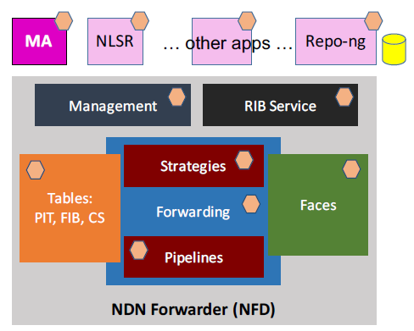
Design
Client-Agent interaction:
4-way handshake
Similar to RICE approach
→ Measurement request
← Reply containing token
→ Interest with token
← Data with results

Slide 5
New Effort
DNMP: Distributed Network Measurement Protocol
Pollere’s project funded under a NIST SBIR Phase1, started August 1.
Uses a brokerless publish-subscribe communications model for both the measurement requests and the resulting measurement data
with goal to automate process of adding measurement probes using trust schema templates
 | Purpose | Duration | Funding level
Phase I | Feasibility | 6 months | Up to $100K
Phase II | R&D with commercialization plan | 2 years | Up to $300K

Slide 6
Path Tracing
Think of path tracing as just one of the probes within the NDN Measurement Framework
Challenges for tracing in ICN vs. in IP
In IP: one next-hop, one path
In ICN, due to Caching/Multiple paths/Forwarding strategy: path(s) followed by one Interest can change over time even if routing (i.e. FIB entry) doesn’t change
Send a “trace” Interest to discover how a “regular” Interest would be routed
Returns list of traversed nodes
Associated RTTs
Potentially other information as well
Parameters in trace request include:
Exploring multiple paths
Discover all available paths while bypassing strategy
Ignore cached content to discover producers

Slide 7
NDN-Trace Design

Slide 8
Other Traceroute Proposals
CCNinfo / Contrace (https://tools.ietf.org/html/draft-asaeda-icnrg-ccninfo-01)
For tracing multiple paths:
requires PIT entries (created by trace requests) to be kept alive for some timeout period
represents a significant departure from the “flow balance” principle
Does not provide RTT measurements between the client node and intermediate nodes on the path
only provides RTT between client and the node where the content is found (same as ping)
also provides one-way delay, but requires synchronized clocks
Trace built in the request packet as it travels upstream
ICN Traceroute (https://tools.ietf.org/html/draft-mastorakis-icnrg-icntraceroute-03)
Resembles the mechanism used by IP traceroute tool
Iteratively discovers the path by issuing Interests with a progressively increasing HopLimit field
Uses new PathSteering header:
constructed hop-by-hop while the reply travels back to the client
included in subsequent trace requests that must be forwarded along the same path

Slide 9
NMF: NDN Network Measurement Framework
NDN-Trace is just one of the many “probes” of the NDN Measurement Framework.
Poster at ACM ICN’17
https://conferences.sigcomm.org/acm-icn/2017/proceedings/icn17-1005.pdf

Slide 10
NMF: Status
Completed implementation of first version, including:
Node agent with a few measurement probes
https://github.com/usnistgov/nmf-agent
C++ client library and interactive command-line tool
https://github.com/usnistgov/nmf-client
Design of new features ongoing
“Long-term” storage of measurements data (repo?)
Access control (NAC?)
Capability discovery/negotiation (pub-sub?)
Two main use cases
Monitoring of operator networks, POV of the operator
Measure/probe the network from the edge (RIPE Atlas, CAIDA Ark)

Slide 11
NMF: Basic Interaction

Slide 12
NMF: Eventual Goals
Extensibility
Anyone can add a custom probe
We will define an internal API for probes and provide a small library to help writing new probes
App developers can integrate the framework in their app
Integration with access control protocols
Measurement data can be sensitive
Different clients have different access privileges
Long-term storage and querying of historical data

Slide 13
NMF: Protocol Details
Verbs
measure
query
retrieve
interrupt
We have defined:
Packet format, including TLV encoding
Client <-> agent protocol

Slide 14
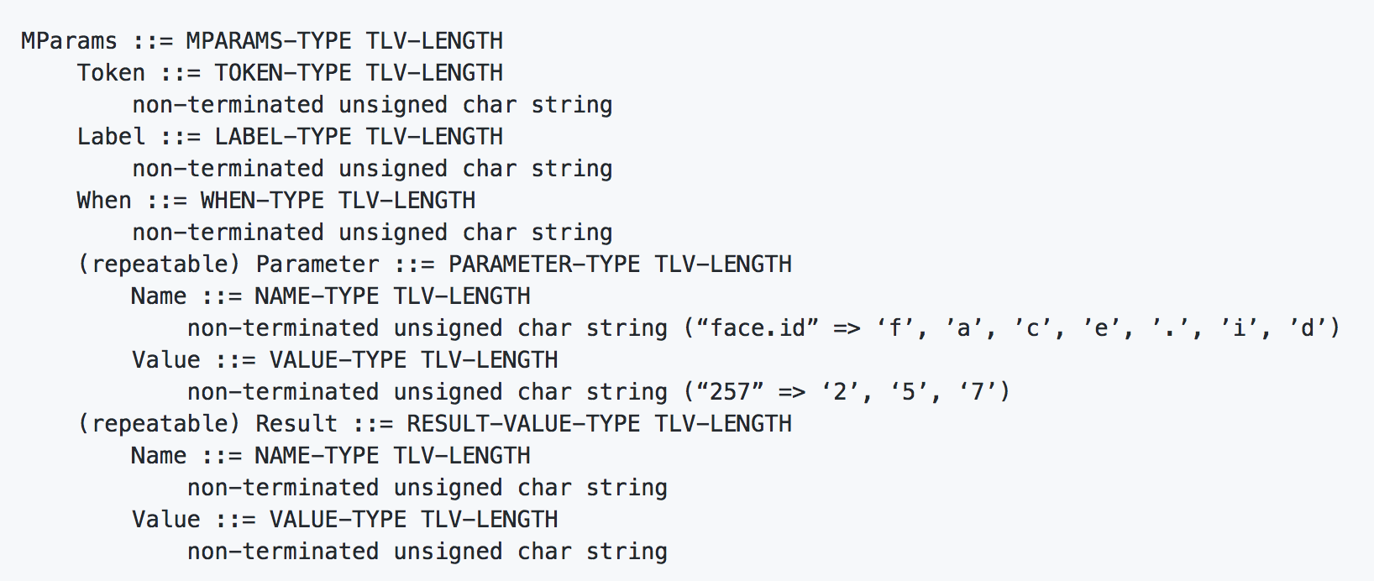
NMF: Protocol Details
/<domain>/<node>/NMF/<verb>/<MParams>/<CIComps> (still based on v0.2 packet format)

Slide 15
Old NDN-Trace Design

Slide 16
Old NDN-Trace Design
Current v1 implementation is considered “done”
Paper at ACM ICN’17
https://conferences.sigcomm.org/acm-icn/2017/proceedings/icn17-86.pdf
Tested by John DeHart on ONL
However:
It requires non-trivial changes to every strategy
Code is hard to maintain
We’d like to have more power over the tracing process (e.g., trace only a subset of next hops)

Slide 17
NDN-Trace: New “In-Forwarder” Design
Forwarding plane dispatches trace requests and responses to a traceroute module.
Strategy’s Interest forwarding API adds a dry-run mode.
In dry-run mode, the chosen strategy offers its forwarding decisions, but does not transmit Interests or alter any state or data structures.
The traceroute module invokes strategy dry-run mode, transmits trace requests to next hops as needed, and collects and returns responses.

Slide 18
NDN-Trace: Router Behavior
Let the strategy decide which next hops it would use for an Interest, assuming the Interest was retransmitted T times (T=0 for new Interests).
Send trace requests to the first K next hops chosen by the strategy.
Collect the first R trace responses that come back before a timeout TO expires, discard the rest.
Combine the responses into one (how?) and send it back.
trace module
forwarding
strategy
FIB
downstream
upstream

Slide 19
NDN-Trace: Request
NFD 3
Client
I3
I1
NFD 1
I2
NFD 2
I4
NFD 4

Slide 20
NDN-Trace: Reply
NFD 3
Client
D1
D4
NFD 1
D3
NFD 2
D2
NFD 4

Slide 21
NDN-Trace: Router Behavior
Reply forwarding/aggregation: two approaches
Hop-by-hop wrapping and signing, maintains existing signatures
Discard signature, re-sign, send downstream
Trace process termination
Producer
Cache
Either producer or cache, whichever is found first
Abnormal termination
No route
Administratively prohibited
…

Slide 22
Bypassing the Forwarding Strategy
It can be argued that a path (next hop) that appears in FIB but would never be considered by a strategy is not a meaningful path.
Some strategies do not use the FIB, e.g.:
Flooding strategy always floods.
Self-learning strategy may flood. FIB may be empty.
Hyperbolic FIB (in eventual implementation) maps prefixes to coordinates instead of next hops. FIB does not contain next hops.
Therefore the traceroute module should never look at the raw FIB entries without going through a strategy.
But what if we need to explore alternative paths that the current strategy would not consider?
Do we need this functionality, e.g. for strategy debugging?

Slide 23
NDN-Trace: Future Work
Currently exploring how to adapt NDN-Trace to take advantage of new features in NDN Packet Format v0.3
Use typed name components to recognize trace Interests?
Carry parameters in Interest Parameters TLV
Explore deployment/testing on the NDN Testbed
Lots more…

