Slide 1
Intent Based Networking
Laurent Ciavaglia
17-01-2019

Slide 2
Agenda
1 Why
Intent driven networking is important
2 What
Definitions and activities
3 How
Challenges and enablers

Slide 3
Our industry challenge is network complexity

Slide 4
Complexity
is inherent to network as a system of (distributed) systems
will not disappear
will grow…
The more we enable and expose new data and behaviors, the more we create complexity

Slide 5
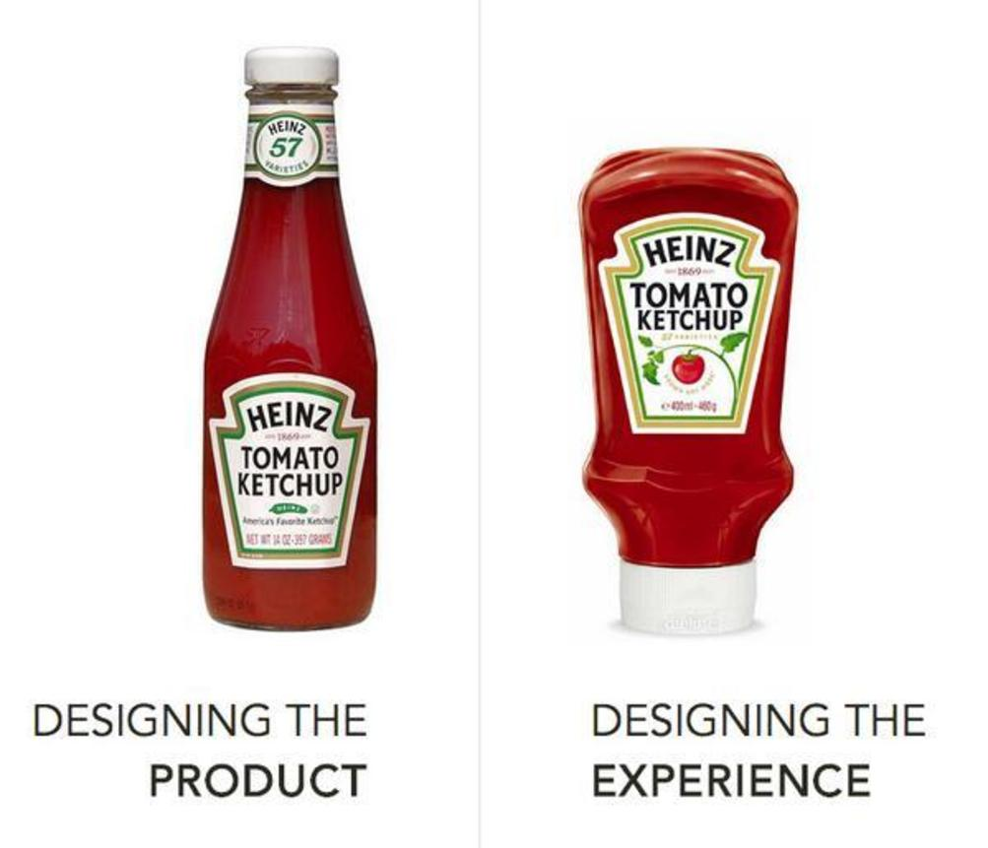
The problem…
We’ve chosen the wrong bottle of ketchup…
Notes:
We, engineers, have focused on designing the product rather than the experience.
Intent driven networking is all about extracting simplicity to change the network management or network operation experience.

Slide 6
Networks need a radical shift in usability

Slide 7

Enabling a shift in usability
Recognize intentions in any form of data

Slide 8

Enabling a shift in usability
Intelligence drives automation and adaptation

Slide 9

Enabling a shift in usability
Accountable for decisions and efficiency

Slide 10
The promises of intent-driven networks

Slide 11
Performance gain
1 intent =? 1000’s command lines
alleviate the (imperative) policy explosion problem
lower personal training
Create time!
Notes:
Enormous gains in performance (doing things better and faster several orders of magnitude)
Performance may be lower for some functionality or in early solution stages

Slide 12
Functionality gain
simpler (?) policy conflict detection and resolution
greater flexibility in system response
More challenging to identify (and quantify)
but respectively more important

Slide 13
Agenda
1 Why
Intent driven networking is important
2 What
Definitions and activities
3 How
Challenges and enablers
Notes:
Various angles / facets, trying to draw a more comprehensive definition of intent driven networking.
Also cover various groups developing intent based networking solutions be it in research, standards, or the industry.

Slide 14
Intent = what not how

Slide 15
Intent-driven networks
Networks configuring and adapting autonomously to the user or operator intentions (i.e., a desired state or behavior)
without the need to specify every technical detail of the process and operations to achieve it (i.e., the "machines" will figure out on their own how to realize the user goal).

Slide 16


Intent as an envelope of utility function
Intents
Constraints
fn ((max(utility_{user}), min(cost_{operator}))
User
Operator
Capabilities
Network
Notes:
Intent = envelope of utility function
Objective = characterize the envelope to derive parameters to control/functions to program to stay in the envelope.

Slide 17
Intent as a declarative policy
Imperative
Declarative
Intelligence
Human
Machine
Notes:
To say it in other words,
Displace where and by whom intelligence is done
In imperative: intelligence is provided mostly by humans, involved deeply in the process, relying on the human intelligence (domain expertsie, cognitive capabilities) to define the solution (what and how).
In declarative (or intent type of policy): mostly by machines. Human operator defines ‘what’ is expected, and the system / the machines compute a solution meeting the requirements. Transfer of intelligence to the machines.

Slide 18
Imperative policy
from J. Strassner
Event – Condition – Action (ECA)
Explicit programming of state
→ rationality is compiled into the policy !
Pros: can be simple, system knows exactly what to do
Cons: explosion of policies #, conflict detection and resolution can be very difficult, difficult to read, complex to write

Slide 19
Declarative policy
from J. Strassner
Express what should be done, not how to do it
Specifies criteria for choosing a set of states
→ rationality is generated by optimizer/planner
Pros: more abstract, potentially more flexible, fewer, easier to write and comprehend
Cons: requires sophisticated translation and optimization modules

Slide 20
The intent jungle

Slide 21
The intent jungle
ZSM
MEF
HPe
SUPA
Juniper
ONF
Boulder
Aspen
Google ZTN
ANIMA
ENI
Auvik
Huawei
MEF
OpenStack
Congress
GBP
Cisco
TMF
NMRG
NEMO
ONOS
Intent
framework
Nokia
Open Daylight
NIC
GBP
Fortinet
FortiOS
Telefonica
Orange
OASIS
TOSCA
APSTRA
AOS
Veriflow

Slide 22
Open Networking Foundation (ONF)
A reference document – TR 523 (2016)
Intent NBI – Definition and Principles
https://www.opennetworking.org/images/stories/downloads/sdn- resources/technical-reports/TR-523_Intent_Definition_Principles.pdf

Slide 23
Open Networking Foundation (ONF)
Notes:
Mappings represent an information intermediation mechanism that permits consumer and provider
systems to communicate in terms “natural” to each.
As noted earlier, non-prescription, provider independence and declaration all generally impose a
requirement for an adjunct to Intent NBI service interfaces, which we call mappings. Mappings are keyvalue
stores, e.g., accessible by API, and are usefully considered, conceptually, as tables which permit
providers to interpret the terms that appear in Intent NBI requests, by translating from the (“simple and
intuitive”) consumer frame-of-reference terms that appear in Intent NBI requests to the detailed,
specific provider frame-of-reference terms that permit the provider to properly interpret the requests.
As a rule, in applications wherein the Intent NBI
paradigm is a natural “fit”, consumer frame-of-reference terms may tend to be relatively humanoriented
and intuitive, slowly-evolving and persistent, etc.; whereas corresponding provider frame-ofreference
terms may tend to be relatively more “machine-oriented”, potentially faster-evolving and
more ephemeral, etc.

Slide 24
IETF ANIMA working group
Standardizing a reference framework and protocols for autonomic networks.
https://datatracker.ietf.org/wg/anima/documents/

Slide 25
IETF ANIMA working group
An abstract, declarative, high-level policy used to operate an autonomic domain
as per draft-ietf-anima-reference-model-10 and RFC7575
Intent lifecycle
One Autonomic Network = Multiple Intents
One Intent = Multiple Outputs
Network operators/administrators writes Intents
Autonomic Functions define what Intents they understand
draft-du-anima-an-intent-05 (expired)
ANIMA Intent Policy and Format
draft-liu-anima-intent-distribution-00 (expired)
Intent Distribution for Autonomic Networking

Slide 26
IETF ANIMA working group
Examples of intents (not ANIMA specific)
  -Do the right thing
  -Freeze network enrollment
  -Arrange VM guest distribution so that (CPU) utilization is < 70%
  -Assign prefixes to RAN nodes
  -Protect premium users traffic
  -Maximize energy savings

Slide 27
IETF SUPA working group (concluded)
Simplified Use of Policy Abstraction
RFC 8328 Policy-Based Management Framework for the Simplified Use of Policy Abstractions (SUPA)
draft-strassner-supa-generic-policy-info-model
Defines an information model for representing policies using a common extensible framework independent of language and , protocol.

Slide 28
IRTF NM research group
Active research item on Intent based Networking
draft-clemm-nmrg-dist-intent-01
Clarifying the Concepts of Intent and Policy
draft-draft-li-intent-classification-00
Intent Classification
draft-moulchan-nmrg-network-intent-concepts-00 (expired)
Concepts of Network Intent
Dedicated workshop at IETF 102 in July 2018 + regular follow-ups at RG meetings

Slide 29
IRTF SDN research group (concluded)
An instructive presentation from Pr. John Strassner on Policy Based Management with a discussion on “intent” policy
https://datatracker.ietf.org/meeting/95/materials/slides-95-sdnrg-1

Slide 30
IETF IBNEMO (mailing list)
Nemo is an intent-based North Bound (NB) interface consisting of an application protocol running over HTTP (RESTful interfaces) to
exchange intent-based primitives between applications and
meta-controllers controlling virtual network resources (networks,
storage, CPU).
https://www.ietf.org/mailman/listinfo/Ibnemo
but mostly inactive/silent since Spring 2016…

Slide 31
MEF Orchestration WG
Policy-Driven Orchestration Project
MEF Approach
•Management and Orchestration must be model-driven
• The model needs to do as good a job modeling business concepts as it does modeling resources and services
• We need a mechanism to advertise capabilities and impose constraints
• Orchestration uses Policy to make its decisions
• Orchestration is multi-layer and distributed (not a single God-Box)
Few publicly available information.

Slide 32
ETSI ZSM ISG
Zero Touch Network and Service Management
ZSM005 – Means of Automation
describes different, existing and proven mechanisms or approaches aimed at achieving automation and zero-touch network management while analyzing their implications on the design and specification of the ZSM framework architecture and their utilization as a basis for future ZSM compliant solutions.
Chapter on Intent based orchestration and networking
Potential implication for ZSM002 – Architecture to be defined

Slide 33
ETSI ENI ISG
Experiential Networked Intelligence
ETSI GR ENI 003 - Context-Aware Policy Management Gap Analysis
In ENI, an intent policy is a type of declarative policy that uses statements to express the goals of the policy, but not how to accomplish those goals. Each statement in an Intent Policy may require the translation of one or more of its terms to a form that another managed functional entity can understand.
In the present document, Intent Policy will refer to policies that do not execute as theories of a formal logic. They typically are expressed in a restricted natural language, and require a mapping to a form understandable by other managed functional entities.

Slide 34
Observations
A proper analysis would require a complete survey of all these initiatives and contributions. Volunteers?
Highly fragmented space, common denominator very small
Most preeminent work on “Intent for SDN” addressing essentially a pure connectivity need
Interestingly, “Intent for NFV” has a quite low activity threshold
Scientific literature is scarce or spread over multiple domains / disciplines

Slide 35
Agenda
1 Why
Intent driven networking is important
2 What
Definitions and activities
3 How
Challenges and enablers

Slide 36

Challenge 1
User input
and data
Operator input
and data
Sensori
input
Intent generation and validation
Shared goals
Patterns
Ability to learn and reason on intent sets
Notes:
Ability to learn and reason on intent sets that are heterogeneous, issued from multiple sources (e.g. different tenants), written or expressed in different formats with non-explicit or contradictory goals and produce formal knowledge out of them indicating real-time adaptive decision plans or recommendations to network operational teams.

Slide 37
(some) Research directions
Natural Language Processing / Understganding (NLP/NLU)
Ontologies and semantic analysis
Lazy learning
Knowledge representation and building:
Languages, templates, models…
graph databases, data dependencies…
Notes:
From an algorithmic point of view, this translates to design and validate learning algorithms capable to detect and identify high level goal from various sources of online and offline data, produce propositional (or reuse learned) patterns for the realization of identified shared goals, predict solution utility against the high level goal and quality against network diagnostic.
How to represent, recognize and interpret 'intentions' in structured and unstructured sets of data; calling for development in natural language processing, semantics, knowledge graphs, first-order/propositional/fuzzy logic...

Slide 38
Challenge 2
Shared goals
Patterns
Operational
constraints
Formulate and solve problem
Decisions
Ability to optimize and re-optimize decisions
Notes:
Ability to optimize and re-optimize the decision plans according to constraints (e.g. specialized slice for connected car), context, and criteria and ensure their actuation and realization.

Slide 39
(some) Research directions
Automatization of the generation of resolution methods (by decomposition)
Learning on choice of resolution method based on theoretical gain
Notes:
From an algorithmic point of view, this leads us to design and validate algorithms to automate the formulation and concurrent resolution of mathematical programs using validated intent expressions together with operational constraints to output decisions for provisioning reliable services (trade-off between sustainability, resource-consumption and resilience) and ensuring their continuity (trade-off between robustness and adaptation).

Slide 40
Challenge 3
Decisions
Execution
constraints
Program generation, specification and verification
Instructions
Ability to generate and verify programs
Notes:
How to automatically generate and verify programs (decisions realization), considering the execution constraints of/over virtual/physical infrastructures.
Importance of virtualization and programmability of the devices / systems: virtualization enables to run and scale functions (agents) when/whereever they are needed based on the outcome of step 2 (optimal decision plan). And programmability enables to dynamically, at run time generate code/programs that will realize the functions instantiating the solution.

Slide 41
(some) Research directions
Automatic program generation
Program distribution towards agents and collective decision process on resolution approach considering local/global variables and constraints

Slide 42
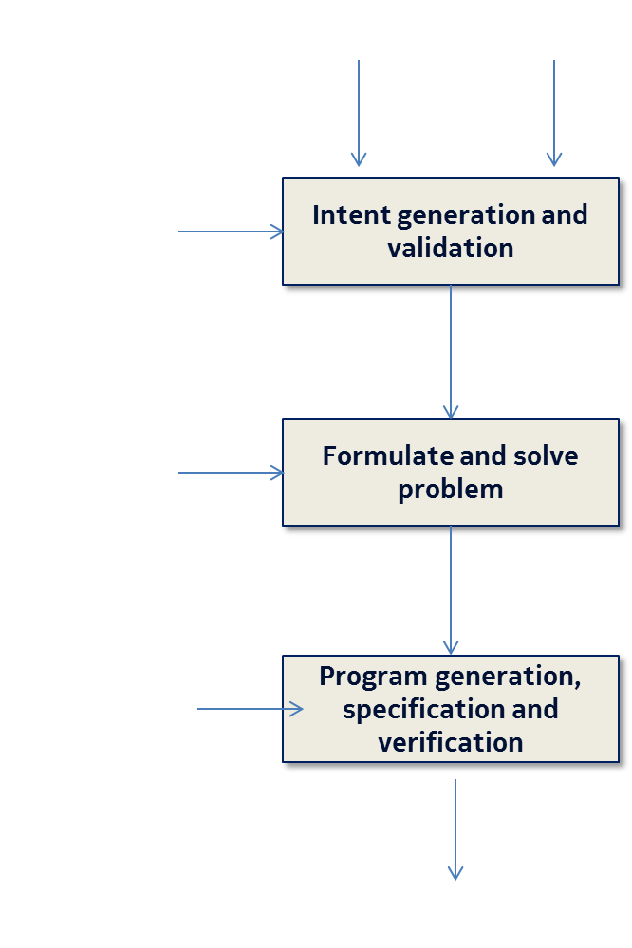
Challenge 4
Control points
and run-time assessment
mechanisms
Notes:
Ability to assess the quality of the actuations i.e. cognition on the feedback loop and investigation.
How to evaluate the quality of the end-to-end process e.g. as Quality of Intent (QoI) via adequate feedback/control mechanisms, and analysis of decisions'/actions' effects.

Slide 43
(some) Research directions
Quality of Intent (QoI) evaluation framework
Self-evaluation, self-testing mechanisms
Increased role for telemetry and analytics
Intent checking, normalization
Intent recommendation, learning, optimization
Intent extraction out of CLIs
Multiple sources, formats, time and space of intents
More or less explicit / implicit formulation of intents

Slide 44
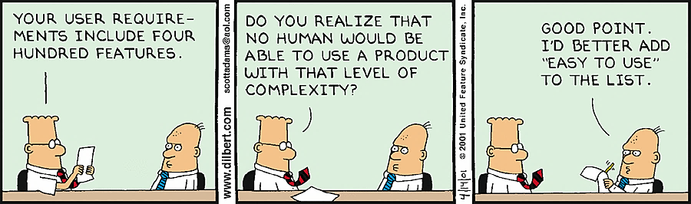
Conclusion

