Slide 1
IETF 107 (Virtual) May 2020
SR Generic FEC TLV for LSP Ping
(draft-nainar-mpls-spring-lsp-ping-sr-generic-sid)
Nagendra Kumar Nainar, (Presenter)
Carlos Pignataro,
Zafar Ali,
Clarence Filsfils
(Cisco Systems, Inc.)
Tarek Saad,
(Juniper)

Slide 2
Problem Statement
Requires new target FEC Stack sub-TLV definition and standardization efforts for each new Segment ID defined.
Define new TLV.
Update FEC validation procedure of RFC-8029
Requires domain/node wide software upgrade depending on the type of the Segment ID defined.
Raises scalability challenges.

Slide 3
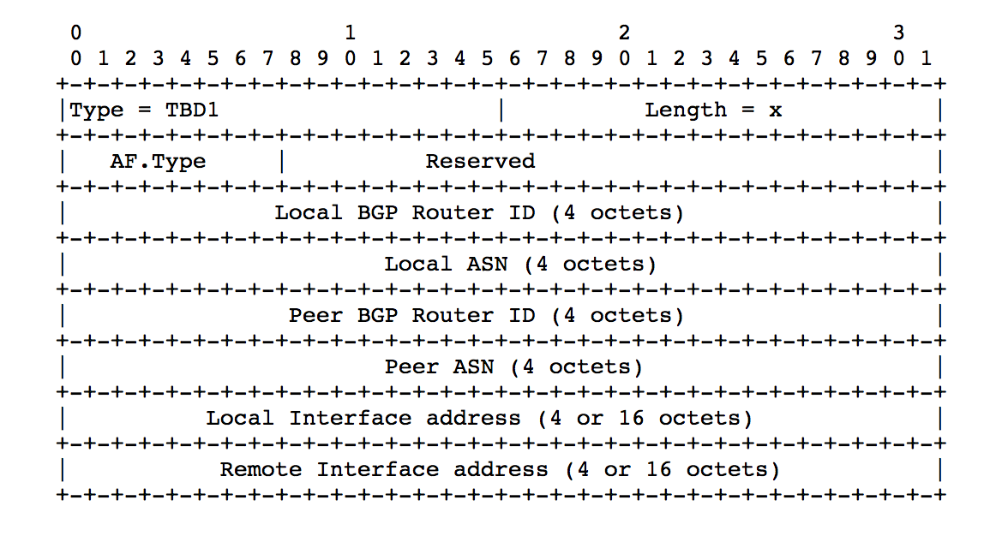
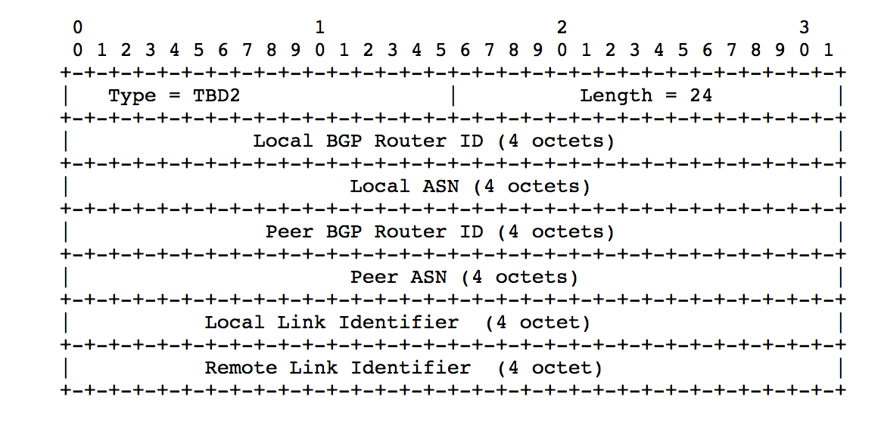
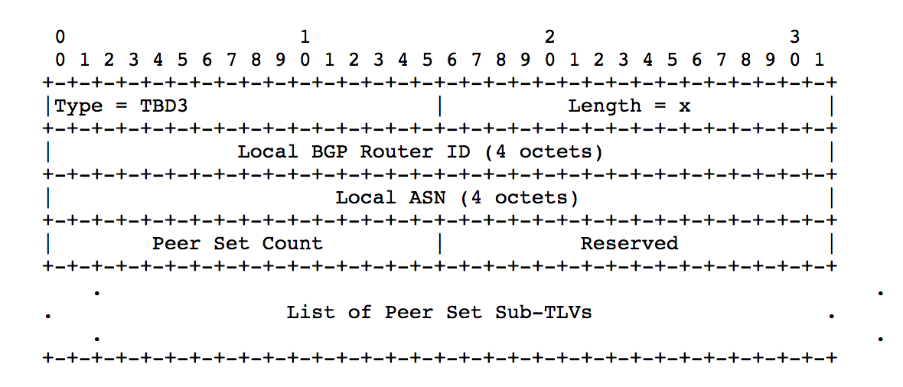
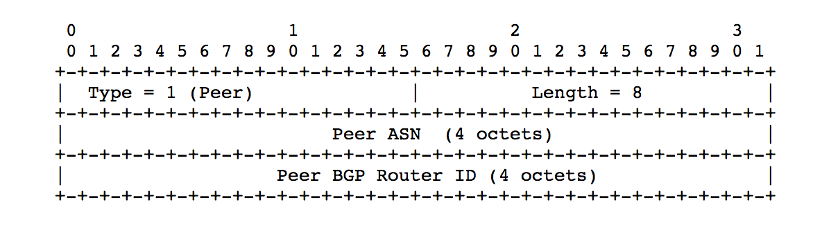
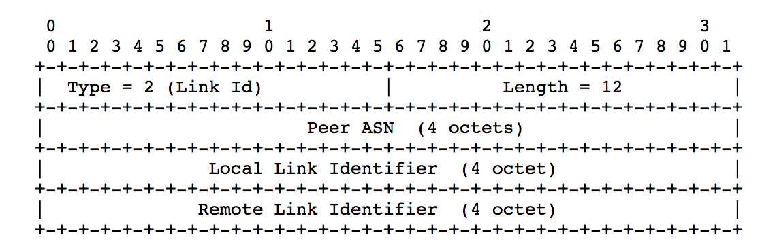
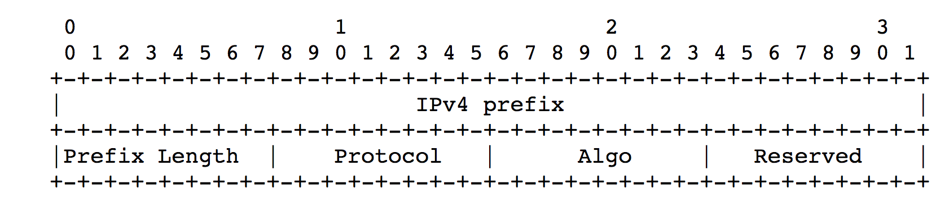
Problem Statement (A partial list of New SR FECs)
BGP Peer Node SID
BGP Peer Adj-SID
BGP Peer Set SID
BGP Peer Set SID Sub-TLVs
FEC changes for Flex-Algo

Slide 4
Problem Statement (Cont’ed)
Requires a lot of information to be derived by the Initiator to include in the Echo Request.
Complex FEC filling procedures at Ingress (one for each Prefix SID type).
Complex validation procedures at Egress (one for each Prefix SID type).

Slide 5
Solution
SR SID data model is:
Segment ID (Label)
FEC validation Procedure
Segment ID to Interface mapping is maintained by any node.
Local implementation matter
Initiator defines the SID value and LSP EndPoint while triggering LSP Ping
Manually defined via CLI or dynamic PCE query.
Responder validates if it is the LSP End Point and if the probe is received over the right incoming interface.
Respond based on the validation.

Slide 6
SR Generic Label Sub-TLV
SR SID (20 Bits)
SR SID
Carries 20 bits of Segment ID used for validation.

Slide 7
Procedure
Prefix SID Validation
16000x → Prefix SID for Rx for Algo 0
16128x → Prefix SID for Rx for Algo 128
3
5
LSP Ping Echo Request
Link 1
1
2
7
8
Link 2
4
6
Initiator (R1) triggers LSP Ping with below SR Generic Label Sub-TLV:
For Prefix SID 160008 {SID=160008}
For Prefix SID 161288 {SID=161288}
R8 validates if LSP-EndPoint is self; and if 160008 is assigned locally.

Slide 8
Procedure
Parallel Adj-SID Validation
16000x → Prefix SID for Rx for Algo 0
16128x → Prefix SID for Rx for Algo 128
9zxy → Adj-SID from Rx to Ry over Link z
3
5
LSP Ping Echo Request
Link 1
1
2
7
8
9378
Link 2
4
6
Initiator (R1) triggers LSP Ping with below SR Generic Label Sub-TLV:
For Parallel Adj SID 9378 {SID=9378}
R8 validates if LSP-EndPoint == self; and if Inteface-I matches interface for 9378.

Slide 9
Procedure
Parallel Adj-SID Validation
16000x → Prefix SID for Rx for Algo 0
16128x → Prefix SID for Rx for Algo 128
9zxy → Adj-SID from Rx to Ry over Link z
3
5
Link 1
8
1
2
LSP Ping Echo Request
7
9378
Link 2
88
4
6
9378 is load balanced to R8 or R88
Initiator (R1) triggers LSP Ping with below SR Generic Label Sub-TLV:
For Parallel Adj SID 9378 {SID=9378}
Responder (R8 or R88) validates if SIDis assigned by upstream; validates if Inteface-I matches interface for 9378.

Slide 10
Procedure
Segment ID to Interface Mapping
16000x → Prefix SID for Rx for Algo 0
16128x → Prefix SID for Rx for Algo 128
9zxy → Adj-SID from Rx to Ry over Link z
3
5
9178
Link 1
1
2
7
8
9378
9278
Link 2
4
6
R8 maintains the below mapping:
160008 → Incoming Interface: {Any}
161288 → Incoming Interface: ({Any}
9178 → Incoming Interface: {Link 1}
9278 → Incoming Interface: {Link 2}
9378 → Incoming Interface: {Link 1 or Link 2}

Slide 11
In a nut shell
One Target FEC Stack Sub-TLV that covers multiple Segment IDs.
Drastically reduces the information required on the Initiator.
Ease of operation.
Reduces the information to be processed by the responder.
Extendable to accommodate future Segment IDs.

Slide 12
IANA Registry Allocation
Request for a new Sub-TLV for TLV types 1, 16 and 21.
Value from range 38-31743 (Unassigned range)
Re-uses existing Return codes and Return Sub-codes

Slide 13
I-D Status
Next Steps:
WG feedback sought
Textual Contributions Welcomed!
WG Adoption request
Thank you!

