Slide 1
YANG Data Node Self Explanation Tags draft-tao-netmod-yang-node-tags-01
Ran Tao(taoran20@huawei.com)
Qin Wu (bill.wu@huawei.com)
Benoit Claise (bclaise@cisco.com)
Liang Geng(gengliang@chinamobile.com)
Zongpeng Du（duzongpeng@chinamobile.com）

Slide 2
Status
Presented in NETMOD session IETF 106, discussed the relation with System capability and YANG Push Capability draft
Changes in v-01 since IETF 106
  Polish the use case to discuss the usage of self explanation tags in two typical use cases.
  Introduce additional self explanation tagging parameters to support multiple dimensional operational data classification.
  Add metric precision and scale support
  Add seven new registries for additional self explanation tags.
  Update model with additional self explanation tags.

Slide 3
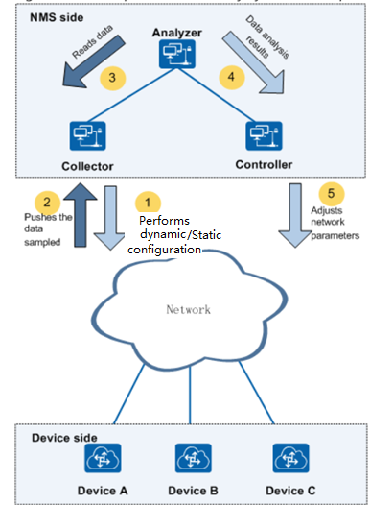
Problem Statement
YANG Push Telemetry provides a mechanism to select and subscribe to operational state data objects based on selection filter.
The Collector or NETCONF client usually doesn’t know select which data objects are of interest without subscription policy or hints to selection filter, alternative way is to fetch all the datastore nodes from all the models.
When using opstate model developed in IETF such as BGP model, ACL, QoS model or provided by vendors as data source, the state of all subscriptions (e.g.,tens of models) to be fetched for a particular Subscriber is usually huge, which cause massive data collection and processing in the network side;
Collectors
Opstate Model
Opstate Model
Opstate Model

Slide 4
Telemetry data self explanation tags
Objective
  Using Telemetry data self explanation tags to capture characteristic data and provide multiple dimension network visibility analysis
Motivation
  Identify Performance measurement related data for service assurance application.
  Provide Network visibility to Network load, traffic flow, capacity, Network QoS data category in milliseconds or seconds
    The dimensions of telemetry data can be categorized from performance metric group, data source, statistics operation(Max, Min, Average, threshold), object type
  Provide tendency prediction, threshold based telemetry, anomaly detection, KPI/KQI Correlation, RCA, etc data analysis capability
  Improve data quality by making structured data more usable
  Provide consistent representation and reporting for characteristics data from multiple data source and multiple dimensional data
  …

Slide 5
Telemetry data tag Classification
OPM Tag: Object type, property, metric is abbreviation of opm. Opm tag can be used to capture characteristics data of telemetry data;
  Operational type tag: Statistics operation of performance metric related to telemetry data node;
  Metric-scale: Provide an additional metric scale (e.g., Measurement scaling factor of 10^0, 10^-3,10^3) information associated with the performance metric related to telemetry data node;
  Metric-precision: Provide an additional metric precision (e.g., the range -8 to -1, 0, the range 1 to 9) information associated with the performance metric related to telemetry data node;
Service Tag: most data can be used for multiple purposes, service tag can be used describe each purpose
Data source type: Provide an additional data source type (e.g., Connectivity, Resource, Hardware, QoS, Policy) information associated with the performance metric related to telemetry data node;
Parent-grouping: identify multiple source (e.g., line card,member link in an aggregated Ethernet interface) related to performance metric related data node or interface related to data node.;

Slide 6
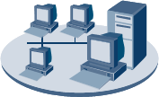
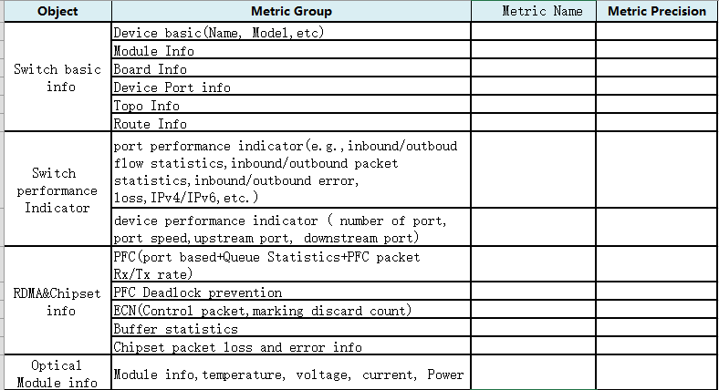

Telemetry data tag usage Example
Multiple Dimensional Telemetry data analysis
Telemetry data tagging
OPM
The relation between OPM tag and Opstate model
Insight
Analysis
Object
Property
Metric
Metric-Group
Network administrator
⑤Multi-Dimension
Telemetry data
analysis
Status
Counter
Alarm
…
Network Element
②Telemetry data tagging capability
notification
Hardware
Alarm
ACL
Interface
…
④Telemetry data export
③ Dynamic /configured subscription based on telemetry data tagging(e.g, performance metric group, data source type)
Telemetry data analysis
①Telemetry data tagging definition and population
Tag telemetry data with opm-tag in the hardware model, interface model, main board model that is populated in devices.
Advertise telemetry data tagging capability using capability notification extension.
Dynamic/Configured subscription based on performance metric group opm-tag
Export telemetry data and provide multi-dimensional telemetry data analysis
Device-1
Device-2
Device-3
Device-4

Slide 7
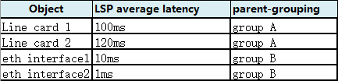
Telemetry data tag usage Example
Multi-Source Telemetry data aggregation
Telemetry data tagging
OPM
Insight
Analysis
Object
Property
Metric
Parent-grouping tag
Network administrator
⑤Multi-Source Telemetry data
Aggregation analysis
Network Element A
Network Element B
②Telemetry data tagging capability
notification
Line card 1
Interface module
Line card 2
Interface module
Eth inf 1
Interface module
Eth Inf 2
Interface module
…
④Telemetry data export
③ Dynamic /configured subscription based on telemetry data tagging(e.g, performance metric group, data source type)
Telemetry data analysis
①Telemetry data tagging definition and population
Data from different sources (such as multiple line cards) for the same metric, such as label-switched path (LSP) statistics or filter counter statistics.
Data from multiple sources, such as input and output statistics for aggregated Ethernet interfaces.
Network Element-A
Network Element-B
Device-C
Device-D

Slide 8
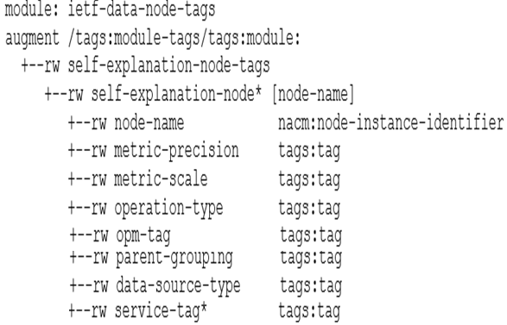
Proposal: Telemetry data Tagging
Proposal :
  augments Module tag model and
  provides a list of data node entries to allow for adding or removing of data node self explanation tags
  as well as viewing the set of self explanation tags associated with a YANG data nodes.

Slide 9
Proposal
Key value:
  Identify Performance measurement related data for service assurance application.
  Provide Network visibility to Network load, traffic flow, capacity, Network QoS data category in milliseconds or seconds
  Provide tendency prediction, threshold based telemetry, anomaly detection, KPI/KQI Correlation, RCA, etc data analysis capability
Adopt it as WG work item?

