Slide 1

Automated Design of
Network Services from Network Service Requirements
Navid Nazarzadeoghaz
ECE, Concordia University
Montreal, Canada
Ferhat Khendek
ECE, Concordia University
Montreal, Canada
Maria Toeroe
Ericsson Inc.
Montreal, Canada

Slide 2
Outline
Background
Motivation
Goal
Overall Picture
Modeling Framework
Method Steps
Prototype Tool
Conclusion & Future Work

Slide 3
Background
Network Service (NS)
  An interconnection of Network Functions (NF) provides a composite functionality/behavior
Network Function (NF)
  A functional block in a network with defined functionality and external interfaces
NFV Management and Orchestration (NFV-MANO) requires a deployment template for an NS in order to deploy it in the NFV system
Network Service Descriptor (NSD)
  A deployment template for an NS that describes its elements and characteristics w.r.t. virtualization aspect

Slide 4
Motivation
NSD generation requires designing the desired NS
  NS design process: Selecting NFs and arranging them together to achieve a composite functionality/behavior
  Out of NFV scope
  It is done manually by experts
Issues
  NS design process is knowledge-extensive
  Manual NSD generation is error-prone
  Does not fit in Telecom’s zero-touch vision
→ Automation of NS and NSD design is desirable

Slide 5
Goal
Devise a method for
    Automatic NS design that fulfills the tenant’s intents (NSReq)
      Intents may be high level
    Generating NSDs accordingly (based on ETSI-NFV standards)
      To be used by NFV-MANO for NS management and orchestration
Methodology
  Model-driven approach

Slide 6





Overall Picture
GAP
NSReq
(Intents)
NSD
NFV
Management
and Orchestration
(MANO)
(ETSI Standard)
Tenant

Slide 7


Overall Picture
map
1
NFO
Forwarding
Graphs
Decomposing the NSReq
Adding architectural information
3
4
NSReq
(Intents)
VNF selection
Generate
Generate
NFV
Management
and Orchestration
(MANO)
NSD
2
(ETSI Standard)
Tenant
Project
scope
VNF Catalog

Slide 8
Modeling Framework: Basis
NF
Architectural
Functional
Implementation
(Product):
VNF, PNF, …
Architecture
Block
Realized By
Functionality

Slide 9
Modeling Framework: NSReq
NSReq Example
  A VoLTE service with
    Voice Call and Registration
  6 Mb/s throughput and 50 Request per Second respectively
  Using IMS architecture
IMS
VoLTE
Registration
Voice Call
6 Mb/s
50 RPS
NSReq Model Example

Slide 10
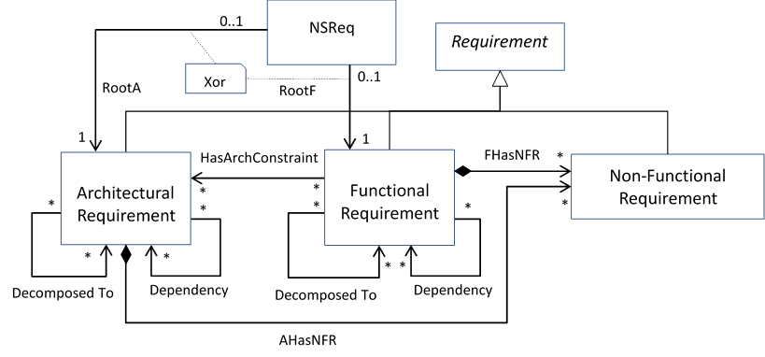
Modeling Framework: NSReq
NSReq
  Functional Requirements
    Decomposition
    Dependency
  Architectural Requirements
    Decomposition
    Dependency
  Non-functional Requirements
Architectural
Requirement
Functional Requirement
Service Access Point Requirement
AR
FR
NFR
Constrained by
…
FR
FR
F. Dependency
NSReq Meta-Model Overview
IMS
VoLTE
Registration
Voice Call
6 Mb/s
50 RPS
NSReq Model Example

Slide 11
Modeling Framework: Network Functional Ontology
NF Ontology
  Functionality
    Decomposition
    Dependency
  Architectural Block
    Decomposition
    Dependency
    Interface
  Service Access Point (SAP)
Arch. Block
Realized By
Interface
Functionality
AB
F
SAP
Arch.
Composition
Service Access Point
AC
AC
F
F
AB
AB
F. Dependency
A. Dependency
F
F
NF Ontology Meta-Model Overview
IMS
VoLTE
AC
User Info Storage
Registration
Authentication
Voice Call
Messaging
PCSCF
ICSCF
SCSCF
HSS
AS
SAP2
SAP1
NF Ontology Model Example

Slide 12
Modeling Framework: VNF
ETSI standard
Our extension
VNF information elements:
On-boarded VNF Package Info
Sw. Image Info
VNFD
VNF
Architecture
Descriptor
Vnf Functionality
Vnf Components Functionality
Vnf Interfaces
Artifact Info
Virtualisation
perspective
Application
perspective
. . .
(Not enough for NS design)
VNF Catalog

Slide 13
Method Steps
Step 1: SM model initialization
  Solution Map (SM): An intermediary model captures the information throughout the NSD generation
Step 2: Map to NF Ontology
  Goal: Decompose requirements
  Map FRs to functionalities
    Add further decompositions
  Add ABs realizing the mapped functionalities
    According to the ARs
  Define the SAPs based on SAPRs
    From NF Ontology OR directly from the SAPR
Step 3: Map to VNF Catalog
  Goal: Select VNFs
  Add VNFs mapped to ABs
NF-Ontology
NSReq
VNF Catalog
SM
SM

Slide 14
Method Steps (Cont’d)
Step 4: Generating Forwarding Graphs (FGs)
  Goal: Separate alternative solution
  Create Functional FGs (FFG)
    FFG: Sequence of functionalities which all together compose the root functionality of the NS
  Create Architectural FGs (AFG)
    AFG: Sequence of ABs that realize the functionalities in an FFG
  Create Pre-VNFFGs
    Pre-VNFFG: A VNFFG without the networking elements, i.e. VLs and network forwarding paths
      A sequence of VNFs implementing all the ABs in an AFG
NF-Ontology
NSReq
VNF Catalog
SM
SM
FFG
AFG
Pre-VNFFG

Slide 15
Method Steps (Cont’d)
Step 5: Generating NSDs (generic)
  With respect to the functionality and architecture
  Create NSD from each Pre-VNFFG
    Create VLDs, SAPDs
    Create VNFFGDs
      Reference VNFDs and VLDs
    Create NS Deployment Flavor (NsDf)
      Only for connectivity purposes not QoS
Step 6: Updating NF Ontology
  Based on new decompositions from NSReq
  Pre-condition: successful NSD generation
  Update actions
    Adding new decompositions from NSReq
    Adding new aliases
NF-Ontology
NSReq
VNF Catalog
SM
SM
FFG
AFG
Pre-VNFFG
NSD

Slide 16
Method Steps (Cont’d)
Step 7: Tailoring generic NSD (w.r.t NFRs)
  Design Flows
    For specific functionalities that the tenant has specified
    Using dependencies between the VNFs and VNFs’ internal flows
  NFR propagation
    Propagate the NFRs through all the VNFs using the flows
  VNF dimensioning
    According to its deployment flavors
    Based on the predicted load for it
    Select the most desirable deployment flavor
  NsDf tailoring
    Generate all the NS instantiation and scaling levels
      To cover minimum to maximum required QoS

Slide 17



Prototype Tool
We have developed a prototype tool as a proof of concept
  Methodology
    Model-driven
  Model transformation language
    ATL
  Metamodels
    UML profiling
    Papyrus environment
  Use case
    VoLTE service using IMS architecture

Slide 18
Conclusion & Future Work
We have proposed a method to automatically
  Design network services based on network service requirements (Intents)
    By decomposing the requirements using a knowledge-base
    Selecting the suitable VNFs from a catalog
    Designing the forwarding graphs
  Generate all the possible NSDs (ETSI-NFV standard)
    Can be used by the NFV-MANO for deployment
  Refine the NSDs according to the NFRs
    Dimensioning the VNFs
    Tailoring the NS Deployment Flavor
Future Works
  Validate our work with several case studies
    3GPP Mission Critical System

Slide 19


Slide 20
Background: Network Service
Network Service (NS)
  An interconnection of Network Functions (NF)
    Provides a desired functionality/behavior
Network Function (NF)
  A functional block
    Defined functionality
    Defined external interfaces
NS
NF3
NF2
NF1
Functionality A
NF1
Functionality A1

Slide 21



Background: NFV
Network Function Virtualization (NFV)
  A framework to automate NS management and orchestration
  Decouples functionality from the hardware
  By leveraging
    Virtualization
    Software-Defined Networking (SDN)
Virtualized Network Functions
(VNF)
vNF
vNF
vNF
vNF
Virtualization
General Purpose Hardware
Storage
Compute
Network

Slide 22
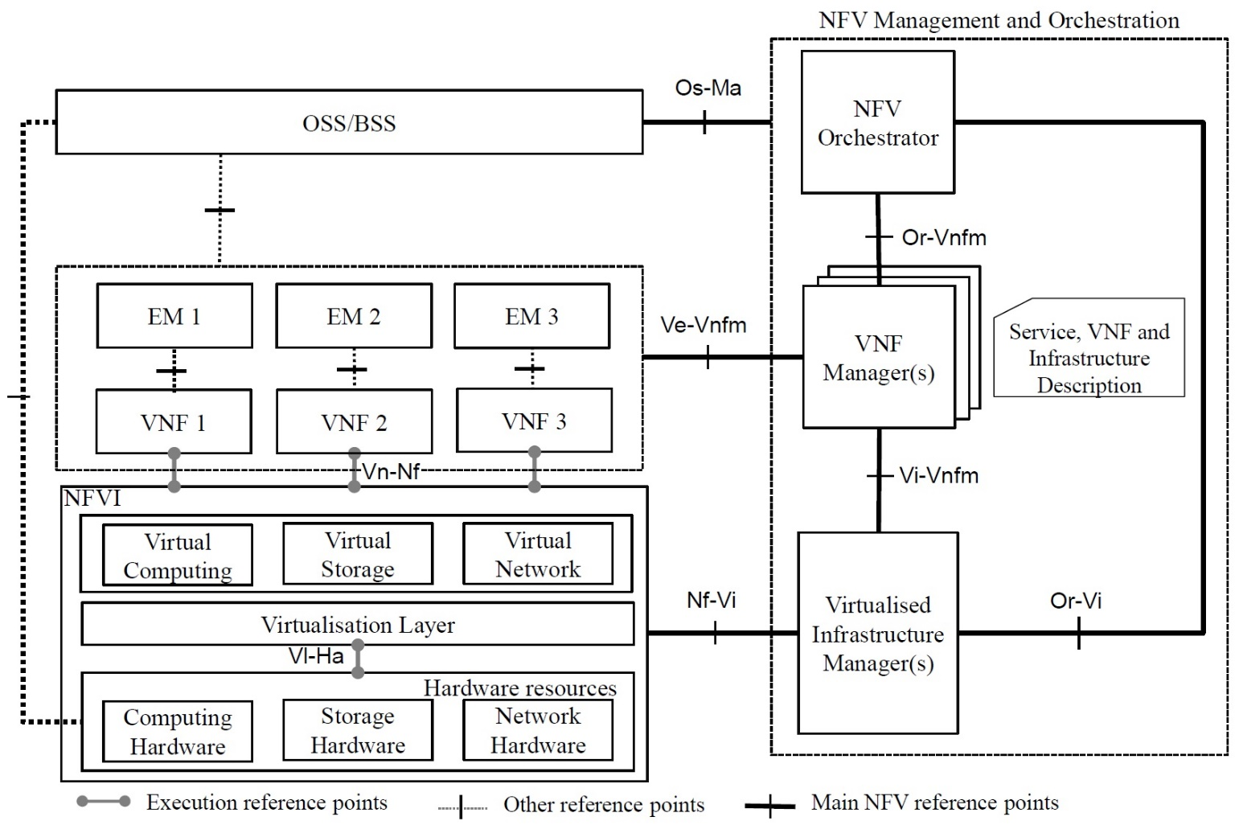
Background: NFV (Cont’d)
Network Function Virtualization (NFV)
  Reference Architecture
NS Lifecycle
Management:
Instantiation
Scaling
Monitoring
Termination
…
VNFs
NFV-MANO

Slide 23
Background: NFV (Cont’d)
NFV Management and Orchestration (NFV-MANO)
  Requires a deployment template for NS
    Referred to as Network Service Descriptor (NSD) (standardized by ETSI-NFV)
NSD
  Describes the NS characteristics w.r.t. virtualization aspect
    NS elements
    Deployment requirements for the infrastructure
VL
NS
NSD
VNFFG
SAP
VNF3
VNF2
VNF1
VNFD
VLD
SAPD
VNFFGD
Deployment
Flavor
…

