Slide 1
Service Assurance for Intent-based Networking Architecture
&
YANG Modules for Service Assurance
draft-claise-opsawg-service-assurance-architecture-02
B. Claise (Cisco), J. Quilbeuf (Cisco), Y. El Fathi (Orange), D. Lopez (Telefonica), D. Voyer (Bell Canada)
draft-claise-opsawg-service-assurance-yang-04
B. Claise (Cisco), J. Quilbeuf (Cisco), P. Lucente(NTT), P. Fasano (Telecom Italia Mobile)
IETF 107, Virtual

Slide 2
Issues
A service being configured doesn’t mean it’s operating correctly
Too much data in telemetry: needle in a haystack
When a service degrades, where is the fault?
  what are the symptoms?
  what is the root cause?
When a network component fails, which services are impacted?
How to solve closed loop automation, as a first step

Slide 3
Proposal
The end goal: intent-based networking
Service Assurance for Intent-based Networking Architecture proposal:
  Decompose the problem into smaller components (=subservices)
  The assurance graph links those subservices to map the service “intent”
  The subservices are assured independently
  Inferred service health score
This complement the end-to-end synthetic tests

Slide 4
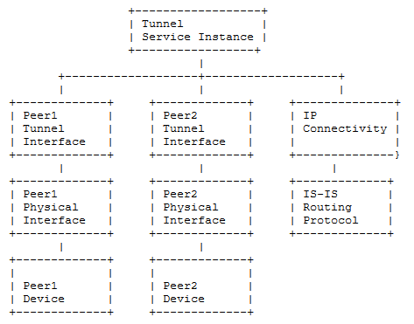
Assurance Graph
Service
Instance
Subservice
Instances

Slide 5
Score & Symptoms
An inferred health score
+ a series of symptoms

Slide 6
(Impacting or Informational) Dependencies
Impacting
Dependency
Impacting
Dependency

Slide 7

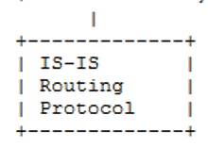
(Impacting or Informational) Dependencies
Informational
Dependency
ECMP

Slide 8
So far, we know…
When a service degrades, where is the fault
  what are the symptoms?
  what is the root cause?
When a network component fails, which services are impacted

Slide 9
Open and Flexible Architecture
Open architecture for multi-vendor support
  How? With a YANG module:
    Can augment the YANG module
    Even for vendor-specific subservices
Flexible architecture:
  Components
  Service & subservices
  Distributed graph
  Physical and virtual

Slide 10
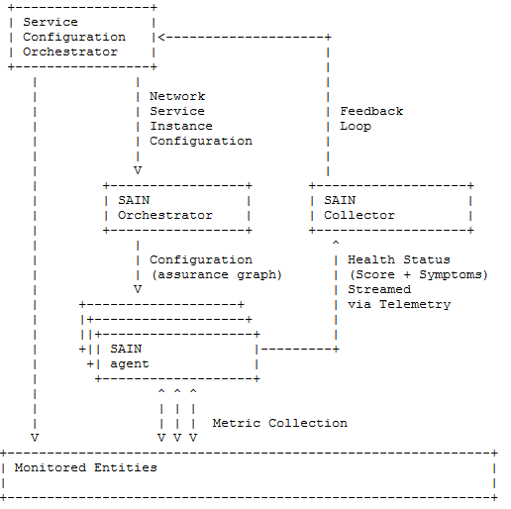
Architecture

Slide 11
Flexible Architecture
Could be a single box
Agent could be in or off routers

Slide 12
Open Architecture with YANG Models
YANG
YANG

Slide 13

Open Architecture with YANG Models
Out of scope
YANG
Out of scope
YANG

Slide 14
module: ietf-service-assurance
+--ro assurance-graph-version? yang:counter32
+--ro assurance-graph-last-change? yang:date-and-time
+--rw subservices
+--rw subservice* [type id]
+--rw type identityref
+--rw id string
+--ro last-change? yang:date-and-time
+--ro label? string
+--rw under-maintenance? boolean
+--rw maintenance-contact string
+--rw (parameter)?
| +--:(service-instance-parameter)
| +--rw service-instance-parameter
| +--rw service? string
| +--rw instance-name? string
+--ro health-score? uint8
+--rw symptoms
| +--ro symptom* [start-date-time id]
| +--ro id string
| +--ro health-score-weight? uint8
| +--ro label? string
| +--ro start-date-time yang:date-and-time
| +--ro stop-date-time? yang:date-and-time
+--rw dependencies
+--rw dependency* [type id]
+--rw type -> /subservices/subservice/type
+--rw id -> /subservices/subservice[type=current()/../type]/id
+--rw dependency-type? identityref

Slide 15
Assurance Tree API
module: ietf-service-assurance
+--rw subservices
+--rw subservice* [type id]
+--rw type identityref
+--rw id string
…
+--rw dependencies
+--rw dependency* [type id]
+--rw type -> /subservices/subservice/type
+--rw id -> /subservices/subservice[type=current()/../type]/id
+--rw dependency-type? identityref
Dependency relationship

Slide 16
Health Score and Symptoms API
module: ietf-service-assurance
+--ro assurance-graph-version? yang:counter32
+--ro assurance-graph-last-change? yang:date-and-time
+--rw subservices
+--rw subservice* [type id]
….
+--ro health-score? uint8
+--rw symptoms
| +--ro symptom* [start-date-time id]
| +--ro id string
| +--ro health-score-weight? uint8
| +--ro label? string
| +--ro start-date-time yang:date-and-time
| +--ro stop-date-time? yang:date-and-time
Health score and Symptoms per subservice

Slide 17
Subservice Parameters API
module: ietf-service-assurance
+--ro assurance-graph-version? yang:counter32
+--ro assurance-graph-last-change? yang:date-and-time
+--rw subservices
+--rw subservice* [type id]
+--rw type identityref
+--rw id string
+--ro last-change? yang:date-and-time
+--ro label? string
+--rw under-maintenance? boolean
+--rw maintenance-contact string
+--rw (parameter)?
| +--:(service-instance-parameter)
| +--rw service-instance-parameter
| +--rw service? string
| +--rw instance-name? string
NEW
Subservice Parameters
Notes:
Note: A way to set a subservice as “under-maintenance”, not to receive any symptoms
Ex: device upgrade, optic replacement, routing protocol adjustment

Slide 18
New Subservices, with different Sets of Parameters
+--rw (parameter)?
| +--:(service-instance-parameter)
| | +--rw service-instance-parameter
| | +--rw service? string
| | +--rw instance-name? string
| +--:(service-assurance-device:device-idty)
| | +--rw service-assurance-device:device-idty
| | +--rw service-assurance-device:device? string
| +--:(service-assurance-interface:device)
| | +--rw service-assurance-interface:device? string
| +--:(service-assurance-interface:interface)
| +--rw service-assurance-interface:interface? string
| +--:(example-service-assurance-device-acme:acme-device-idty)
| +--rw example-service-assurance-device-acme:acme-device-idty
| +--rw example-service-assurance-device-acme:device? string
| +--rw example-service-assurance-device-acme:acme-specific-parameter? string
New subservice type
New subservice type
New vendor-specific subservice type
Notes:
New inte

Slide 19
Changes since Last IETF
A way to set a subservice as “under-maintenance”, not to receive any symptoms
  Ex: device upgrade, optic replacement, routing protocol adjustment
New interface health subservice with two parameters:
  1. Device id
  2. Interface id

Slide 20
Feedback
To do: aligned with draft-irtf-nmrg-ibn-concepts-definitions
Valid problem to solve industry-wide?
At the IETF?
Going in the right direction?
If yes, please consider as WG adoption (in OPSAWG)

