Slide 1
5G E2E Network Slice Mapping
https://tools.ietf.org/html/draft-geng-teas-network-slice-mapping-00
draft-geng-teas-network-slice-mapping-00
Xuesong Geng, Jie Dong, Huawei
Tomonobu Niwa, KDDI
Jaehwan Jin, LGU+
IETF 107 Interim Meeting

Slide 2
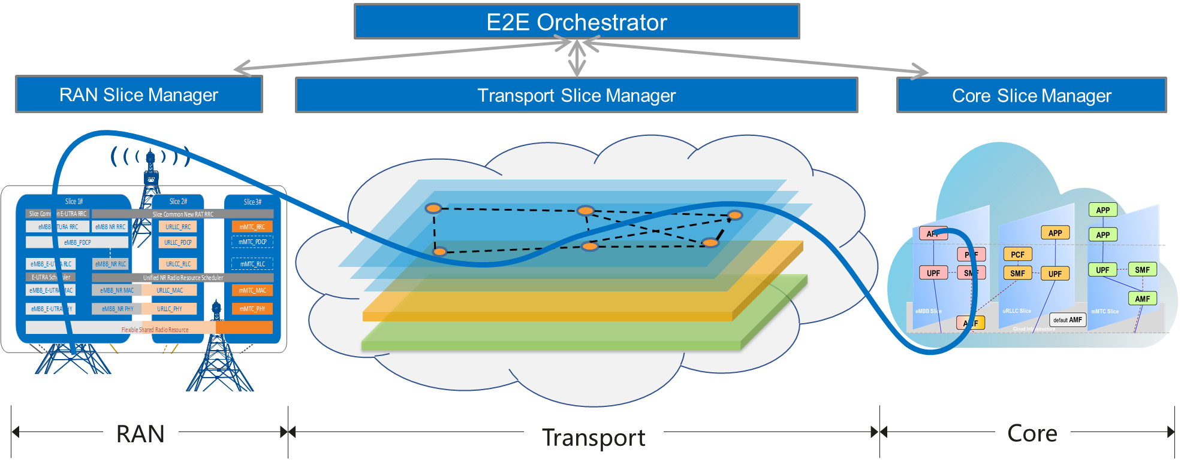




5G E2E Network Slicing
Notes:
Application 图

Slide 3
5G E2E Network Slice Identification
Network slice related identifiers in management plane, control plane and data(user) plane play an important role in end-to-end network slice mapping.
NSI : Network Slice Instance, end-to-end network slice defined in management plane [3GPP TS23501];
NSSI: Network Slice Subnet Instance, network slice defined in subnet’s management plane , e,g,. AN NSSI, CN NSSI [3GPP TS2850];
TN-NSSI: Transport Network Slice Instance, network slice defined in transport network’s management plane . TN-NSSI is newly defined in this draft. It may change based on the progress of IETF.
S-NSSAI: Single Network Slice Selection Assistance Information, end-to-end network slice identifier in control plane [3GPP TS23501];
TNSII: Transport Network Slice Interworking Identifier, network slice identifier which is used for mapping end-to-end network slice into transport network slice in data plane. TNSII is newly defined in this draft.
TNSI: Transport Network Slice Identifier, transport network slice identifier in data plane. TNSI is newly defined in this draft.
Notes:
缩写放到前面

Slide 4
5G E2E Network Slicing Overview
NSMF
NSI Identifier
Service Profile
TN Network Slice Profile
Management Plane
AN NSSMF
TN NSSMF
CN NSSMF
AN-NSSI Identifier
TN-NSSI Identifier
TN-NSSI Identifier
Function Management
Network Slice Selection
(S-NSSAI)
Control Plane
UPF
TNSII
Transport Slice Interworking Identifier
Data Plane
TNSII
Transport Network Slice Interworking Identifier
TNSI
Transport network slice Identifier
NSMF: Network Slice Management Function
NSSMF: Network Slice Subnet Management Function

Slide 5
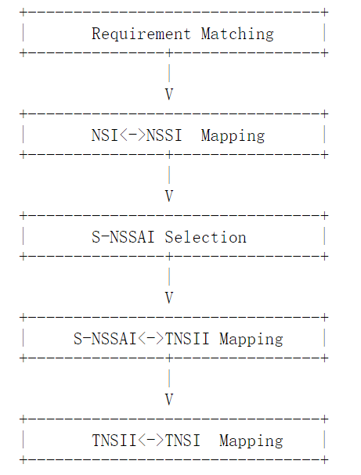
5G E2E Network Slice Mapping Procedure
In the management plane:
NSMF receives network slice request from CSMF.
NSMF split the NSI requirements to requirements for each NSSI (including AN NSSI, CN NSSI and TN NSSI).
NSMF sends Transport Network Slice requirement to TN NSSMF for TN NSSI allocation.
TN NSSMF allocates TN network slicing subnet instance (TN NSSI) and sends the result to NSMF.
NSMF acquires the mapping relationship between NSI Identifier and TN NSSI Identifier.
NSMF: Network Slice Management Function
NSSMF: Network Slice Subnet Management Function

Slide 6
5G E2E Network Slice Mapping Procedure-cont.
In the control plane and data plane:
6. When a PDU session is set up between AN and CN, S-NSSAI is used to select network slice instance for the PDU session.
The AN/CN edge nodes encapsulate the user’s packet using the transport network slice interworking identifier (TNSII) according to the S-NSSAI or the NSI. *
The edge node of transport network parses the TNSII from the packet and maps the packet to the transport network slice. It may encapsulate a transport network slice identifier (TNSI) into the packet.
9. The nodes in transport network forward the packet inside the corresponding transport network slice.
* Network Slice could also be differentiated by physical interface, if different network slices are transported through different interface;

Slide 7
TNSII Data Plane Options
Slice Mapping
Slice Mapping
Slice 1
TN Slice 1
Slice 1
Slice 2
Slice 2
TN Slice 2
Slice 3
Slice 3
…
AN
Edge Node
TN
Edge Node
…
TN
Edge Node
CN
Edge Node
…
Slice M
TN Slice N
Slice N
TNSII
TNSII
Layer 2: VLAN ID
Layer 3: DSCP, MPLS label, IP DA, SRv6, new headers
Upper Layer: UDP source port
TNSII：Transport Network Slice Interworking Identifier

Slide 8
Motivation of the Document
Informational track
Give guidance for SPs to deploy 5G E2E Network Slicing
Promote cooperation between IETF and 3GPP in the topic of E2E Network Slicing
Help to discover whether there are gaps in implementing E2E Network Slice Mapping

Slide 9
What is the next?
Find a proper home for this draft
Collect more feedback from WG and operators
Revise the draft based on the comments

Slide 10
Thank you and Be Safe

Slide 11
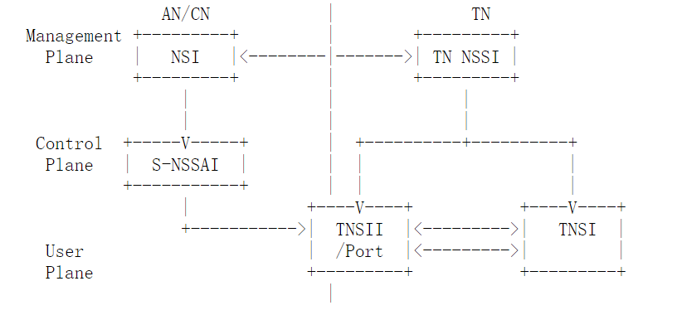
Backup

