Slide 1
Enforcing end-to-end delay bounds via queue resizing
draft-aft-detnet-bound-delay-queue-00
20230621 - Antoine Fressancourt

Slide 2
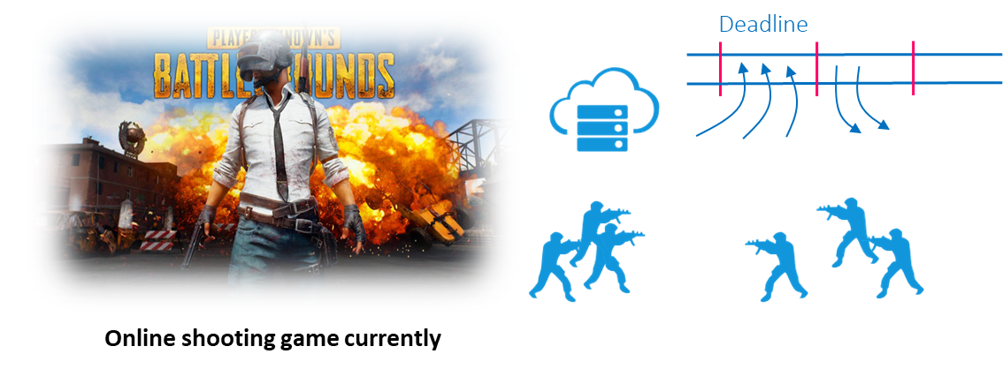
Introduction
Use cases for bounded latency over large scale networks
Some use cases would greatly benefit from an end to end delay assurance in large scale networks:
Online gaming:
  Commands must arrive at the server before a target deadline
  Variation in animation duration can help smooth jitter effects as soon as deadlines are met
  Large number of nodes in the network (potentially large number of players)
Other use cases in the consumer market:
  Augmented reality
  Virtual reality
  Online collaboration
2

Slide 3
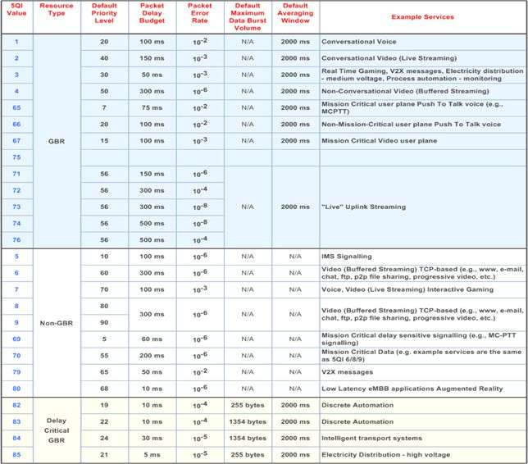
From 3GPP TS 23.501 v18.1.0
System architecture for the 5G System (5GS); Stage 2
Use cases targeted by the present draft:
Real time gaming
V2X messages
Mission critical user plane push to talk
Mission critical video user plane
Delay is critical BUT device can buffer packets in case the jitter is high
Typical DIP / TSN use cases ➔ Not targeted
3

Slide 4
Draft idea
Cover the gap between :
  TSN / Deterministic IP technologies which are used to enforce latency AND jitter guarantees at a cost
    Complex queueing management, Need for synchronization, Centralized management
  More traditional QoS enforcement mechanism
    Enforce properties on average (Active Queue Management)
The draft presents:
  A dynamic queue capacity adaptation mechanism
    Queue served in a deterministic round robin fashion
    No synchronization
    Coupled with a strict flow acceptance policy, delay bound can be guaranteed.
  A signaling method based on RSVP used by nodes to enforce end to end delay for some flows by reserving capacity in node queues.
  RSVP behavior adapted to allow probing multiple paths and giving either the source or the destination the choice over the path to be taken
4

Slide 5
Bounding delay at the switches
Adapting queueing capacity to enforce delay constraints

Slide 6
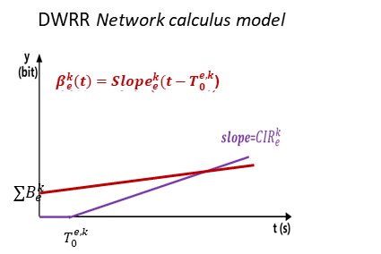
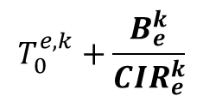

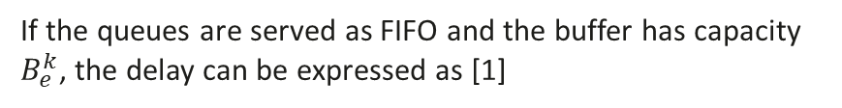
Tradeoff between resource utilization and latency
If the queues are served as FIFO and the buffer has capacity $B_{e}^{k}$, the delay can be expressed as [1]
Network calculus allows deriving a model for precise delay bounds as function of traffic per queue
Buffer capacity of the queue
$$T_{0}^{e,k}+\frac{B_{e}^{k}}{{CIR}_{e}^{k}}$$
Worst queue delay:
max queue time
(depends on assigned resource)
Allocated CIR (committed information rate) Service Rate on queue
Examples:
$T_{0}^{e,k}=0.1;$ with 2 queues
Queue1:
Worst queue delay = 4.1
Buffer capacity = 2
CIR = 0.5
Increase capacity
In the following the CIR is fixed, and we adapt the buffer capacity
Queue1:
Worst queue delay = 8.1
Buffer capacity = 4
CIR = 0.5
s
t
s
t
Queue2:
Worst queue delay = 4.1
Buffer Capacity = 2
CIR = 0.5
Queue2:
Worst queue delay = 2.1
Buffer Capacity = 1
CIR = 0.5
Decrease delay
[1] J.-Y. Le Boudec, P. Thiran, Network Calculus: A Theory of Deterministic Queuing Systems for the Internet, Vol. LNCS 2050, Springer-Verlag, 2001.
6

Slide 7
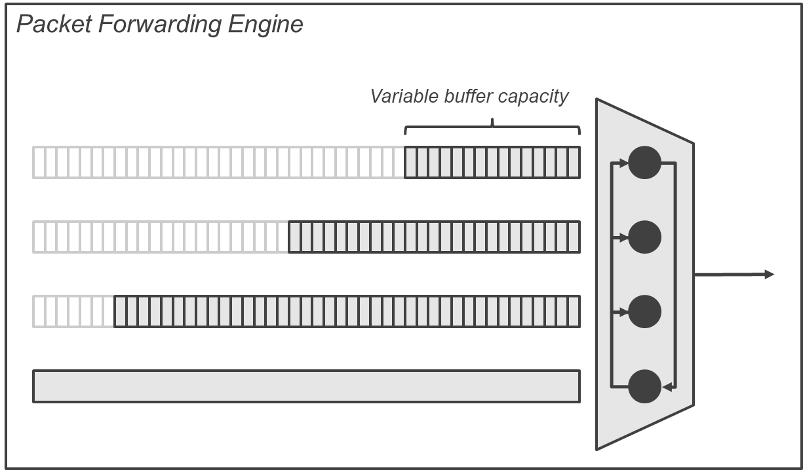
Queue size and latency (QoS)
Relationship between the maximum queue delay and the buffer capacity
Hardware queues can be managed in software to throttle the capacity of each buffer or interleave packets in a hardware queue according to a policy
In modern switch packet processing pipelines, several physical queues are typically present to accommodate various types of traffic.
Packets are taken from various hardware queues and sent in a round robin fashion.
➔ It is possible to set such switches to have a set of queues with increasing priority, for which the maximum queueing delay is given by the formula:
D_{max} = T₀ + B_{e} . T . n
Where T₀ is a constant (floor), B_{e} is the buffer capacity (in units), T is a packet processing time and n is the number of queues to serve.
7

Slide 8
Adapting queue size according to demand
Principle (See section 4 in the draft)
Each queue has 2 thresholds:
  A “nearly full” occupancy threshold (for instance when 80 % of a queue is occupied)
  A “minimal occupancy” threshold (for instance when 20 % of a queue is occupied)
Thresholds are observed whenever a new request for deterministic delay queue capacity allocation arrives.
  If the reservation is for a flow that cannot be served because the delay is too low:
    The node observes queues with an occupancy below the “minimal occupancy” threshold and see whether it can reduce their size to accept the reservation
  If the reservation is for a flow that cannot be accepted because too much capacity is requested:
    The node can observe the delay contract for the “nearly full” queues to see if it can enlarge those queues sizes
No signalling required to adapt the queue’s sizes
Distributed mechanism, no coordination needed
8

Slide 9
Adapting queue size according to demand
Reducing the size to lower the maximum delay (1/3)
Reservation 1:
max-E2E d.: 50ms
Bw: 1.5 Mbps
Reservation 2:
max-E2E d.: 55ms
Bw: 2 Mbps
Minimal occupancy threshold
Queue:
max-E2E delay: 50ms
min-contract: 50ms
Capacity: 20 Mbps
Utilized: 3.5 Mbps
9

Slide 10
Adapting queue size according to demand
Reducing the size to lower the maximum delay (2/3)
Reservation 1:
max-E2E d.: 50ms
Bw: 1.5 Mbps
Reservation 2:
max-E2E d.: 55ms
Bw: 2 Mbps
Minimal occupancy threshold
Queue:
max-E2E delay: 50ms
min-contract: 50ms
Capacity: 20 Mbps
Utilized: 3.5 Mbps
max-E2E delay: 40ms
Min-contract: 40ms
Capacity: 16 Mbps
Utilized: 5.5 Mbps
Demand:
max-E2E delay: 40ms
Bw: 2 Mbps
Queue occupation below the minimal occupation threshold
➔ We can reduce the queue’s capacity to decrease the maximum delay and accept the demand
10

Slide 11
Adapting queue size according to demand
Reducing the size to lower the maximum delay (3/3)
Reservation 3:
max-E2E d.: 40ms
Bw: 2 Mbps
Reservation 1:
max-E2E d.: 50ms
Bw: 1.5 Mbps
Reservation 2:
max-E2E d.: 55ms
Bw: 2 Mbps
Minimal occupancy threshold
Queue:
max-E2E delay: 40ms
min-contract: 40ms
Capacity: 16 Mbps
Utilized: 5.5 Mbps
11

Slide 12
Adapting queue size according to demand
Increasing the queue capacity while respecting commitments (1/3)
Reservation 10:
max-E2E d.: 50ms
Bw: 2 Mbps
Reservation 7:
max-E2E d.: 55ms
Bw: 3 Mbps
“Nearly full” occupancy threshold
Queue:
max-E2E delay: 40ms
min-contract: 50ms
Capacity: 16 Mbps
Utilized: 15 Mbps
12

Slide 13
Adapting queue size according to demand
Increasing the queue capacity while respecting commitments (2/3)
Reservation 10:
max-E2E d.: 50ms
Bw: 2 Mbps
Reservation 7:
max-E2E d.: 55ms
Bw: 3 Mbps
“Nearly full” occupancy threshold
Queue:
max-E2E delay: 40ms
min-contract: 50ms
Capacity: 16 Mbps
Utilized: 15 Mbps
max-E2E delay: 50ms
min-contract: 50ms
Capacity: 20 Mbps
Utilized: 16.5 Mbps
Demand:
max-E2E delay: 60ms
Bw: 1.5 Mbps
Queue occupation over the maximal occupation threshold
➔ We can increase the queue’s capacity while respecting the minimal delay contract
13

Slide 14
Adapting queue size according to demand
Increasing the queue capacity while respecting commitments (3/3)
Reservation 15:
max-E2E d.: 60ms
Bw: 1.5 Mbps
Reservation 10:
max-E2E d.: 50ms
Bw: 2 Mbps
Reservation 7:
max-E2E d.: 55ms
Bw: 3 Mbps
“Nearly full” occupancy threshold
Queue:
max-E2E delay: 50ms
min-contract: 50ms
Capacity: 20 Mbps
Utilized: 16.5 Mbps
14

Slide 15
Setting up an end-to-end path with a delay bound

Slide 16
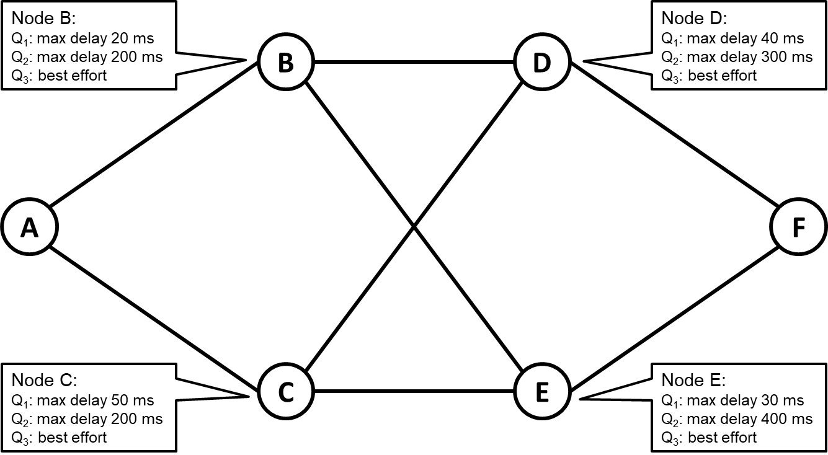
Setting up an end-to-end path with a delay bound
Let’s consider the network presented in the schema
Node A uses a reservation protocol to send a resource reservation request to Node F for a flow
  Maximum end-to-end delay requirement: 85 ms
  Maximum capacity (including bursts): 2 Mbps
The mechanism allows:
  Exploration of multiple paths in the reservation procedure
  Either source or destination can decide which path will be used if multiple paths are explored
16

Slide 17
Setting up an end-to-end path with a delay bound
Resource reservation request
Node B:
Q₁: max delay 20 ms
Q₂: max delay 200 ms
Q₃: best effort
Node D:
Q₁: max delay 40 ms
Q₂: max delay 300 ms
Q₃: best effort
As
D_{max} = T₀ + B_{e} . T . N
The max delay depends linearly on the buffer size
B
D
Request:
max-E2E delay: 85ms
E2E-delay-commit.: 0ms
Bw: 2 Mbps
Record-route: A
RSVP Path
max-delay: 20ms
Volume: 2 U
A
F
This box is presenting a reduced Request message format.
The full message takes the form:
Request:
ID: Nonce
Flow-ID: f-ID;
max-E2E delay: 85ms
E2E-delay-commit.: 0ms
Bw: 2 Mbps
Record-route: A
Node C:
Q₁: max delay 50 ms
Q₂: max delay 200 ms
Q₃: best effort
C
E
Node E:
Q₁: max delay 30 ms
Q₂: max delay 400 ms
Q₃: best effort
17

Slide 18
Setting up an end-to-end path with a delay bound
Resource reservation request
Node B:
Q₁: max delay 20 ms
Q₂: max delay 200 ms
Q₃: best effort
Node D:
Q₁: max delay 40 ms
Q₂: max delay 300 ms
Q₃: best effort
B
D
Request:
max-E2E delay: 85ms
E2E-delay-commit.: 20ms
Bw: 2 Mbps
Record-route: A, B
RSVP Path
max-delay: 85ms
Volume: 2 U
A
F
Request:
max-E2E delay: 85ms
E2E-delay-commit.: 50ms
Bw: 2 Mbps
Record-route: A, C
RSVP Path
max-delay: 85ms
Volume: 2 U
Node C:
Q₁: max delay 50 ms
Q₂: max delay 200 ms
Q₃: best effort
C
E
Node E:
Q₁: max delay 30 ms
Q₂: max delay 400 ms
Q₃: best effort
18

Slide 19
Setting up an end-to-end path with a delay bound
Resource reservation request
Node B:
Q₁: max delay 20 ms
Q₂: max delay 200 ms
Q₃: best effort
Node D:
Q₁: max delay 40 ms
Q₂: max delay 300 ms
Q₃: best effort
B
D
Request:
max-E2E-delay : 85ms
E2E-delay-commit.: 60ms
Bw: 2 Mbps
Record-route: A, B, D
A
Request:
max-E2E-delay : 85ms
E2E-delay-commit.: 50ms
Bw: 2 Mbps
Record-route: A, B, E
F
Request:
max-E2E-delay : 85ms
E2E-delay-commit.: 80ms
Bw: 2 Mbps
Record-route: A, C, E
Node C:
Q₁: max delay 50 ms
Q₂: max delay 200 ms
Q₃: best effort
C
E
Node E:
Q₁: max delay 30 ms
Q₂: max delay 400 ms
Q₃: best effort
19

Slide 20
Setting up an end-to-end path with a delay bound
Resource reservation reply – Destination is chosing the path
Destination
is chosing the path
Only one Resv message is sent for the Path chosen by the destination
Node B:
Q₁: max delay 20 ms
Q₂: max delay 200 ms
Q₃: best effort
Node D:
Q₁: max delay 40 ms
Q₂: max delay 300 ms
Q₃: best effort
B
D
A
Reply:
max-E2E-delay: 85ms
E2E-delay-commit.: 50ms
Bw: 2Mbps
Route: A, B, E, F
F
This box is presenting a reduced Request message format.
The full message takes the form:
Reply:
ID: Nonce
Flow-ID: f-ID;
max-E2E-delay: 85ms
E2E-delay-commit.: 50ms
Bw: 2Mbps
Route: A, B, E, F
Node C:
Q₁: max delay 50 ms
Q₂: max delay 200 ms
Q₃: best effort
C
E
Node E:
Q₁: max delay 30 ms
Q₂: max delay 400 ms
Q₃: best effort
20

Slide 21
Setting up an end-to-end path with a delay bound
Resource reservation reply – Destination is chosing the path
Node B:
Q₁: max delay 20 ms
Q₂: max delay 200 ms
Q₃: best effort
Node D:
Q₁: max delay 40 ms
Q₂: max delay 300 ms
Q₃: best effort
B
D
Reply:
max-E2E-delay: 85ms
E2E-delay-commit.: 50ms
Bw: 2Mbps
Route: A, B, E, F
A
F
Node C:
Q₁: max delay 50 ms
Q₂: max delay 200 ms
Q₃: best effort
C
E
Node E:
Q₁: max delay 30 ms
Q₂: max delay 400 ms
Q₃: best effort
21

Slide 22
Setting up an end-to-end path with a delay bound
Resource reservation reply – Destination is chosing the path
Node B:
Q₁: max delay 20 ms
Q₂: max delay 200 ms
Q₃: best effort
Node D:
Q₁: max delay 40 ms
Q₂: max delay 300 ms
Q₃: best effort
B
D
Reply:
max-E2E-delay: 85ms
E2E-delay-commit.: 50ms
Bw: 2Mbps
Route: A, B, E, F
A
F
Node C:
Q₁: max delay 50 ms
Q₂: max delay 200 ms
Q₃: best effort
C
E
Node E:
Q₁: max delay 30 ms
Q₂: max delay 400 ms
Q₃: best effort
22

Slide 23
Setting up an end-to-end path with a delay bound
Resource reservation reply – Source is chosing the path
Source
is chosing the path
A Resv message is sent for each received Path message
Node B:
Q₁: max delay 20 ms
Q₂: max delay 200 ms
Q₃: best effort
Node D:
Q₁: max delay 40 ms
Q₂: max delay 300 ms
Q₃: best effort
B
D
Reply:
max-E2E-delay: 85ms
E2E-delay-commit.: 60ms
Bw: 2Mbps
Route: A, B, D, F
A
Reply:
max-E2E-delay: 85ms
E2E-delay-commit.: 50ms
Bw: 2Mbps
Route: A, B, E, F
F
Reply:
max-E2E-delay: 85ms
E2E-delay-commit.: 80ms
Bw: 2Mbps
Route: A, C, E, F
Node C:
Q₁: max delay 50 ms
Q₂: max delay 200 ms
Q₃: best effort
C
E
Node E:
Q₁: max delay 30 ms
Q₂: max delay 400 ms
Q₃: best effort
23

Slide 24
Setting up an end-to-end path with a delay bound
Resource reservation reply – Source is chosing the path
Node B:
Q₁: max delay 20 ms
Q₂: max delay 200 ms
Q₃: best effort
Node D:
Q₁: max delay 40 ms
Q₂: max delay 300 ms
Q₃: best effort
B
D
Reply:
max-E2E-delay: 85ms
E2E-delay-commit.: 60ms
Bw: 2Mbps
Route: A, B, D, F
Reply:
max-E2E-delay: 85ms
E2E-delay-commit.: 50ms
Bw: 2Mbps
Route: A, B, E, F
A
F
Reply:
max-E2E-delay: 85ms
E2E-delay-commit.: 80ms
Bw: 2Mbps
Route: A, C, E, F
Node C:
Q₁: max delay 50 ms
Q₂: max delay 200 ms
Q₃: best effort
C
E
Node E:
Q₁: max delay 30 ms
Q₂: max delay 400 ms
Q₃: best effort
24

Slide 25
Setting up an end-to-end path with a delay bound
Resource reservation reply – Source is chosing the path
Node B:
Q₁: max delay 20 ms
Q₂: max delay 200 ms
Q₃: best effort
Node D:
Q₁: max delay 40 ms
Q₂: max delay 300 ms
Q₃: best effort
B
D
Reply:
max-E2E-delay: 85ms
E2E-delay-commit.: 60ms
Bw: 2Mbps
Route: A, B, D, F
Reply:
max-E2E-delay: 85ms
E2E-delay-commit.: 50ms
Bw: 2Mbps
Route: A, B, E, F
A
F
Reply:
max-E2E-delay: 85ms
E2E-delay-commit.: 80ms
Bw: 2Mbps
Route: A, C, E, F
Node C:
Q₁: max delay 50 ms
Q₂: max delay 200 ms
Q₃: best effort
C
E
Node E:
Q₁: max delay 30 ms
Q₂: max delay 400 ms
Q₃: best effort
25

Slide 26
Information encoding in RSVP messages

Slide 27
Use of RSVP to carry reservation requests and replies
RSVP is an obvious cadidate to encode the reservation requests and replies presented earlier
Formating:
  Choice to stick to already existing RSVP objects, even if encoding the information can be tedious
  Use of a specific object as suggested in draft-trossen-detnet-rsvp-tsn-02 (even if expired) ?
Protocol mechanism:
  To the best of our knowledge, no clear policy in RSVP regarding multipath
  In RSVP, the destination decides about the reservation
  No quick failover mechanism
27

Slide 28
Encoding request and reply messages in RSVP
Requests are mapped to RSVP Path messages
Replies are mapped to RSVP Resv messages
In those messages:
  The reservation ID and flow ID are carried by a SESSION data object
  The Record-route list is carried by a ROUTE_RECORD object
  The Route list is carried by an EXPLICIT_ROUTE object
Carrying the maximum delay contract and the delay commitment by the nodes is less direct:
  The maximum delay to be respected on the path needs to be carried either by a SENDER_TSPEC or a FLOWSPEC object including:
    A general token bucket TSpec parameter
    A guaranteed service RSpec parameter
  The delay commitment by the nodes is carried by a ADSPEC object including a set of default general parameters as well as a fragment carrying guaranteed service parameters.
28

Slide 29
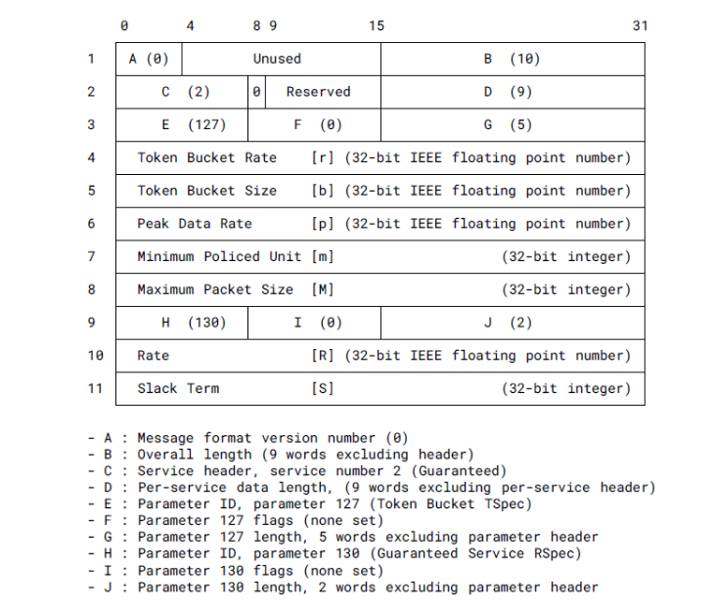
Encoding request and reply messages in RSVP
Token bucket TSpec and guaranteed service RSpec parameters
The end to end delay is given by the formula:
D_{req} = S + b/r
When p=r=R in the message displayed
The end to end delay requirement is given with r, b, p, R and S
The capacity is given by the peak data rate p
29

Slide 30
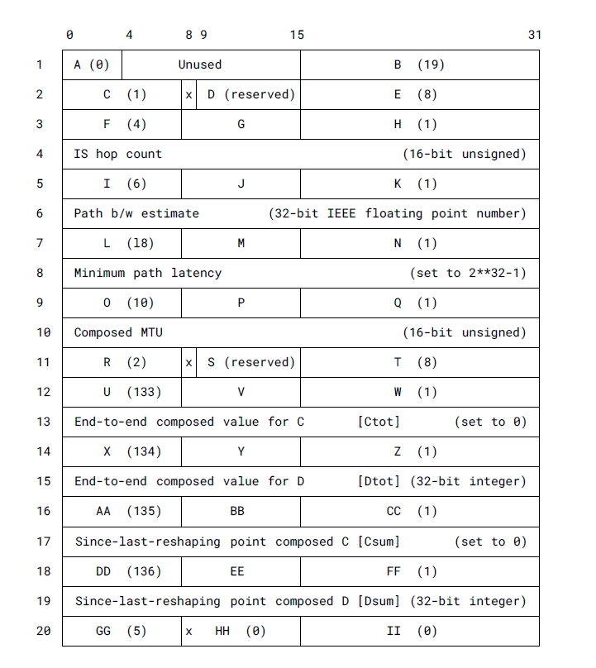

Encoding request and reply messages in RSVP
ADSPEC object format
End to end delay commitment carried by the ADSPEC object.
Minimum path latency is set to the undetermined value specified in RFC2215.
Nodes contribution to the end-to-end delay commitment ➔ added to both the Dtot and the Dsum parameters
Ctot and Csum parameters set to zero
30

Slide 31
Next steps
Interest in the WG for the document?
Position the draft with regards to requirements draft
Follow-ups
  Document RSVP protocol mechanisms in a separate draft?
  Contribute to the design of a less complex RSVP objects taking into consideration DETNET requirements?
Thank you!
Contact: Antoine Fressancourt
antoine.fressancourt@huawei.com
antoine@aft.network
31

