Slide 1
Handling multiple verifiers in RATS architecture draft-zhang-rats-multiverifiers-00
Jun Zhang, Houda Labiod , Tieyan Li , Thanassis Giannetsos , Henk Birkholz
RATS Interim meeting
27th September 2024

Slide 2
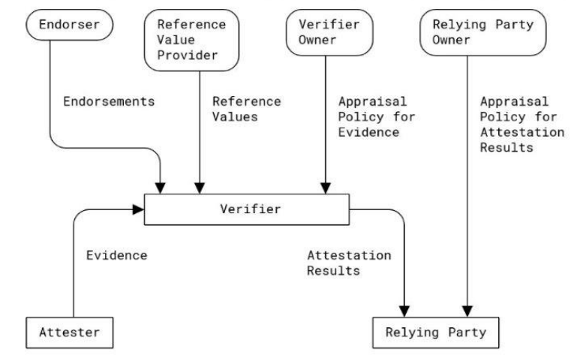
Motivation
RFC9334 specifies the information flow between 1 Attester, 1 Verifier and 1 Relying Party for RATS.
Single verifier may face single-point of failure, “achilles’ heel” of the attestation verification system (AVS).
Augment the RATS architecture to explicitly multiple Verifiers scenarios?
  Scalability: How many evidences to generate?/How many verifiers to contact?
  Robustness: How to handle heterogeneous verifiers (delayed update, compromised, different RIM policy, …)
Fig. 1: RATS information flow in RFC9334
Goal
Acknowledge and address potential inconsistent behaviors of Verifier by:
Aggregating Attestation Results collected from multiple Verifiers at the Relying Party
Simplifying the policy and operation
Verifier X
Verifier Y
Verifier Z
Fig. 2: RATS architecture with multiple Verifiers

Slide 3


Possible issues to handle multiple verifiers in current RATS architecture
Passport model
Background-check model
Case a: Attester does the attestation in vain because RP does not trust attestation result from certain verifier
Case c: A trusted verifier can be compromised, or not available.
Verifier A
Verifier B
Verifier A
Verifier B
(RP): I do not trust verifier A at all!
Attestation Result A
Evidence
Attestation Result A
Evidence
Evidence
Attester
Relying Party
(RP): I trust verifier A.
Attester
Relying Party
Case b: The attester can cheat by dropping attestation results that it does not like.
Case d: Multiple verifiers may have inconsistent behaviors
Verifier 1
Attester
Evidence
Evidence 1
Attestation Result 1 (positive)
Evidence
Verifier A
Attestation Result 1
Attestation Result (+)
Attester
Relying Party
Relying Party
Attestation Result (-)
Evidence 2
Attestation Result 2 (negative)
Evidence
Verifier B
Verifier 2
Conflicting!

Slide 4
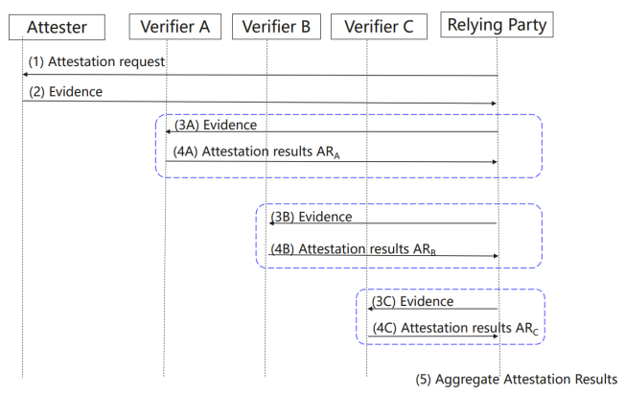
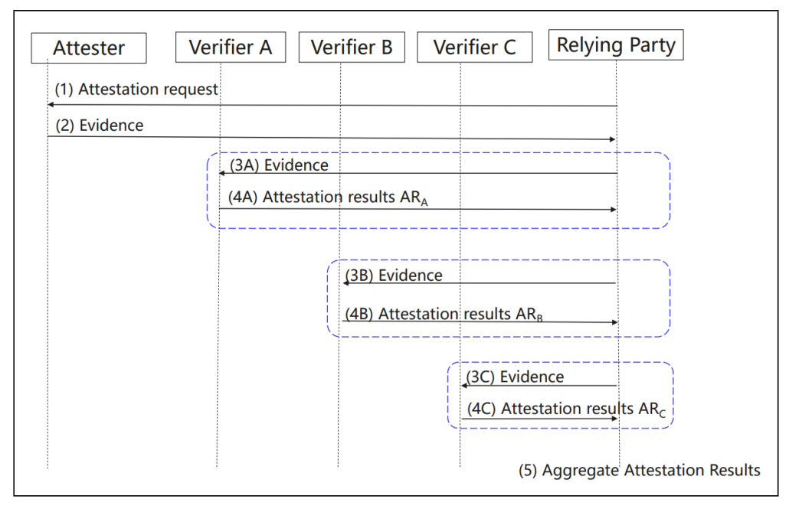
Handling multiple verifiers
Extension of background-check model
Objective: introduce multiple Verifiers to ensure the resilience of the attestation service
Extension of the background-check model
Mostly on relying party side
  RP initiates the attestation flow and generates the nonce.
  RP forwards evidence to all its recommended Verifiers.
  RP aggregates the attestation results from these Verifiers.
Benefit
  Ensure attestation is not done in vain.
  Ensure availability & security of remote attestation by “Wisdom of Crowds”
  Avoid redundant generation of evidence
  Shortlisted Verifiers (detailed in Verifier Manager part)
Fig. 3 Augmented Background-Check Model to support the aggregation of Attestation Results from multiple Verifiers
.

Slide 5
Verifier manager
Objective: support for flexible verifiers configuration at relying party
Introduce verifier manager in the architecture to:
Provide a recommended Verifier list to RP based on input of a seed anchor verifier list and required # of Verifiers
Enable RP contacts small set of Verifiers that follow same Reference Values
Enable RP flexible configuration of policy
Verifier A
Recommended verifiers
Verifier B
Verifier C
Verifier D
Seed anchor verifier list, #
Recommended verifier list
……
Verifier X
Verifier Y
Verifier Manager
Verifier Z
Fig. 4 Interaction between a verifier manager and a relying party

Slide 6
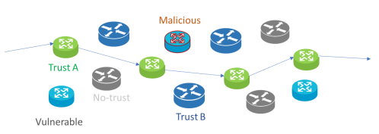

Use case 1: Node Attestation for Trusted Routing
Challenge:
Single Verifier may not be available or may be compromised
Trusted Routing requires traffic to go through trusted nodes while they can be appraised by the Verifier (Fig. 5).
Fig. 5 Trusted routing Use Case from NASR use cases
Solution:
Provide multiple Verifiers (primary and secondaries) to ensure the availability of the attestation verification service (AVS) for nodes in the network (Fig. 6)
Verifier A
(Primary)
Verifier B
(secondary)
Verifier C
(secondary)
Evidence
Attestation Result
PCE
Node trust score
Orchestrator
(Relying Party)
Anchor seed verifiers
Verifier Manager
Recommended Verifiers
Evidence
Fig. 6 Node attestation for trusted routing with multiple Verifiers

Slide 7
Use case 2: Attestation in Data Centers
In Data Center (Fig. 7), units (CPU, DPU,GPU) appraise each other to guarantee the trustworthiness of the workload inside the units. Each unit (as attester) can be appraised by many Verifiers (Fig. 8). This results in large amount of request of evidence from the Attester.
Two challenges to address
Handle the case when some Verifiers do not work (not available, compromised)
Reduce the number of evidence to generate
Following our proposal to handle multiple verifiers (Fig. 9).,
Resilience to the dysfunction of certain verifiers
One evidence is sufficient for verification requirement from n units
GPU
CPU
CPU
GPU
DPU 4
(RP&Verifier)
DPU 3
(RP&Verifier)
CPU 1
(RP&Verifier)
GPU 1
(RP&Verifier)
Local storage
DPU
DPU
(3) Evidence, nonce
(4) Attestation result
Fig. 7 Interaction between units in Dater Center
(1) Attestation request, nonce
(5) (Aggregated) Attestation Result
DPU 2 (RP&Verifier)
DPU 1 (attester)
DPU 2 (RP&Verifier)
DPU 1 (attester)
Appraised by
DPU 3 (RP&Verifier)
(2) Evidence, nonce
CPU 1
(RP &Verifier)
GPU 1
(RP &Verifier)
Fig. 9 Handling multiple Verifiers for the attestation in Data Center
Fig. 8 Attestation between units in Dater Center

Slide 8
Thank you

