Slide 1
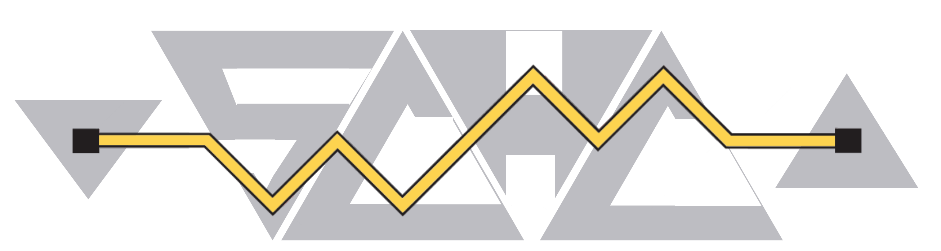
Interim meeting SCHC#12 2024
September 03 2024
This session is being recorded
Internet Engineering Task Force
© 2022 IETF Trust
Production by Meetecho

Slide 2
Note Well
This is a reminder of IETF policies in effect on various topics such as patents or code of conduct. It is only meant to point you in the right direction. Exceptions may apply. The IETF's patent policy and the definition of an IETF "contribution" and "participation" are set forth in BCP 79; please read it carefully.
As a reminder:
By participating in the IETF, you agree to follow IETF processes and policies.
If you are aware that any IETF contribution is covered by patents or patent applications that are owned or controlled by you or your sponsor, you must disclose that fact, or not participate in the discussion.
As a participant in or attendee to any IETF activity you acknowledge that written, audio, video, and photographic records of meetings may be made public.
Personal information that you provide to IETF will be handled in accordance with the IETF Privacy Statement.
As a participant or attendee, you agree to work respectfully with other participants; please contact the ombudsteam (https://www.ietf.org/contact/ombudsteam/) if you have questions or concerns about this.
Definitive information is in the documents listed below and other IETF BCPs. For advice, please talk to WG chairs or ADs:
BCP 9 (Internet Standards Process)
BCP 25 (Working Group processes)
BCP 25 (Anti-Harassment Procedures)
BCP 54 (Code of Conduct)
BCP 78 (Copyright)
BCP 79 (Patents, Participation)
https://www.ietf.org/privacy-policy/(Privacy Policy)

Slide 3
Agenda bashing
16:00 | Opening, agenda bashing (Delegate Chair) Note-Well, Scribes, Agenda Bashing Status of drafts | 10mn
16:10 | SCHC over network prone to disruptions and Proxies Presenter: Pascal Thubert | 10mn
16:20 | Deep Space BoF and SCHC Presenter: Marc Blanchet and Laurent Toutain | 10mn
16:30 | IESG Reviews of draft-ietf-schc-protocol-numbers Presenter: Pascal Thubert | 10mn
16:40 | SCHC Architecture Presenter: authors | 15mn
16:55 | AOB | QSP

Slide 4
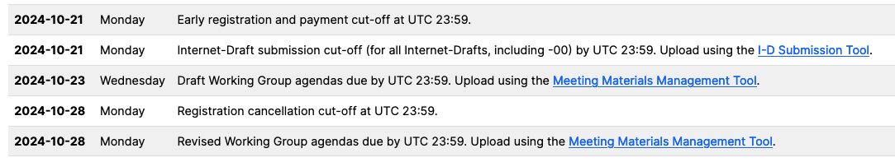
IETF121 Dublin
Will request 2h slot, as we had for IETF120
Important dates
Penultimate interim on Oct 15th
Last interim on Oct 29th

Slide 5
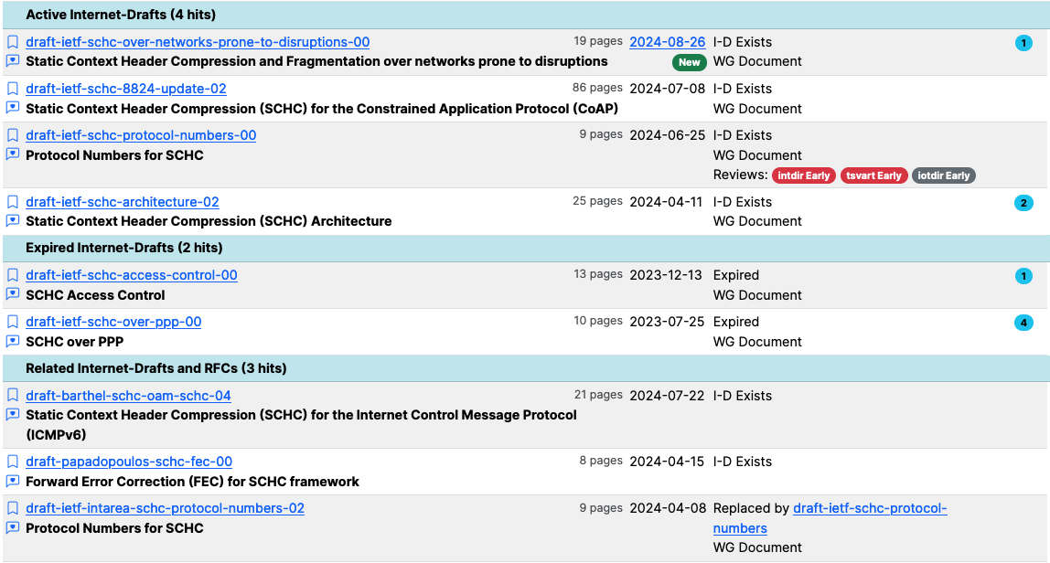
WG Document Status – Next Steps

