Slide 1
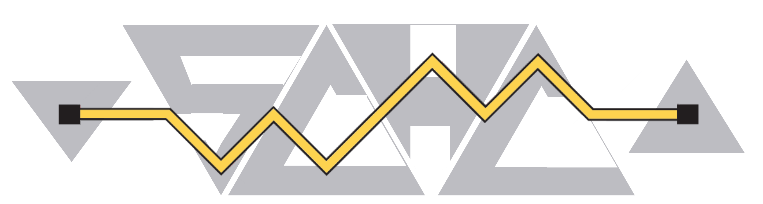
Interim meeting SCHC#7 2026
May 12th, 2026
This session is being recorded
Internet Engineering Task Force
© 2022 IETF Trust
Production by Meetecho

Slide 2
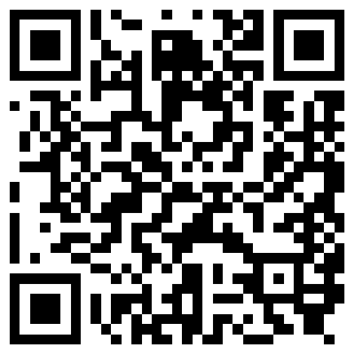
Note Well
By participating in the IETF you agree to follow IETF processes and policies. This Note Well is a reminder of some of those policies. For a linked version of this text, please visit www.ietf.org/note-well or use the QR code below.
IETF participants are expected to behave in a professional manner and extend respect and courtesy to their colleagues at all times (see RFC 7154: IETF Guidelines for Conduct and IETF Anti-Harassment Policy). If you have any concerns about behavior, please contact the Ombudsteam who have a duty of confidentiality and extensive powers to act, as set out in RFC 7776: IETF Anti-Harassment Procedures.
If you are aware that any IETF contribution (as defined in RFC 5378: Rights Contributors Provide to the IETF Trust) is covered by patents or patent applications that are owned or controlled by you, your employer or your sponsor, you must disclose that fact, or not participate in the discussion (see RFC 8179: Intellectual Property Rights in IETF Technology).
For detailed process information consult RFC 2026: Internet Standards Process and RFC 2418: IETF Working Group Guidelines and Procedures and updates to those.
The IETF routinely makes public written, audio, video, and photographic records of IETF activities, including your personal information as set out in the IETF Privacy Statement.
For advice, please talk to Working Group chairs or Area Directors.
Notes:
The IETF Note Well should be shown at the start of every IETF working session. The guidance below is adapted from IETF legal counsel presentation during IETF 120
DO
Do make sure people have enough time to read through the slide before you move on,
Do give a high-level summary of what’s covered in the Note Well: “IETF policies on conduct, privacy and IPR.”,
Do encourage people to read through all the linked policies & documents in detail before participating or contributing,
Do explain where people can direct questions or concerns (IETF Executive Director or Ombudsteam).
DON'T
Don’t dismiss the importance or relevance of any of the information on the Note Well.
Don’t interpret the meaning or get into the substance of any of the topics or content of the policies.
Don’t communicate that the Note Well conveys all the information participants need to know.
Don’t address questions or concerns in the meeting itself.

Slide 3
Agenda bashing
16:00 | Opening, agenda bashing Note-Well, Scribes, Agenda Bashing Document Status | 10mn
16:10 | Update on the SCHC Architecture Fundamental concepts - Endpoint, Instance, Stratum, ... Presenter: Marion Dumay, Quentin Lampin | 30mn
16:40 | AOB | QSP

Slide 4
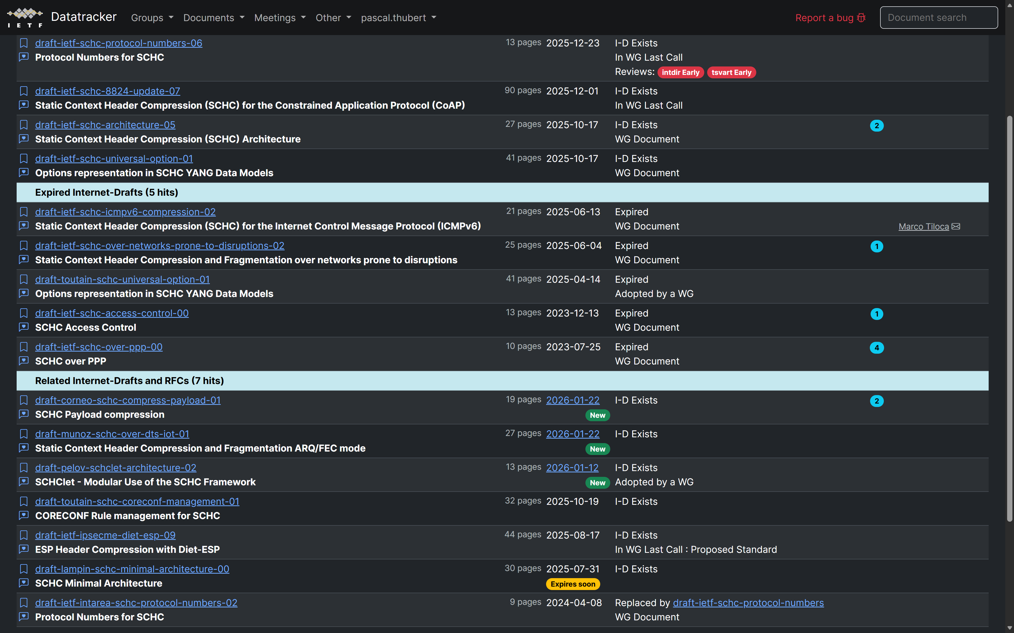
WG Docs

Slide 5
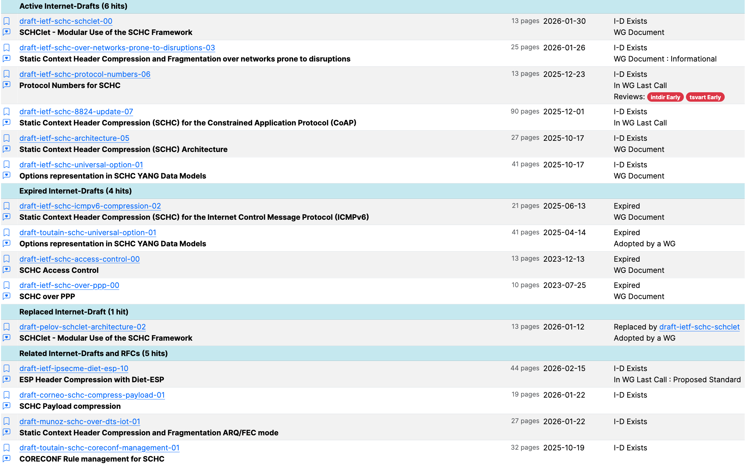
WG docs

Slide 6
WGLC for SCHC protocol numbers
Documents in WGLC
SCHC Protocol Numbers
Reviews by Carles, Marco, Pascal
Review by Alexander – not ready
Shepherd -> Quentin (merci !)
SCHC 8824-update-07
Votes by Rikard Höglund, Carles, people present at the last interim
One more review ?
Shepherd –> Alexander
Not in WGLC – submit updated version to proceed? draft-ietf-schc-over-networks-prone-to-disruptions
draft-ietf-schc-icmpv6-compression

